Slide 1
ATRP
Sandip Argekar

Slide 2
ATRP
Atom Transfer Radical Polymerization
Halogen transfer through metal complex induced reversible heterolysis
resulting in the formation of reversible free radicals to initiate and propagate polymerization.

Slide 3
Formation of induced reversible free radical?
R
X
R – Propagating species/ tethered initiator
X – halogen atom (usually Cl/Br)
M^{n}
M^{n} – Transition metal in lower oxidation state
(Copper is most commonly used)
. .
Ligand – Lewis base to stabilize transition metal forming a complex

Slide 4
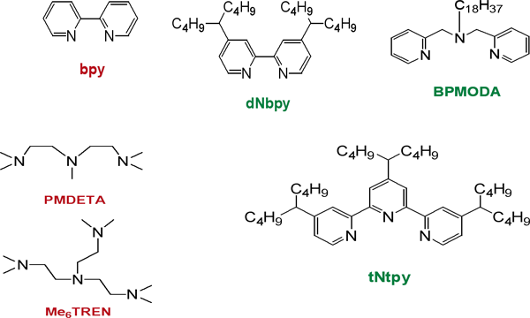

Slide 5
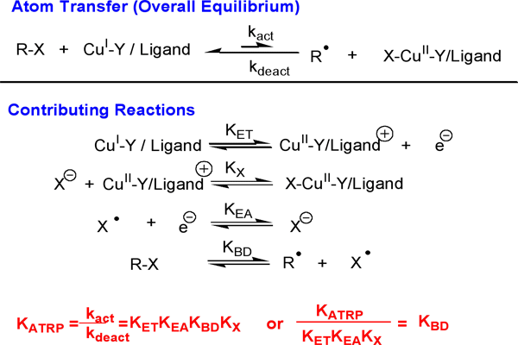
Formation of induced reversible free radical?

Slide 6
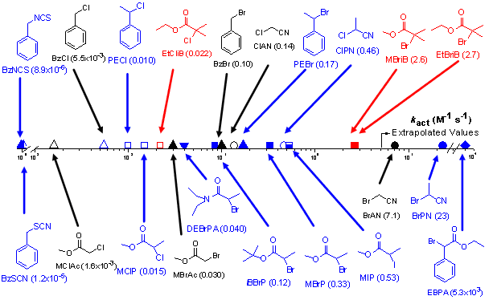

Slide 7
ATRP types
Normal ATRP
Reverse ATRP
Introduce higher oxidation state metal
Reaction results in lesser concentration of radicals
More control and better PDI

Slide 8
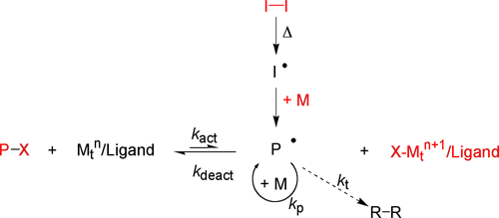
Simultaneous Normal & Reverse ATRP (SR&NI)
Add small amount of free radical initiator
Allows reaction propagation for active catalysts

Slide 9
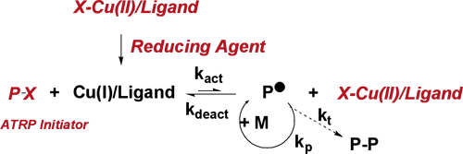
Activator Generated Electron Transfer ATRP
Reducing agent induced activation
Allows catalysts to be added in their stable state

Slide 10
Why ATRP?
Control
Compositions
Topology
Functionality

Slide 11
Composition
Statistical polymer
Reactivity ratios
Block copolymers
Macro initiators
ABC type copolymers
Gradient copolymers
X

Slide 12
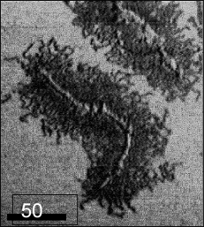
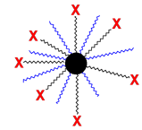
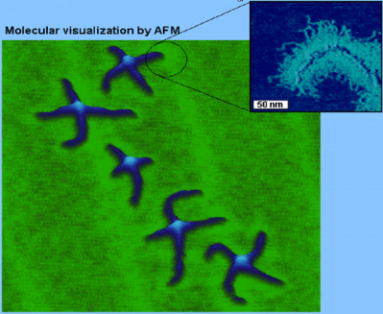
Topology
Simple
architecture
Complex architecture
Linear
Brush copolymers
Surface modification
Graft copolymers
Star polymers
Star shaped copolymers

Slide 13
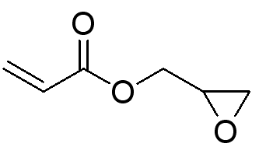
Functionality
Functional monomers
eg. Glycidyl methacrylate
Modification post polymerization
Functional ATRP initiators
eg. Glycidyl 2-bromopropionate
End-group transformation chemistry

Slide 14
Shortcomings of ATRP
Oxygen hinders polymerization forming stable copper oxides.
Degassing
Addition of reducing agent (Cu) provides tolerance
No control over tacticity due to radical nature.
Unwanted catalyst color
Catalyst removal problems

Slide 15
References
Matyjaszewski Group – Research
http://www.chem.cmu.edu/groups/maty/about/research/index.html

