Slide 1
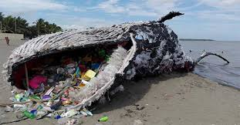
An Overview of Plastics
to Understand their Problems and Potential

Slide 2
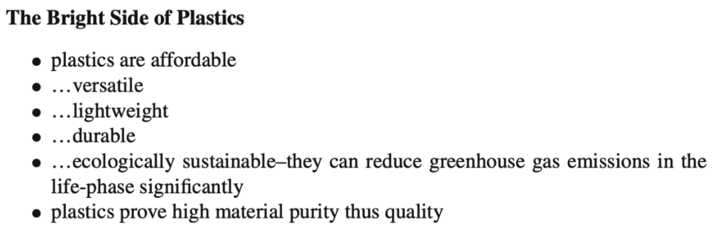
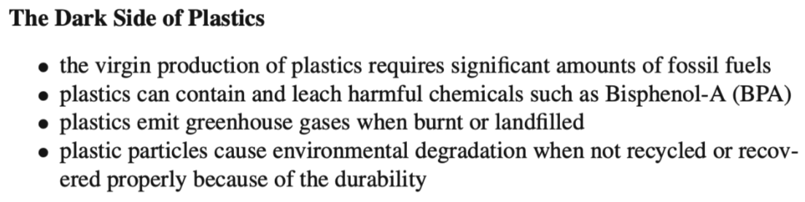
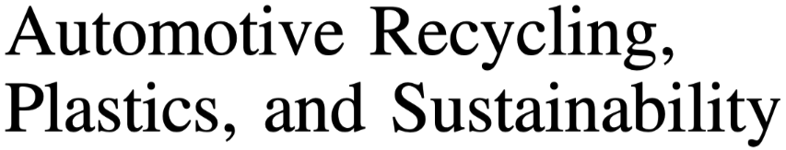


Slide 3
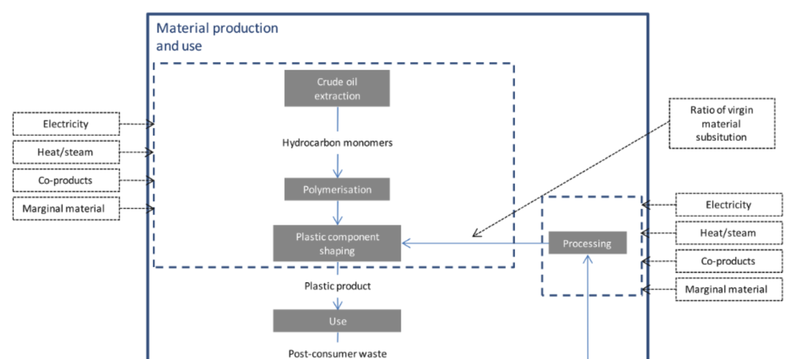
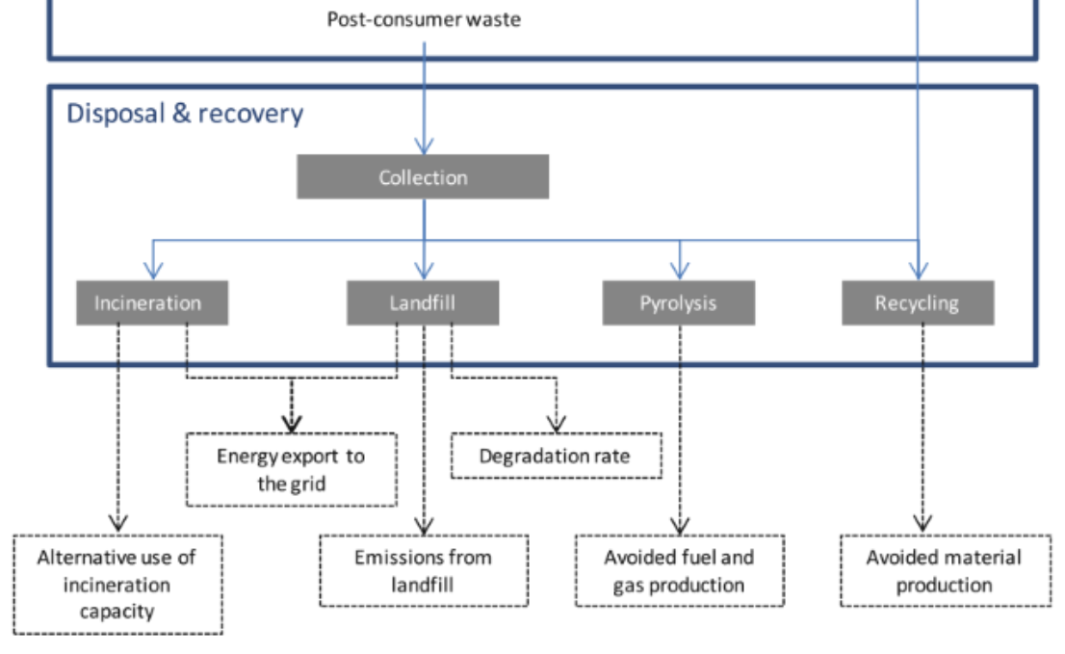

Slide 4
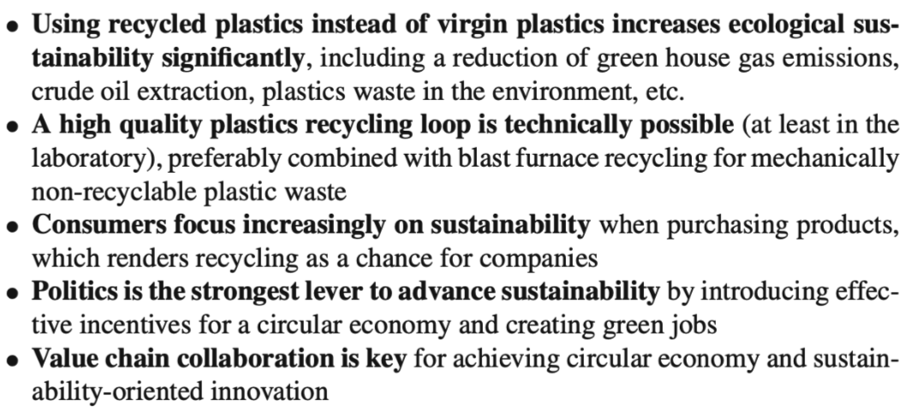

Slide 5
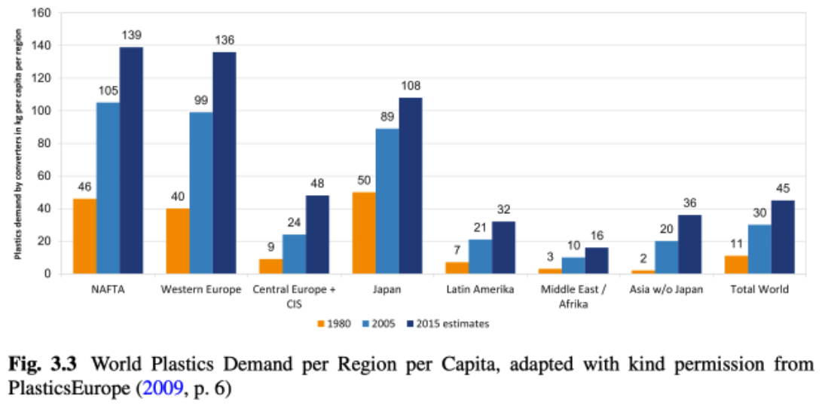

Slide 6
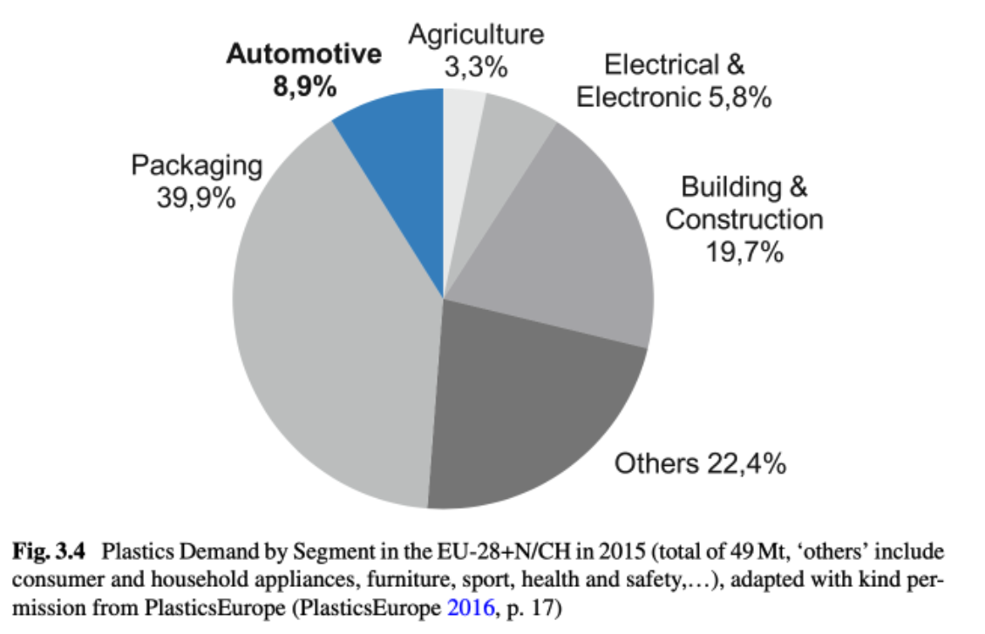

Slide 7
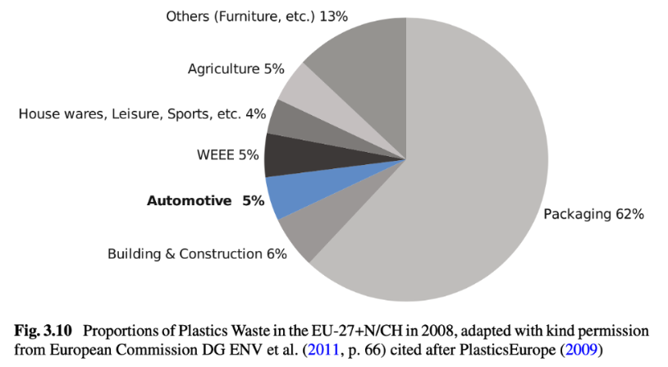

Slide 8
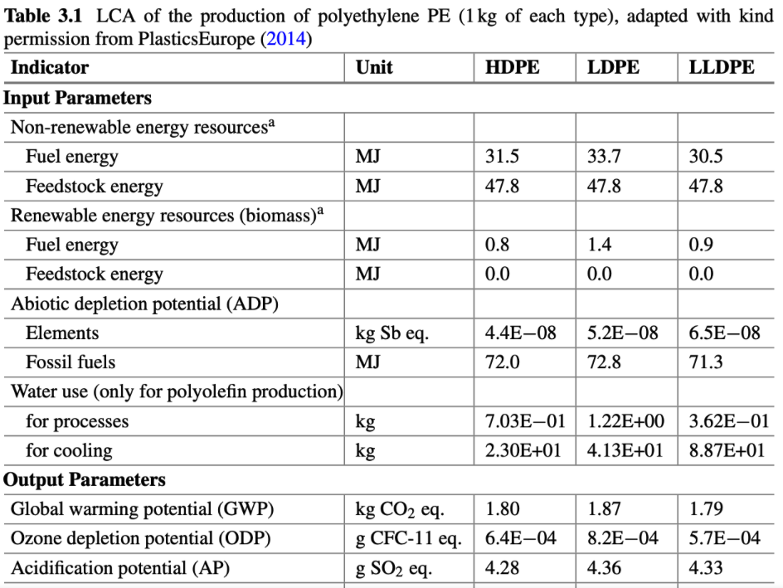
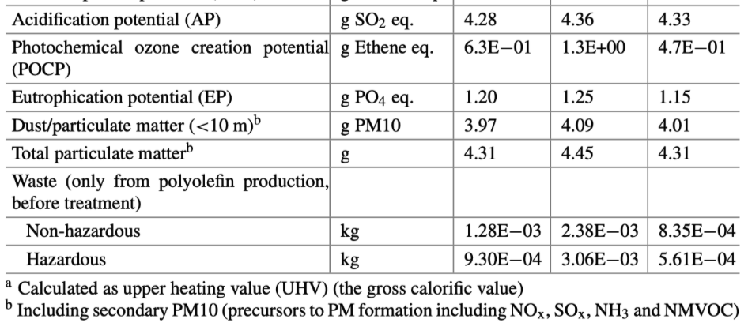

Slide 9
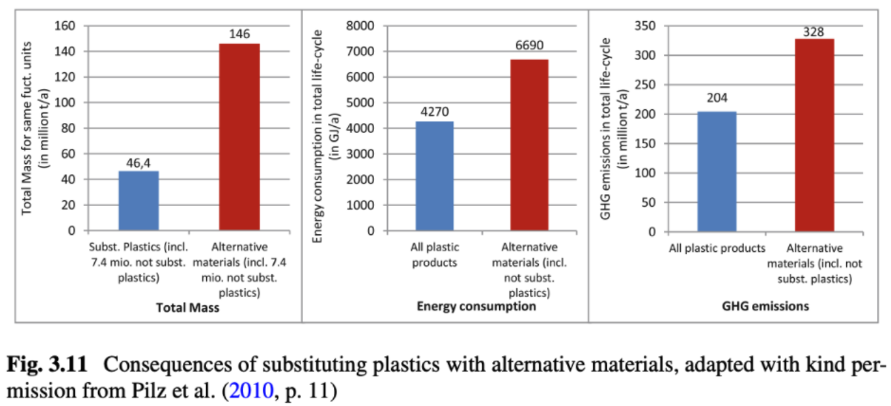

Slide 10
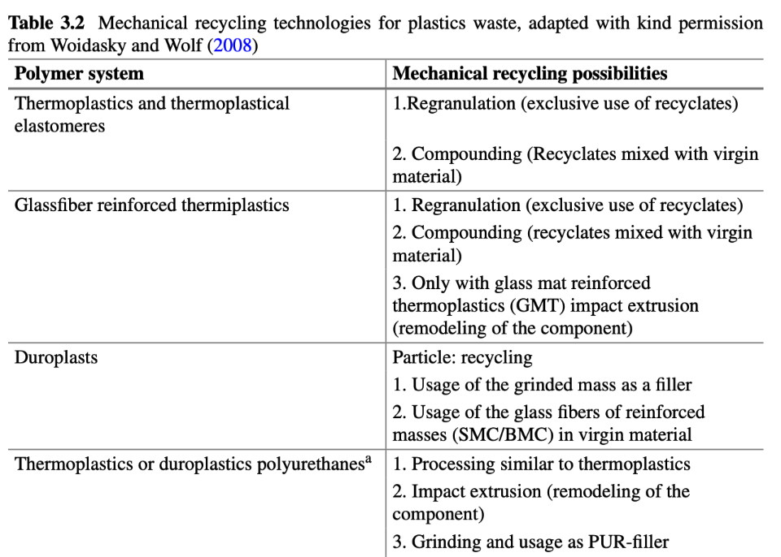
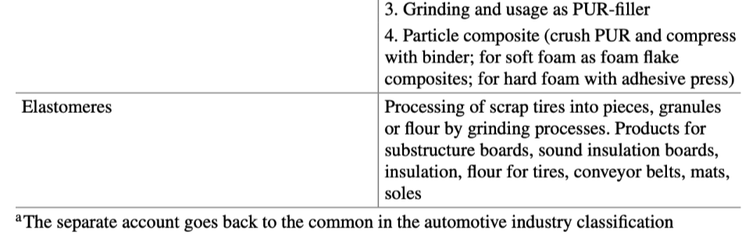

Slide 11
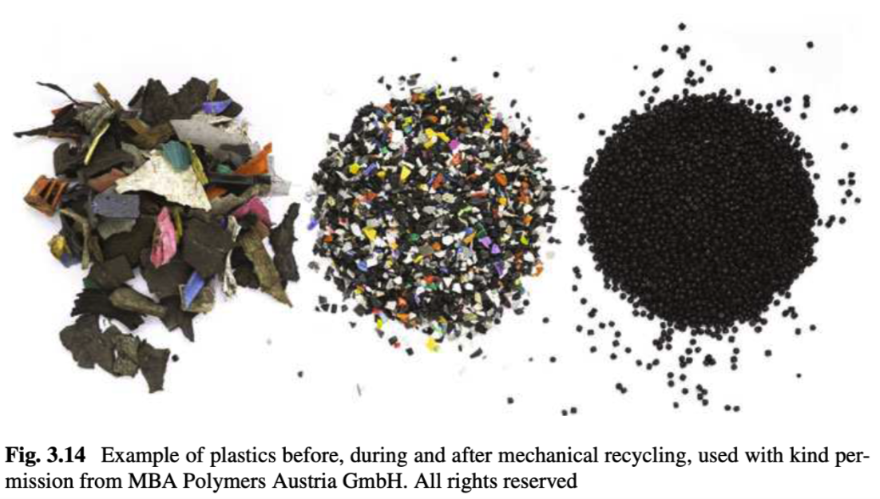

Slide 12
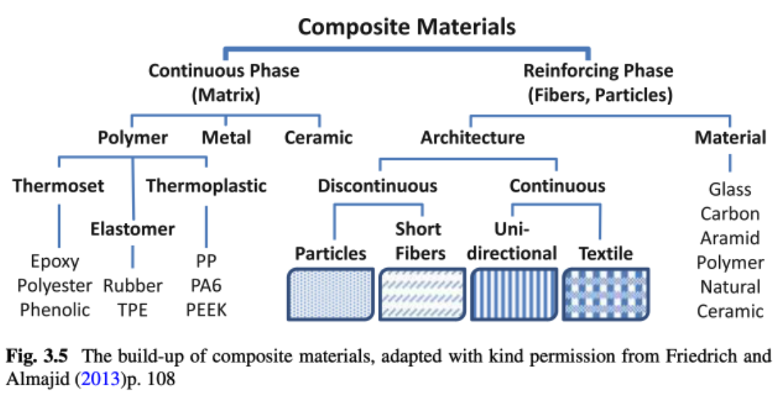

Slide 13
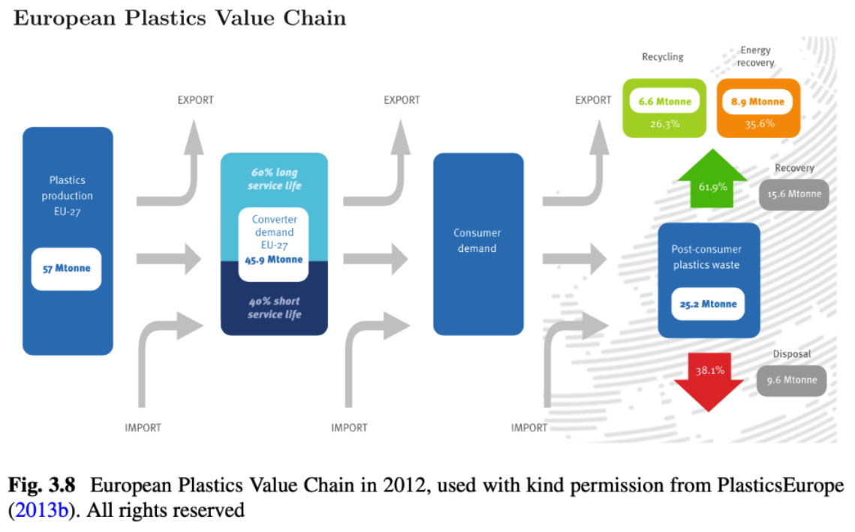

Slide 14
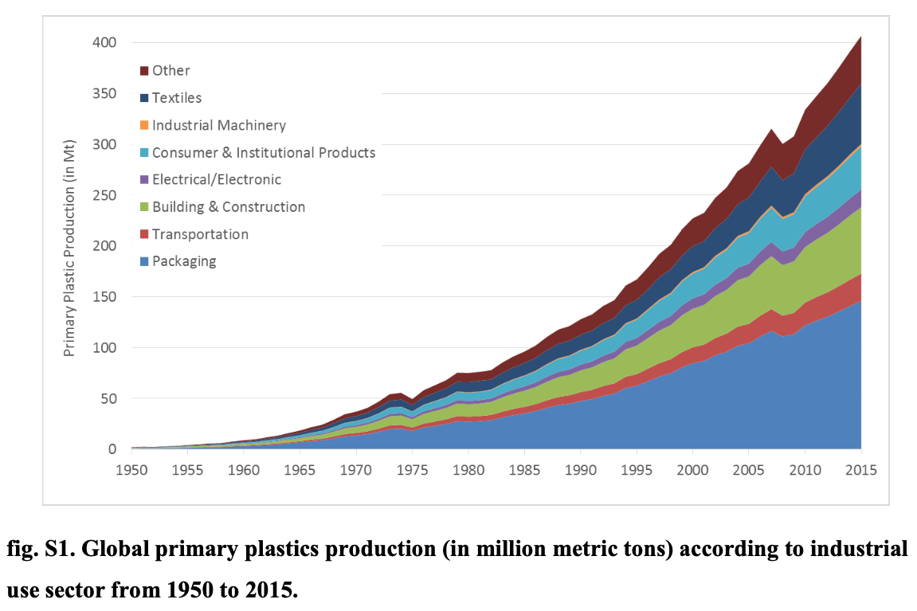

Slide 15
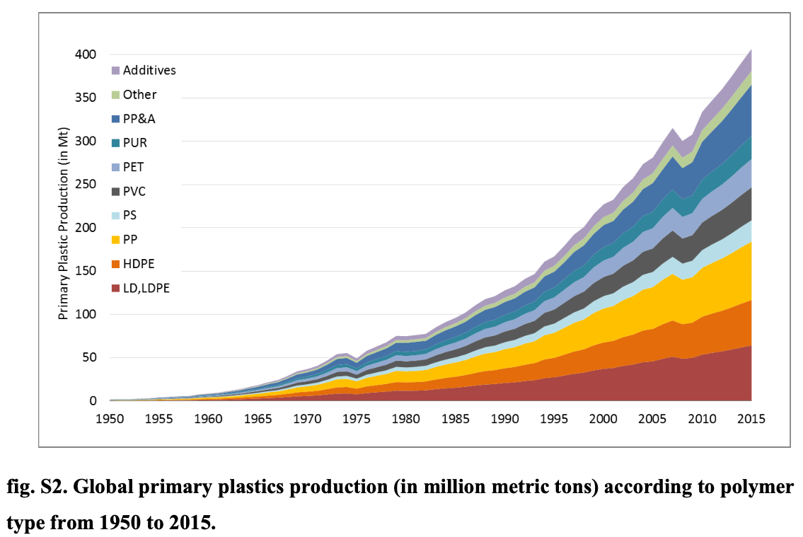

Slide 16
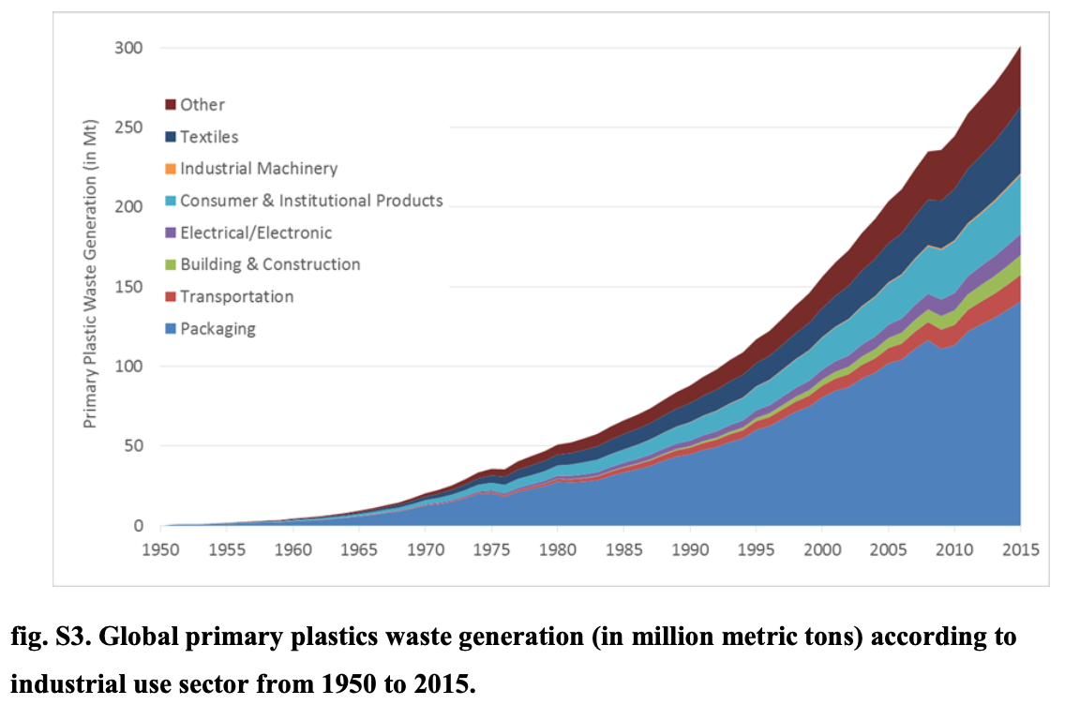

Slide 17
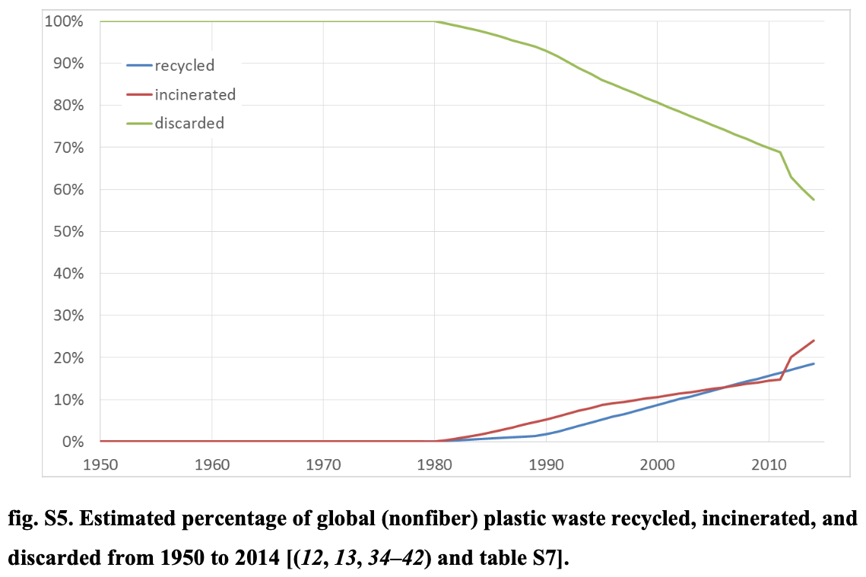

Slide 18
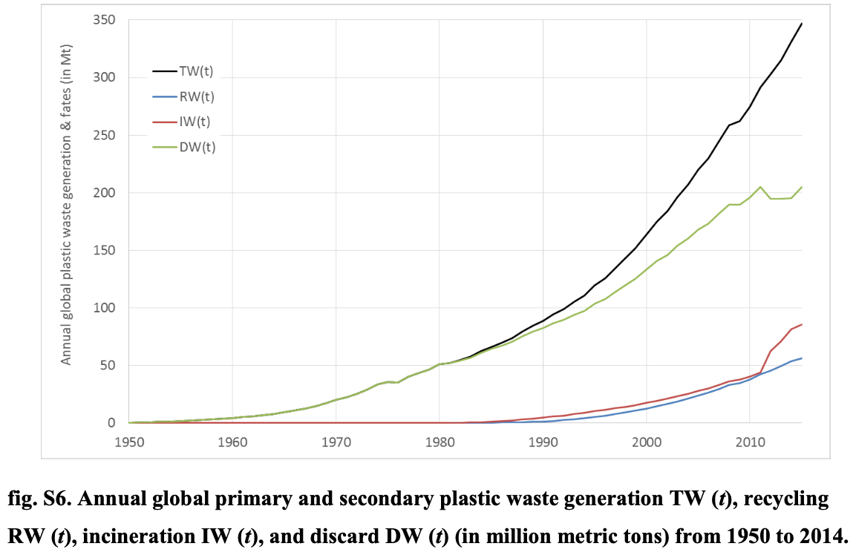

Slide 19
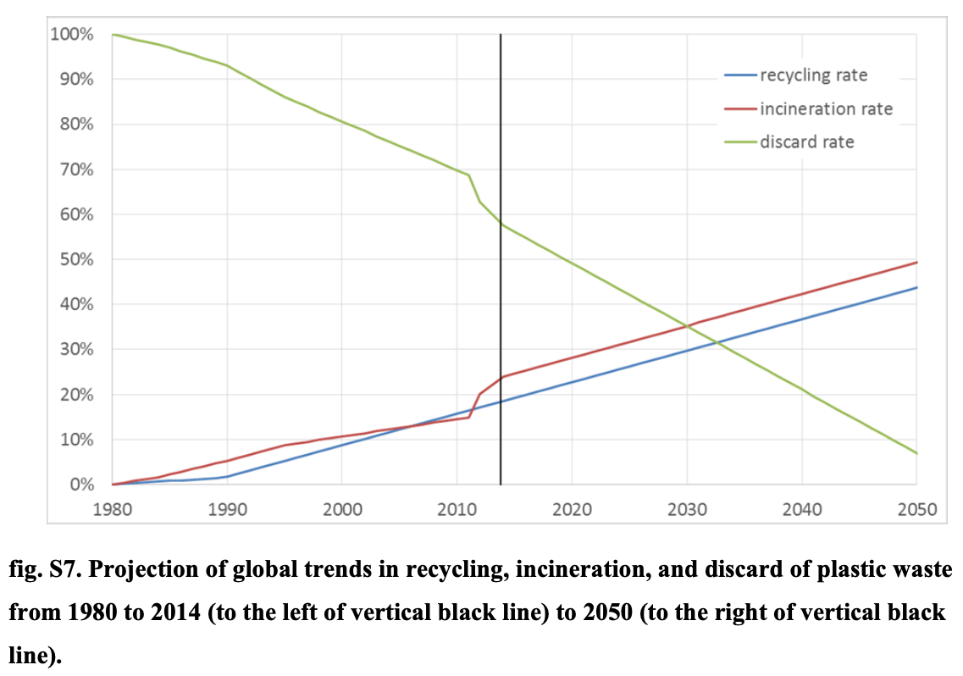

Slide 20
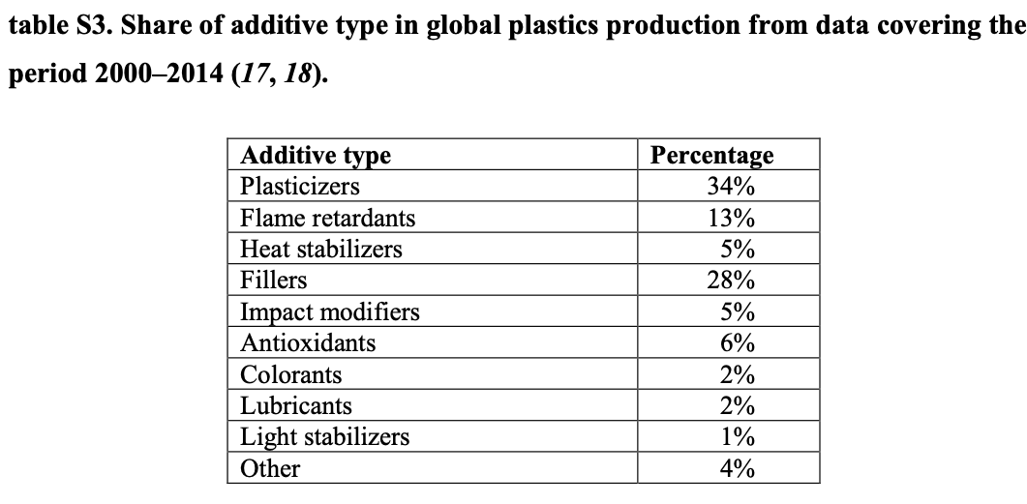

Slide 21
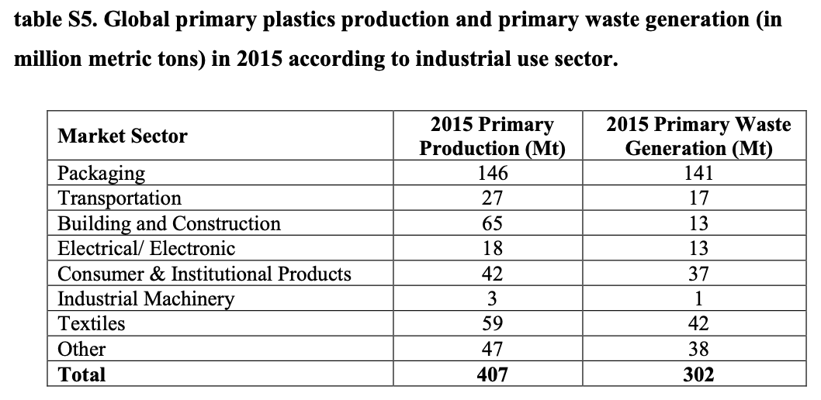

Slide 22
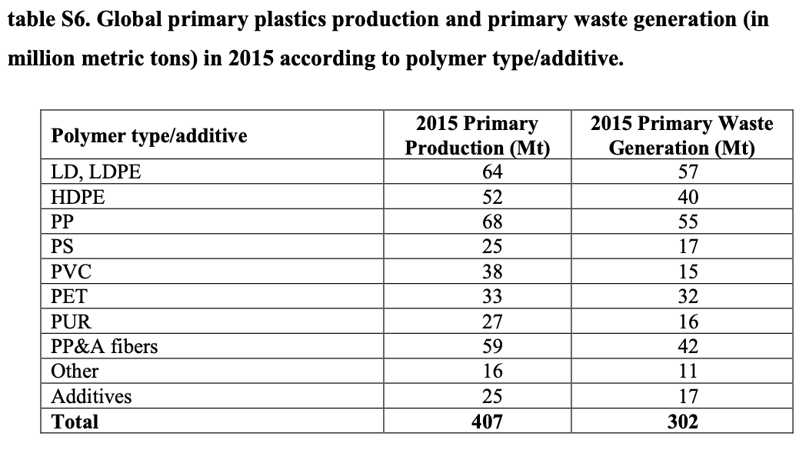

Slide 23
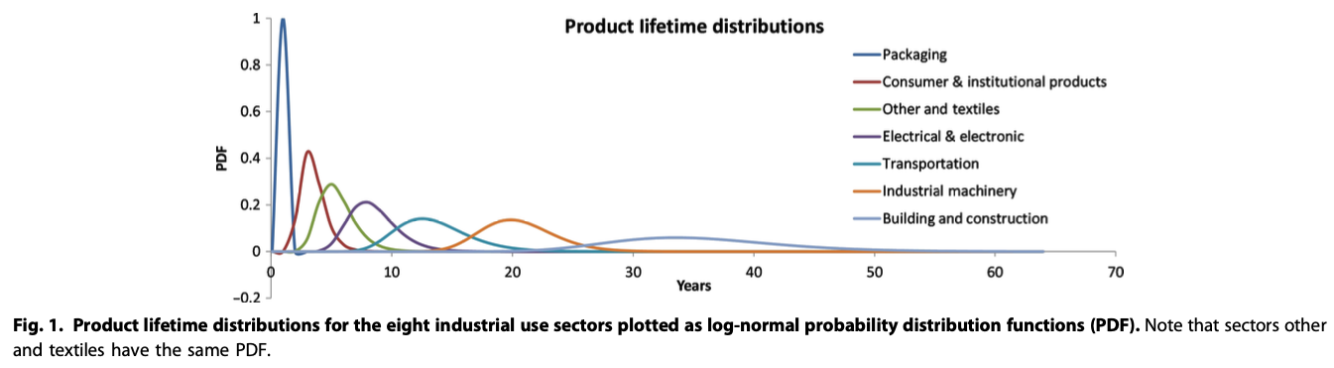

Slide 24
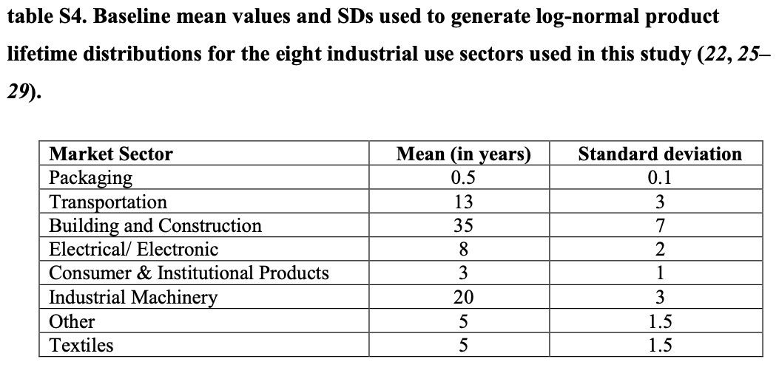

Slide 25
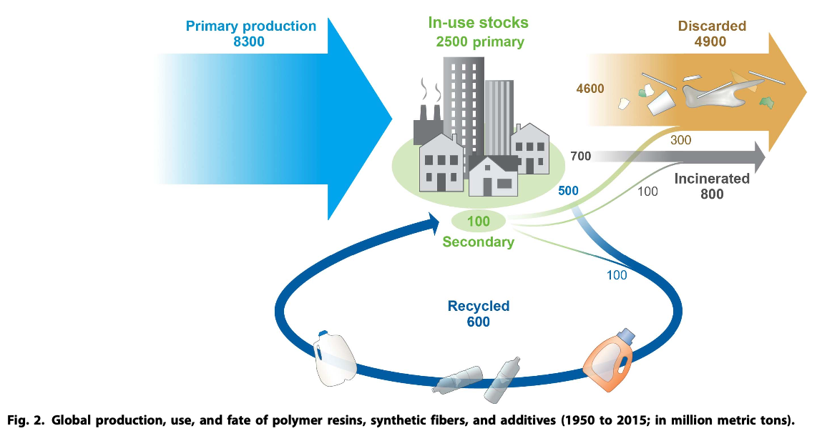

Slide 26
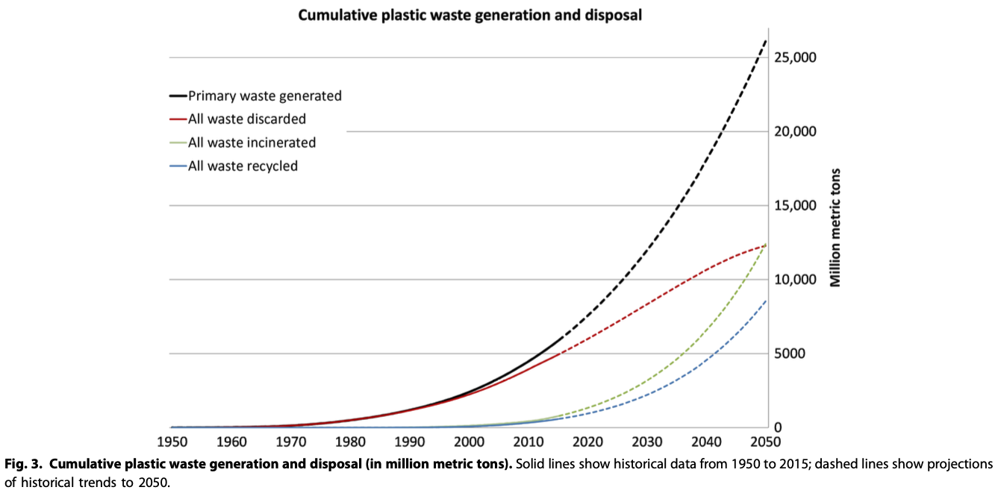

Slide 27
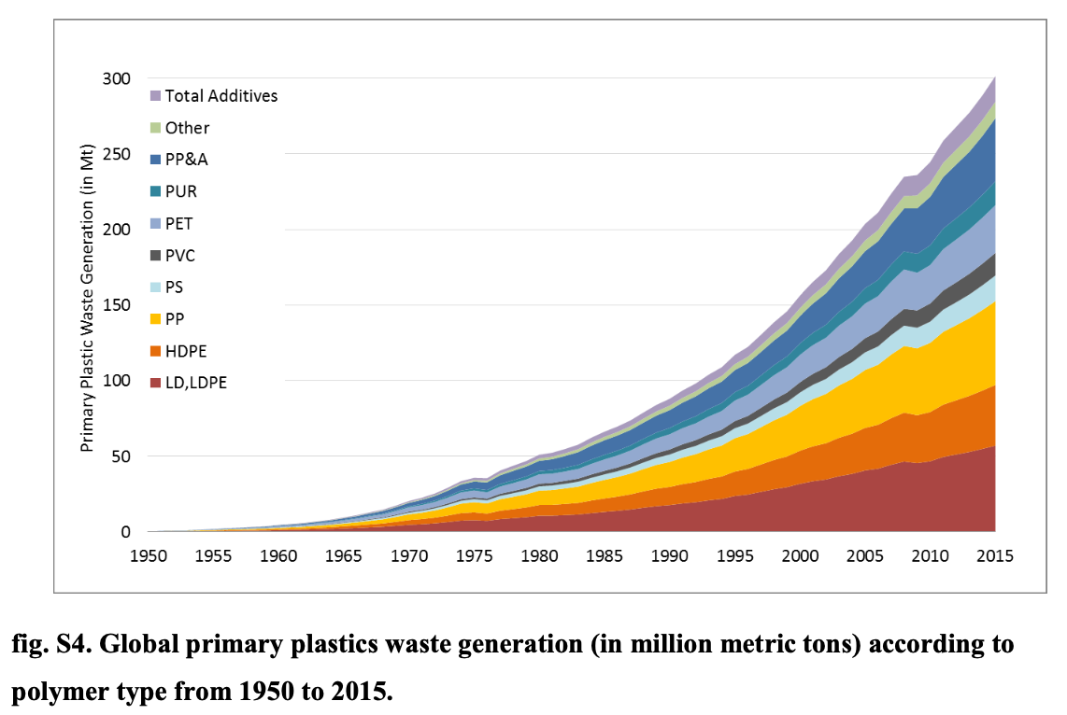

Slide 28
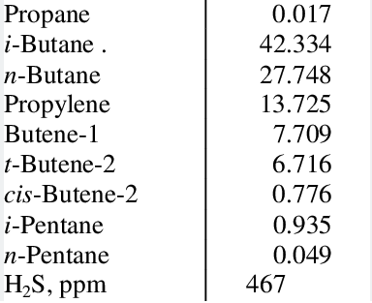
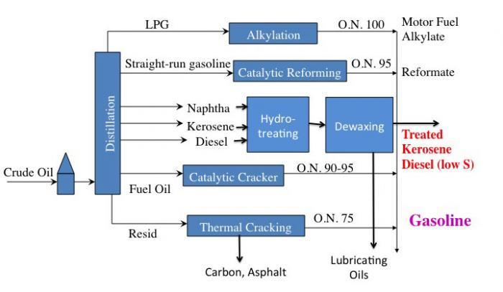

Slide 29
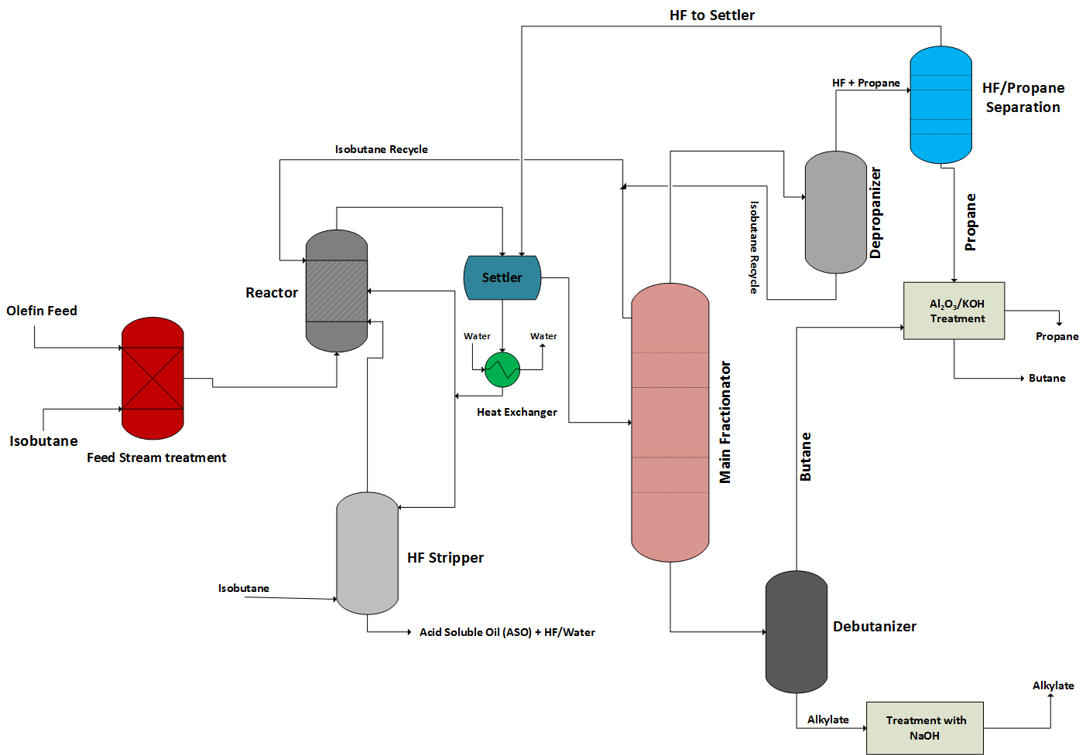
LPG Alkylation using HF

Slide 30
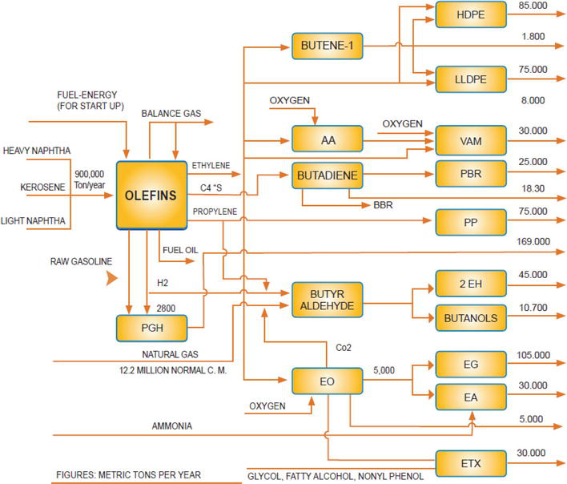
Shazand Petrochemical complex

Slide 31
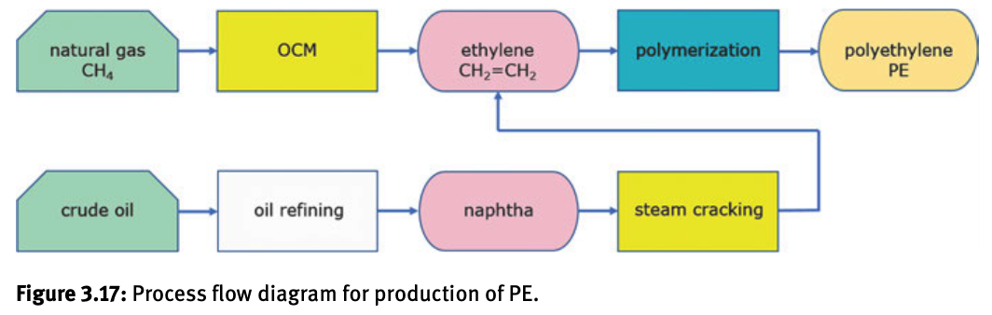
It is possible to balance the products of oil refining to meet market demand to some extent but there is some connection between the amount of petrochemical fuels used and the amount of olefins produced.
There is a direct link between the price of polyethylene/polypropylene and the price of oil.
If we stop using polyolefins it will have an impact on the petrochemical industry possibly leading to more waste. The petrochemical system is complex.
A more obvious link between plastics and industrial waste streams is Cl₂.
OCM Oxidative Coupling of Methane

Slide 32
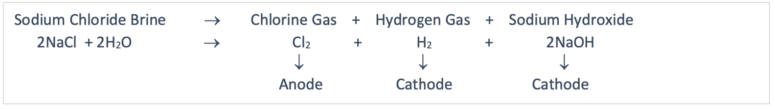
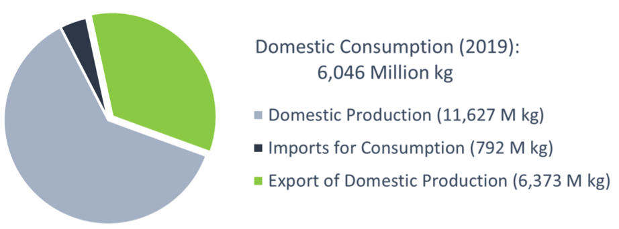
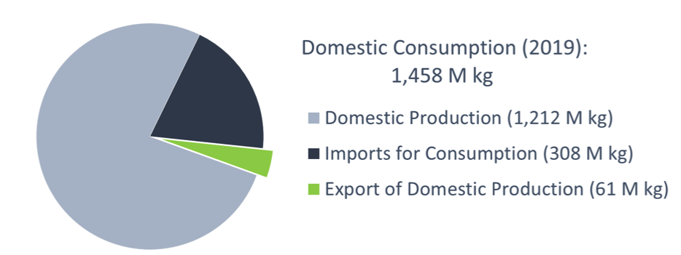
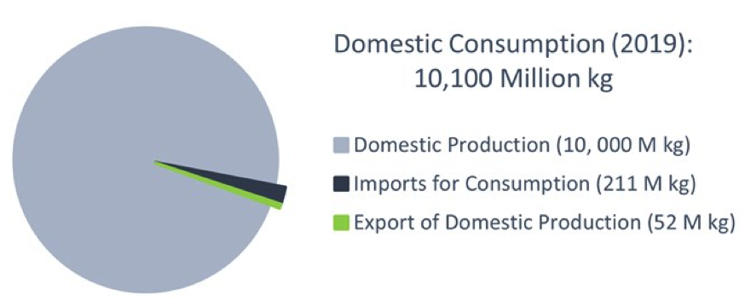
NaOH (40g/mole)
It would appear that without PVC, CPE and other polymers we would have 4,000 M kg extra Cl₂
which would be waste
Many polymers are essentially long-term disposal methods
HCl
(36.5g/mole)
Cl₂
(71g/mole)

Slide 33
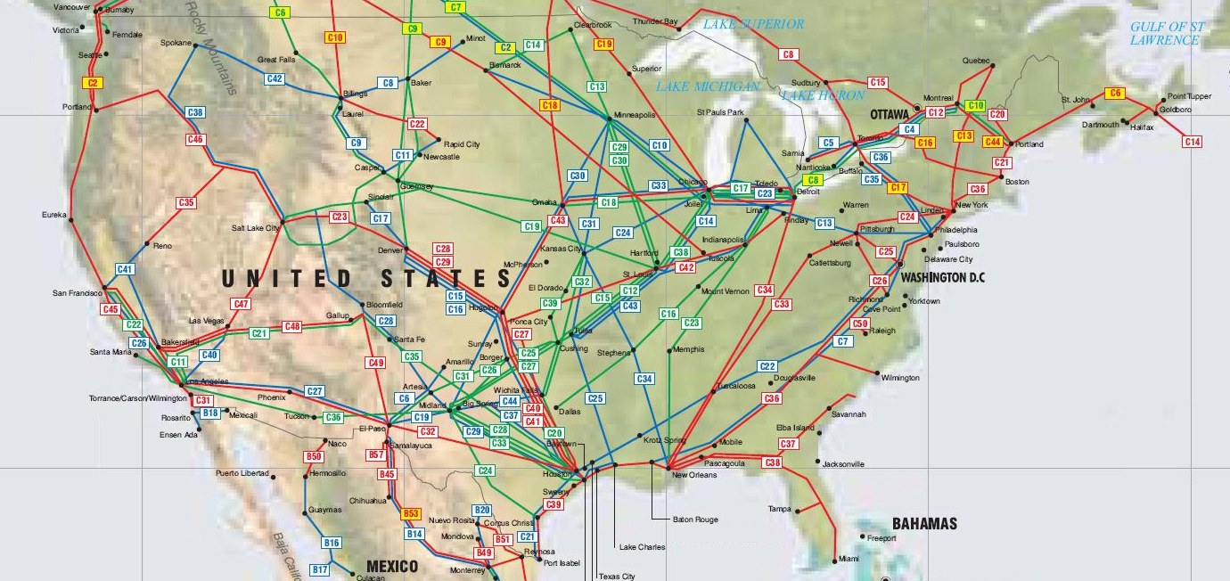
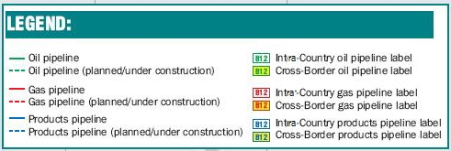

Slide 34
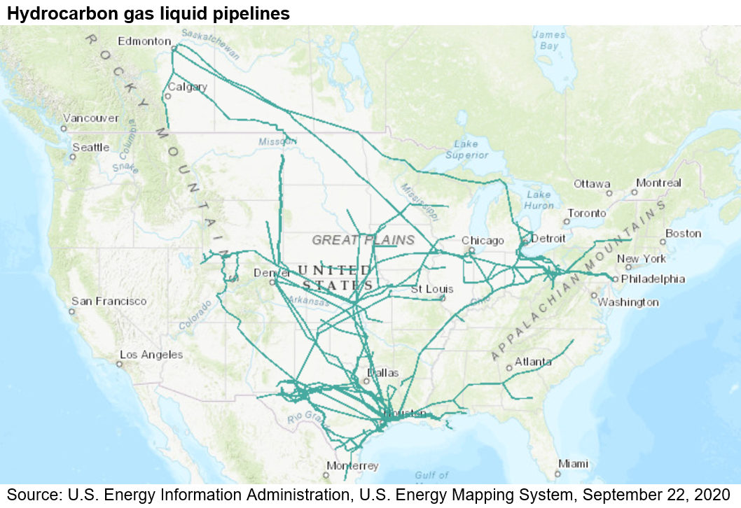
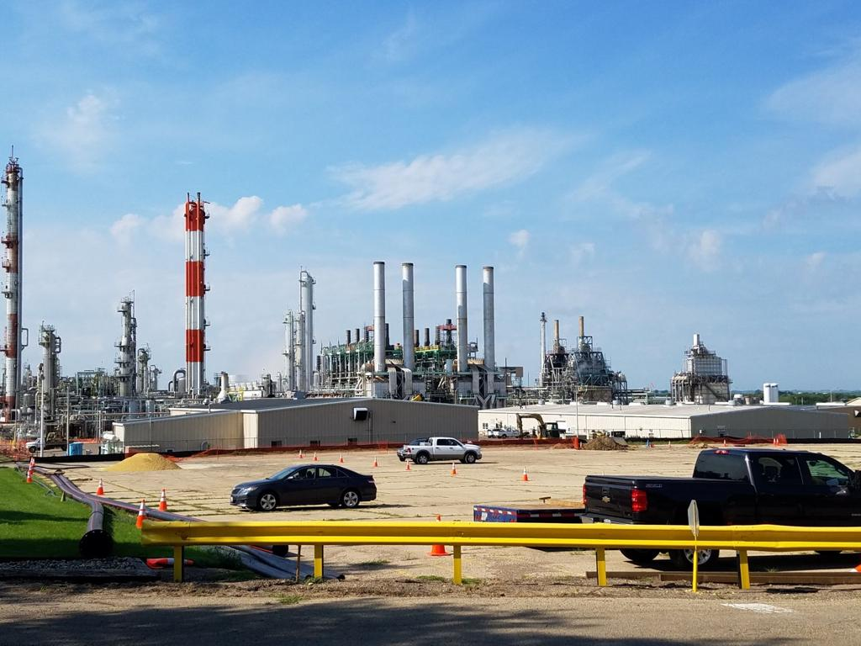
Ethane and Propane feed lines to crackers for olefin production
LyondellBasell
Clinton Iowa Polyethylene Plant

Slide 35
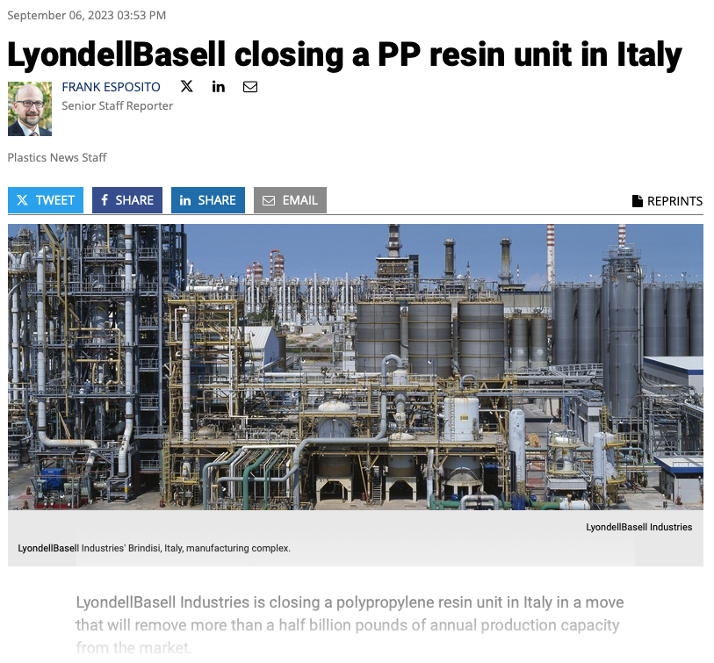

Slide 36
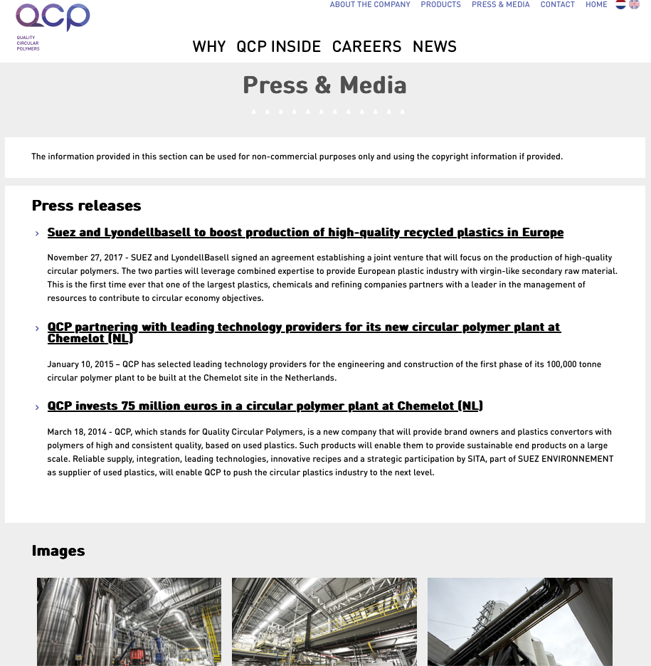
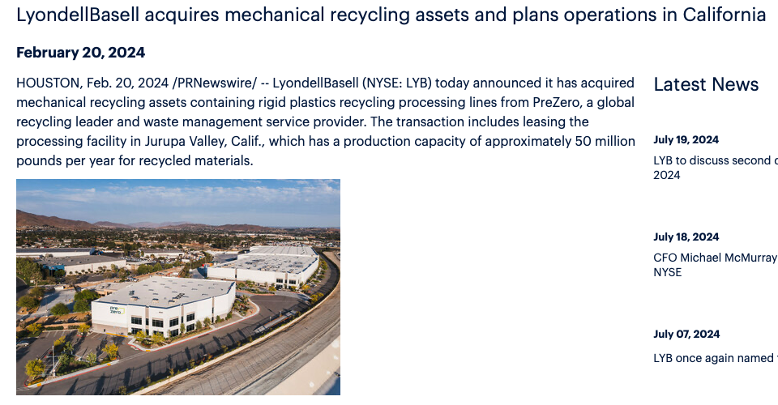
https://www.qcpolymers.com/en/about-the-company/
https://youtu.be/Vrz1h2cwKL0?si=263vUVOwkrPArEMV
https://www.lyondellbasell.com/en/news-events/corporate--financial-news/lyondellbasell-acquires-mechanical-recycling-assets-and-plans-operations-in-california/

Slide 38
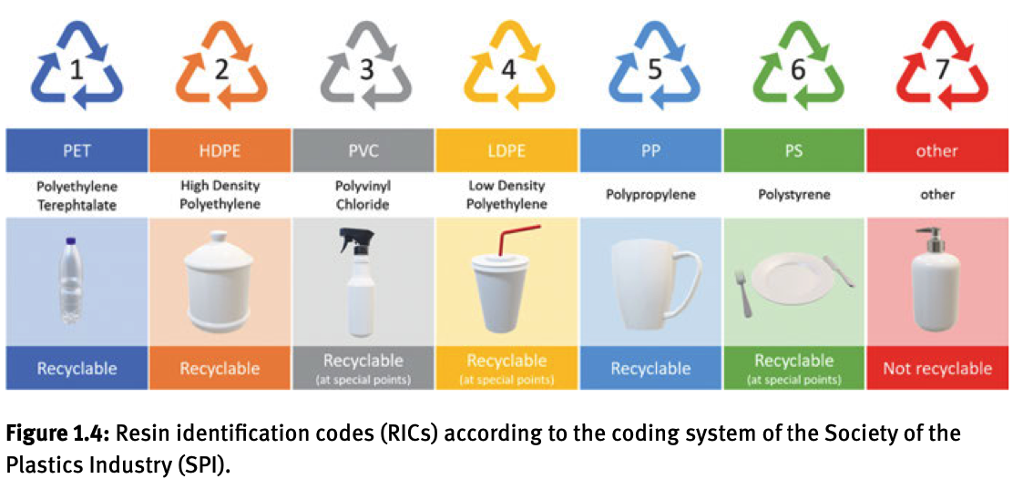

Slide 39
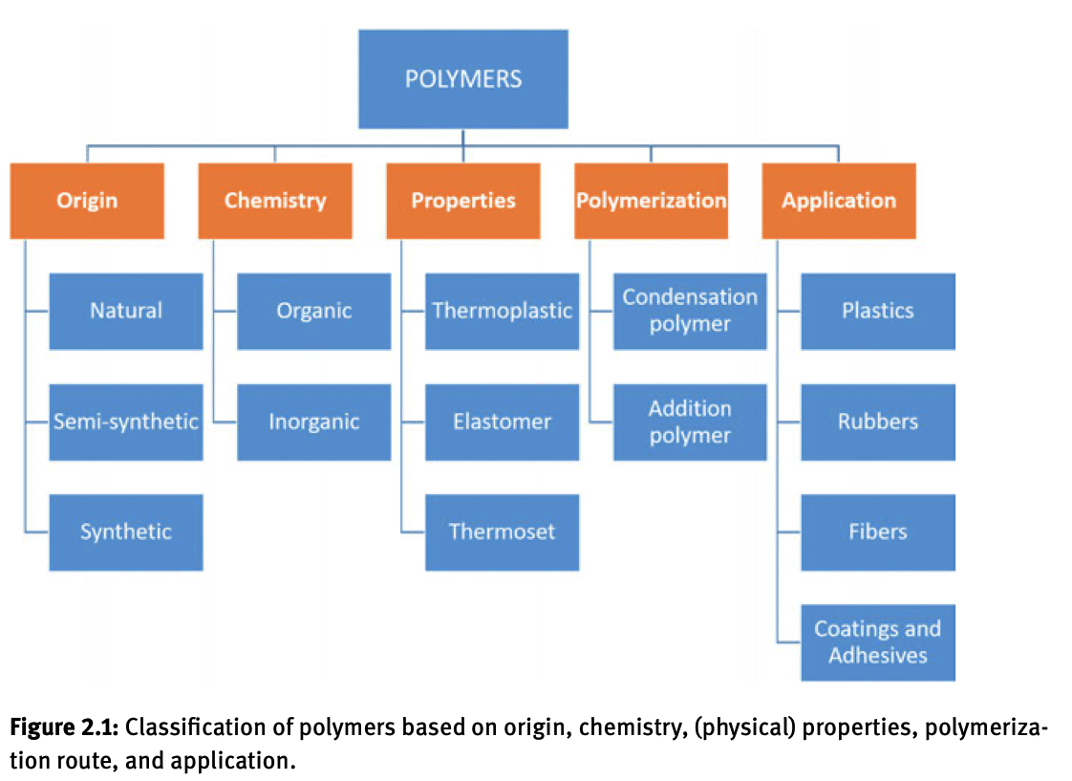

Slide 40


Slide 41

SBR for tires is anionically polymerized triblock
Pluronics for hand sanitizer is a PEO/PPO block copolymer
Long chain branching (HDPE)
Short chain branching (LLDPE)
Metallocene PE
LDPE

Slide 42


Slide 43

Sulfur vulcanization of polyisoprene (natural rubber)
PDMS silicone rubber crosslinked with TEOS

Slide 44


Slide 45


Slide 46


Slide 47
21 Common Plastics (the short list)
(Polymers, Rubbers, Thermoset, Thermoplastic, Colloids, Latexes, Adhesives, Lubricants, Coatings, Inks)
PS
Free Radical
Anionic
HIPS
PS Foam
Rigid Plastic
PET or PETE
Condensation
Bottles, Rugs
PE
Free Radical
Single Site Metallocene
Ziegler-Natta
HDPE,LDPE, LLDPE,
Metallocene
Bags, Jugs,
Climbing Toy
i-PP
Ziegler-Natta
Tough plastic
PVC CPE
Plasticized Crystalline Polymer
Dashboard
Pipe
Polycarbonate
Condensation
Polyester
CDs, subway
windows
Polyvinylalcohol
Free Radical
Fibers
PDMS ring-opening
Condensation
Rubber
SBR
BCP
Anionic
Nylon PA
Condensation
Fibers
PLA
Condensation
Bio sourced
PHB (PHAs)
Random CPs
Bio sourced
Polyurethane
Condensation
Foam/coatings
Acrylics
Free Radical/Anionic
Plexiglass® PMMA
superabsorbent
PI
Natural
Rubber
Anionic
Ziegler-Natta
Polybutadiene
Free Radical
Anionic
Resorcinol-Formaldehyde
Condensation
Electronics
Pluronic
PEO-PPO
BCP
Ring opening
condensation
Polysulfone
Free radical
Prison
Dishes
PEO or PEG
Ring opening
condensation
PPO
condensation
Epoxy ring opening
Condensation
Composites

Slide 48
Some Common Additives
(Pigments, Foaming Agents, Silica, Carbon Black, Titania, Calcium Carbonate, Flame Retardants,
Anti-oxidants, Processing Agents, Lead Stearate, Residual Catalyst, Chromium, Plasticizer, Magnetite,
Ferrite, Glass Fiber, Sizing Agent)

Slide 49




PS
Free Radical
Anionic
HIPS
PS Foam (EPF)
Rigid Plastic
Ethylene + Benzene over AlCl₃ makes ethylbenzene, dehydrogenated by heat makes styrene (1000°C)
A suspension of styrene in water using barium sulfate or polyacrylate as a suspension agent. Water cools the reaction, and the product is a suspension of PS beads.

Slide 50


Slide 51


Gel Permeation Chromatography (GPC) or High-Pressure Liquid Chromatography (HPLC)
-About 50 MPa pressure.
-Flow rate is very slow, 1-2 ml/min
So, molecules have time to explore the gel matrix by lateral diffusion
-The gel matrix is a mass-fractal network, so the volume explored goes as 1/(the size of the probe molecule)^{df} where d_{f} is the mass fractal dimension from 1 to 3 typically 2.5 for a random network.
-Small molecules explore a much larger volume, so they spend a lot longer in the column and have a larger “elution volume”
-Branched chains are smaller than linear chains of the same molecular weight

Slide 52




Slide 53

SBR
BCP
Anionic

Slide 54


Slide 55


Slide 56



ABS
Tertiary CP
Anionic Polymerization
Processing/mixing

Slide 57


Slide 58

HIPS
Free Radical
Free radical polymerization of a mixture of the monomers. PBD initially polymerizes as the majority phase, styrene polymerizing later. A phase inversion occurs where the polystyrene becomes the matrix phase with inclusions of polybutadiene that have polystyrene drops within the rubber. The process is dependent on vigorous mixing during polymerization. The two components are immiscible.
Dixie cup

Slide 59


Colloidal PS
Emulsion Polymerization
Latex paint
Water, Monomer (oil), Surfactant
Polymerization in the Latex/Colloidal particles
Latex Paint, colloidal polystyrene (monodisperse spherical particles)
Exfoliants in cosmetics

Slide 60


Slide 61


Slide 62


Slide 63


Slide 64


Slide 65


Slide 66

https://en.wikipedia.org/wiki/File:Plastic_Injection_Molding.webm

Slide 67

Polystyrene Foam
Residual Styrene
Hexane
CFC
Blowing Agents

Slide 68




PS
HIPS (Crazing)
ABS (Shear Banding)

Slide 69


PET or PETE
Condensation
Bottles, Rugs
In “bio-PET” the ethylene glycol is derived from sugar fermentation.

Slide 70


Multi reaction vessels
“Prepolymer”
“Polymerization”
PET
Polyethylene

Slide 71


Slide 72


Slide 73




Polycarbonate
Condensation
Polyester
CDs, subway
windows

Slide 74





Polycarbonate
Condensation
Polyester
CDs, subway
windows
https://www.youtube.com/watch?v=O3FQzwNzUE4

Slide 75

Blow Molding

Slide 76


Slide 77






Slide 78


Slide 79


Slide 80





Slide 81


Slide 82


Slide 83


Slide 84


Slide 85


Slide 86


Slide 87


Slide 88



PE
Free Radical
Single Site Metallocene
Ziegler-Natta
HDPE,LDPE, LLDPE,
Metallocene
Bags, Jugs,
Climbing Toy
Ziegler-Natta Catalyst for i-PP and HDPE
Initiation
Propagation

Slide 89

Termination

Slide 90



Phillips Chromium Catalyst
HDPE

Slide 91


High Pressure Polymerization for LDPE
1000-3000 Atm (250 MPa)
150-300°C
Supercritical Ethylene
T_{c} = 9.5°C P_{c} = 5.06 Mpa
Originally in Autoclave,
Later in Tubular Reactor
And in combination of Autoclave and Tubular
Tube has lower surface area so can withstand more pressure
i.e. safer
Tube has better heat transfer to remove heat from reaction
Short Chain Branching
(Back biting)
Long Chain Branching
(Chain Transfer)

Slide 92









Metallocene Catalysts

Slide 93


This can lead to controlled structure and tacticity due to the steric effects at the active site
i.e. rubbery PE or blocky tactic PP
https://www.pslc.ws/mactest/mcene.htm#pol

Slide 94


Slide 95


HDPE has ”long chain branches” about 1/10,000 which can increase the melt viscosity by a factor of 8
LDPE has arboreal branching or branch on branch structure
LLDPE Does no have arboreal branching but has controlled short chain branching that reduces the degree of crystallinity (DOC)

Slide 96


Ultra-high Molecular weight Polyethylene (UHMWPE)
Typically, molecular weight is about 80,000 g/mole for HDPE/LDPE/LLDPE
UHMWPE is about 5,000,000 g/mole (20 times normal PE)
It can’t be melt processed so it is processed in rotational molding to make things like truck bed liners and coal shoots and cups for hip implants
It has great wear resistance and doesn’t make microplastics during wear but very difficult to process
Gel-spinning leads to ultra oriented polyethylene which is used for racing sails and bullet proof vests.
Space Tether, Space Elevator, Skyhook

Slide 97




Blown Film

Slide 98


Cast Film

Slide 99


Wire Coating

Slide 100



Rotational Molding

Slide 101



Multi Layer Blow Molding

Slide 102


i-PP
Ziegler-Natta
Metallocene
Tough plastic
Gas phase, Fluidized bed of catalyst
Slurry Reactor, Alkane solvent and propylene gas passed through slurry
Bulk polymerization, 30-40 atm 60-80°C (sub critical P_{c} = 45 atm, T_{c} = 92.2 °C)

Slide 103

i-PP from Ziegler-Natta Polymerization

Slide 104



PVC CPE
Plasticized Crystalline Polymer
Dashboard
Pipe
80% Suspension Polymerization
12% Emulsion Polymerization
8% Bulk Polymerization
Dibutyl Pthalate Plasticizer

Slide 105




Chlorinated PE
Aqueous suspension of PE powder with Cl₂ gas added

Slide 106



Nylon PA
Condensation
Fibers
Hexanedioic acid

Slide 107



Peptide Bond
https://youtu.be/4GxeSO7DyaE

Slide 108

Polymer melt spinning
Peptide Bond
https://youtu.be/cn6K1m7yH0I

Slide 109



PI
Natural
Rubber
Vulcanize
Anionic Polymerization
or Ziegler-Natta
Natural
Rubber

Slide 110





PLA
Condensation
Bio sourced
Lactic acid is produced by fermentation of organics

Slide 111





PHB (PHAs)
Random CPs
Bio sourced
PHB is directly produced by fermentation
Can be transgenically grown in soybean and other crops

Slide 112


Epoxy ring opening
Condensation
Composites

Slide 113


Resorcinol-Formaldehyde
Condensation
Electronics
Plywood

Slide 114



Polyurethane
Condensation
Foam/coatings
Condensation polymer with no condensate

Slide 115

PDMS ring-opening
Condensation
Rubber

