Slide 1
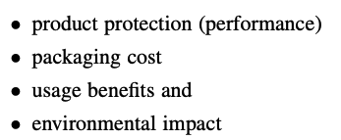
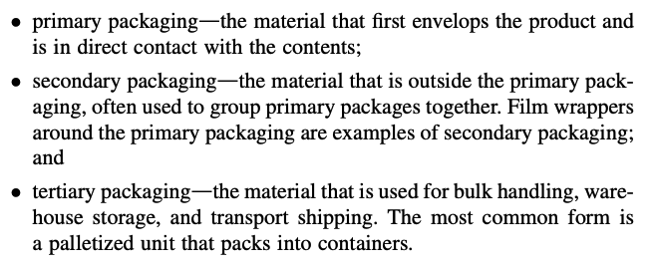
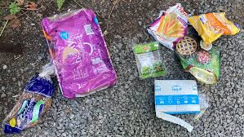
Monolayer Film:
Plastic Wrap
Shopping Bags
Multi-layer Film:
Pouches and Sachets
120 million metric tons of plastic in packaging per year globally
60% of plastics found on beaches
Plastics Packaging

Slide 2
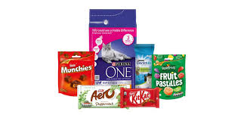
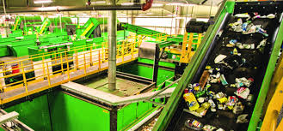
Ideal Packaging:
Protect product from breakage, spoilage, contamination
Extend shelf-life/usage-life
Safeguard hygiene
Attractable appearance
Minimal material usage
Reduce package size
Reduce weight
Packability
Multiuse
Barrier properties tuned to product
Recyclability/Reuse/Downcyclability/Upcyclability?

Slide 3
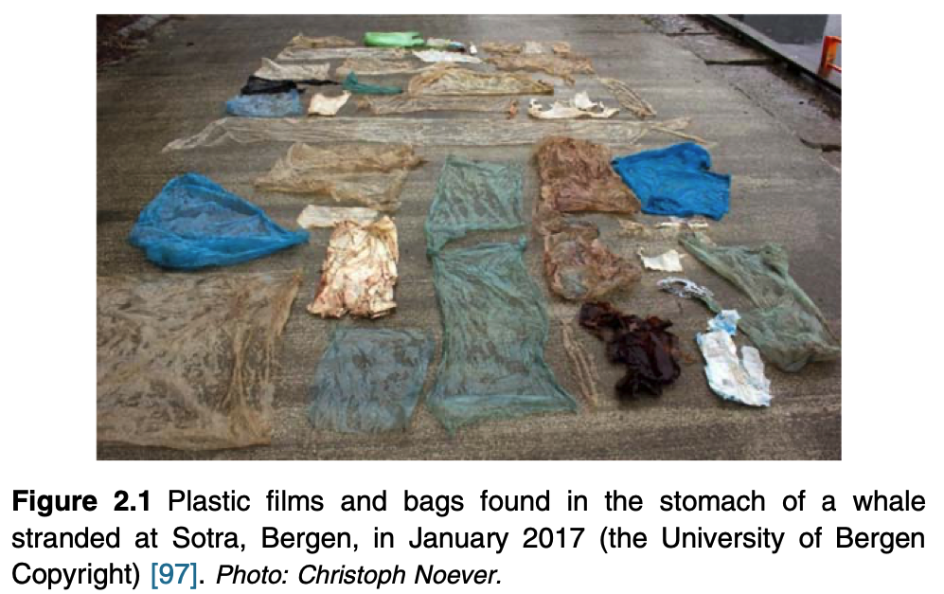

Slide 4
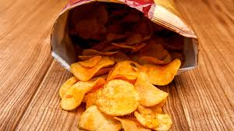
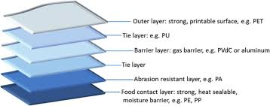
Flexible Packaging:
Usually multilayer
bulk layers (outer)
barrier layers
tie layers
heat sealable layers

Slide 5
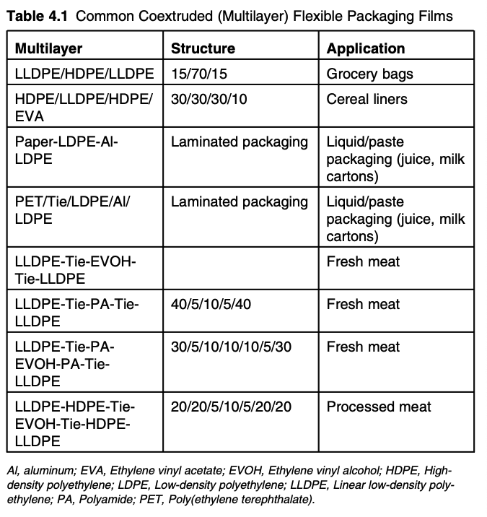

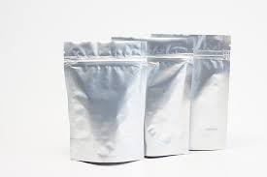
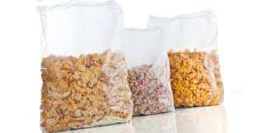

Slide 6
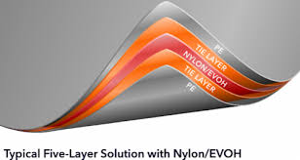
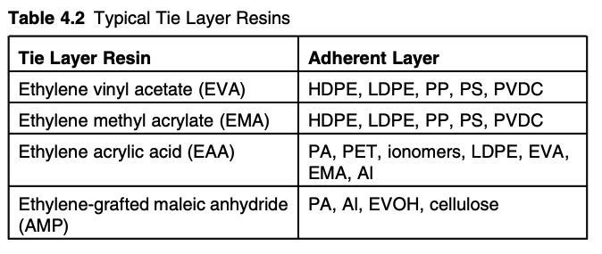

Slide 7
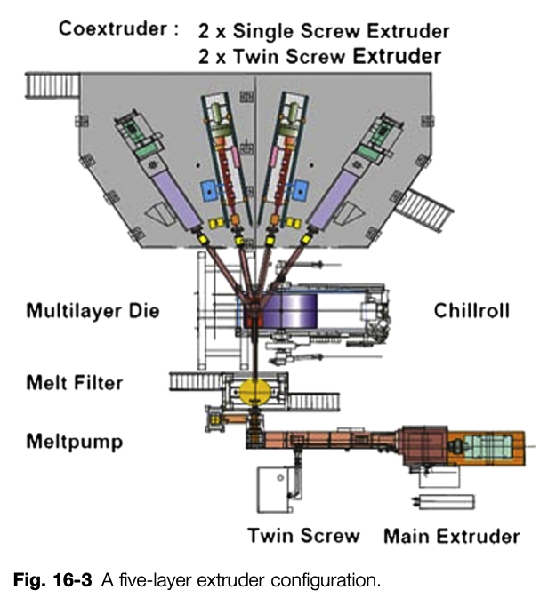
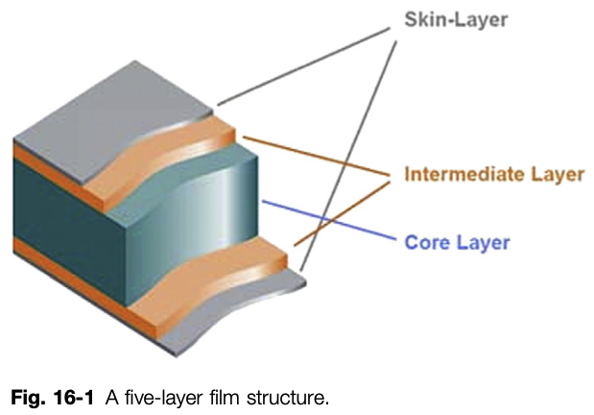

Slide 8
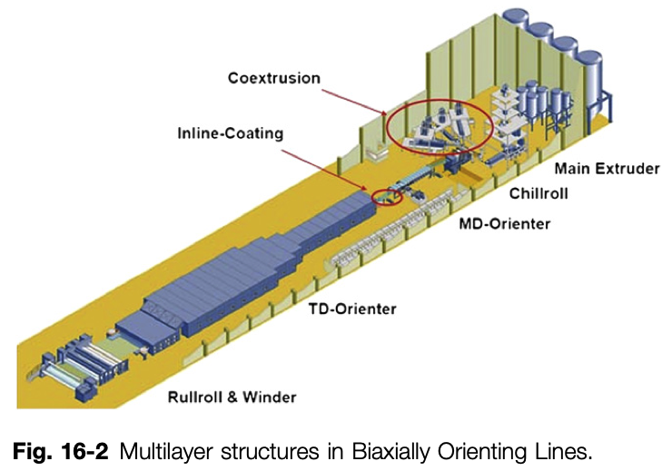

Slide 9
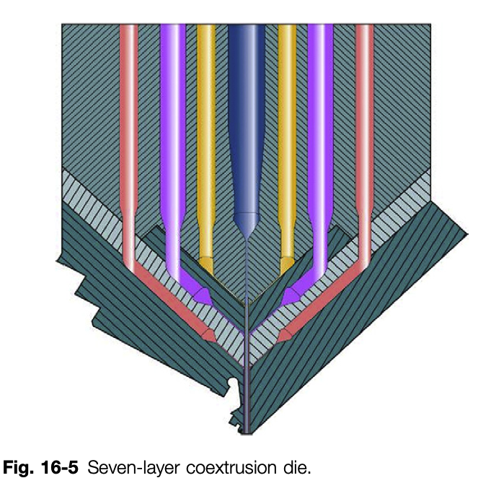

Slide 10
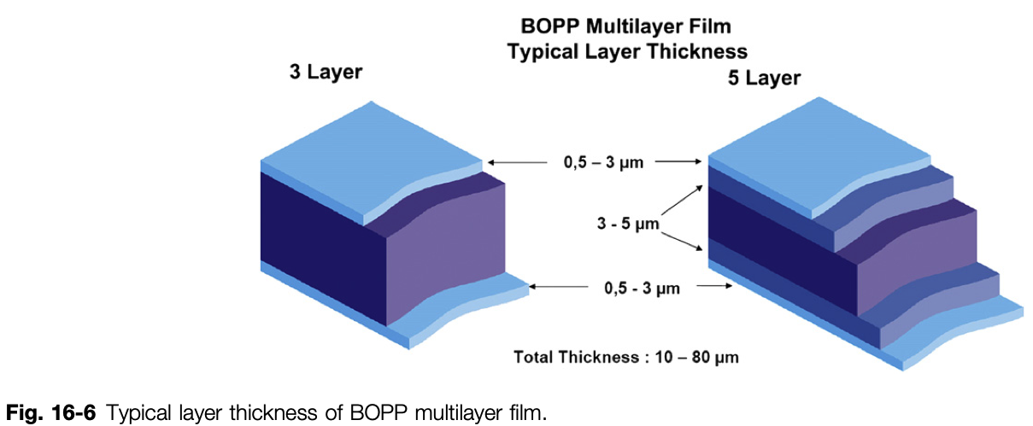
Biaxially Oriented Polypropylene Film

Slide 11
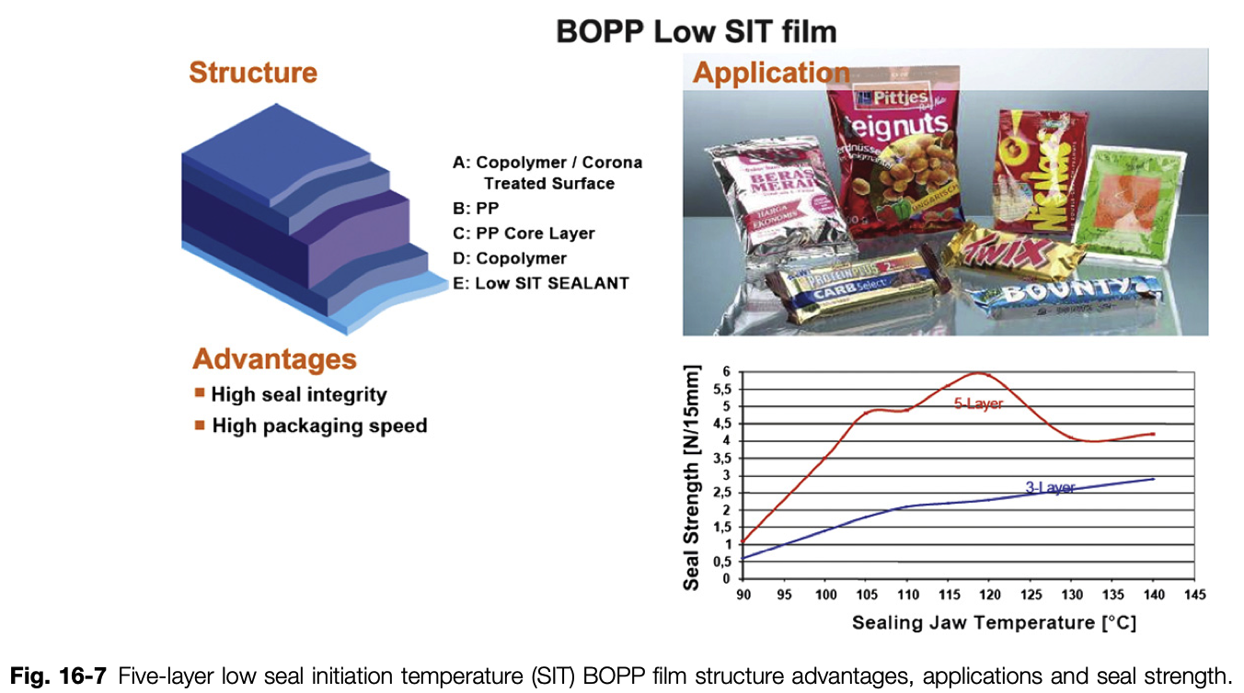
Biaxially Oriented Polypropylene Film

Slide 12
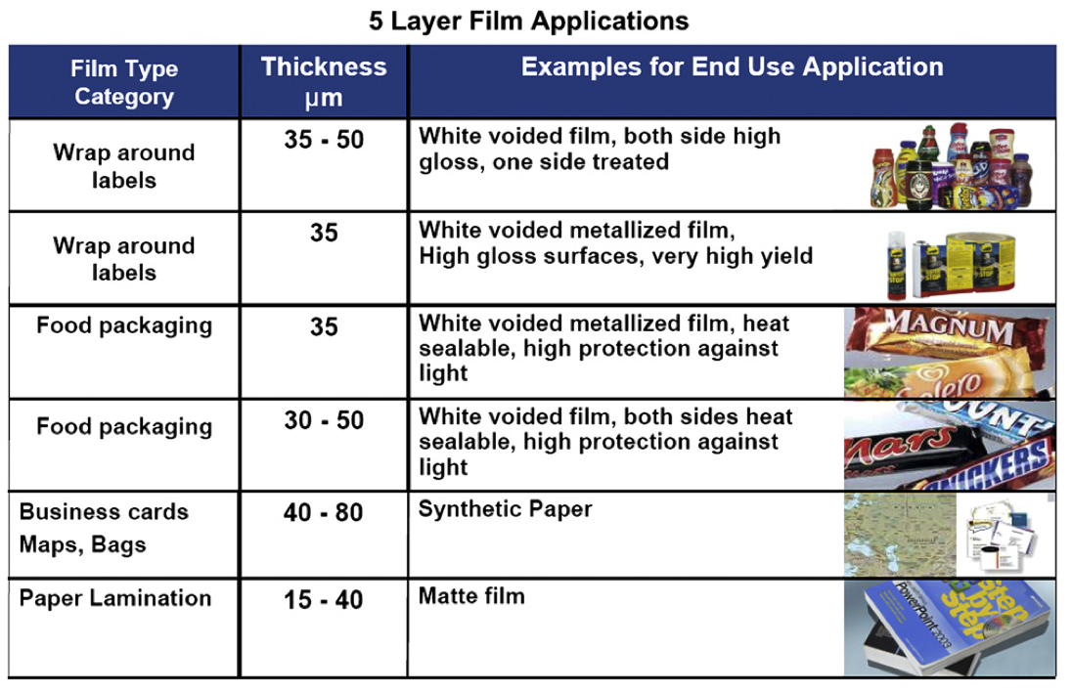

Slide 13
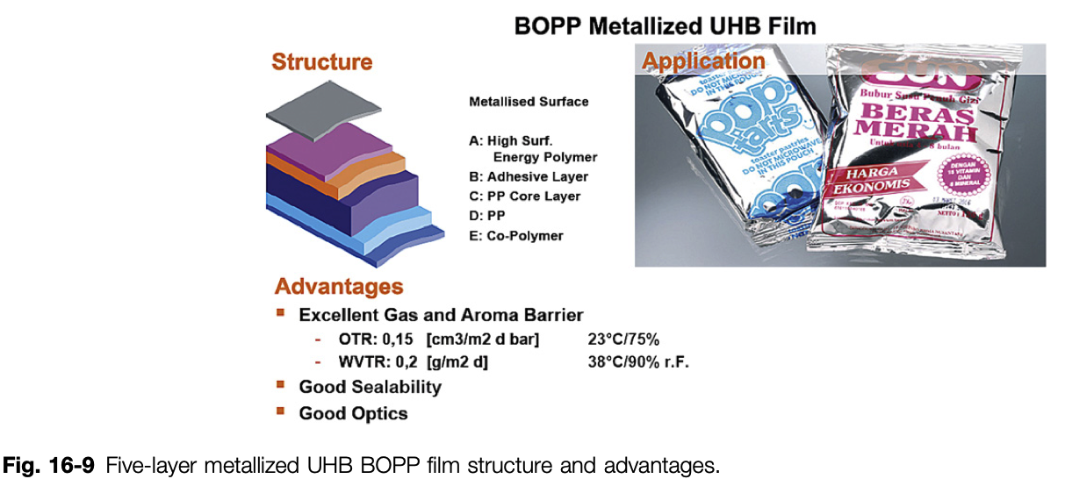

Slide 14
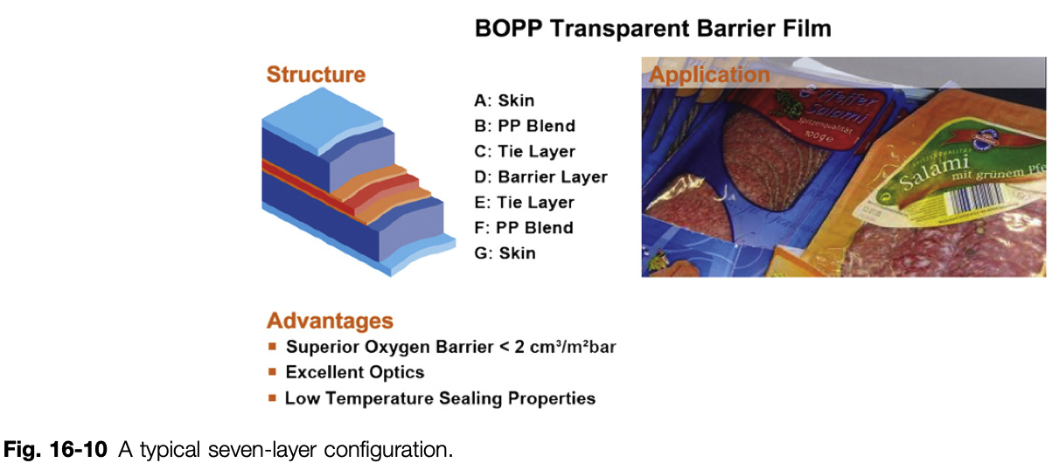

Slide 15
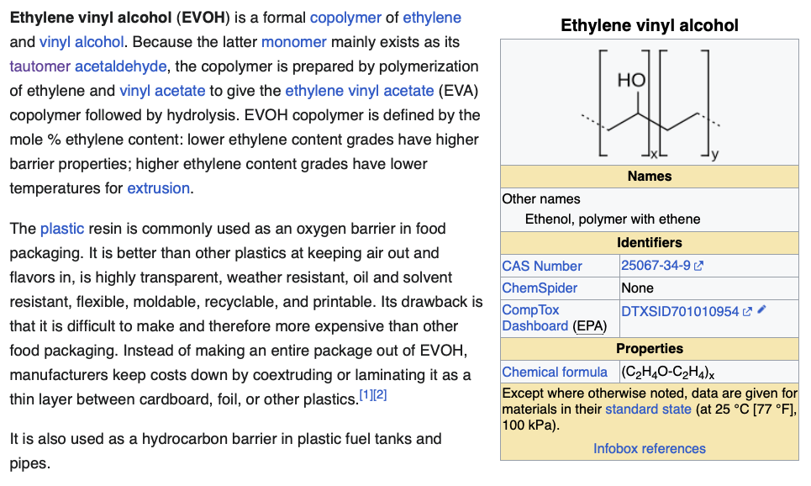

Slide 16
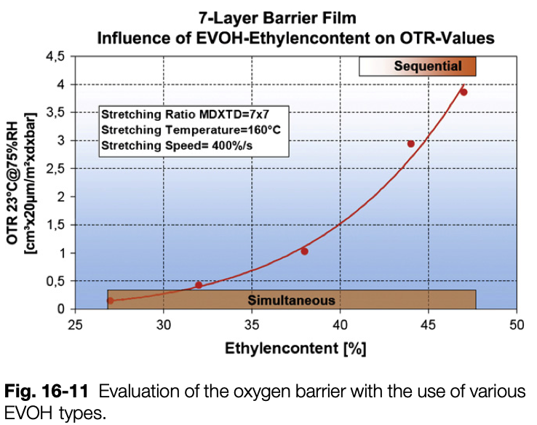
Higher ethylene has lower barrier but lower temp processing

Slide 17
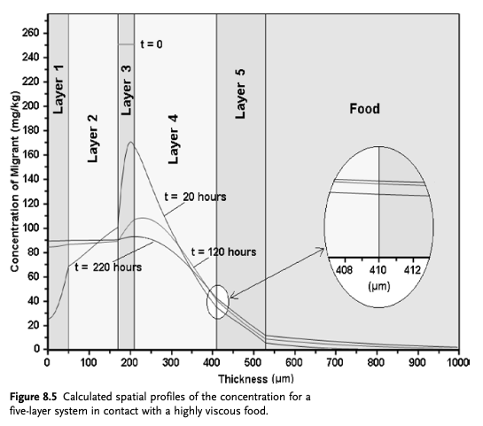

Slide 18
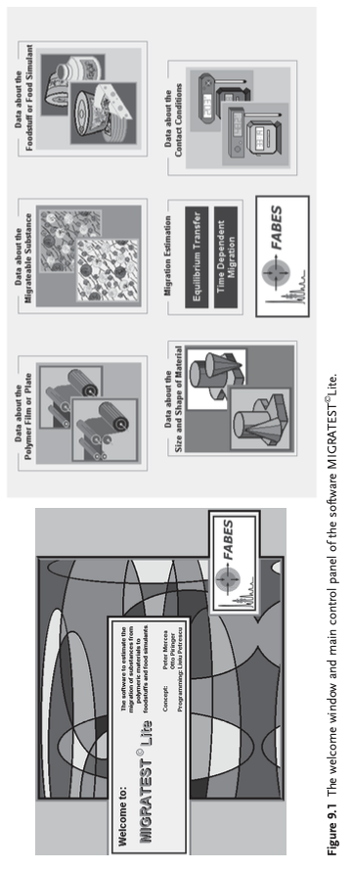

Slide 19
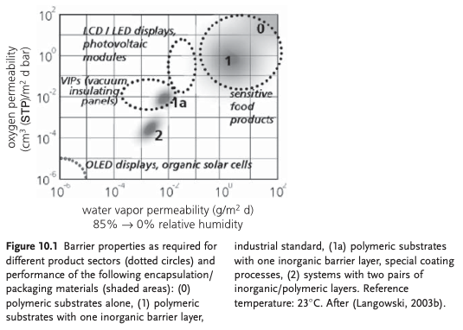

Slide 20
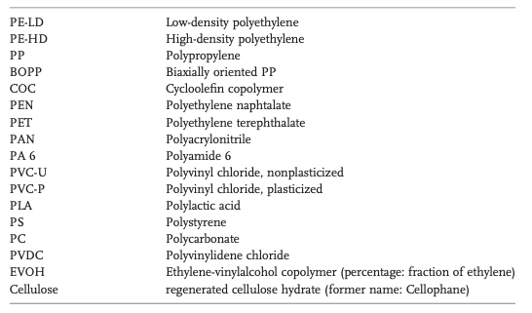
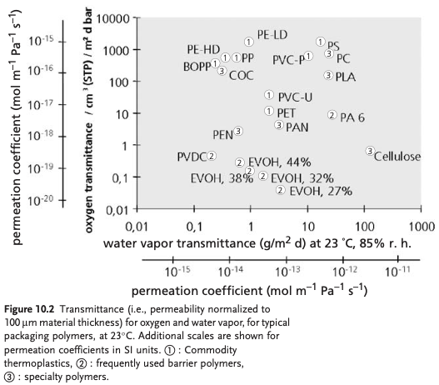

Slide 21
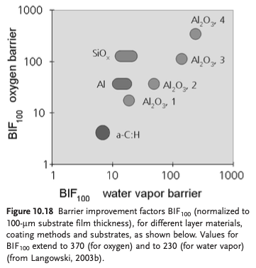
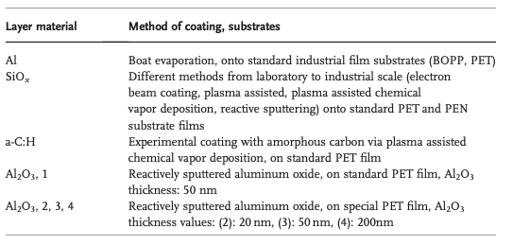

Slide 22
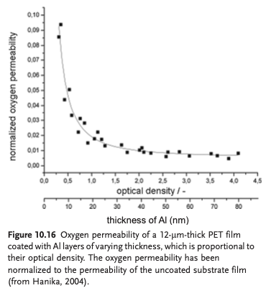

Slide 23
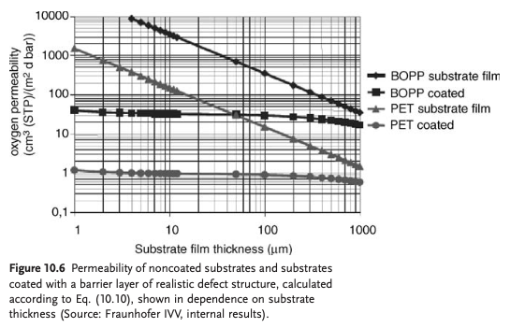

Slide 24
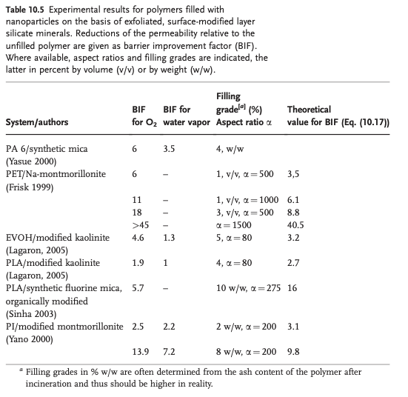

Slide 25
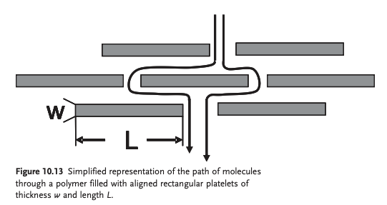

Slide 26
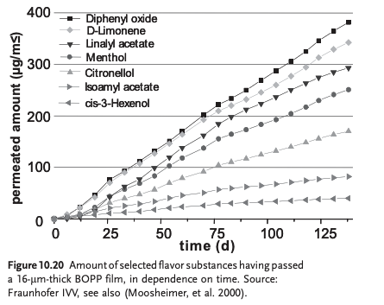

Slide 27
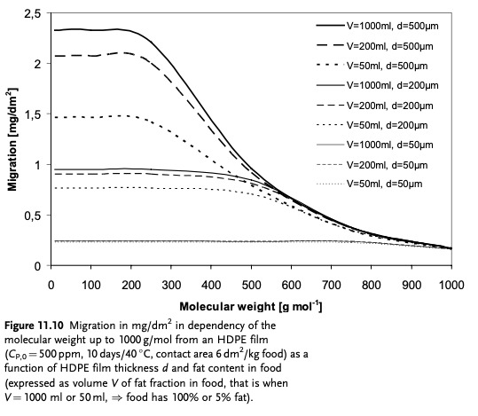
Fat content
MW substance
Film Thickness

Slide 28
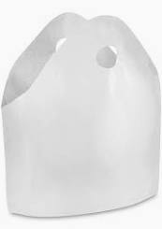
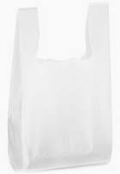
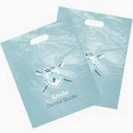

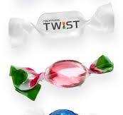
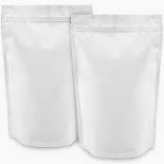

Forms of Flexible Packaging
Soft-loop handle bag
Wave-top bag
T-shirt bag
Die cut handle bag
LDPE, HDPE, iPP
Shrink wrap (LDPE), stretch wrap (LLDPE) , bubble wrap (LDPE), twist wrap (iPP multilayer)
Stand-up pouches SUP
PET, BOPP, nylon, PE,
tie layers, aluminized
or foil
Lay flat/pillow pouches
LDPE, HDPE

Slide 29
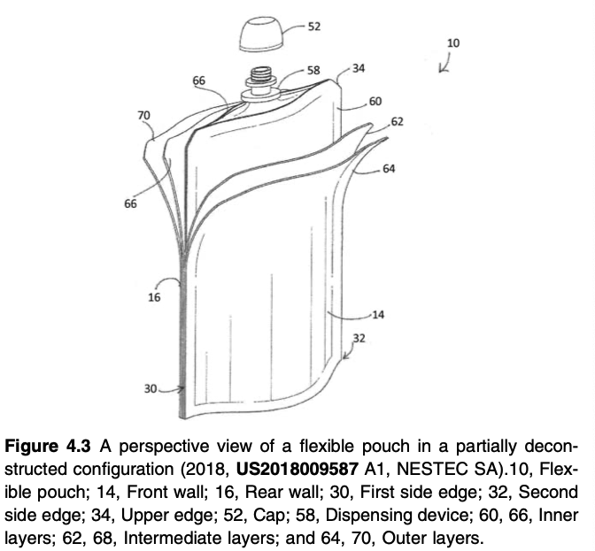
Forms of Flexible Packaging

Slide 30
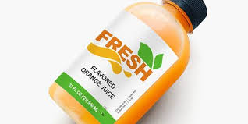
Labels and Sleeves
iPP, OPP, glycol-modified PET (PET-G), LDPE, PVC, PS.
PET-G Shrink wrap label and sleeves for PET containers
Polymer made of the same material as the container or film do not act as further contaminates and can be recycled with the film or container. e.g. OPP label on HDPE or PP bottles

Slide 31
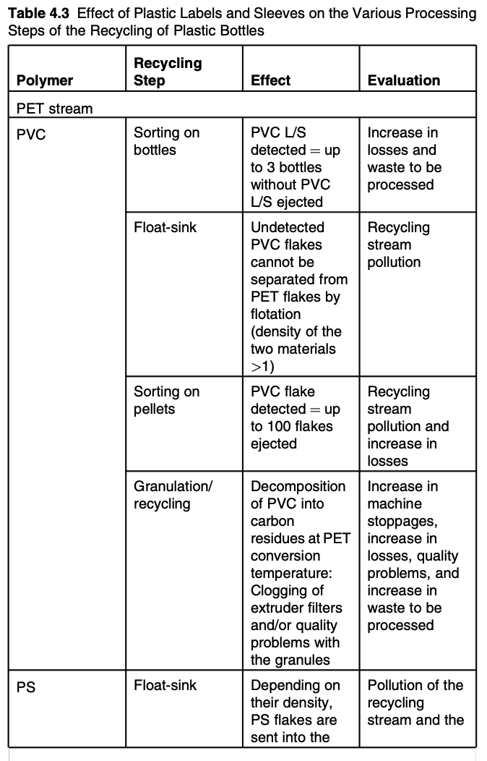
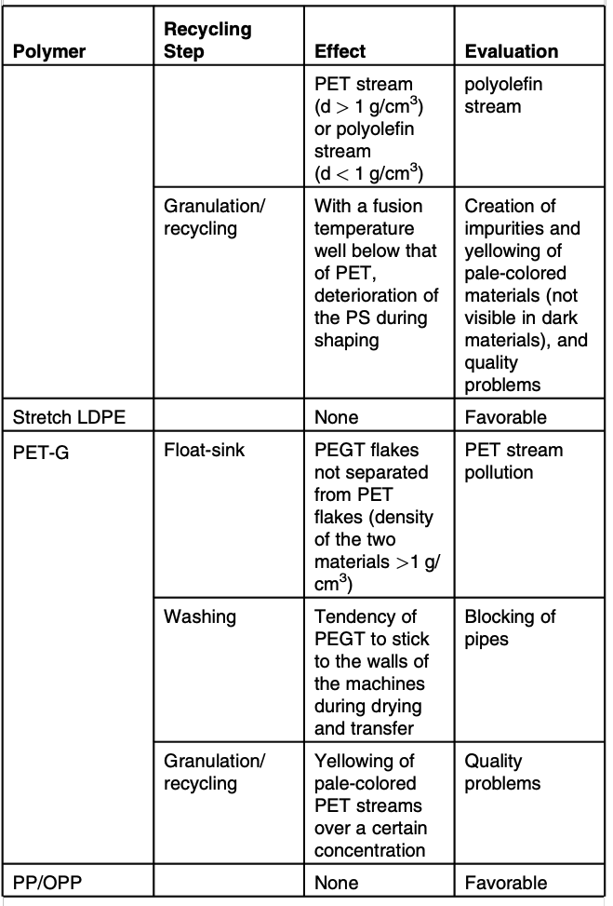
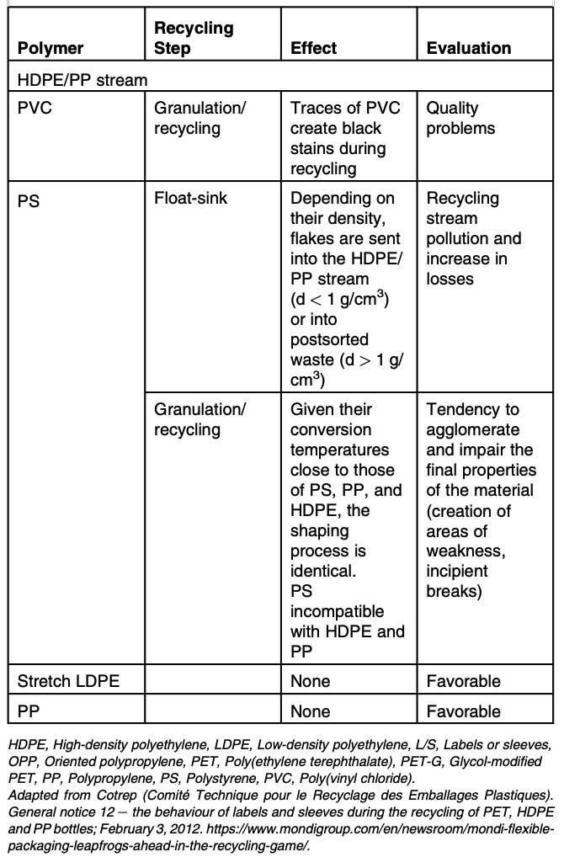

Slide 32
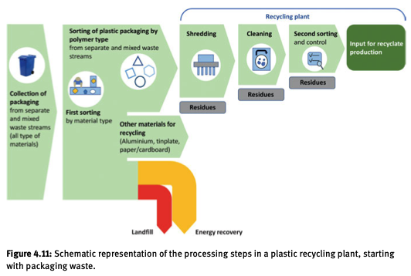
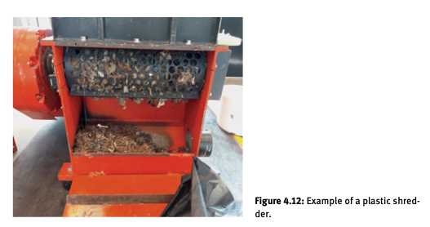
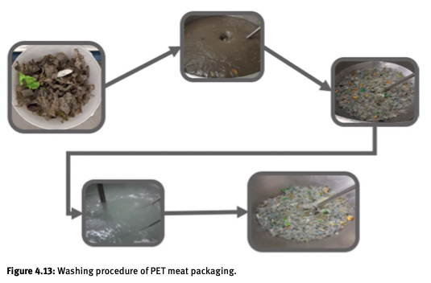

Slide 33





Slide 34



Slide 35

Straps/Tapes/Six-Pack Rings
Straps and Tapes: Thin, flat plastic bands PP or PET
6-Pack Rings are LDPE
None are recyclable

Slide 36

Woven Bags/Net Bags/Sacks
HDPE, PP, PET, Nylon
BOPP
For industrial materials, the bags are recycled

Slide 37



Coated/Printed Film
PVDC, improves barrier for transparent films
Printing:
Flexographic-
UV or IR cure
Printed or coated film can be recycled for trash bags coating can’t be removed.

Slide 38


Rotogravure-
Digital-

Slide 39


Applications of Flexible Packaging
Food and beverage-
Largest Segment
Multilayer films with Aluminum foil and Polyolefins or PET/polyamide
Coating with PVDC to improve O₂ barrier
Heat sealing material like wax

Slide 40

Cleaning Products-
Soap wrappers
Laundry detergent pods (polyvinyl alcohol PVOH)
Liquid detergent pouches
Hand soap tubes
powder soap pouches
Dishwasher pouches
Dishwasher pods
Pouch packing for cleaning chemicals

Slide 41

Medical/Personal Care/Cosmetics
Printed Aluminum Layer
Forming Film
LDPE, LLDPE, BOPP, OPP, PET, polyamide, PVC, PVDC
Considered medical waste

Slide 42

Flexible Pouches for Infusion
-Zero volume chamber
-Retained asepsis
-Reduce waste
PVC or polypropylene

Slide 43


Slide 44


Slide 45


Slide 46


Slide 47

Construction and Building
Stretch Film made of LLDPE
Bricks,
Tiling,
Roofing
Truss structures
Woven PP bags
For sand
Bricks
Cement
PP or PET straps for
Ceramic tile pavers
Building blocks
Recycling is common

Slide 48


E-Commerce
20% of retail sales
Layers of LDPE and HDPE
Usually not for curbside recycling
Labels need to be removed or cut out

Slide 50


Slide 51

Plastics Packaging
Uses less material, less expensive,
Can be designed to be more appealing,
Printable, rigid packaging needs labels often made of flexible packaging
Tunable transport properties minimize material use

Slide 52

Recycling and Flexible Packaging

Slide 53


Recycling and Flexible Packaging
Automated sorting, requires equipment
Sorted material must be shredded to produce flake scrap material
Flake must be pelletized
For rotational molding, spray coating pellets are ground to a powder
Sorting is the main cost and results in material more expensive than virgin resin
80% of flexible packaging are contaminated with food at 10 to 20% of the weight
Packaging films tangle and clog sorting equipment at material recovery facilities

Slide 54


Recycling Multilayer Flexible Packaging
There is no technology for recycling of multilayer flexible packaging or metallized films
Printing ink, labels, metallized material, adhesives, coatings must be removed

Slide 55
Recycling Multilayer Flexible Packaging
Each layer (there could be up to 10 layers) must be
Separated
Analyzed and categorized
Recycled (shredded, pelletized)

Slide 56

Collection of Flexible Packaging
Flexible packaging recycle rate is cited at 2% by some, 3% by others and up to 20% by still others
-Not widely collected around the world
Sources:
Post-consumer
Post-commercial
Post-industrial
If you put your recycle in a plastic garbage bag it is removed from the stream at the MRF and sent to landfill
Post-consumer:
LDPE, LLDPE, HDPE, iPP and multilayer films
Much of it contaminated with organics and labels/printing
TerraCycle Zero Waste Bags

Slide 57

Collection of Flexible Packaging
EU Rules, originally 2025 then Dec 2025 now 2030…

Slide 58


Collection of Flexible Packaging
https://www.hefty.com/hefty-renew-starter-kit

Slide 59

Collection of Flexible Packaging

Slide 60


Collection of Flexible Packaging

Slide 61


Collection of Flexible Packaging

Slide 62



Slide 63


Post Commercial Flexible Packaging Collection
Polyethylene clear film
Large commercial generators
clear bags, stretch wrap film
Doesn’t need to be washed
21% recycling rate
Recycled into trash bags and thicker commercial films
Polyethyelene post commercial mixed color film
Stretch wrap
Polypropylene woven bags

Slide 64

Postindustrial Flexible Packaging

Slide 65



Slide 66


Slide 67
Separation and Sorting and Volume Reduction

Slide 68
Separation and Sorting and Volume Reduction
Materials Recovery Facility (MFR)
separate
densify
Ship to reprocessors or recyclers
Clean MFR works with separated materials
Dirty MRF works with comingled wastes including organic matter
Contamination is a big problem
metals
paper
other plastics
odd objects, batteries, metal parts, etc
Generally flexible plastic films are a contaminant
Plastics Recovery Facility (PRF)
Plastics specific MRF
These don’t exist in the US

Slide 69

Manual and
Vacuum Sorting
Separation and Sorting and Volume Reduction
Feeds into a bale press
Or film screw

Slide 70

Air Separators

Slide 71

Air Separators

Slide 72




Screens
Disc screen
Vibrating screen
Trommel screen
Ballistic screen

Slide 73

Grabbers
Hooks grab bags

Slide 74


Slide 75


Slide 76


Slide 77


Labeling Systems

Slide 78



Optical Sorters
Visible light (VIS)
high speed camera and light sensors to detect
Doesn’t detect chemical makeup
Near-infrared (NIR)
Use IR fingerprint
Doesn’t detect color
Neither work well with carbon black

Slide 79
Fluorescent Light
Add Fluorescent material for identification and separation of plastics
Could separate food contaminated films
Doesn’t seem to be used anyplace

Slide 80

Robotic Sorters

Slide 81


Slide 82
Eddy Current Separators
Remove nonferrous metals
Aluminum, brass, copper
Rotating magnet create “eddy currents”
“eddy currents” cause metal to be repulsed by the magnetic field and ejected from waste stream.
These can remove aluminized multilayered films

Slide 83


Slide 84

Volume Reduction
Compactors

Slide 85


Compactors

Slide 86




Life Cycle Analysis of Flexible Packaging is Favorable
Flexible film packaging typically results in less
global warming potential,
energy use, and
volume/quantity landfilled
than recyclable rigid package alternatives [21].
Case studies: coffee; motor oil; baby food; laundry detergent pods; cat litter, beverages
In all cases lower water use, carbon footprint, fossil fuel use, product to package ratio, material to landfill
21. Reclay StewardEdge. Product stewardship solutions, resource recovery systems, Moore Recycling Associates Inc. Analysis of flexible film plastics packaging diversion systems - Canadian Plastics Industry Association continuous improvement fund stewardship Ontario. Feb. 2013.

Slide 87



Slide 88



For Flexible Packaging
Against Flexible Packaging

Slide 89
Plastics Packaging
Rethink Packaging, Product, System

Slide 90

Plastics Packaging

Slide 91

Plastics Packaging
Recycle
Reuse

Slide 92

Plastics Packaging
Increased quality and functionality in reuse packaging

Slide 93

Plastics Packaging
Standardized packaging reduces design/production costs

Slide 94

Plastics Packaging
Drive sales by brand loyalty through deposit and rewards schemes and personalized products and packaging (mix coke and sprite)

Slide 95


Plastics Packaging

Slide 96
Plastics Packaging
Government and business need to be involved

Slide 97
Plastics Packaging
Use renewable energy to produce H2 to make CH3 and alkanes to make PE PP etc.

Slide 98
Plastics Packaging

Slide 99
Plastics Packaging
https://www.youtube.com/watch?v=xmTQA-RNygQ

Slide 100

Plastics Packaging

Slide 101

Plastics Packaging

Slide 102
Plastics Packaging

