Slide 1
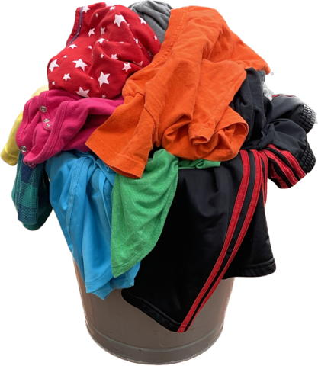
Textiles

Slide 2
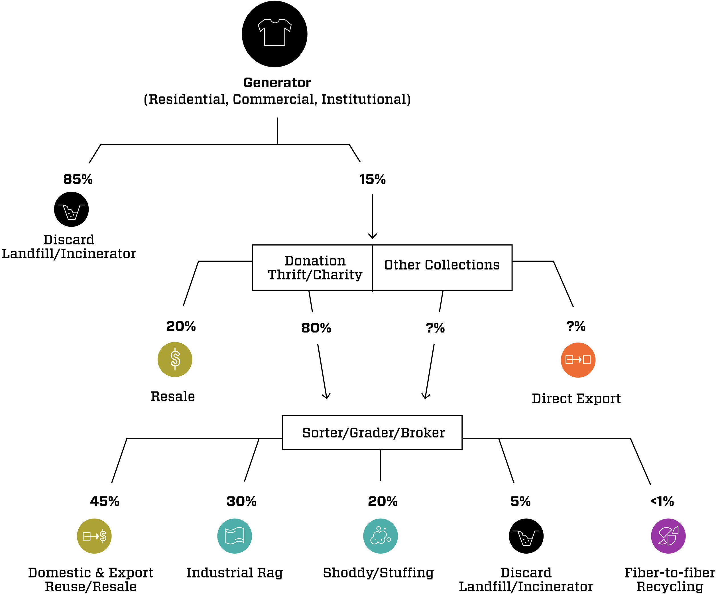
Textiles
5% of total

Slide 3
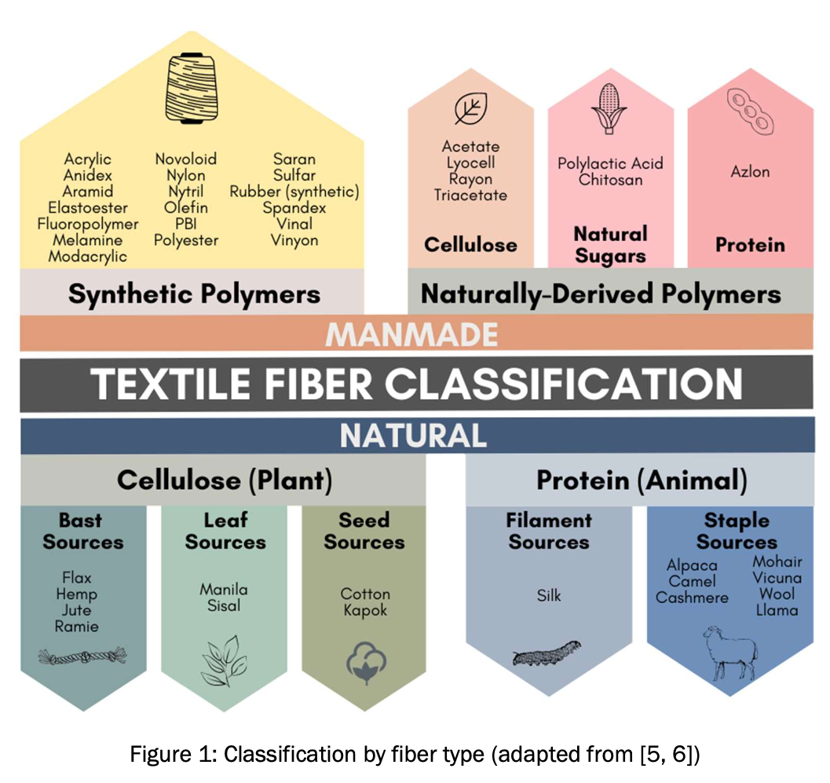
Textiles

Slide 4
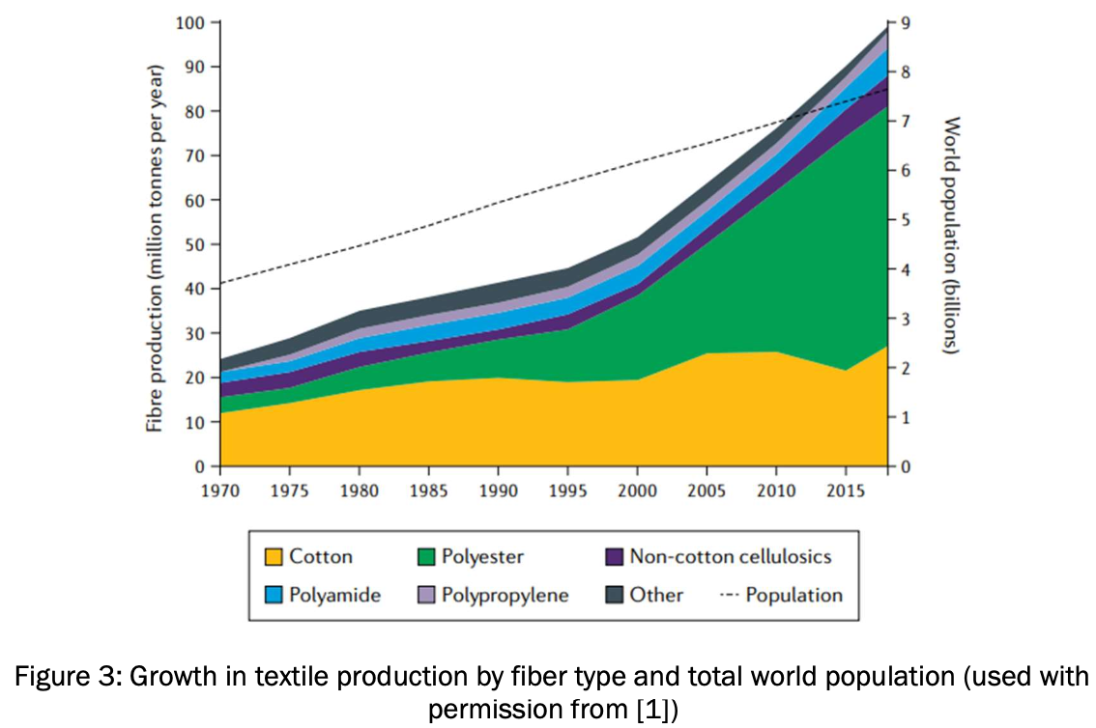
Textiles

Slide 5
Textiles
Textiles include clothing, shoes, bedding, towels, upholstery fabrics and carpeting
But mostly Clothing
2018 each person in the US discarded 103 lbs of clothing
EPA estimated that the generation of textiles in 2018 was 17 million tons. This figure represents 5.8 percent of total MSW generation
The recycling rate for all textiles was 14.7 percent in 2018, with 2.5 million tons recycled. Within this figure, EPA estimated that the recycling rate for textiles in clothing and footwear was 13 percent based on information from the American Textile Recycling Service. The rate for items such as sheets and pillowcases was 15.8 percent in 2018.

Slide 6
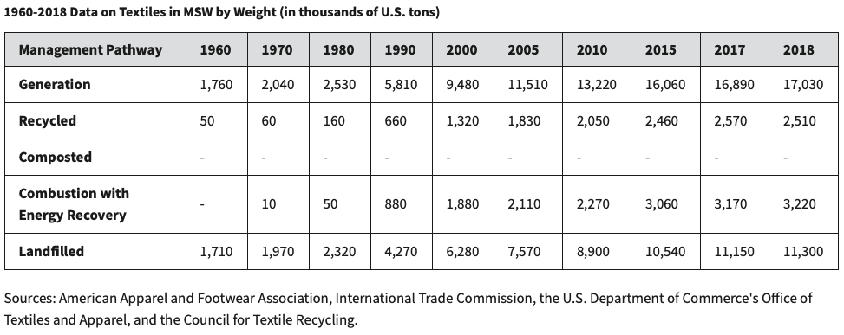
Textiles

Slide 7
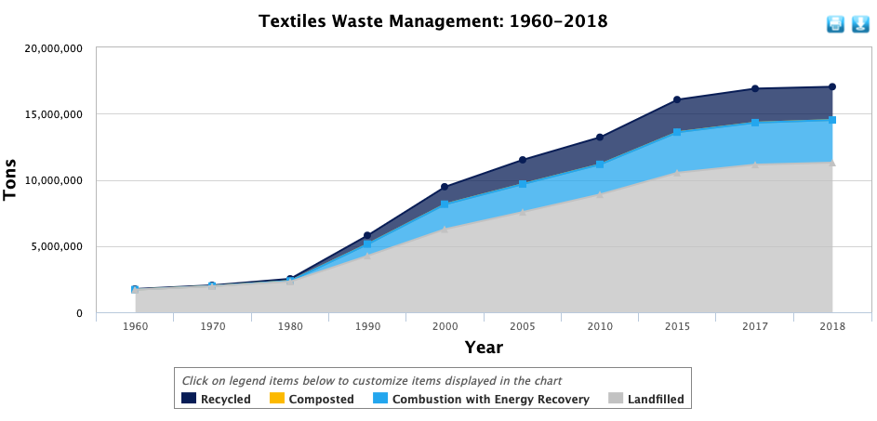
Textiles

Slide 8
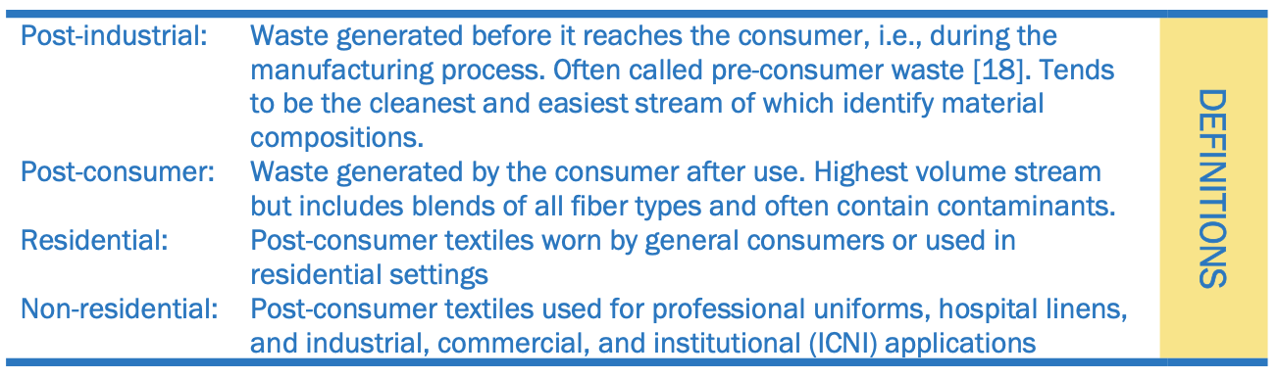
Textile Waste

Slide 9
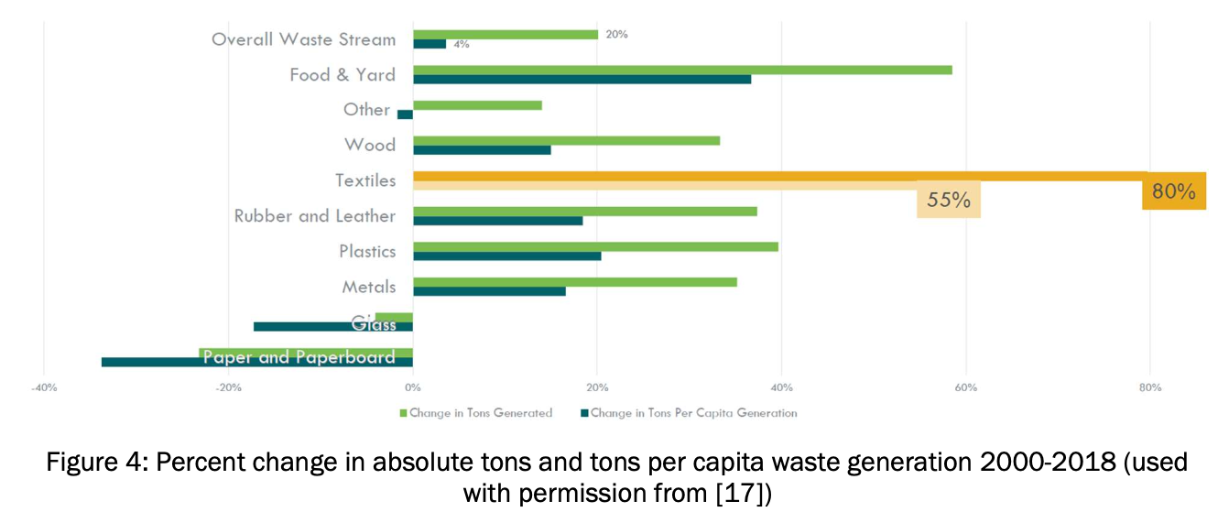
Textile Waste

Slide 10
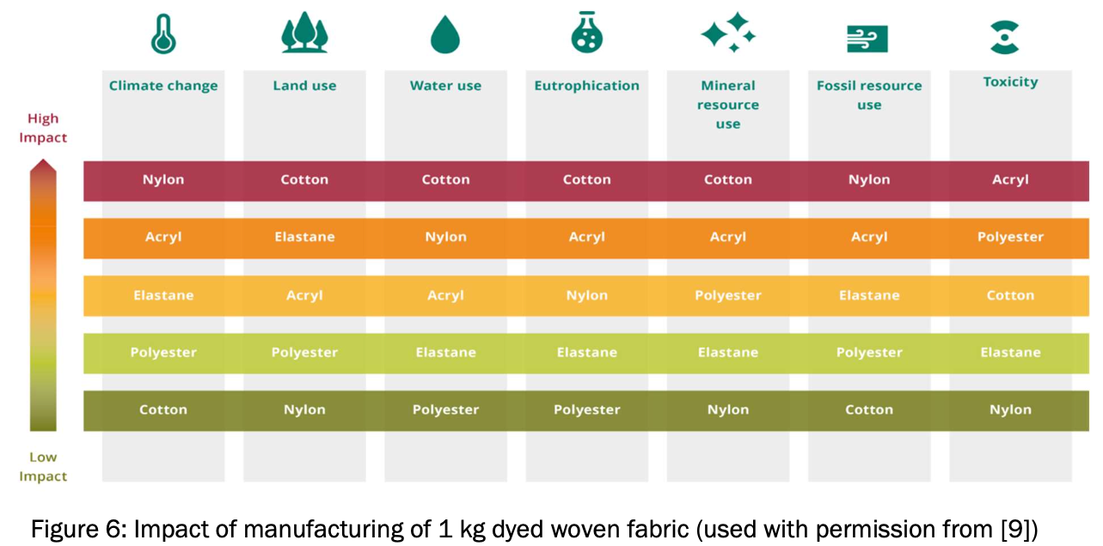
Textile Waste

Slide 11
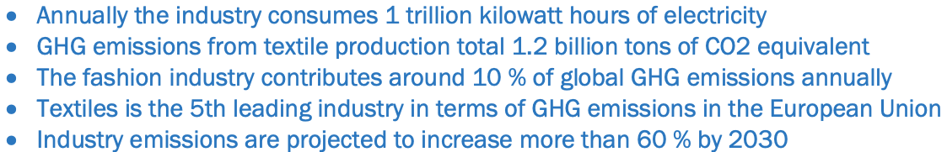
Textile Greenhouse Gas

Slide 12
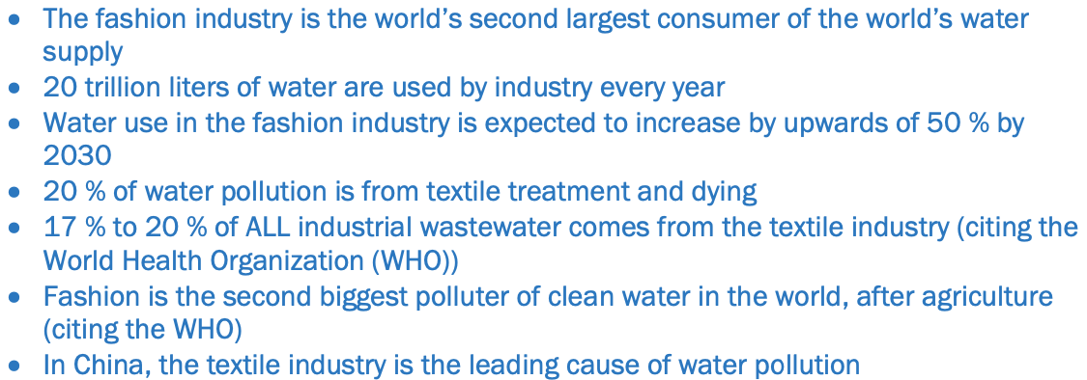
Textile Water Use

Slide 13
Textile Chemicals
Agrochemicals are used on natural fiber crops
Synthetic fibers necessitate different degrees of chemicals
Spinning and weaving, utilize lubricants, accelerators, and solvents
Wet processing of fabrics uses chemicals such as bleaches, dyes, processing aides, and water and stain repellents
Per- and polyfluoroalkyl substances (PFAS) are widely used for “waterproof,” “water resistant,” or “stain-resistant”

Slide 14
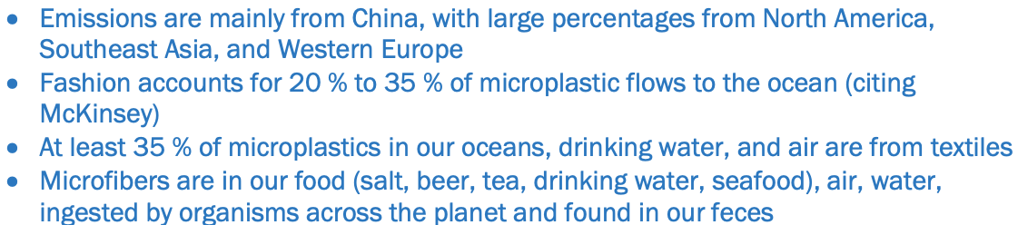
Textile Microplastics

Slide 15

Textile Social Impacts
Employment: variable numbers 65 million people, 85 % of whom are women or 300 million people worldwide
Low-income regions of the world lack occupational health and safety regulations, minimum wage requirements, or child labor restrictions
Collapse of the Rana Plaza building in Dhaka, Bangladesh, which housed five garment factories and resulted in the death of over 1,100 people (24 April 2013)

Slide 16
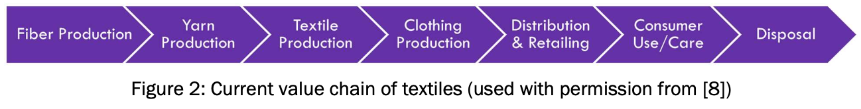
Recent changes in Textiles causing problems
”Fast-Fashion”
increased production of synthetic fiber (e.g., polyester, nylon)
Value chain is setup for linear economy
Agriculture or petrochemical, garment industry, distribution, retail
Produce => Use => Dispose model
Transition to Reuse Repair Recycle
Currently 15% much is shipped to the developing world

Slide 17
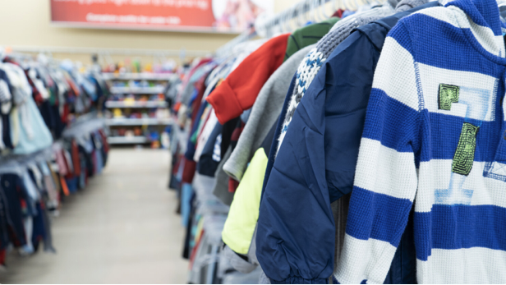
Goodwill (for example)
$ Textiles donated to Goodwill $
Regional Collection Warehouse
Goodwill Retail Stores
Goodwill Outlet Stores
Salvage Buyers (Export)
Landfill (5%)

Slide 18
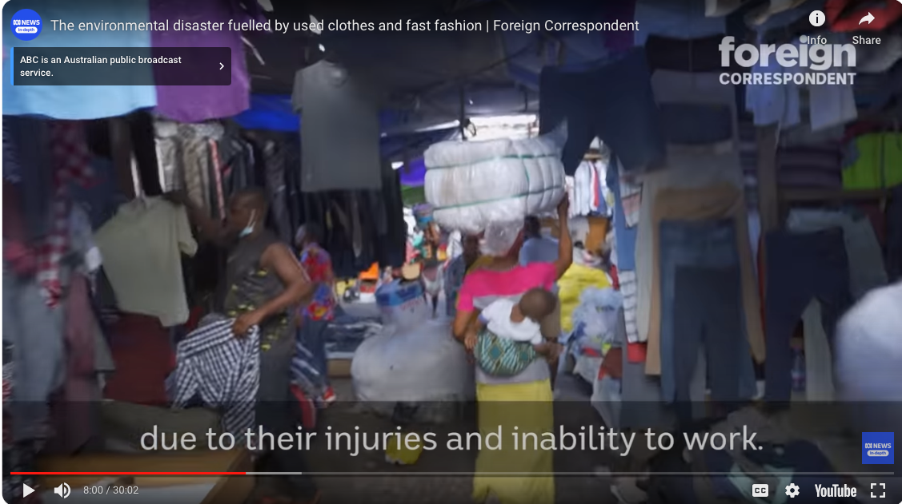
Shipped to Africa

Slide 19
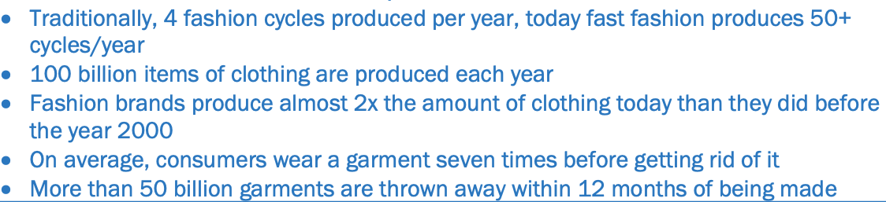
“Fast-Fashion”

Slide 20
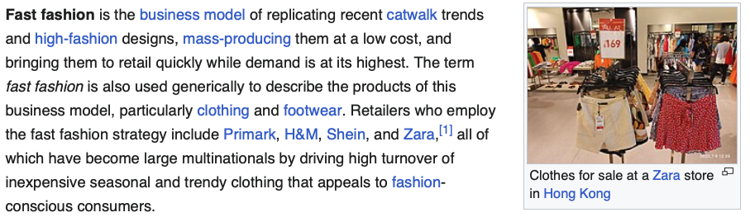
Textiles
In 2014, the average person purchased 60 percent more articles of clothing and kept said clothing for half as long compared to the year 2000.

Slide 21
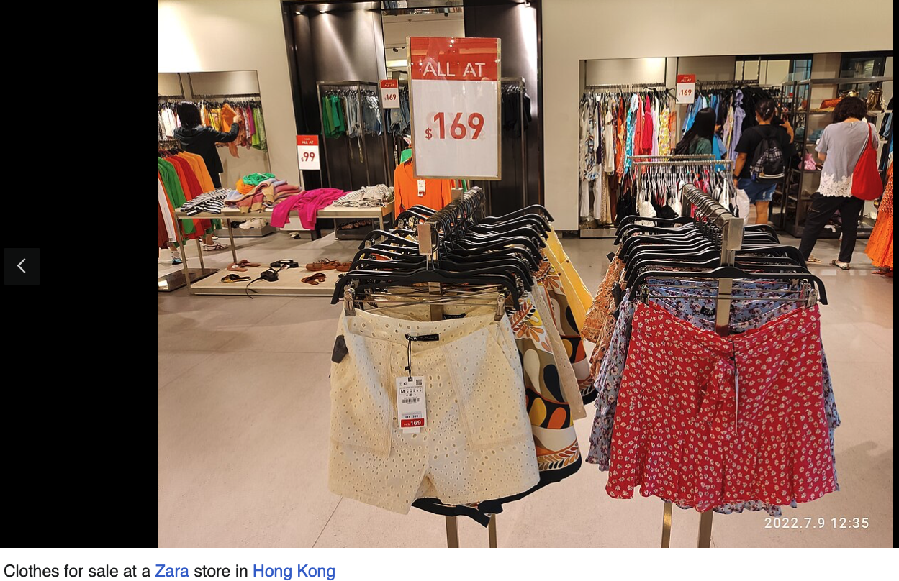
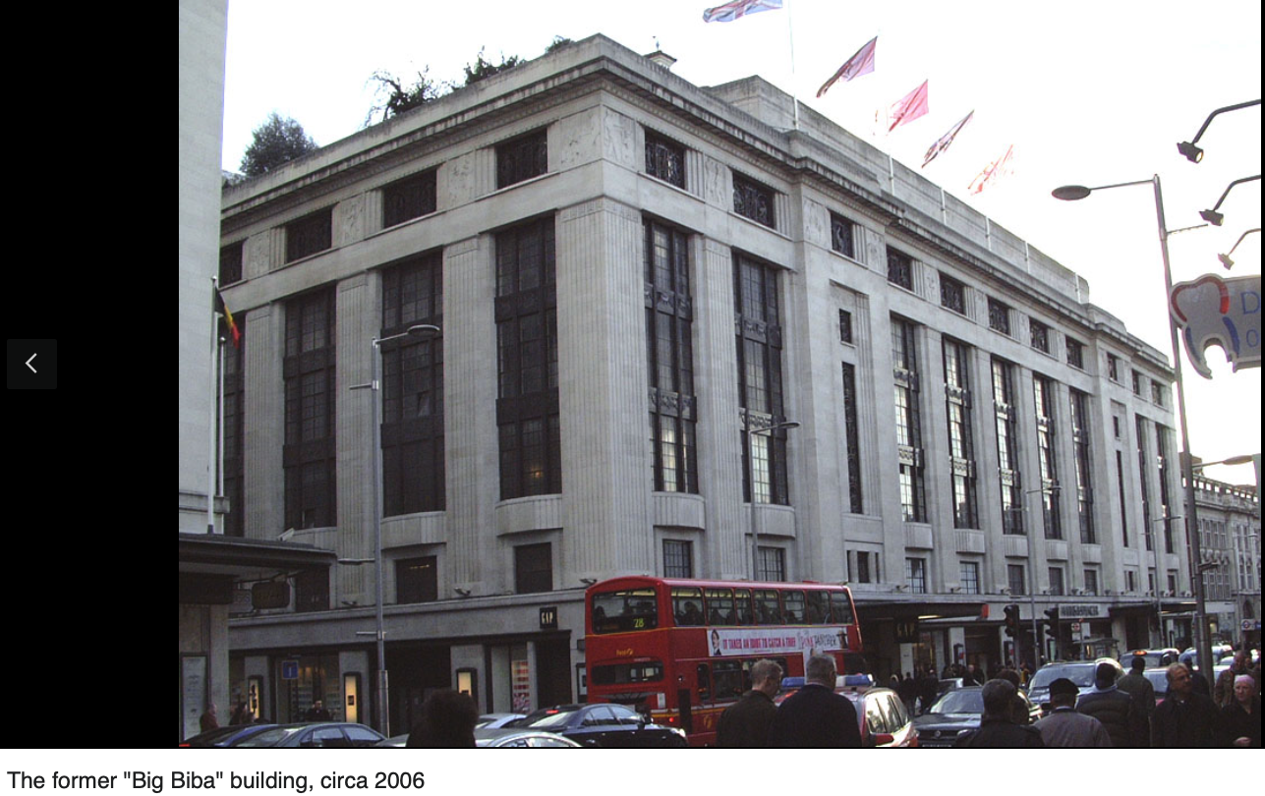
Textiles
Retailers who employ the fast fashion strategy include Primark, H&M, Shein, and Zara,^{[1]} all of which have become large multinationals by driving high turnover of inexpensive seasonal and trendy clothing that appeals to fashion-conscious consumers.

Slide 22
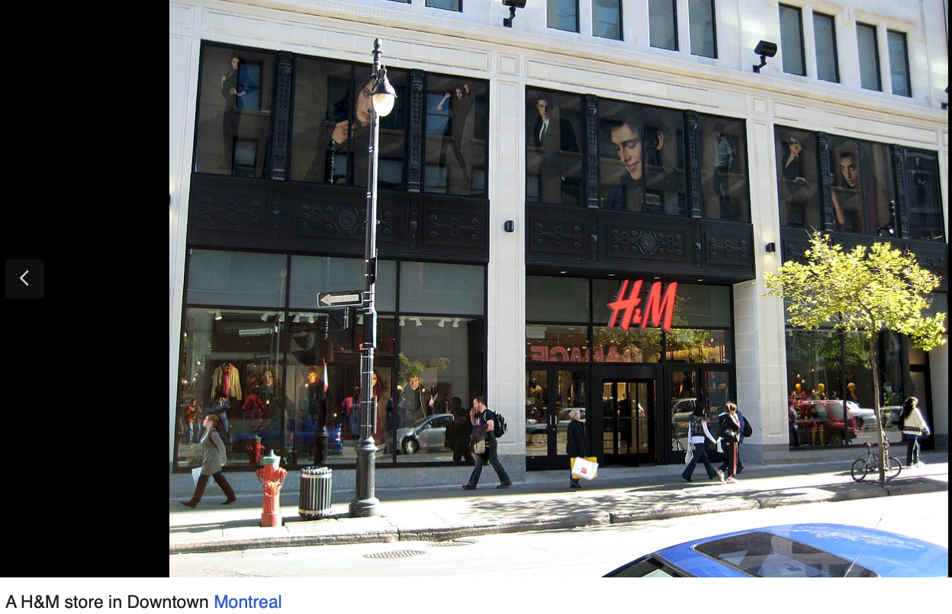
Textiles

Slide 23
Textiles
The global fashion industry is responsible for 8–10% of global carbon emissions per year, to which fast fashion is a large contributor.

Slide 24
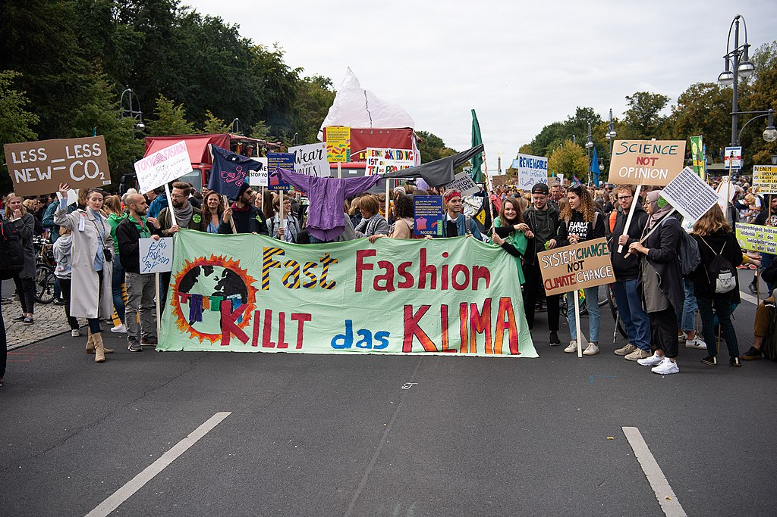
Textiles

Slide 25
To make fast fashion more sustainable:
Zero-waste pattern cutting: This technique eliminates potential textile waste right at the design stage, where the pattern pieces are strategically laid like a jigsaw puzzle onto a precisely measured piece of fabric.
Minimal seam construction: This technique allows faster manufacturing time by lessening the number of seams that are necessary to stitch a garment.
Design for disassembly (DfD): The main intention of this strategy involves designing a product in such a way that it can be easily taken apart at the end of its lifespan and this allows the use of fewer materials
Craft preservation: This technique combines and incorporates ancestral craft techniques into modern designs and in a way it ensures preservation of traditional craftsmanship through innovation.
Pull factor framework: Brands such as L.L.Bean and Harvey Nichols have implemented a pull factor framework, which is a new methodology that strives to make sustainable innovation more enticing for consumers and producers alike.

Slide 26
Key Challenges for Cyclic Textiles
Infrastructure and systems for collection of waste textiles
not well established
2. Sorting and grading
rely on expensive manual labor, No harmonized sorting standards
3. Commercial-scale recycling
fiber-type dependent, require pure feedstock, separation of blends and removal of dyes, additives, and finishes
Textile circularity is not economical
5. Large-scale reuse, repair, and recycling is hindered by high transportation, labor, and processing costs

Slide 27
Opportunities for Advancement
Harmonization of terminology, standards
Publicly available databases, registries and repositories
Advanced labeling strategies
Improve sorting-grading and preprocessing
Advanced recycling process development
Product design, recycled content requirements
Alternative businesses models
Standards for collection, recycling feedstock, sustainable procurement, and microplastic fiber testing
Policy economic incentives, public procurement, bans, mandates, EPR
10. Education and outreach
11. Economic assessment
12. Communication across sectors and value chain

Slide 28
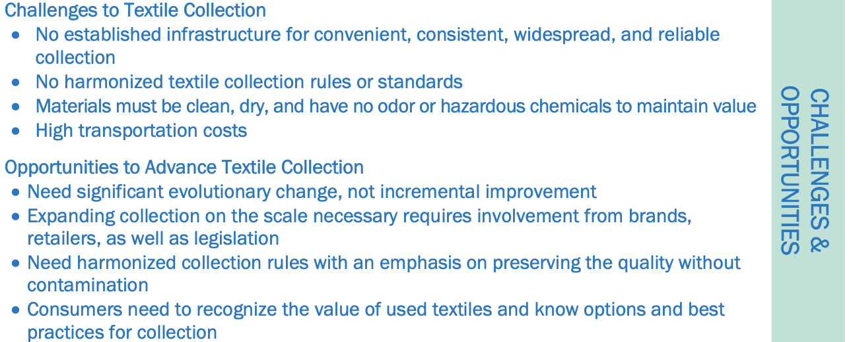
Textile Collection

Slide 29
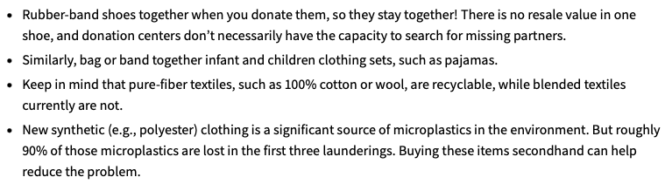
Textiles

Slide 30
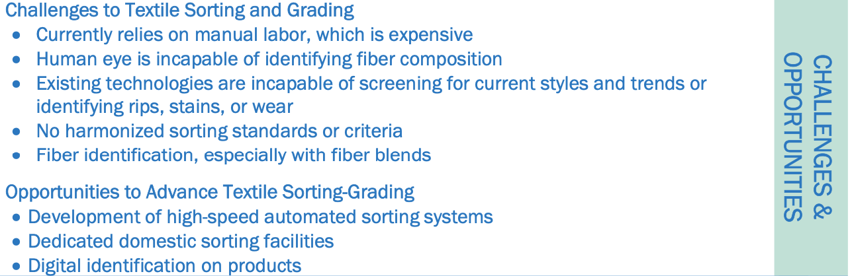
Textile Sorting and Grading

Slide 31
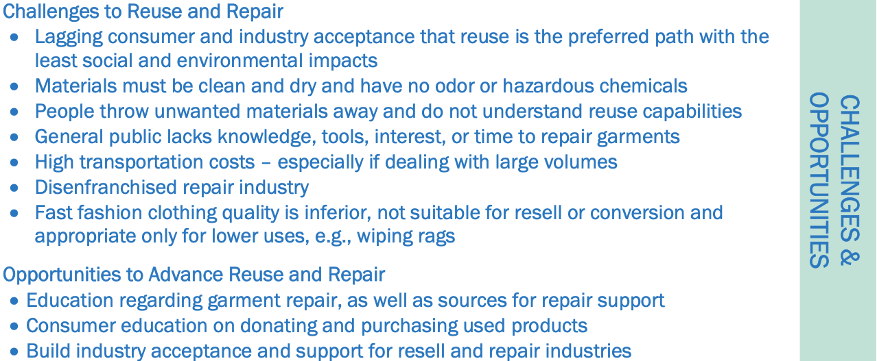
Textile Reuse and Repair

Slide 32
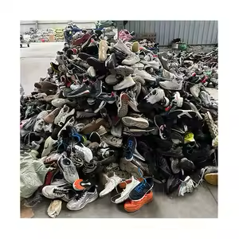
$150/pair
$ 90 for last years model
Resole costs
$50-60
Difficult to justify resoling

Slide 33
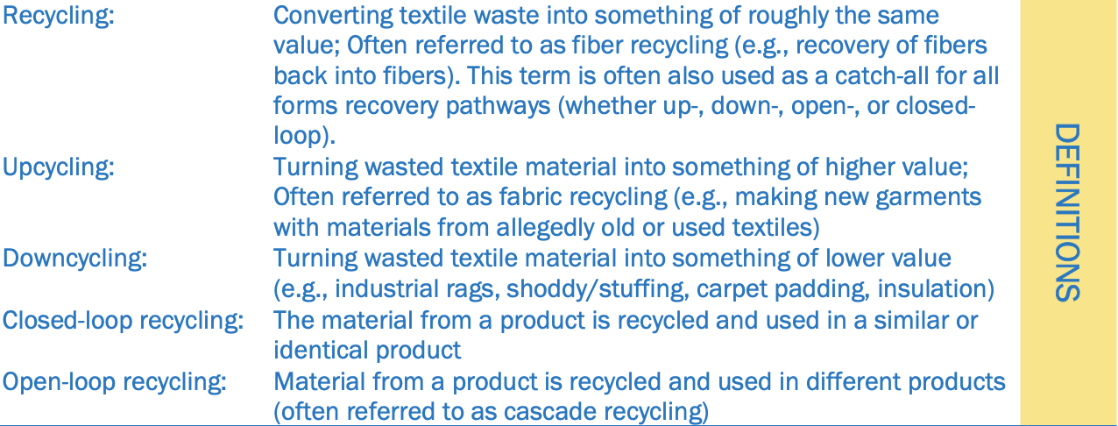
Textile Recycling

Slide 34
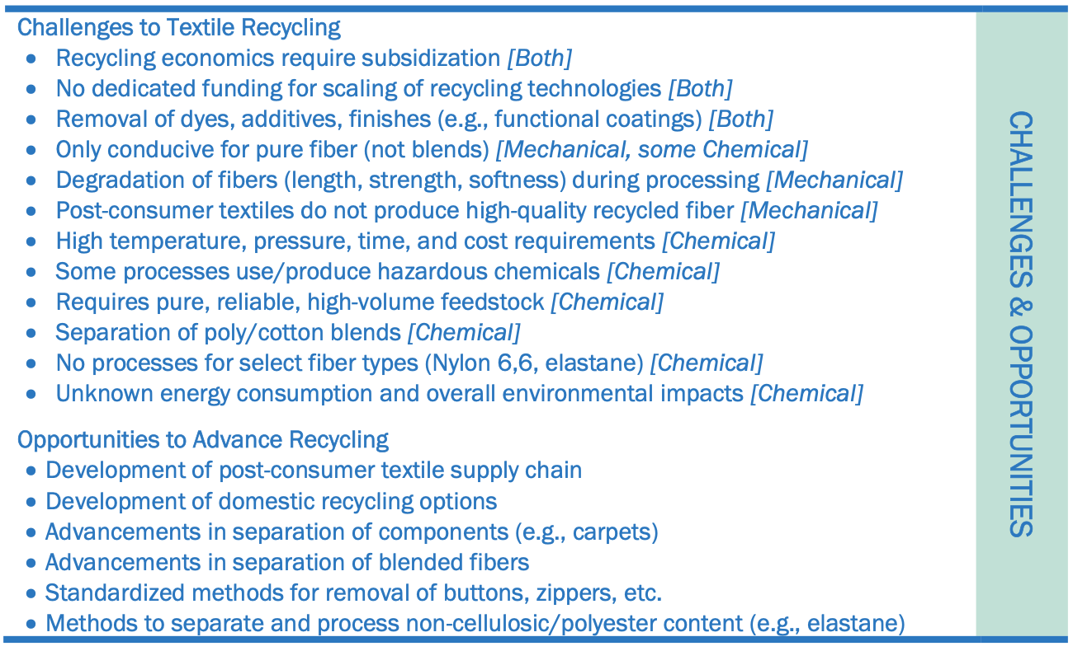
Textiles

Slide 35
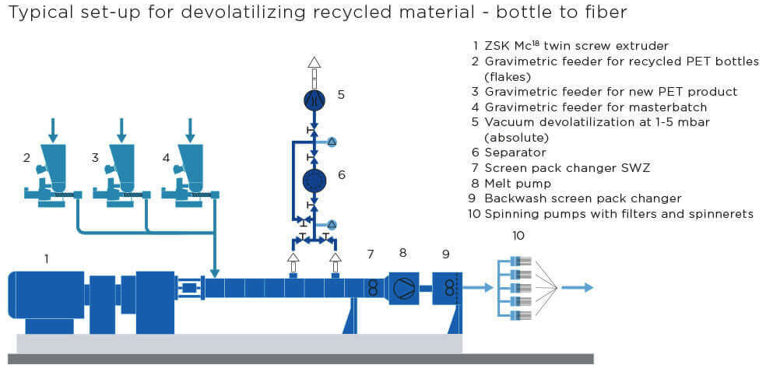
Recycled Plastics to Textiles

Slide 36
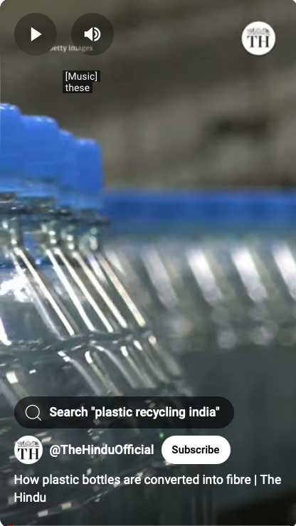
Recycled Plastics to Textiles
Bottles to Fibers Video
Polyester most widely used fiber
14 % comes from recycled inputs
Target is 45 % by 2025
Competition with bottle recycle

Slide 37
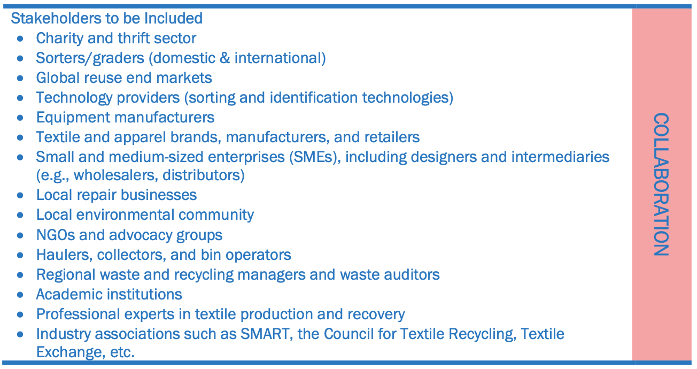
Textiles

Slide 38
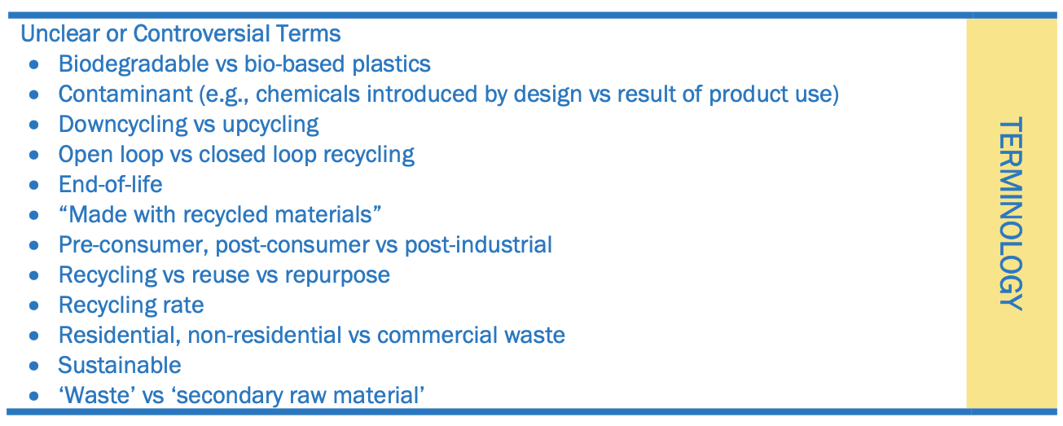

Slide 39
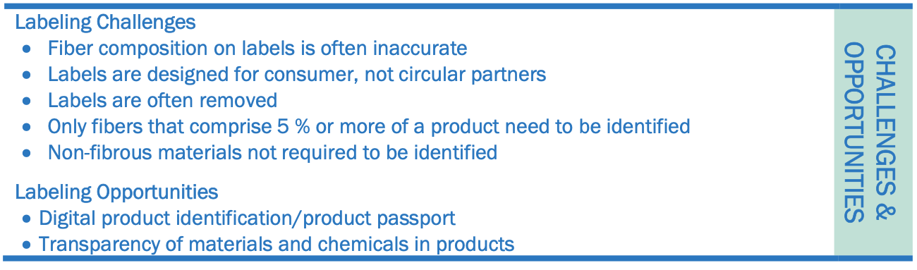
Textile Labels

Slide 40
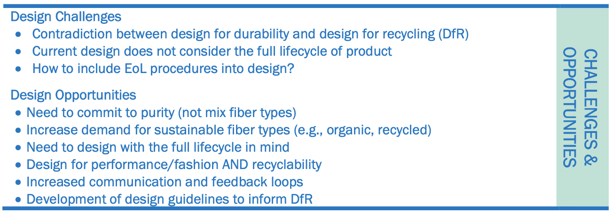
DfR (design for reliability) is a process that ensures a product, or system, performs a specified function within a given environment over the expected lifetime.

Slide 41
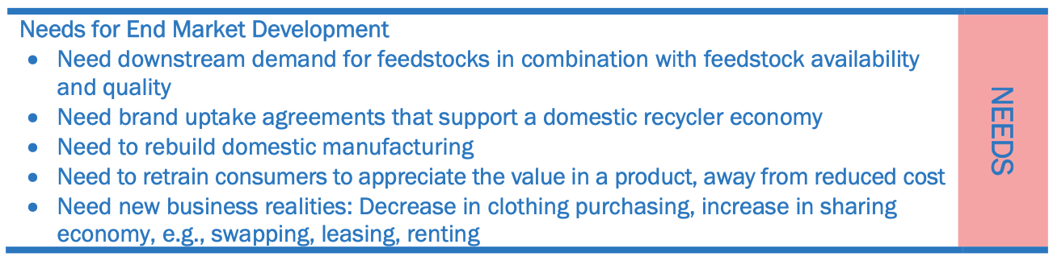

Slide 42
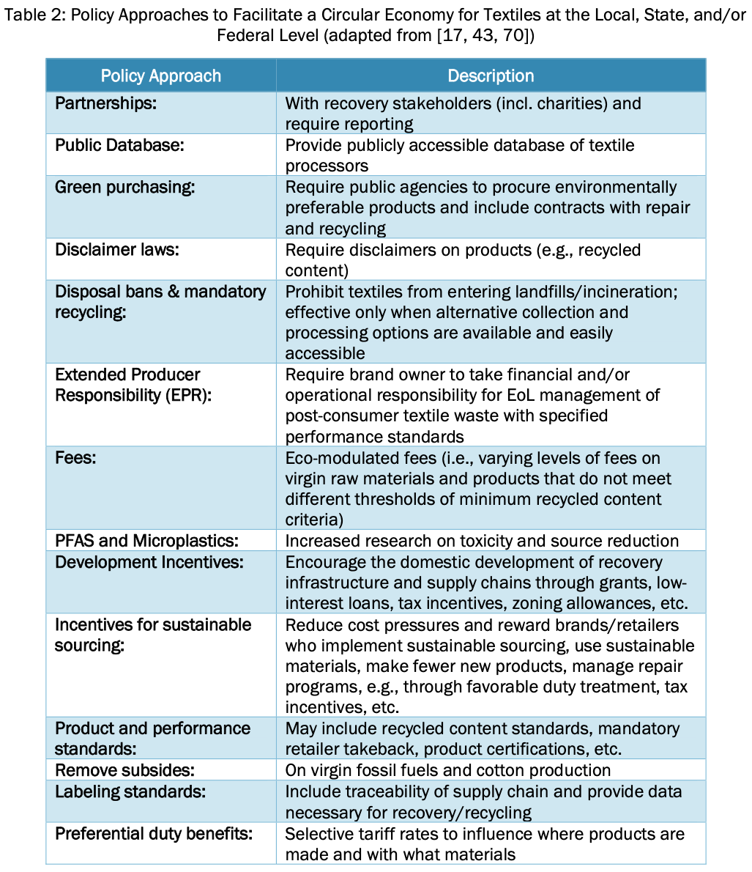
Textiles

Slide 43
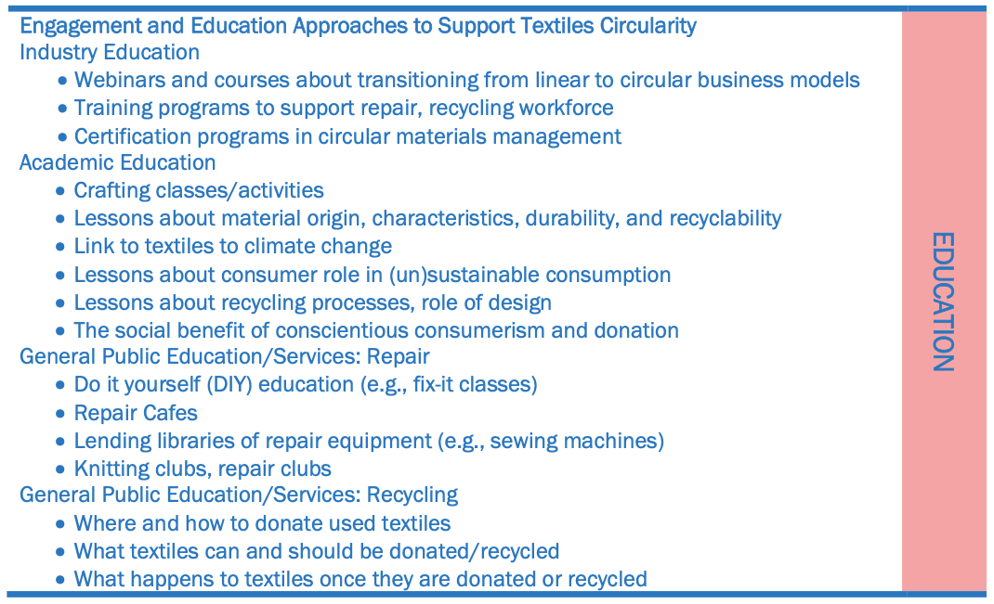
Textiles

Slide 44
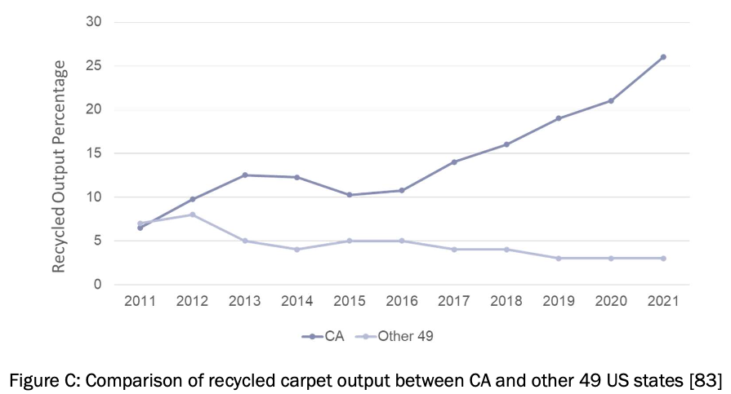
California “Carpet Stewardship Law” CA AB 2398 2010
Textiles

Slide 45
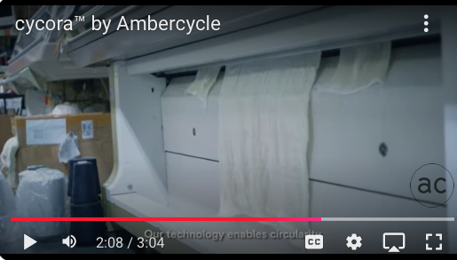
Ambercycle

Slide 46
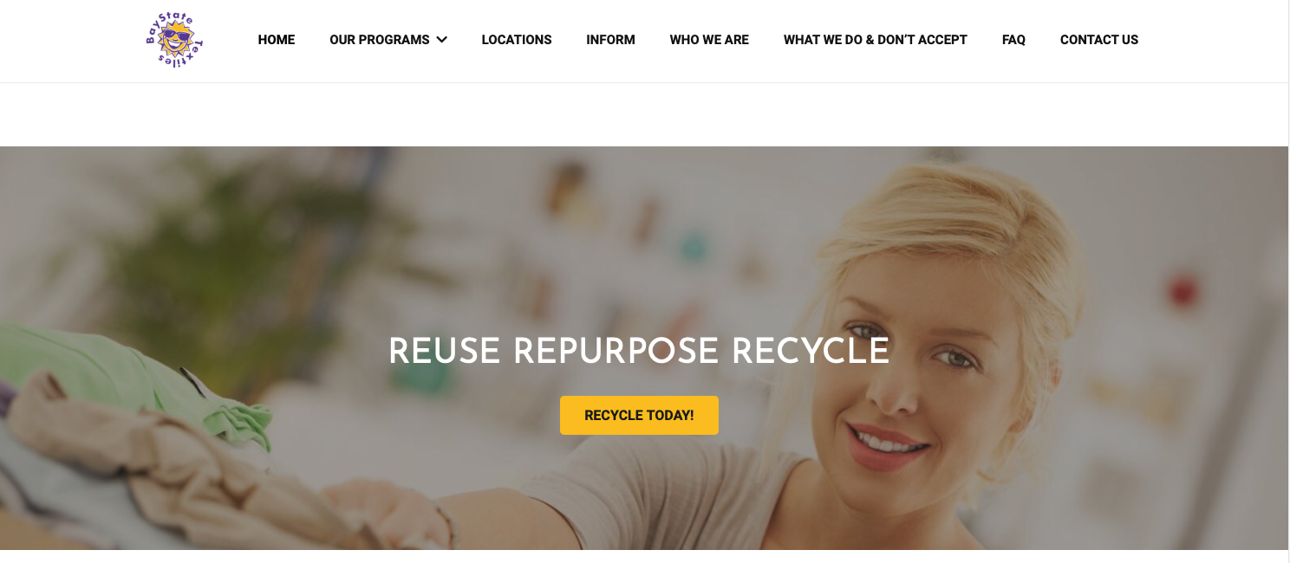
Bay State Textiles

Slide 47
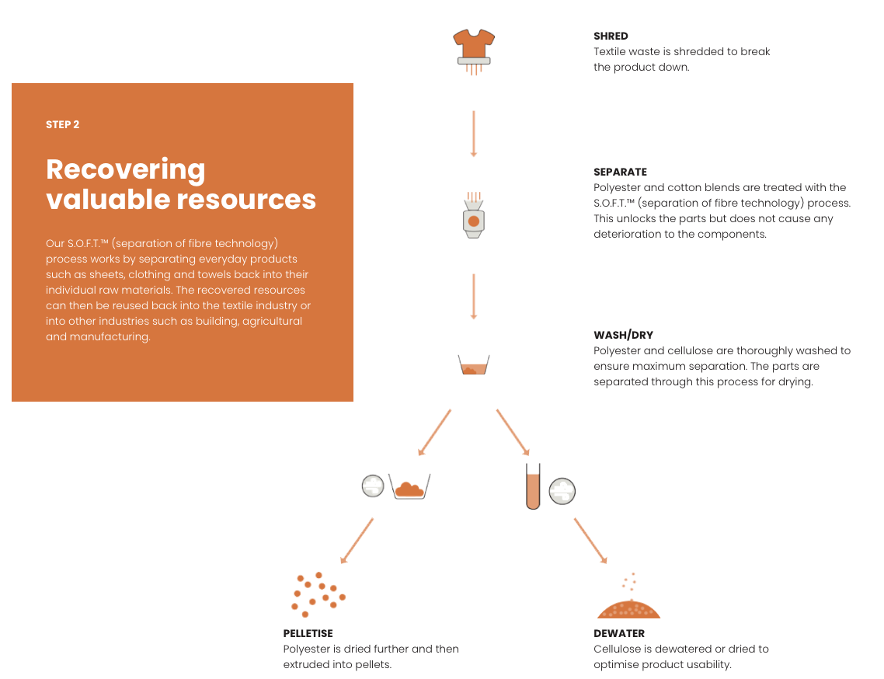
Blocktex (Australia)
Textiles

Slide 48
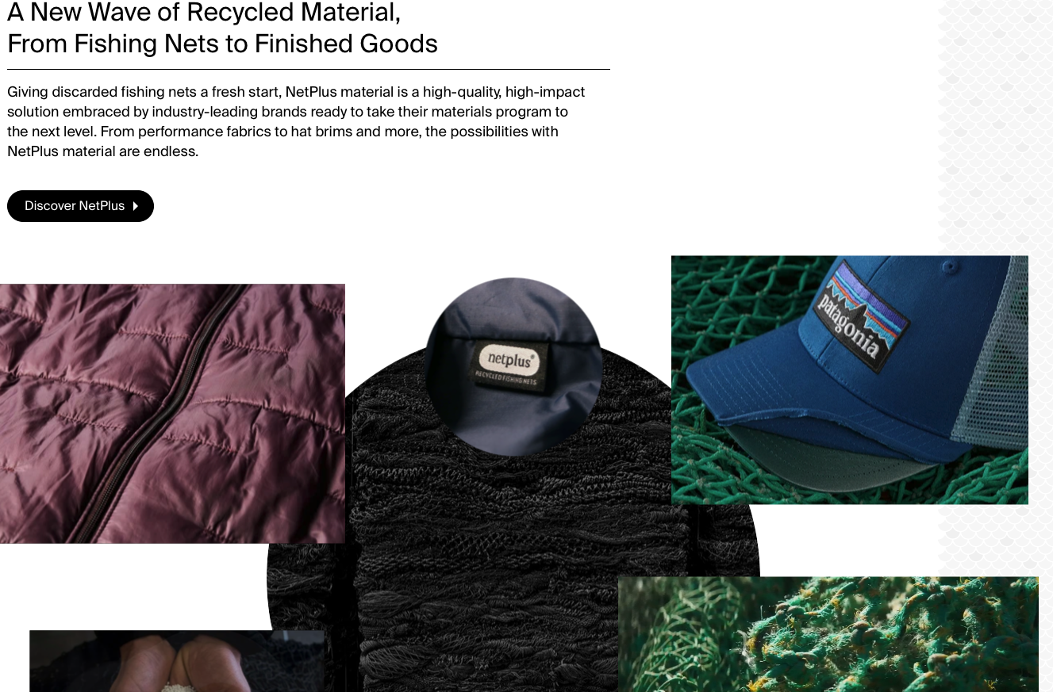
Bureo Fishing Nets to Sweaters
Textiles

Slide 49
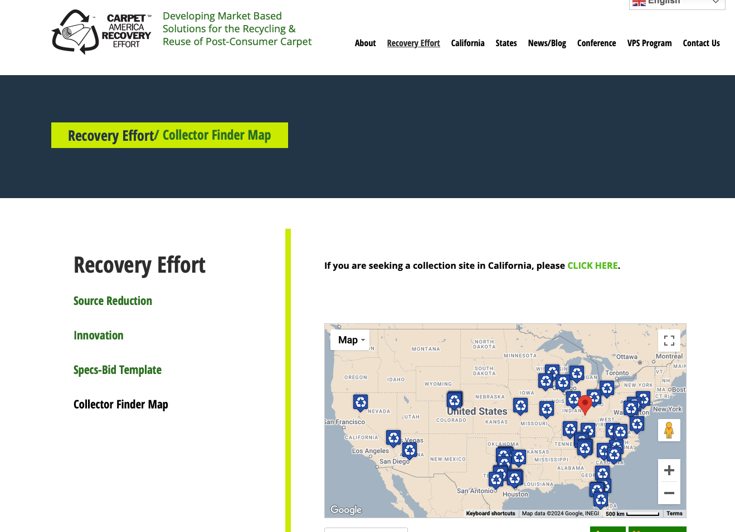
Carpet Recovery America
Textiles

Slide 50
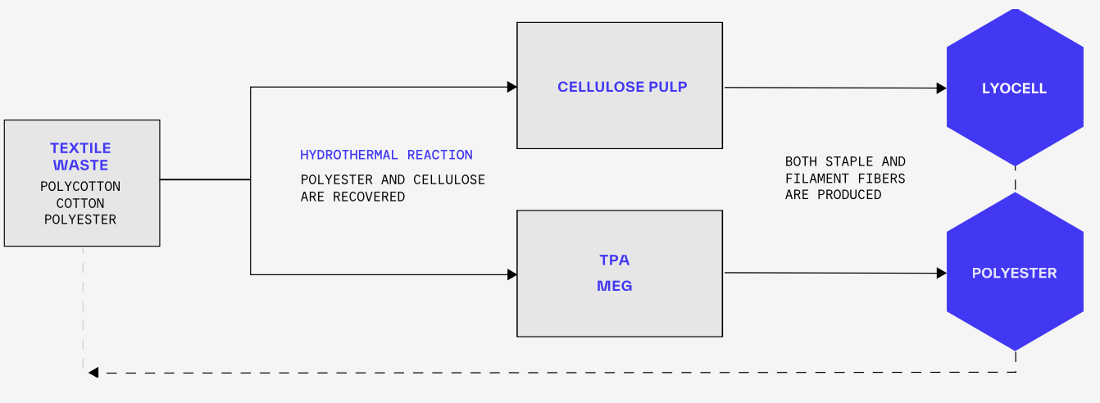
CIRC Chemical Recycler of Textiles

Slide 51
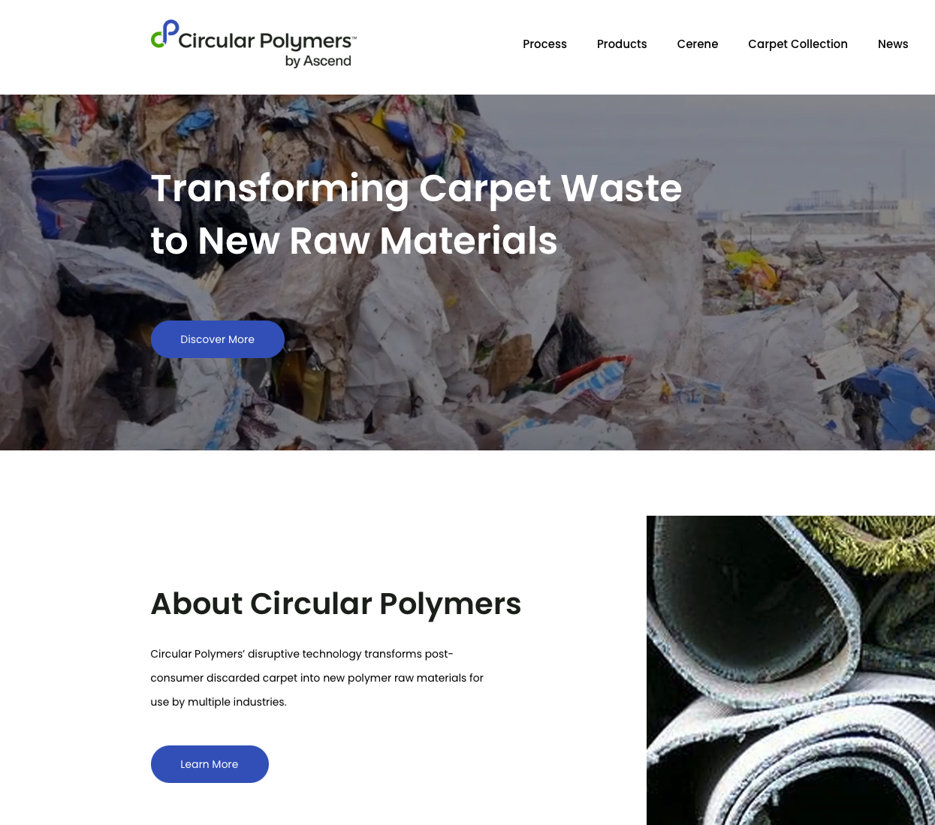
Circular Polymers for Carpet Waste

Slide 52
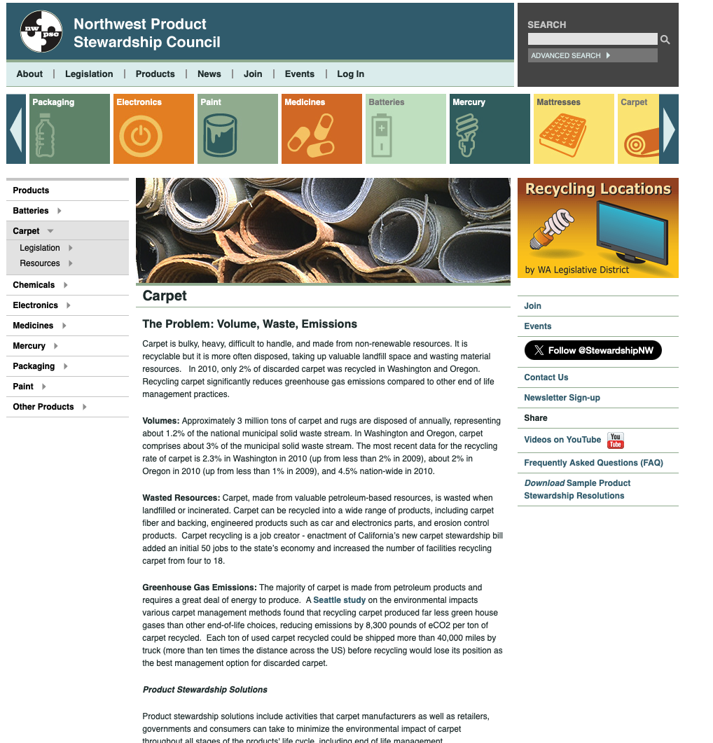
Product Stewardship Councils

Slide 53
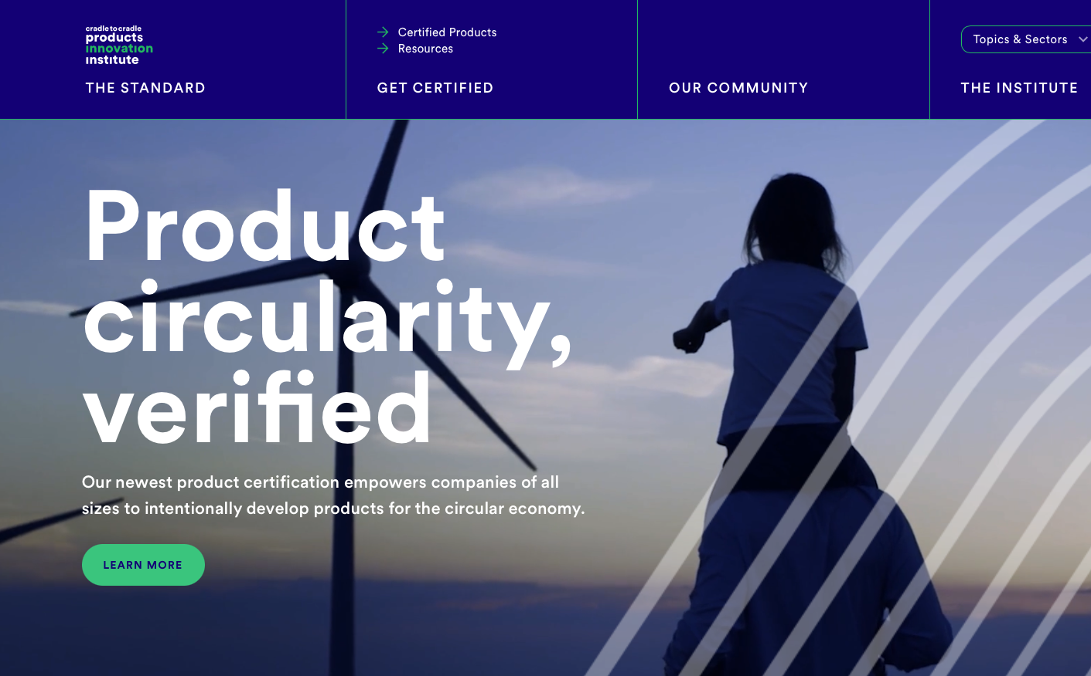
Cradle to Cradle Certification of Companies

Slide 54
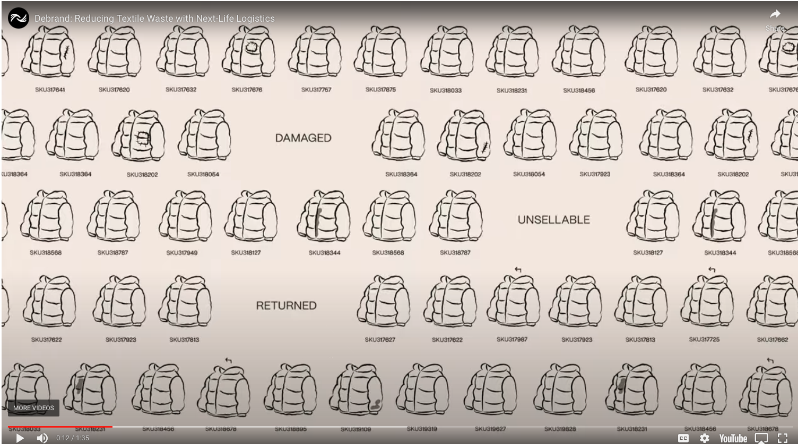
DeBrand Damaged etc cloths

Slide 55
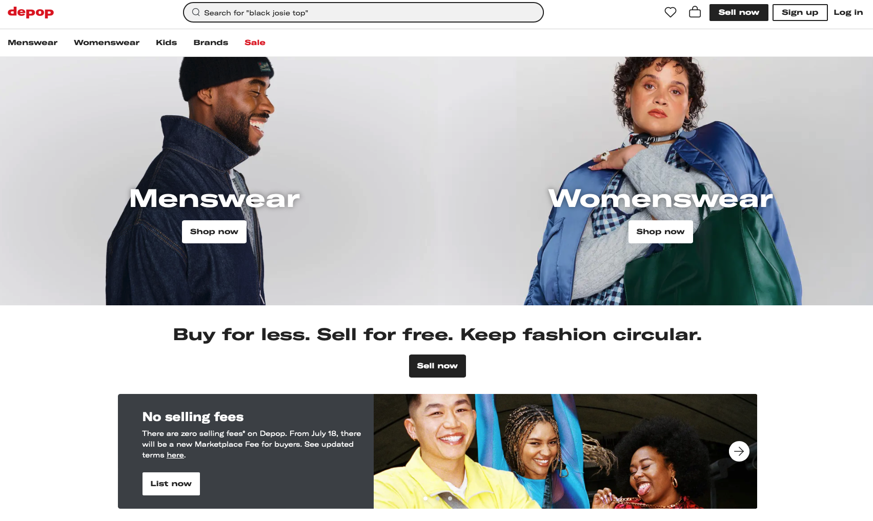
Depop for clothes resale

Slide 56
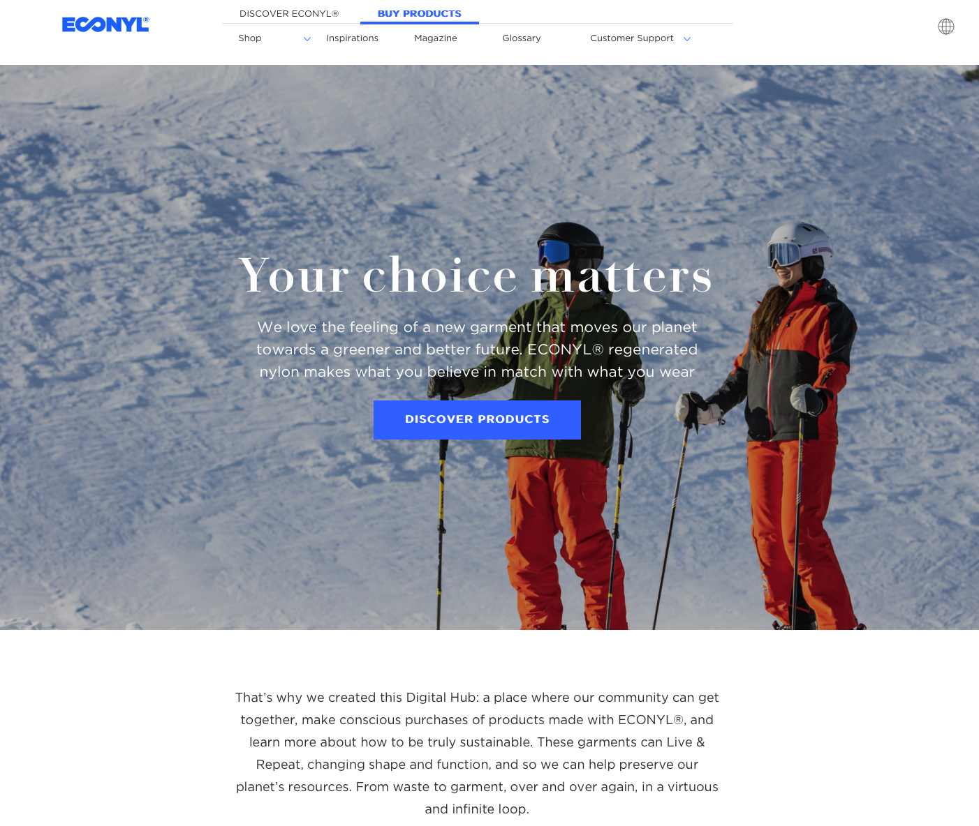
Econyl regenerative nylon

Slide 57

EON Circular Data Protocol (a sticker)

Slide 58

Evrnu cotton recycling (Seattle)

Slide 59

FabScrap Brooklyn fabric recycling

Slide 60

Fashion Pass Rent your cloths

Slide 61

Fashion Revolution USA Activist Organization

Slide 62

FiberShed Something about sheep I guess

Slide 63

FiberSort using IR to detect fabric types

Slide 64

GeoHay recycled carpet to water control

Slide 65

Global Fashion Exchange (swap clothes San Francisco)

Slide 66

Helpsy looks like goodwill

Slide 67

Ioncell ionic liquids for cellulose recycle (Finnish)

Slide 68

Oeko Tex certification for fabrics

Slide 69

PoshMark.com on line goodwill

Slide 70

Queen of the Raw (Excess inventory)

Slide 71

RecoverBrands.com

Slide 72

RecoverFiber (Spanish fiber recycling)

Slide 73

RedBags (Recycled Handbags)

Slide 74

Refibra Cotton recycling

Slide 75

Rent the Runway (rent clothes)

Slide 76
Textiles

Slide 77
Textiles

