Slide 1
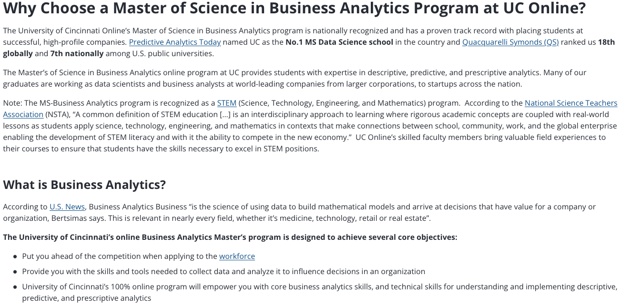
Machine Learning (ML),
Artificial Intelligence (AI),
the Internet of Things (IoT)
UC Center for
Business Analytics

Slide 2
Machine Learning (ML),
Artificial Intelligence (AI),
the Internet of Things (IoT)
Data Analytics ~ Convert raw data (information) to actionable and useful assessments
At what price should gas be set as a function of time of day/day of week/month/year/stock market/oil price etc…
(this would use the IoT, data gathered at the local Speedway pump)
Decide what information is potentially relevant
Collect that data
Apply a model or use ML to draw new (illogical in the current model) relationships
Make predictions for future behavior and actions that will optimize results
Implement these suggestions
If these operations are conducted with limited or no human interaction it appears to be AI (really an algorithm)

Slide 3
Machine Learning (ML),
Artificial Intelligence (AI),
the Internet of Things (IoT)
We know this works in some situations
Amazon suggests your next purchase (simple systems)
When it fails it can fail in embarrassing/frustrating ways
(automatic phone answering at the insurance company etc.)
Intellectual property issues: Who owns the data, who owns the results of data mining, who owns your choices

Slide 4
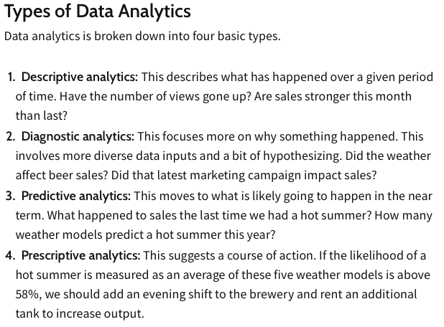
All are important to materials/polymer companies, research labs, academics
ML
AI
https://www.investopedia.com/terms/d/data-analytics.asp

Slide 5
Machine Learning (ML),
Artificial Intelligence (AI),
the Internet of Things (IoT)
Consider obvious problems that might be addressed by this approach:
-Selection of the best combination of materials for a super-conducting alloy
-Best metals for advanced manufacturing (rapid prototyping)
-Processing conditions/compounding for optimizing polymer pipe extrusion
-Optimize a better heterogeneous catalyst for polypropylene synthesis
(once you have the discovery by Ziegler/Natta)
And might not be addressed:
-Solution to global warming
-Solution to the plastics waste problem
-Discovery of room temperature superconductors
-Invention of the internet
-Invention of block-copolymers

Slide 6
Machine Learning (ML),
Artificial Intelligence (AI),
the Internet of Things (IoT)
ML, AI, IoT are hammers, but everything isn’t a nail
Compare you results with random trial and error
Is there a “significant” difference
The infinite monkey theorem states that a monkey hitting keys independently and at random on a typewriter keyboard for an infinite amount of time will almost surely type any given text, including the complete works of William Shakespeare. Émile Borel
1996 speech by Robert Wilensky stated, "We've heard that a million monkeys at a million keyboards could produce the complete works of Shakespeare; now, thanks to the Internet, we know that is not true."

Slide 7
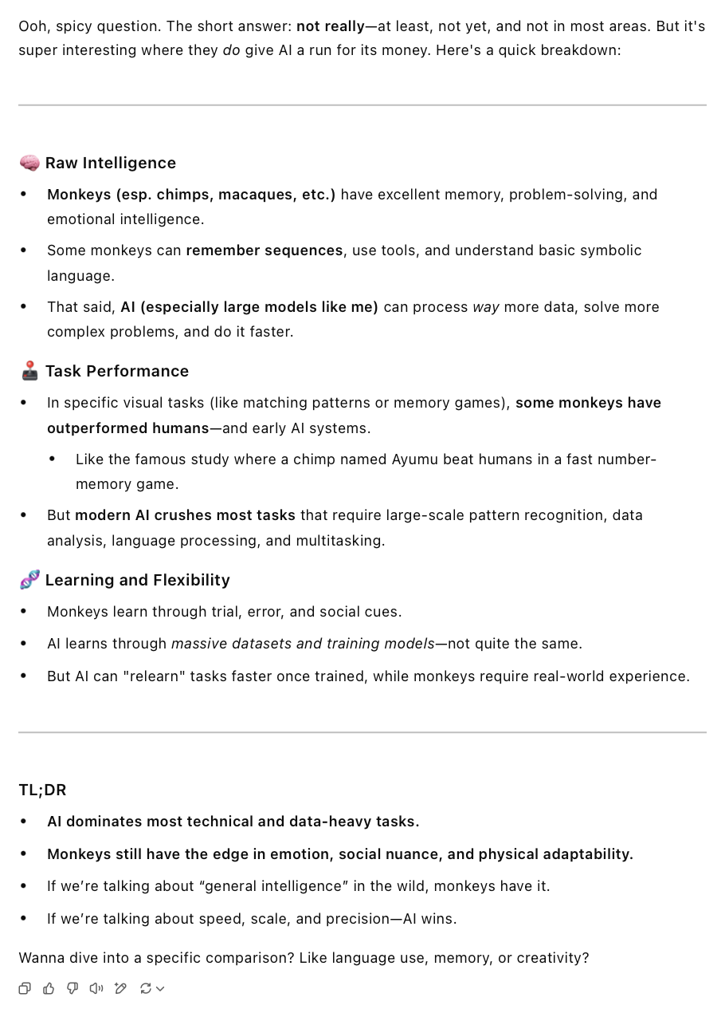
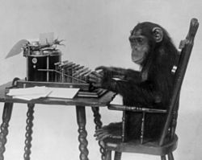
The infinite monkey theorem states that a monkey hitting keys independently and at random on a typewriter keyboard for an infinite amount of time will almost surely type any given text, including the complete works of William Shakespeare. Émile Borel
Short answer: Monkeys are better than people but not AI…

Slide 8
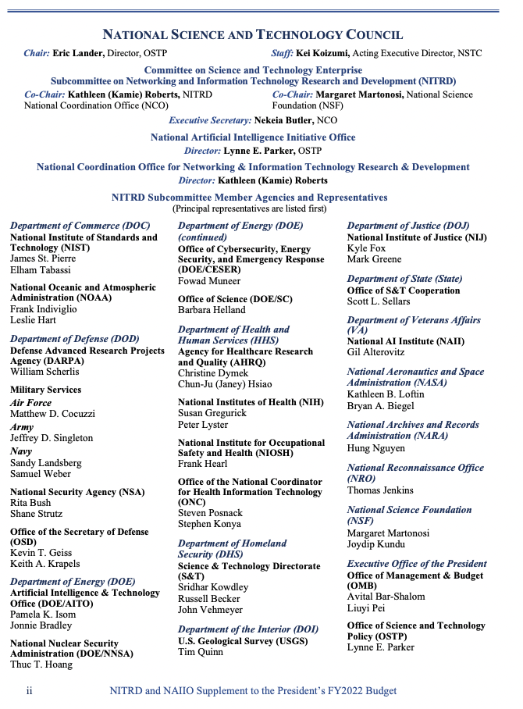
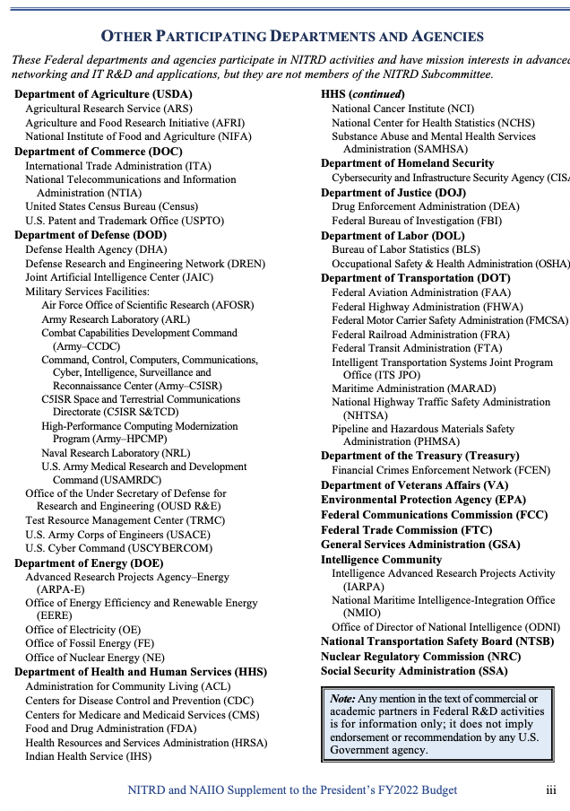
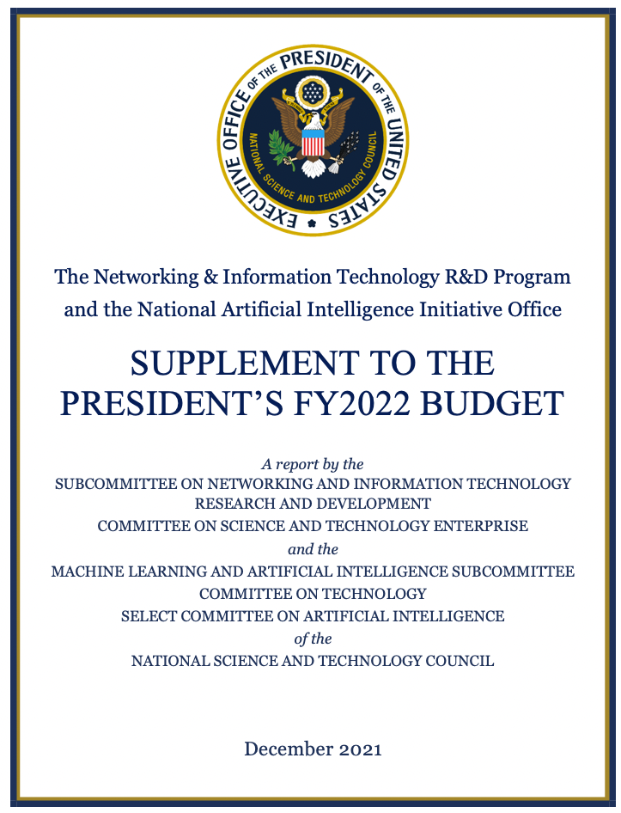
Machine Learning (ML),
Artificial Intelligence (AI),
the Internet of Things (IoT)
$1,670,200,000.00
FY 2022
The world is run on money:

Slide 9
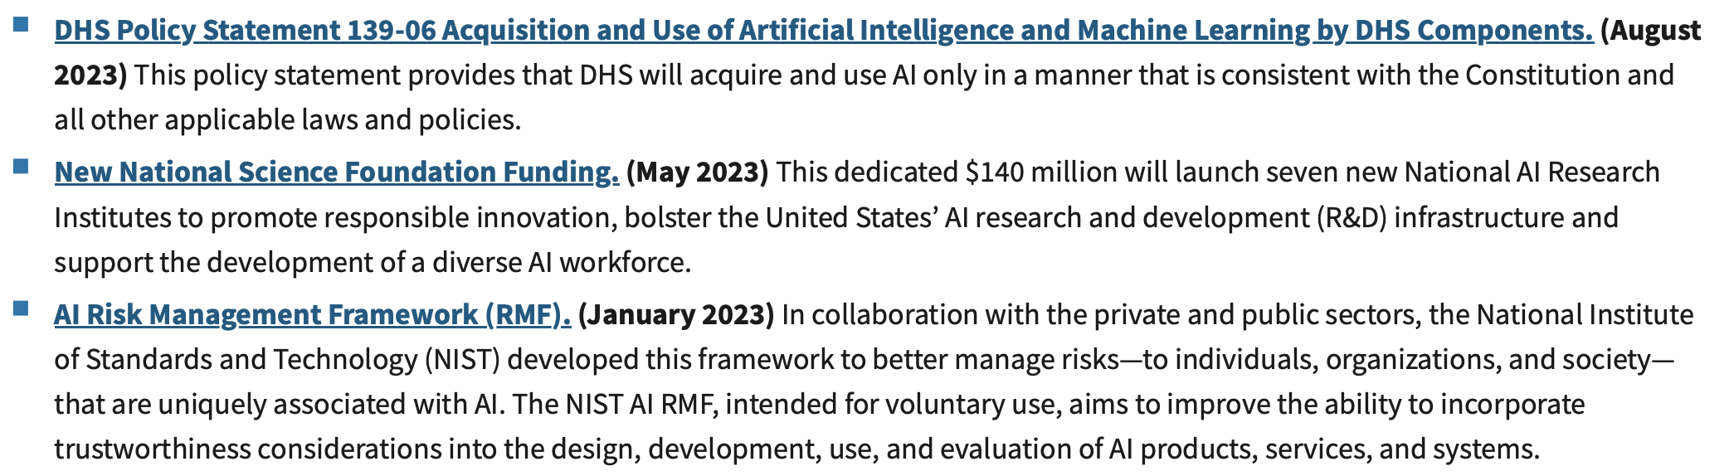
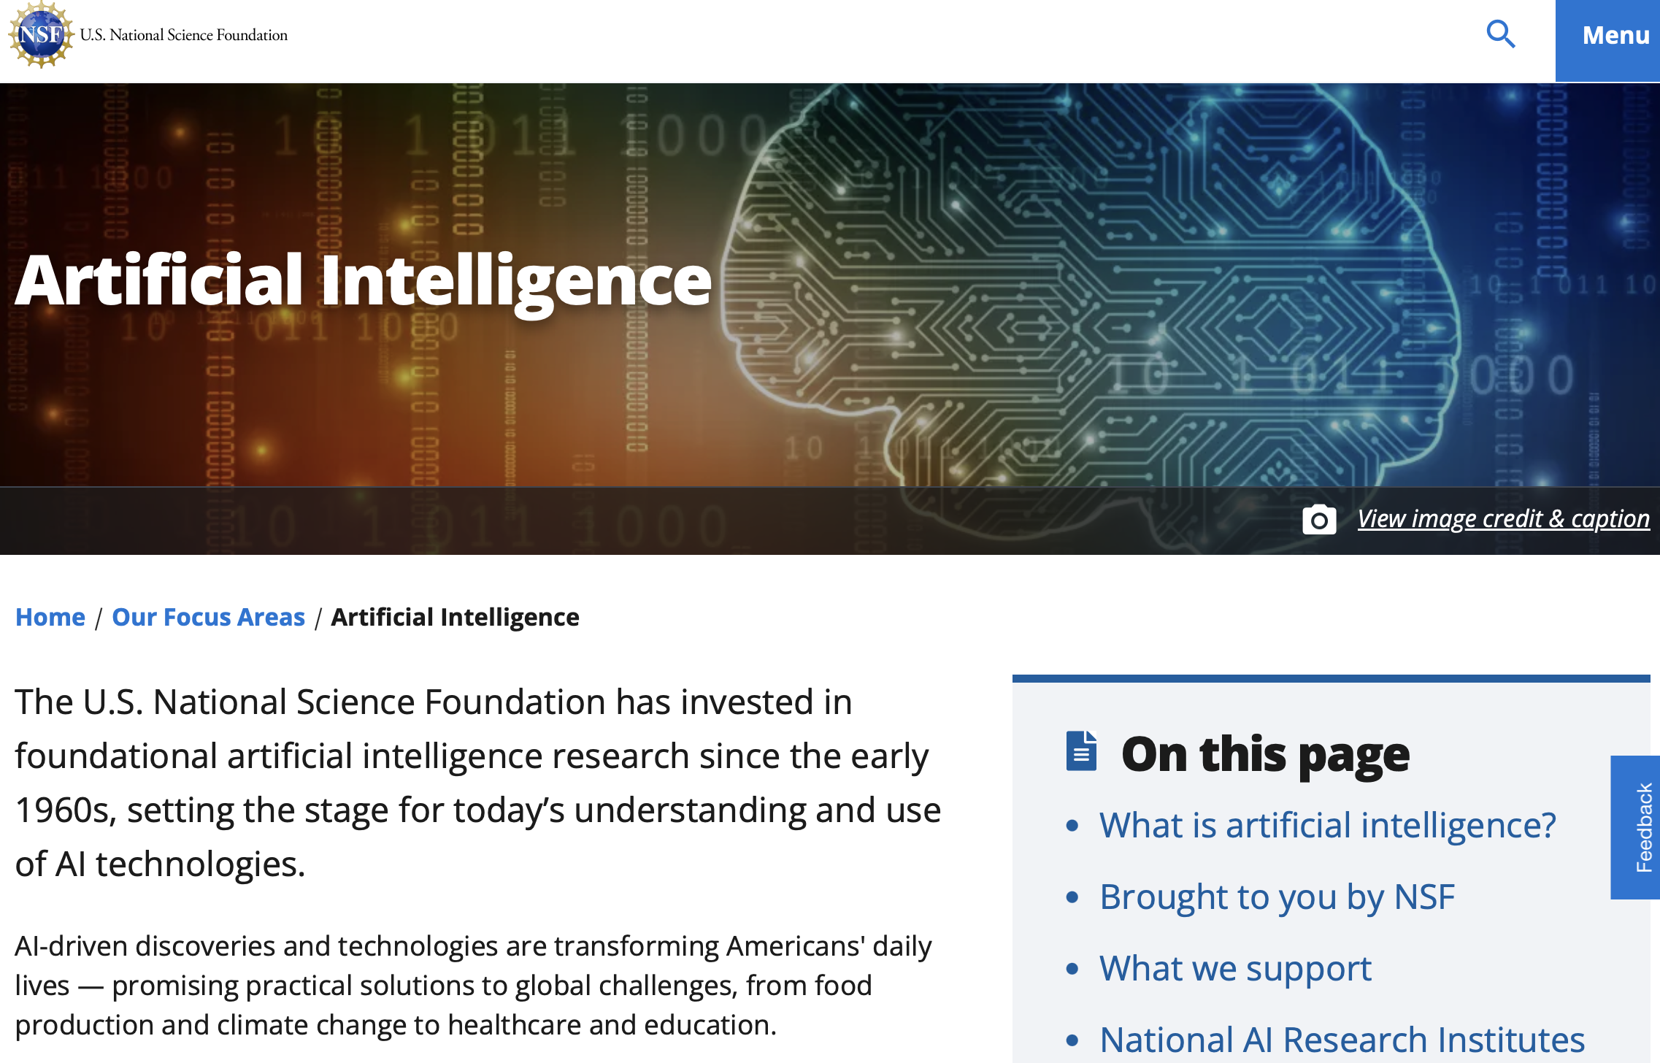
Machine Learning (ML),
Artificial Intelligence (AI),
the Internet of Things (IoT)
The world is run on money:

Slide 10
Materials Informatics
-Identify superior materials from initial training sets and physics simulation scikit-learn; keras; pytorch Learn using datacamp
-Tailor materials data using ML. Take multiple sources, images, diffraction, scattering, spectroscopy, mechanical testing, electrical properties, thermal properties and generate models for materials design
-High–throughput data acquisition. Synchrotron sources are a chief example. Robotics, density functional theory (DFT).
-Post process STEM images.
-Use ML to optimize simulations e.g., modify atomic potential functions or use ML to couple simulations at different length scales (molecular MD, coarse grain MD, Dissipative Particle Dynamics).

Slide 11
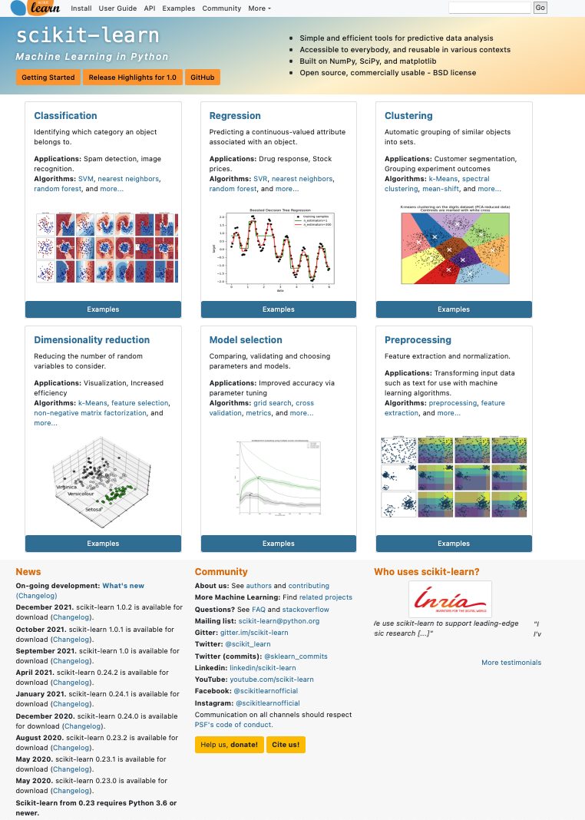


Slide 12
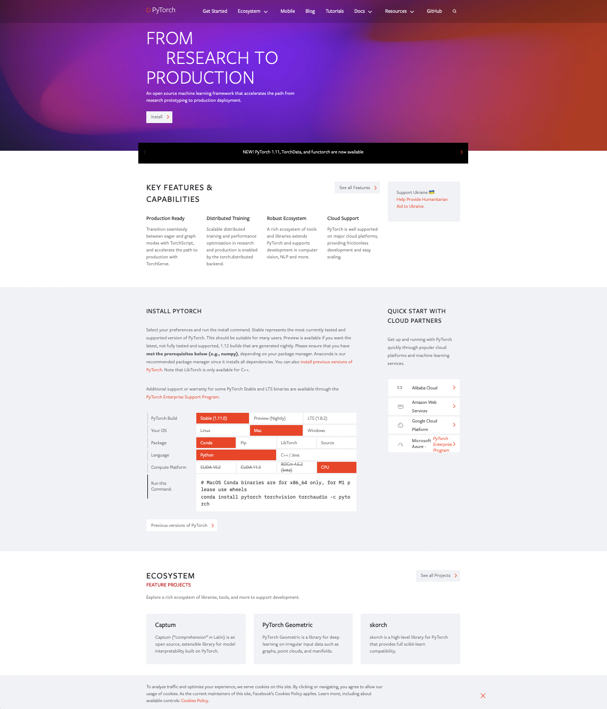

Slide 13
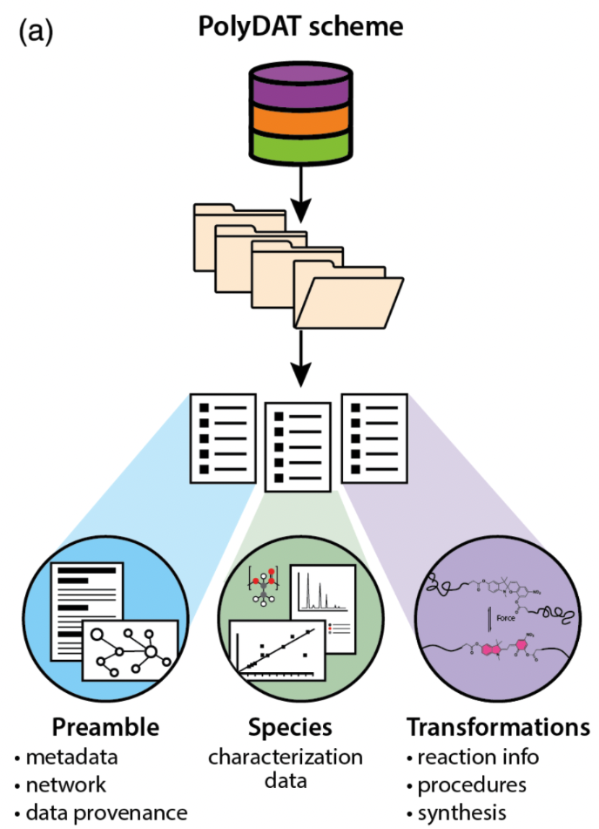
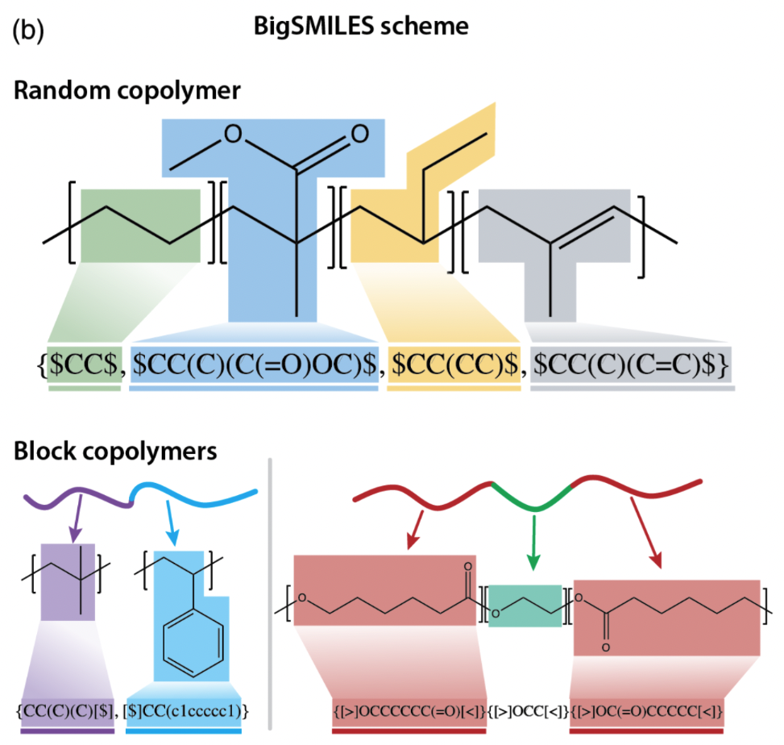
Cencer MM, Moore JS, Assary RS Machine learning for polymeric materials:an introduction Polym. Int. (2021) DOI 10.1002/pi.634

Slide 14
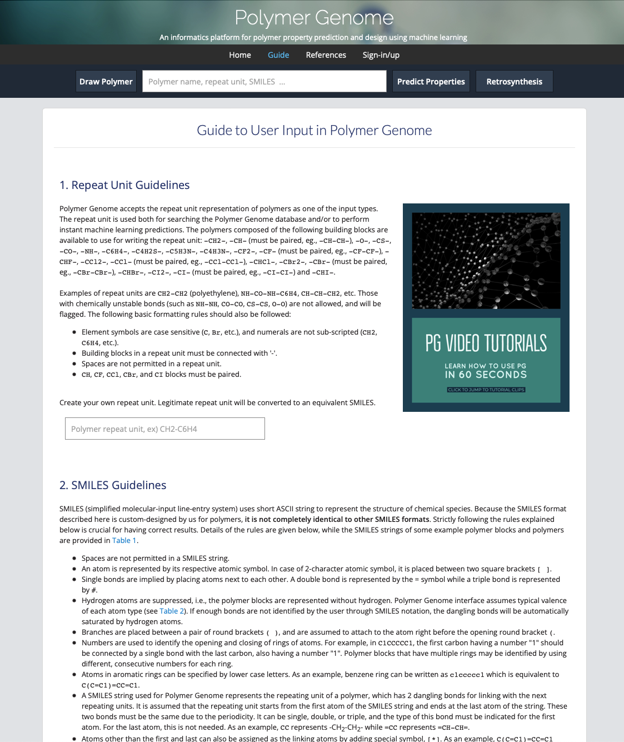

Slide 15
Zhu M-X, Deng T, Dong L, Chen J-M, Dang Z-M Review of machine learning-driven design of polymer-based dielectrics IET Nanodielectrics 5 24-38 (2022).
Evolution Searching (Inverse design method)
Generative Model (vs. Discriminative model)
Genome Approach
Identify Polymers with a linear notation (fingerprint)
simplified molecular‐input line‐entry system (SMILES)
Link fingerprint to properties (machine learning from training dataset)
Kernel regression (expected value within range of learned data)
Decision tree (various indications, some missing, predict answer from other examples)
Neural network (deep learning) (predictive modeling, adaptive control, or trained by dataset: take handwritten “0”’s from 1000 people break into pixels, correlate black and white pixels (1 and 0) with presence of 0 to get an overall probability you have a “0”)

Slide 16
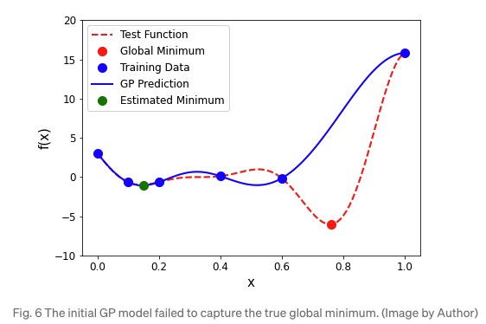
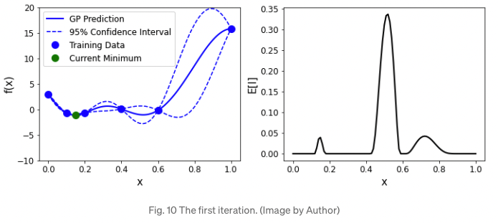
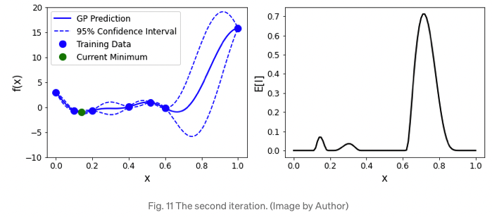
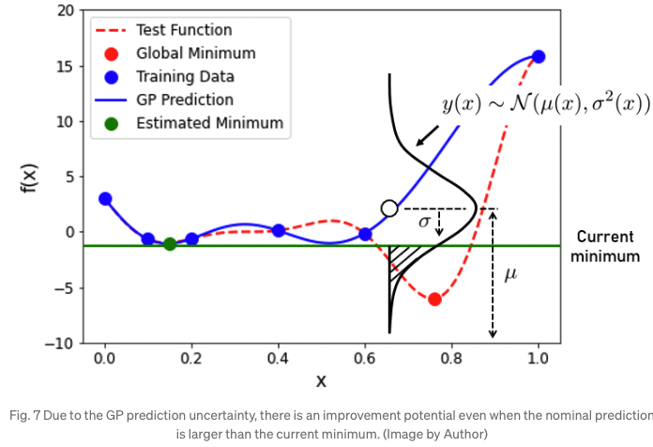
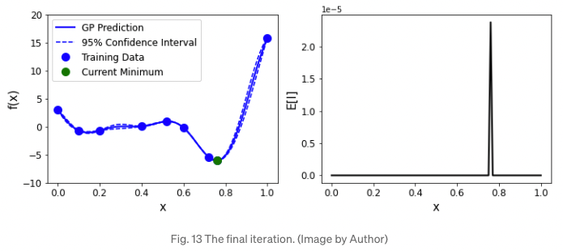
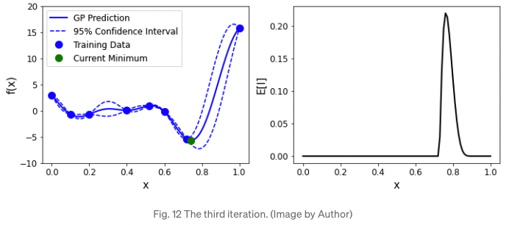
Zhu M-X, Deng T, Dong L, Chen J-M, Dang Z-M Review of machine learning-driven design of polymer-based dielectrics IET Nanodielectrics 5 24-38 (2022).
Surrogate model (example gaussian)

Slide 17
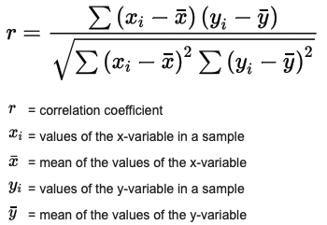
Pearson Correlation Coefficient

Slide 18
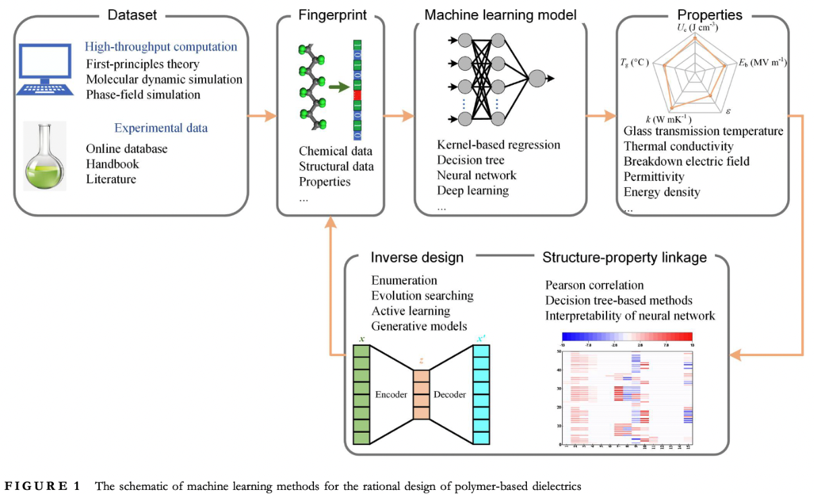
Zhu M-X, Deng T, Dong L, Chen J-M, Dang Z-M Review of machine learning-driven design of polymer-based dielectrics IET Nanodielectrics 5 24-38 (2022).
Phase-field simulation (model interfaces using a gradient of free energy like Gibbs Equation)

Slide 19
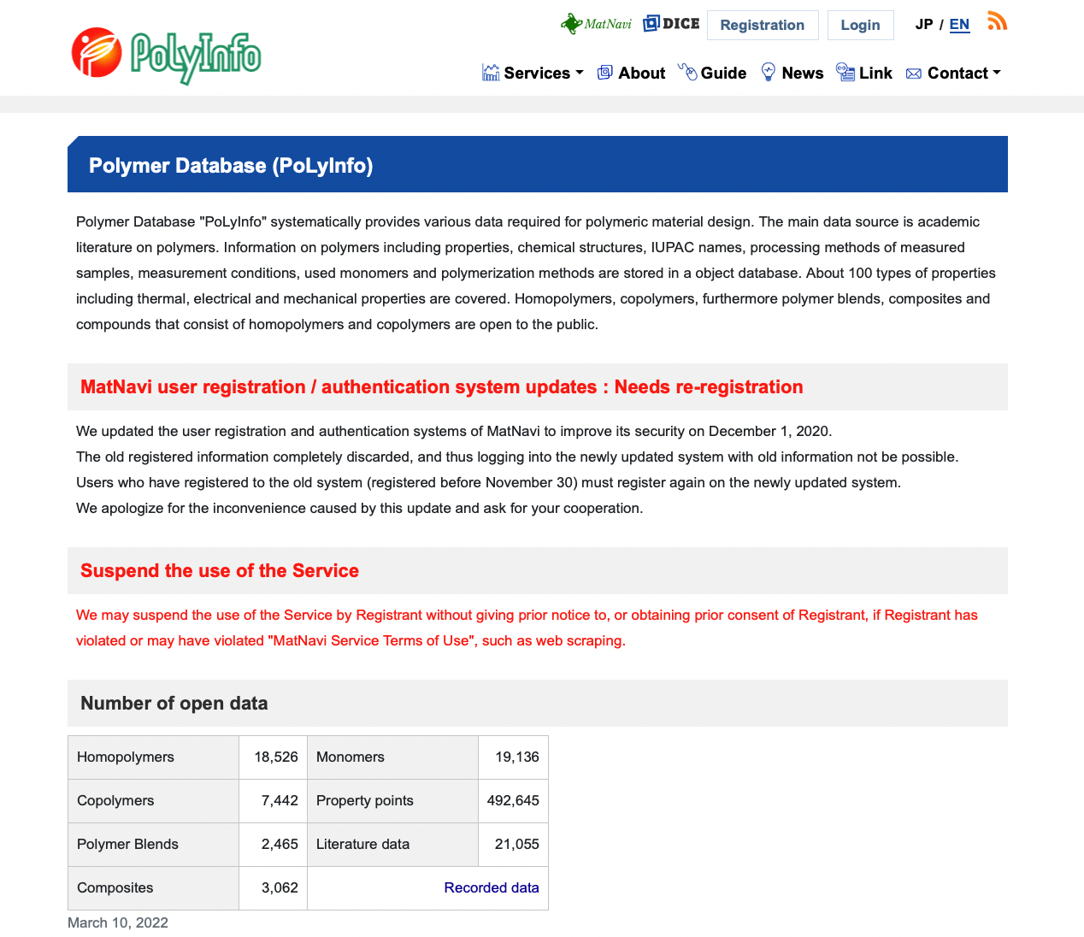
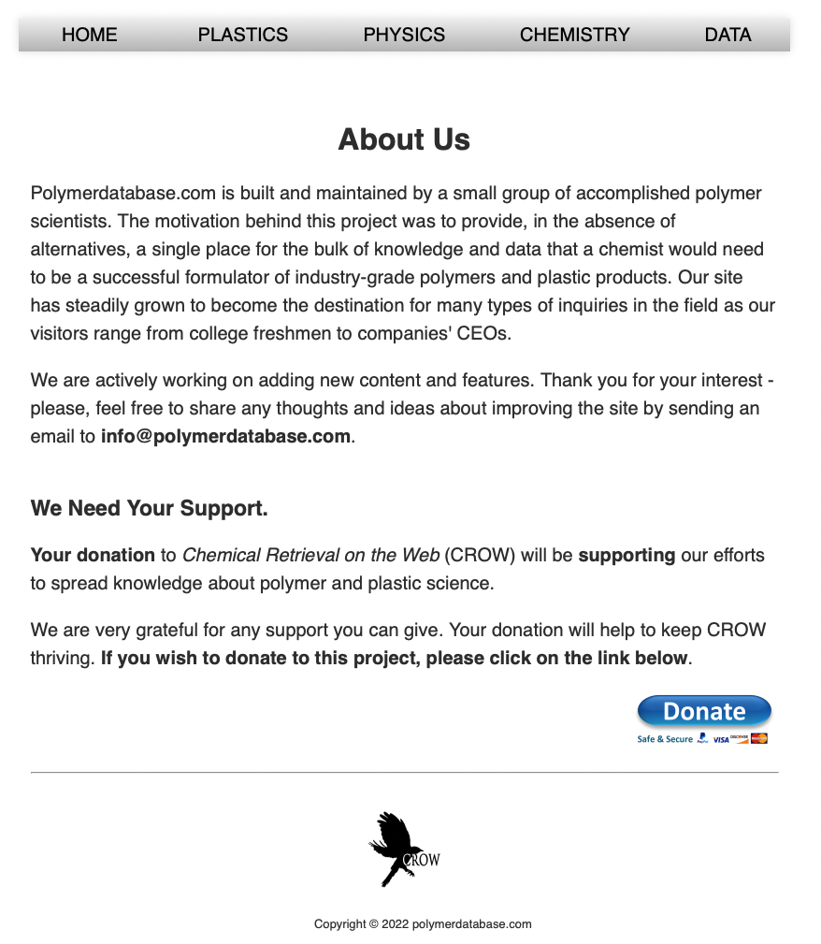
Dataset for polymer dielectrics
Online libraries, experiments and high‐throughput computations
PoLyInfo, CROW Polymer Property Database, Polymer Property Predictor, Database (NIST), Polymer Genome

Slide 20
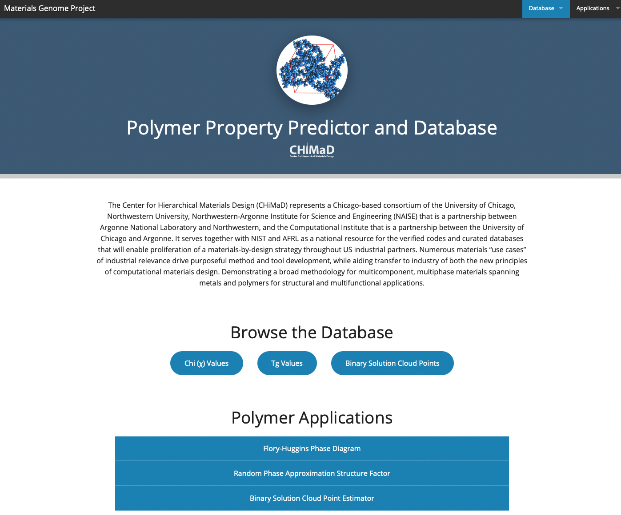
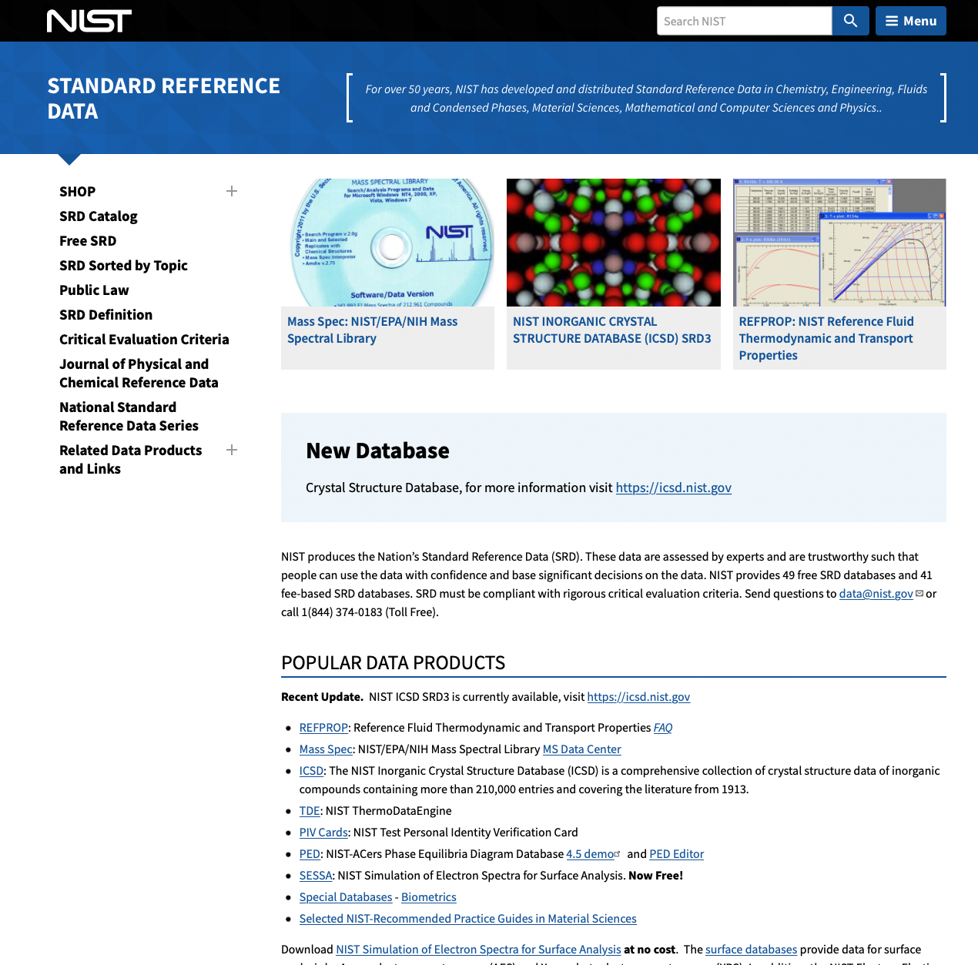
Dataset for polymer dielectrics
Online libraries, experiments and high‐throughput computations
PoLyInfo, CROW Polymer Property Database, Polymer Property Predictor, Database (NIST), Polymer Genome

Slide 21
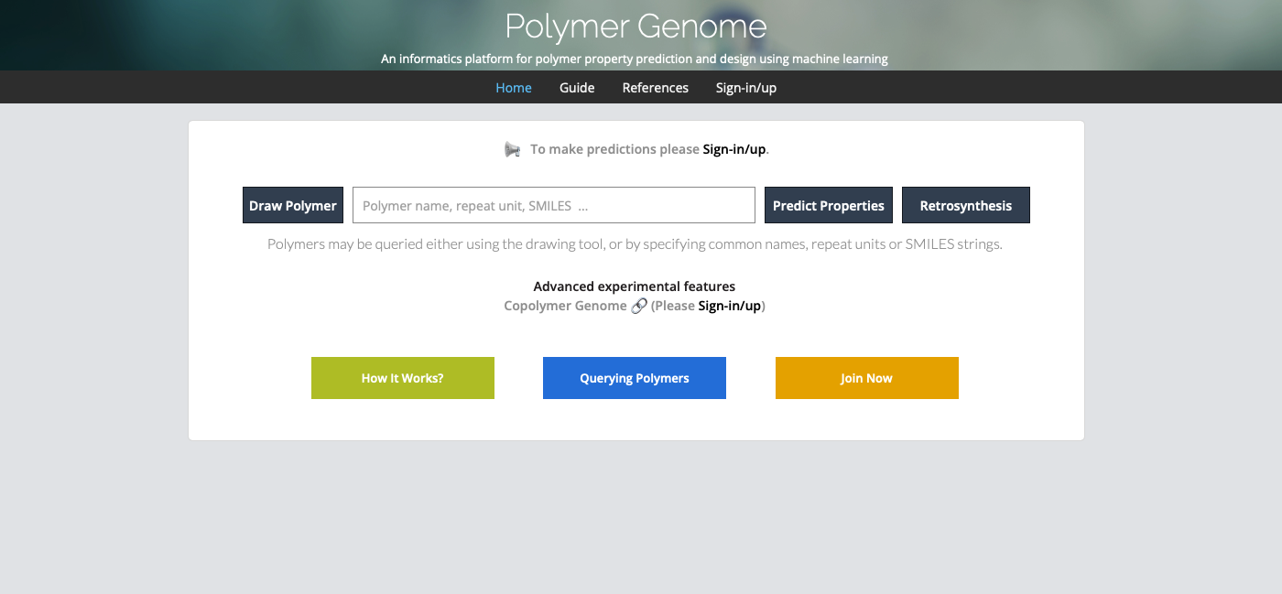
Dataset for polymer dielectrics
Online libraries, experiments and high‐throughput computations
PoLyInfo, CROW Polymer Property Database, Polymer Property Predictor, Database (NIST), Polymer Genome

Slide 22
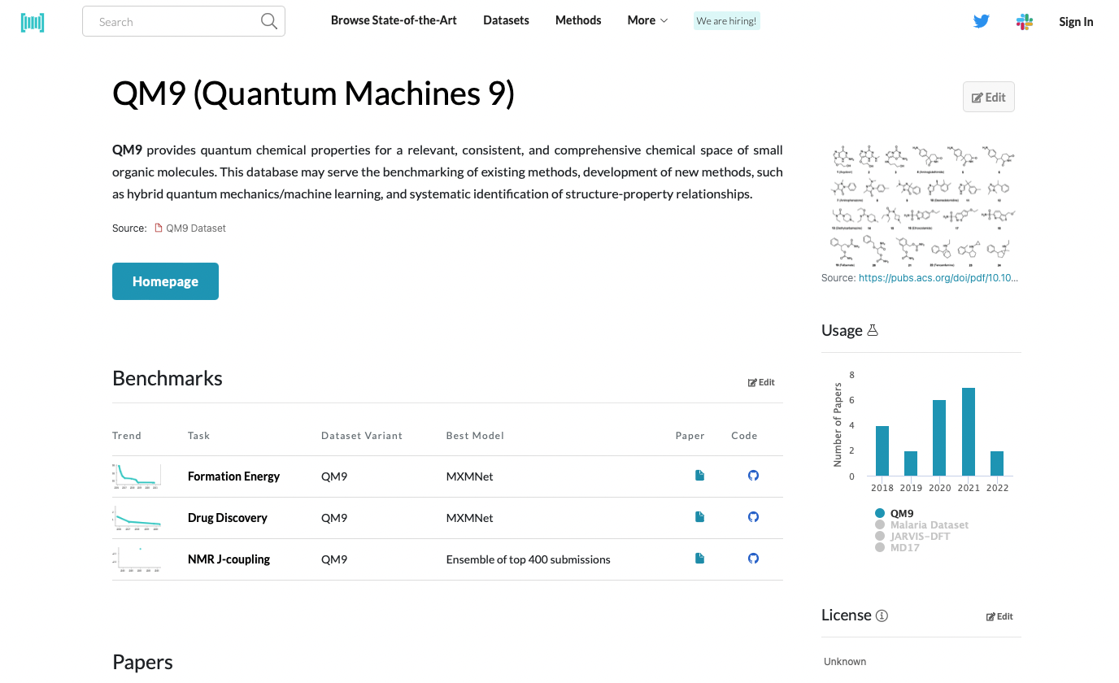
Dataset for polymer dielectrics
Online libraries, experiments and high‐throughput computations
PoLyInfo, CROW Polymer Property Database, Polymer Property Predictor, Database (NIST), Polymer Genome

Slide 23
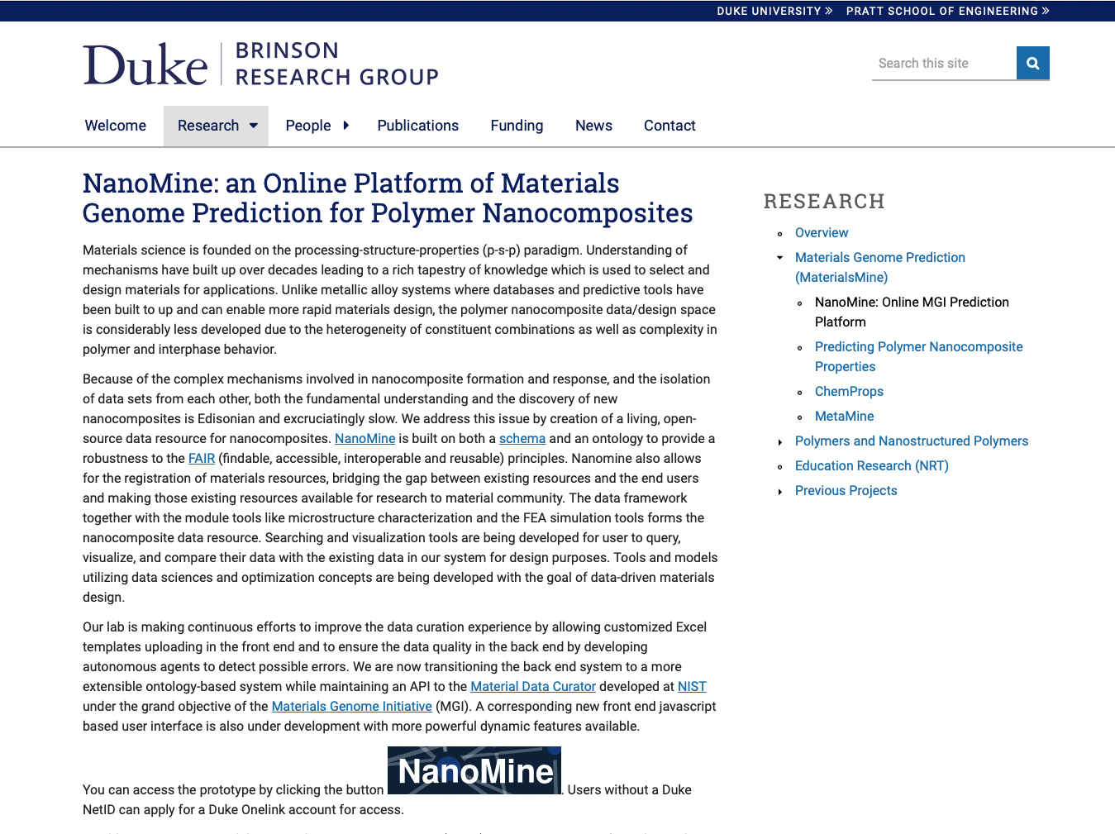
Dataset for polymer dielectrics
Online libraries, experiments and high‐throughput computations
NanoMine for nanocomposites

Slide 24
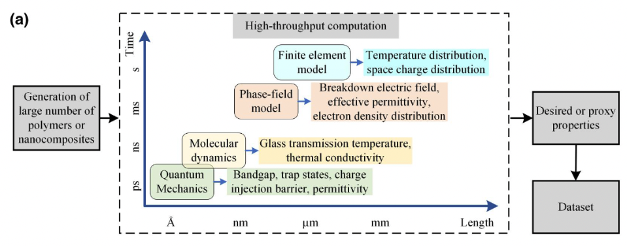
Dataset for polymer dielectrics
Manual search of the literature
High-throughput computations using first principles; MD simulations

Slide 25
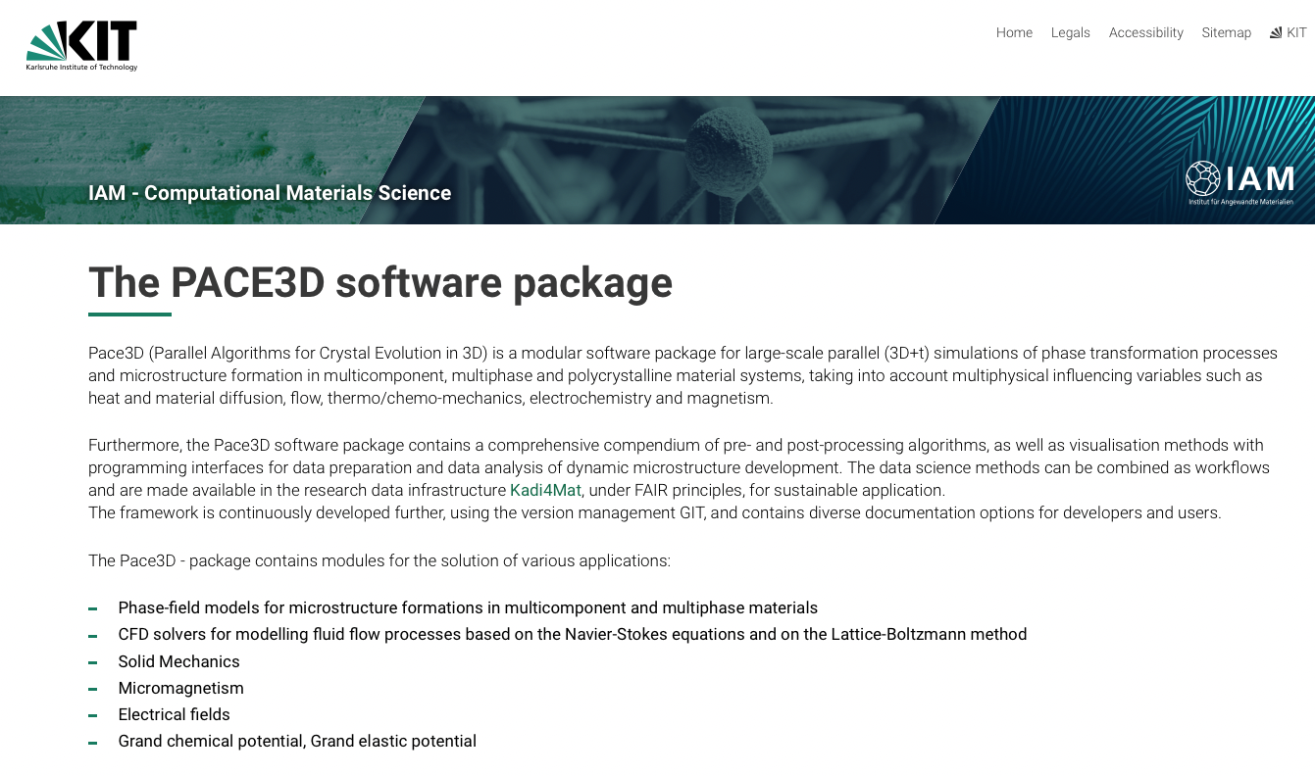

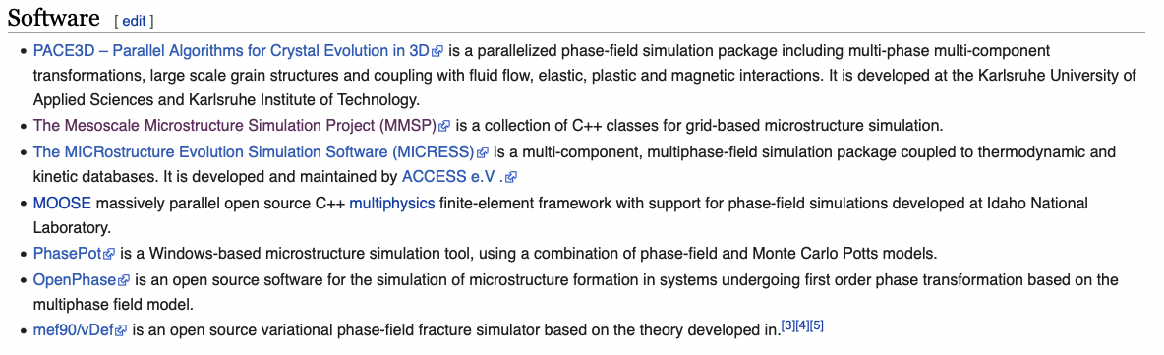
Phase-Field Models (software for interface optimization)

Slide 26
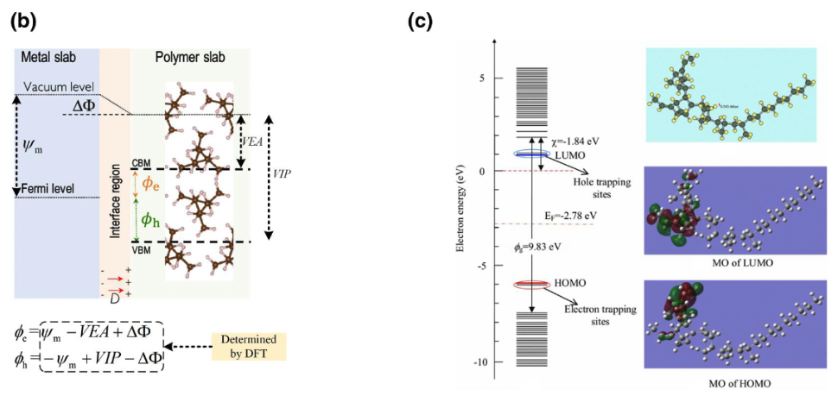
Dataset for polymer dielectrics
(Electron) Density functional theory (DFT) for charge injection barrier from electrode to polymer, trap depth in polymer; ionic electronic and total dielectric constant

Slide 27
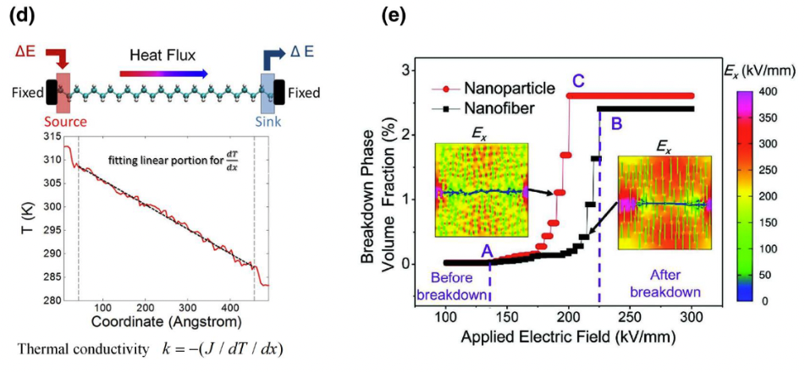
Dataset for polymer dielectrics
d) Non-equilibrium molecular dynamics for thermal conductivity
e) Phase field model for dielectric breakdown in polymer nanocomposites (free energy as a function of composition; composition is subject to diffusion; dynamic model with energy minimization at an interface)

Slide 28
Zhu M-X, Deng T, Dong L, Chen J-M, Dang Z-M Review of machine learning-driven design of polymer-based dielectrics IET Nanodielectrics 5 24-38 (2022).

Slide 29
Machine Learning Strategies
Fingerprinting: Numerical representation of the materials in the datasets
Learning: Map between target property and fingerprint

Slide 30
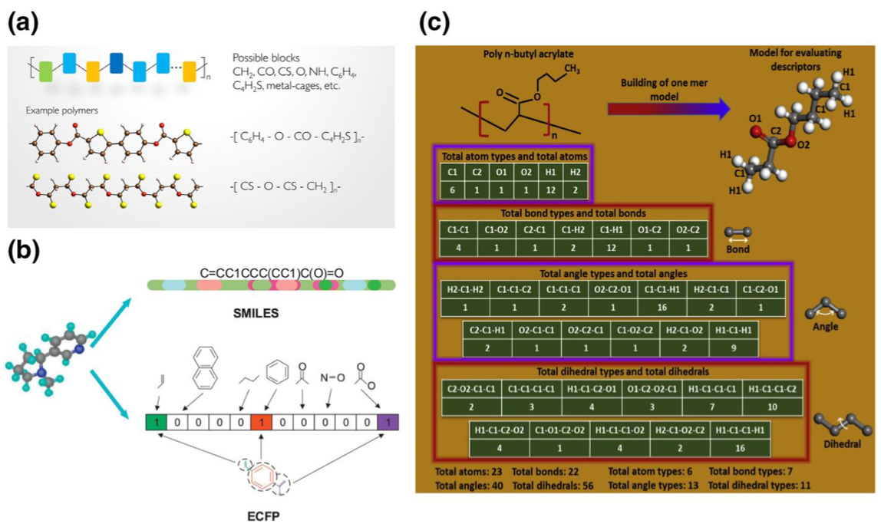
a) Fingerprint based on a group contribution method; b) Simplified Molecular‐Input Line‐Entry System (SMILES) and Extended‐Connectivity Fingerprints (ECFPs)

Slide 31
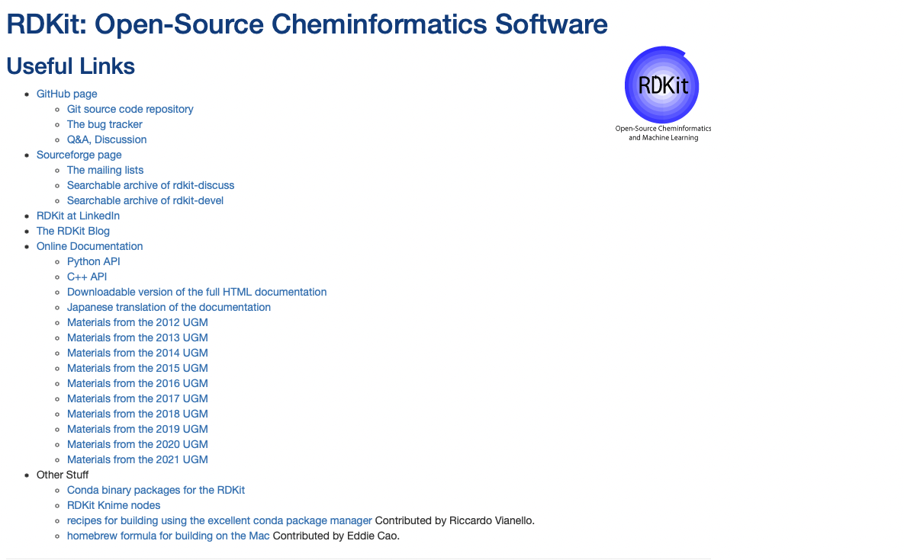
RDKit converts SMILES to numerical vectors

Slide 32
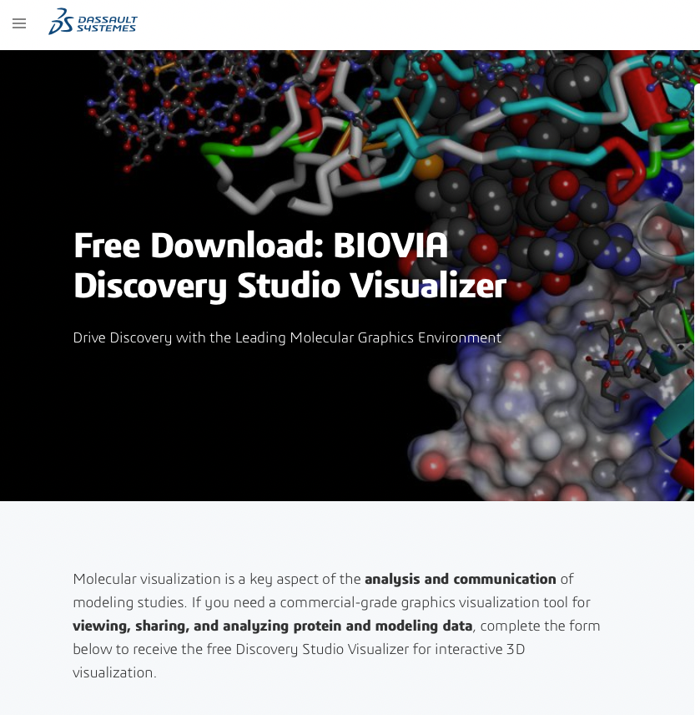
BIOVA gives hierarchical fingerprints

Slide 33
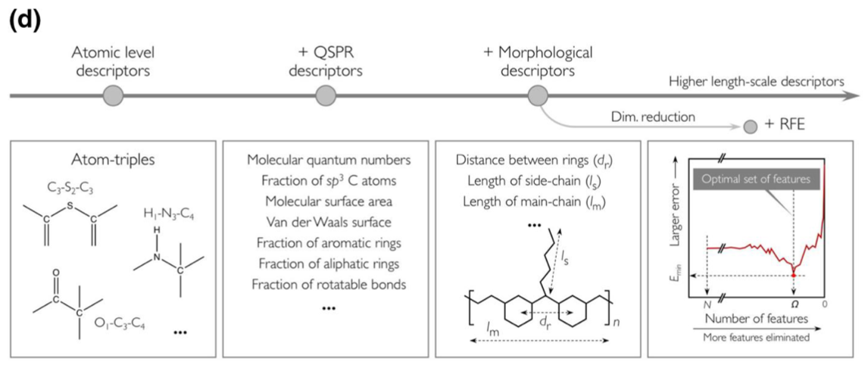
Hierarchical fingerprints
Recursive Feature Elimination (RFE)
Image processing
Quantitative structure–activity relation (QSAR) modeling

Slide 34
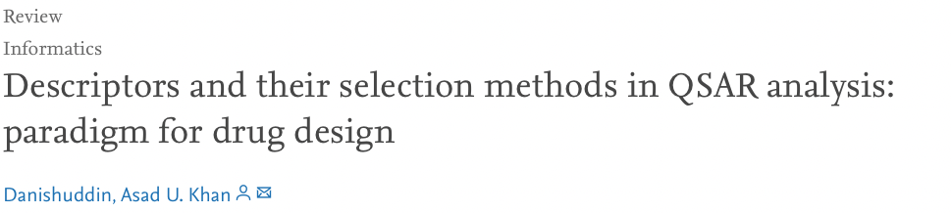

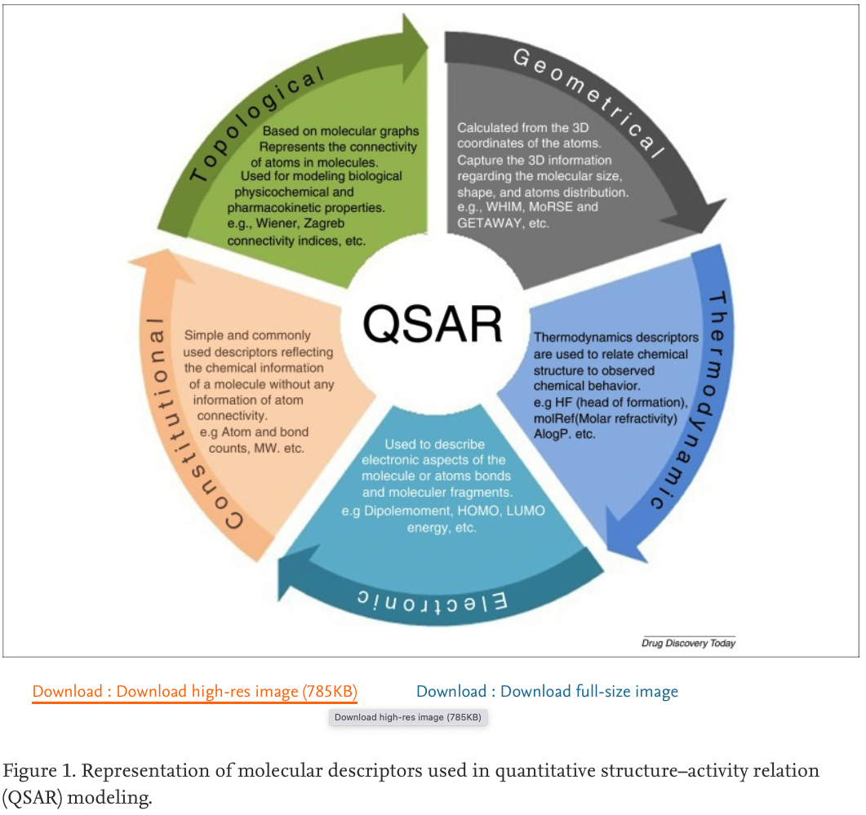
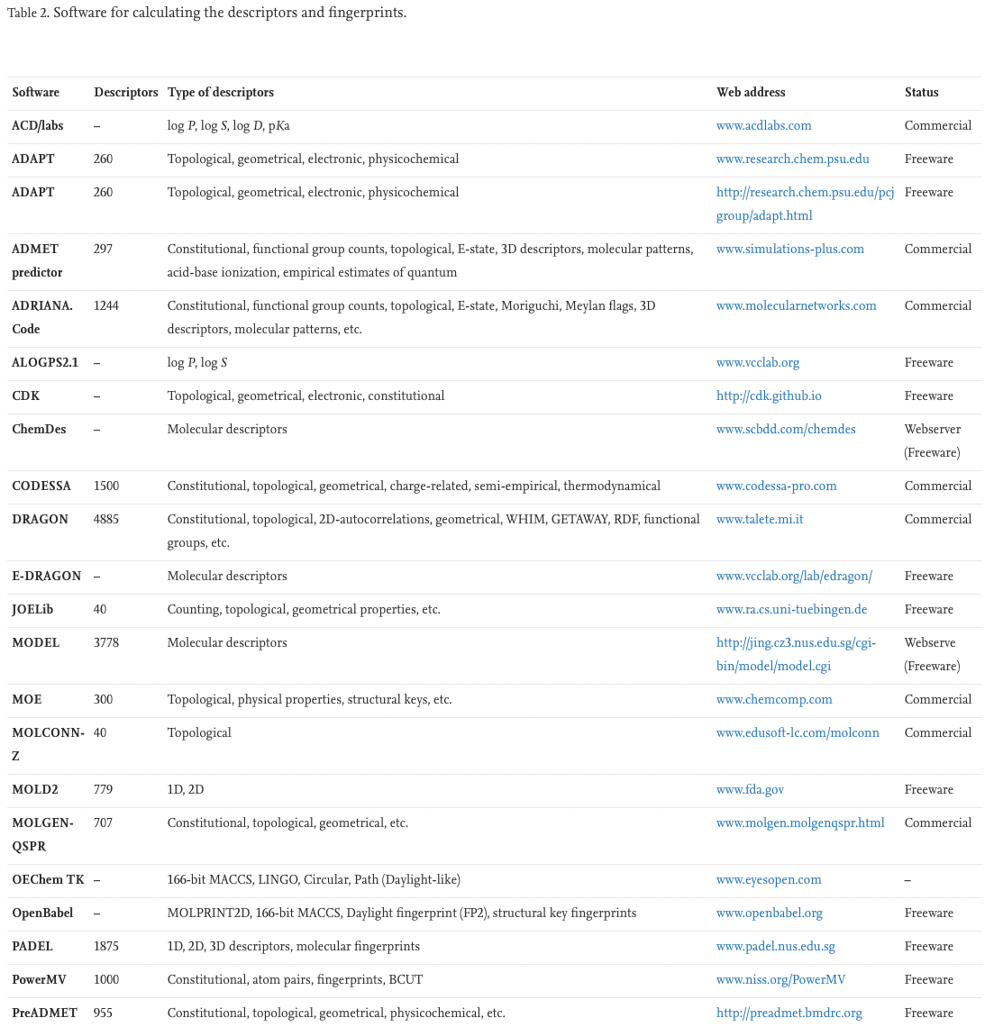
Quantitative structure–activity relation (QSAR) modeling
Hierarchical fingerprints

Slide 35
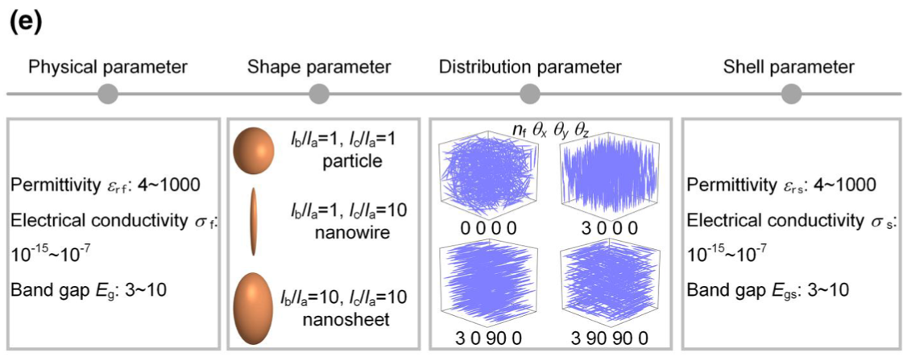
Nanocomposite fingerprint for dielectric properties

Slide 36
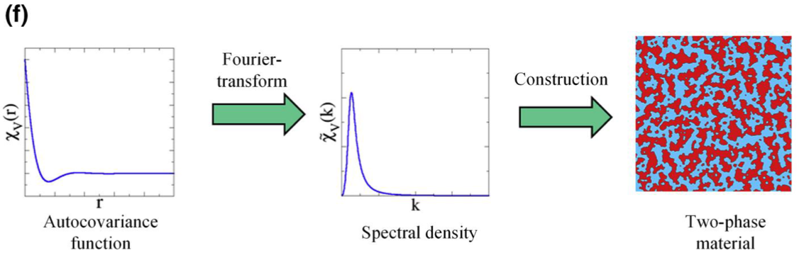
Inverse space nanocomposite fingerprint for structure

Slide 37
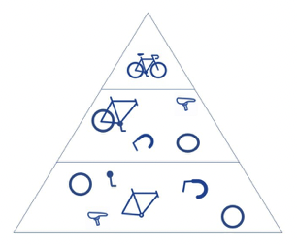
Convolutional neural network (CNN)
Neural network (decision tree type algorithm) with classification optimization using matrix multiplication for images to identify patterns, require GPUs.
-Convolution layer (Initial layer, image)
further convolution layers for color, edges, etc.
-Pooling layer
-Fully connected (FC) layer (Final layer)
Image (height, width, depth RGB)
Convolution, check if a feature is present such as an ”O” using a kernel or filter
Process by rastering across image with dot products resulting in a feature map, activation map or convolution feature
Number of filters; Stride (step of raster); zero padding (background) decides the complexity

Slide 38
For PNCs interfacial regions can be important
This is a major stumbling block

Slide 39
Zhu M-X, Deng T, Dong L, Chen J-M, Dang Z-M Review of machine learning-driven design of polymer-based dielectrics IET Nanodielectrics 5 24-38 (2022).

Slide 40
Machine Learning (ML) Algorithm
Fingerprint => ML => Property
Linear and non-linear regression algorithms
Fingerprint ~ property (linear)
Radial basis function: Property ~ SUM(f(fingerprint-x_{c}))
Polynomial: Property ~ SUM(k_{n} fingerprint^{n})
Kernel based algorithms (alternatives to least squares routines, like a correlation function between measurements in multidimensional space)
Kernel ridge regression (KRR)
Support vector machine (SVM)
Gaussian process regression (GPR)
Artificial neural networks (ANN)

Slide 41
Surrogate model (example gaussian)

Slide 42
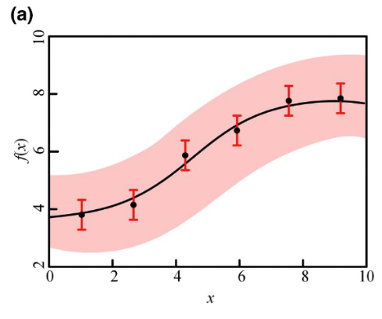
Gaussian process regression

Slide 43
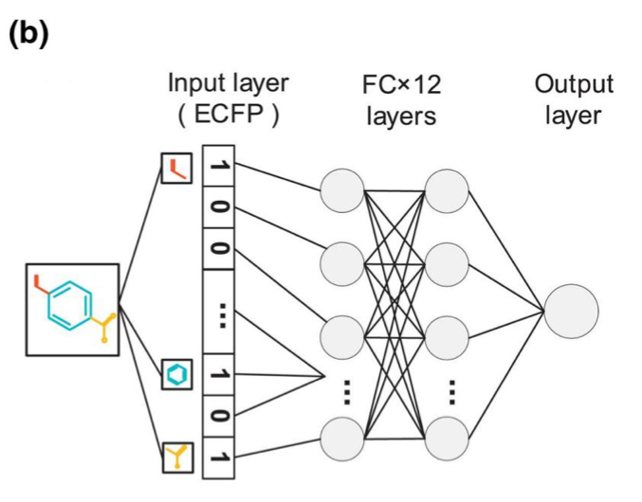
Decision tree algorithms, random forest (RF)
Decision trees with many levels tend to learn irregular patterns
By randomly grouping sets from the input fingerprint irregular patterns can be removed
Artificial neural network

Slide 44
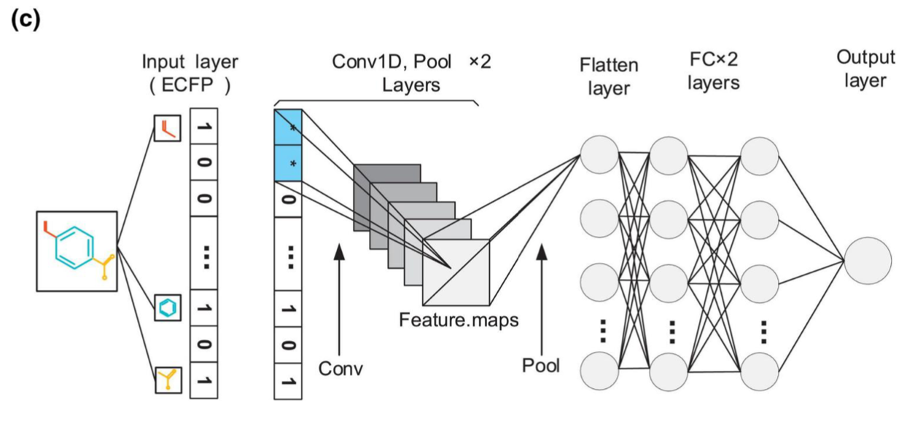
Convolution neural network

Slide 45
Convolutional neural network (CNN)
Neural network (decision tree type algorithm) with classification optimization using matrix multiplication for images to identify patterns, require GPUs.
-Convolution layer (Initial layer, image)
further convolution layers for color, edges, etc.
-Pooling layer
-Fully connected (FC) layer (Final layer)
Image (height, width, depth RGB)
Convolution, check if a feature is present such as an ”O” using a kernel or filter
Process by rastering across image with dot products resulting in a feature map, activation map or convolution feature
Number of filters; Stride (step of raster); zero padding (background) decides the complexity

Slide 46
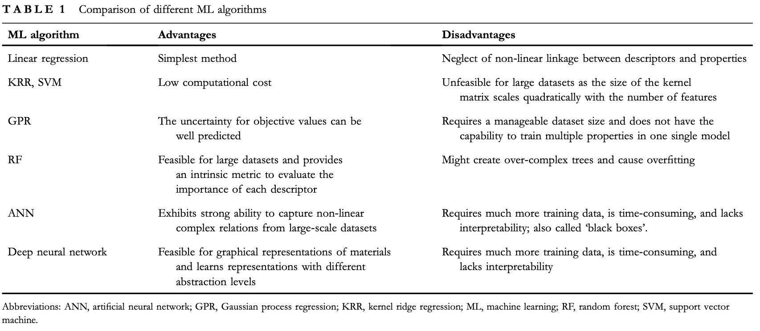

Slide 47
Zhu M-X, Deng T, Dong L, Chen J-M, Dang Z-M Review of machine learning-driven design of polymer-based dielectrics IET Nanodielectrics 5 24-38 (2022).

Slide 48
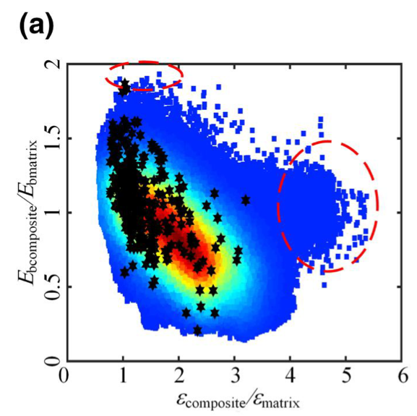
Inverse Design Methods
Enumeration method,
go through each possible solution (complete enumeration) or limit the solutions (incomplete enumeration)
GPR‐based ML model used to screen promising polymer nanocomposites with desired permittivity, breakdown strength and energy density, resulting in several kinds of nanocomposites with desired properties

Slide 49
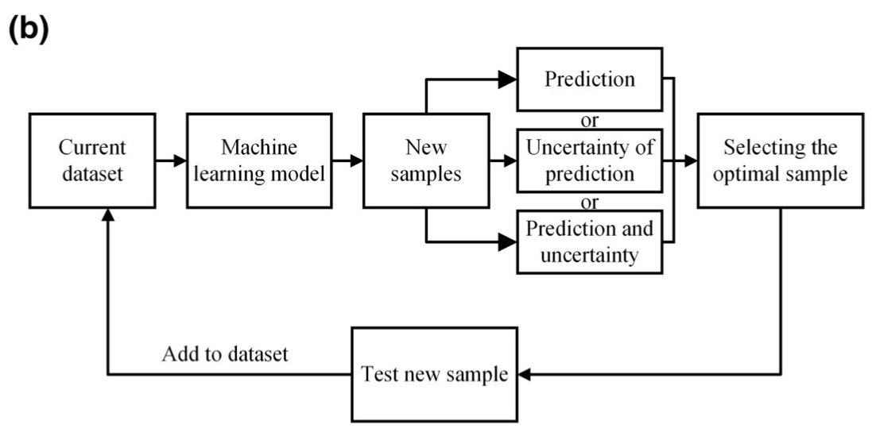
Inverse Design Methods
Active learning algorithm
training the ML‐based surrogate model for property prediction,
selecting the optimal sample based on the prediction results including values and uncertainties, and
supplementing the optimal sample into training dataset
Choosing the optimal sample requires ML models to provide both prediction and uncertainty values of the target property. As a result, the GPR algorithm and a combination of bootstrapping methods with standard ML algorithms (decision tree, SVM etc.), which can estimate the uncertainty of pre- dictions, are common ML methods in active learning.

Slide 50

Evolutionary Strategy (ES)
Generic Algorithm

Slide 51

ES completes a structured search through procedures inspired by natural evolution.
At each iteration, parameter vectors (‘genotypes’, fingerprints in the ML) in a population are updated (selection, crossover and mutation in GA; movement of particle in PSO) to generate an offspring,
followed by an evaluation of the objection function value.

Slide 52

Particle Swarm Optimization (PSO)
Move a particle to improve the situation
moving one particle impacts the other particles
repeat and let the system evolve
Seems similar to a Monte- Carlo/Metropolis simulation

Slide 53

Take the known structure, find a relationship to the desired property, then invert that relationship to regenerate the structure, finally you can set the desired property to your target and generate the associated structure (possibly)

Slide 54


Slide 55


Generate molecule from desired properties
Generate properties from molecule
Learn to do this process correctly by repeating

Slide 56


Slide 57
Zhu M-X, Deng T, Dong L, Chen J-M, Dang Z-M Review of machine learning-driven design of polymer-based dielectrics IET Nanodielectrics 5 24-38 (2022).

Slide 58

Variable Importance
the relevance of features with target properties
Pearson correlation coefficient

Slide 59

Variable Importance
Gradients of convolutional neural networks (CNNs) model

Slide 60


Variable Importance
Deep Learning Important FeaTures (DeepLIFT)

Slide 61

Variable Importance

Slide 62

Variable Importance

Slide 63


Slide 64




Slide 65


Slide 66
3Modules:
5 nanocomposites 0D,1D,2D
Simulate E-field and polarization, charge transport, breakdown path
6615 phase-field calculations
leads to training data set between microstructure and properties
Scoring function Energy density evaluate 2205 composites,
screen fillers using Back Propagation Neural Network (BPNN)
Prepare suggested sample and test

