Slide 1

Nano-Maufacturing
One View of NM
Quantification of nano-dispersion in polymer nanocomposites: A thermodynamic analogy
Greg Beaucage Professor of Chemical and Materials Engineering
Kabir Rishi
CDC/NIOSH Research Laboratory, Cincinnati Ohio
Department of Materials Science & Engineering
University of Cincinnati

Slide 2
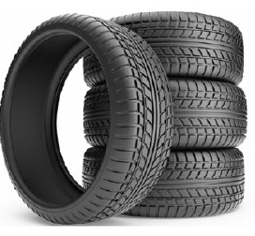
Nano-Maufacturing
One View of NM
A Desired Property: Dynamic Mechanical Spectrum
A Nano Solution: Precipitated Silica
Nano->Colloidal->Micro->Macroscopic
Proposition: Nano-Manufacturing Involves Hierarchy
The Challenge is to Build Hierarchy
Greg Beaucage, University of Cincinnati gbeaucage@gmail.com

Slide 3
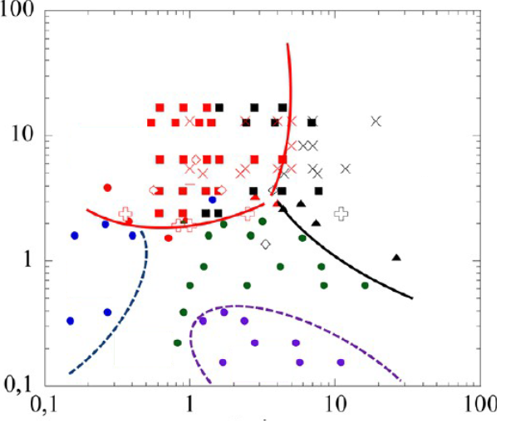


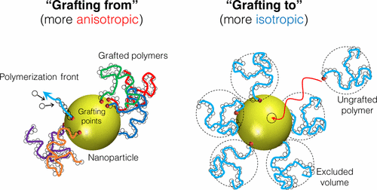
Current academic
state-of-the-art nanocomposite
Monodisperse colloidal particles
Colloidal Solution cast
Thermally
Dispersed
Well dispersed
Phase separated
Density of grafted chains
Sheets, strings, etc.
50Å
Objective:
Enhance miscibility (i.e. no hierarchy)
Grafted/Matrix chain length
Kumar, S.K., Jouault, N., Benicewicz, B. and Neely, T., 2013. Nanocomposites with polymer grafted nanoparticles. Macromolecules, 46(9), pp.3199-3214.
Kumar, S.K., Benicewicz, B.C., Vaia, R.A. and Winey, K.I., 2017. 50th anniversary perspective: are polymer nanocomposites practical for applications?. Macromolecules, 50(3), pp.714-731.
Asai, M., Zhao, D. and Kumar, S.K., 2017. Role of grafting mechanism on the polymer coverage and self-assembly of hairy nanoparticles. ACS Nano, 11(7), pp.7028-7035.
Greg Beaucage, University of Cincinnati gbeaucage@gmail.com

Slide 4
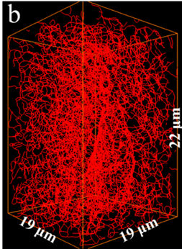
The original nanocomposite
Polydisperse aggregates
Processed under shear
Kinetically mixed immiscible
~50nm
Objective:
Tear resistance
Static charge dissipation
Dynamic mechanical spectrum
1,000 x larger
Why/how do added nanoparticles impact structures 100-1,000 times larger?
Song, L; Wang, Z; Tang, X.; Chen, L.; Chen, P.; Yuan, Q.; Li, L. Visualizing the Toughening Mechanism of Nanofiller with 3D X-ray Nano-CT: Stress-Induced Phase Separation of Silica Nanofiller and Silicone Polymer Double Networks Macromolecules 50 7249-7257 (2017).
Greg Beaucage, University of Cincinnati gbeaucage@gmail.com

Slide 5
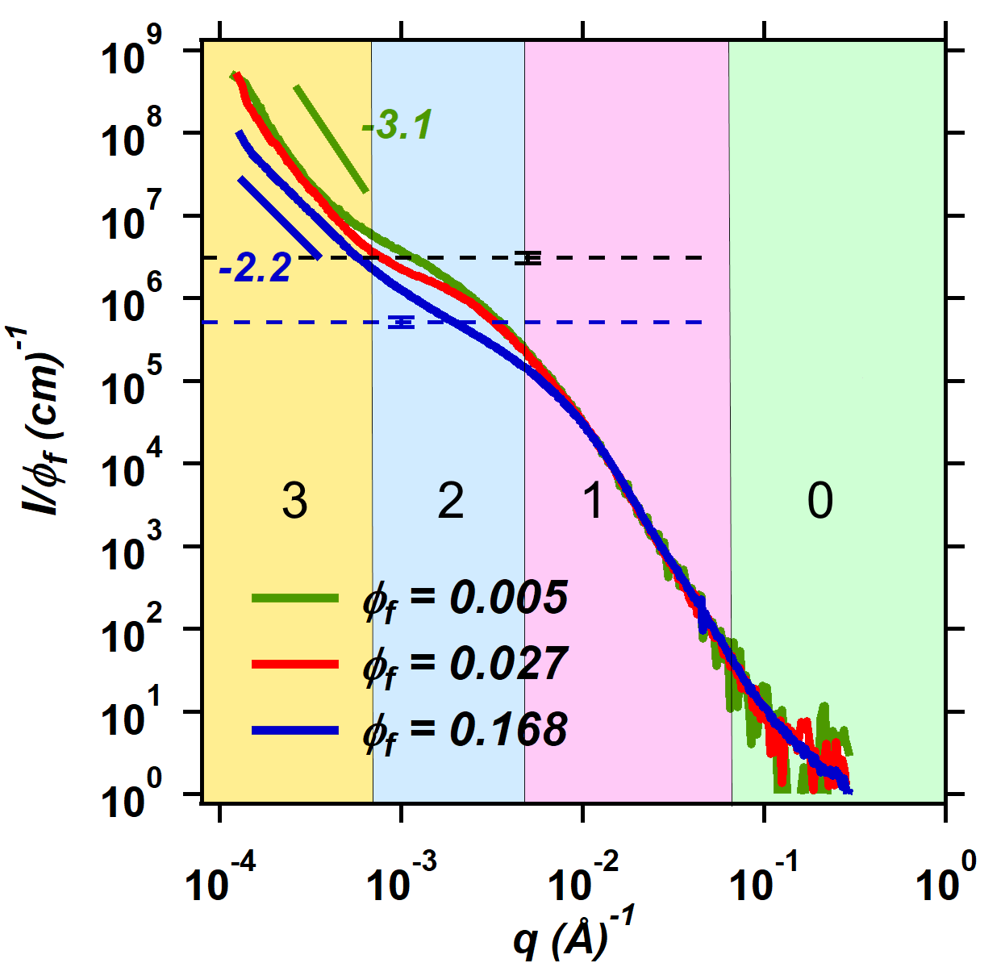
Multiscale Hierarchical Structures
Size
Commercial
System
~50 nm
Aggregates of primary particles
One size scale vs. multiple hierarchical size scales
50Å
State of the Art
Model System
Commercial System
Rishi, K., Beaucage, G., Kuppa, V., Mulderig, A., Narayanan, V., McGlasson, A., Rackaitis, M. and Ilavsky, J., 2018. Impact of an emergent hierarchical filler network on nanocomposite dynamics. Macromolecules, 51(20), pp.7893-7904.
Mulderig, A., Beaucage, G., Vogtt, K., Jiang, H. and Kuppa, V., 2017. Quantification of branching in fumed silica. Journal of Aerosol Science, 109, pp.28-37.
Greg Beaucage, University of Cincinnati gbeaucage@gmail.com

Slide 6
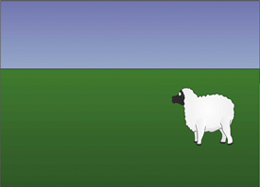
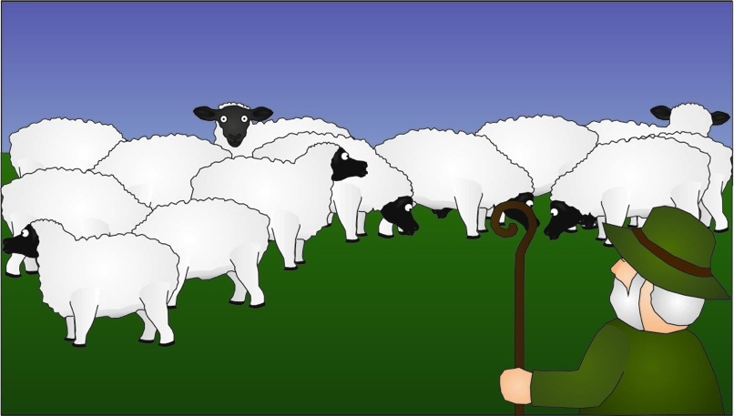
Quantitative measure of nano-dispersion
A₂ (or B₂) from scattering
Pedersen, J. S.; Sommer, C. Temperature Dependence of the Virial Coefficients and the Chi Parameter in Semi-Dilute Solutions of PEG. In Scattering Methods and the Properties of Polymer Materials; Springer Berlin Heidelberg: Berlin, Heidelberg, 2005; pp 70–78.
Vogtt, K.; Beaucage, G.; Weaver, M.; Jiang, H. Thermodynamic Stability of Worm-like Micelle Solutions. Soft Matter 2017, 13 (36), 6068–6078.
Jin, Y.; Beaucage, G.; Vogtt, K.; Jiang, H.; Kuppa, V.; Kim, J.; Ilavsky, J.; Rackaitis, M.; Mulderig, A.; Rishi, K.; Narayanan, V. A Pseudo-Thermodynamic Description of Dispersion for Nanocomposites. Polymer (Guildf). 2017, 129, 32–43.
Greg Beaucage, University of Cincinnati gbeaucage@gmail.com

Slide 7
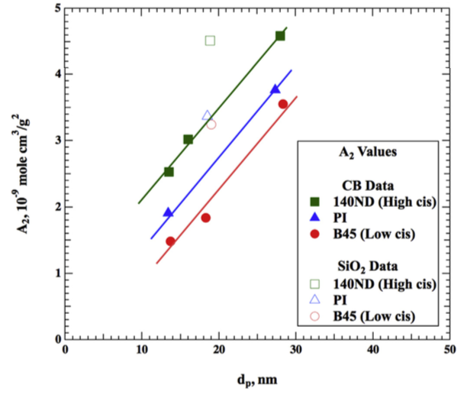
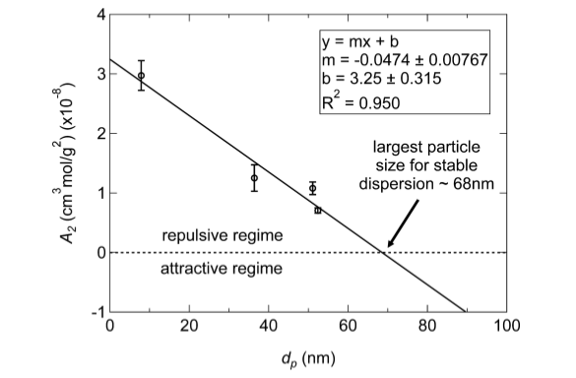
Thermal Dispersion versus Kinetic Dispersion
Immiscible:
Carbon Black and Silica in Elastomer
Miscible:
Organic Pigment with Triton X100
~50nm
Thermally driven nano-dispersion (Stokes drag coefficient)
Mechanically driven nano-dispersion (Lever arm)
Mulderig, A.; Beaucage, G.; Vogtt, K.; Jiang, H.; Jin, Y.; Clapp, L.; Henderson, D. C. Structural Emergence in Particle Dispersions. Langmuir 2017, 33 (49), 14029–14037.
Jin, Y.; Beaucage, G.; Vogtt, K.; Jiang, H.; Kuppa, V.; Kim, J.; Ilavsky, J.; Rackaitis, M.; Mulderig, A.; Rishi, K.; Narayanan, V. A Pseudo-Thermodynamic Description of Dispersion for Nanocomposites. Polymer (Guildf). 2017, 129, 32–43.

Slide 8
Clustering can lead to locally higher concentrations
Traffic is heavy today
Traffic is really heavy today
Greg Beaucage, University of Cincinnati gbeaucage@gmail.com

Slide 9
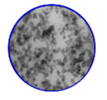
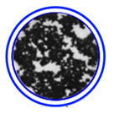
Immiscibility forms clusters
Multiscale Hierarchical Structures
Size
Local network
Bulk network
500nm
5um
Rishi, K., Beaucage, G., Kuppa, V., Mulderig, A., Narayanan, V., McGlasson, A., Rackaitis, M. and Ilavsky, J., 2018. Impact of an emergent hierarchical filler network on nanocomposite dynamics. Macromolecules, 51(20), pp.7893-7904.
Trappe, V. and Weitz, D.A., 2000. Scaling of the viscoelasticity of weakly attractive particles. Physical review letters, 85(2), p.449.
Mulderig, A., Beaucage, G., Vogtt, K., Jiang, H. and Kuppa, V., 2017. Quantification of branching in fumed silica. Journal of Aerosol Science, 109, pp.28-37.
Greg Beaucage, University of Cincinnati gbeaucage@gmail.com

Slide 10
Multiscale Hierarchical Structures
Primary
Particles
Local network
Bulk network
Aggregates
Hashimoto, T., Amino, N., Nishitsuji, S. and Takenaka, M., 2019. Hierarchically self-organized filler particles in polymers: cascade evolution of dissipative structures to ordered structures. Polymer Journal, 51(2), pp.109-130.
Greg Beaucage, University of Cincinnati gbeaucage@gmail.com

Slide 11
Multiscale Hierarchical Structures
Local network
Bulk network
Primary
Particles
Aggregates
Baeza, G.P., Genix, A.C., Degrandcourt, C., Petitjean, L., Gummel, J., Couty, M. and Oberdisse, J. Multiscale filler structure in simplified industrial nanocomposite silica/SBR systems studied by SAXS and TEM. Macromolecules 46 317-329 (2013).
Greg Beaucage, University of Cincinnati gbeaucage@gmail.com

Slide 12
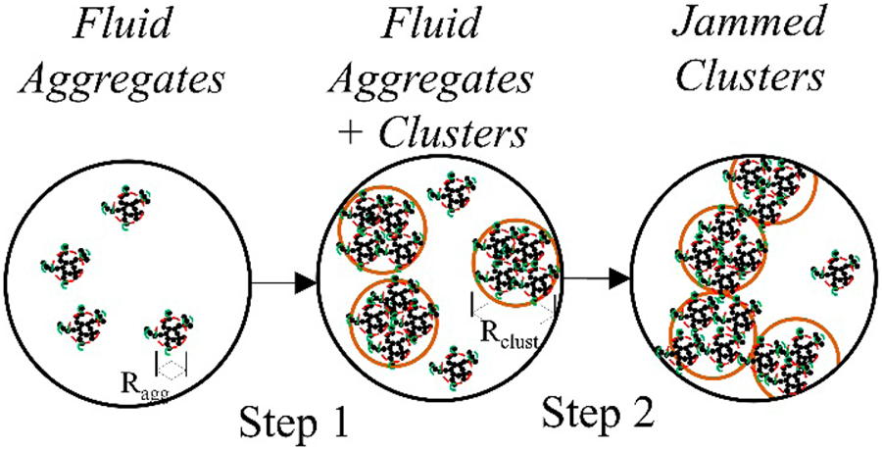
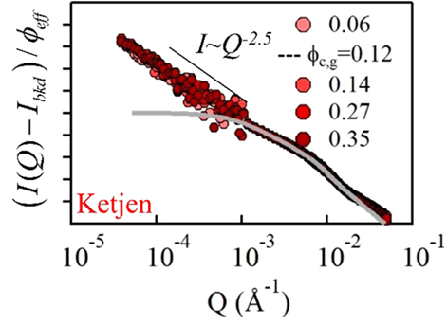
Multiscale Hierarchical Structures
Primary
Particles
Local network
Bulk network
Aggregates
Richards, J.J., Hipp, J.B., Riley, J.K., Wagner, N.J. and Butler, P.D. Clustering and percolation in suspensions of carbon black. Langmuir 33 12260-12266 (2017).
Greg Beaucage, University of Cincinnati gbeaucage@gmail.com

Slide 13
Multiscale Hierarchical Structures
Bulk network
Einstein/Guth-Gold:
G’ = G’₀ (1 + 2.5 φ_{f})
Primary
Particles
Network/Winter:
G’ ~ G” ~ ω^{α}
Local network
Aggregates
Filippone, G., Romeo, G. and Acierno, D. Viscoelasticity and structure of polystyrene/fumed silica nanocomposites: filler network and hydrodynamic contributions. Langmuir 26 2714-2720 (2010).
Filippone, G. and Salzano de Luna, M. A unifying approach for the linear viscoelasticity of polymer nanocomposites.
Macromolecules 45 8853-8860 (2012).
Greg Beaucage, University of Cincinnati gbeaucage@gmail.com

Slide 14
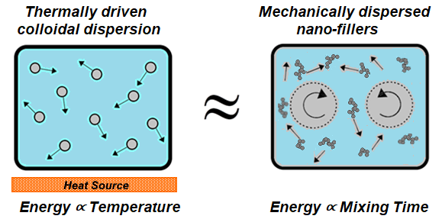
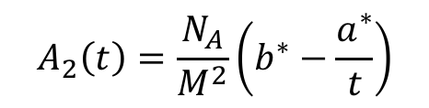
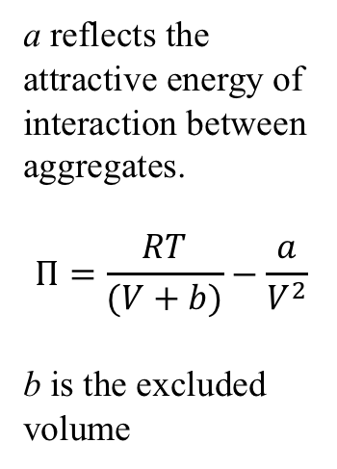

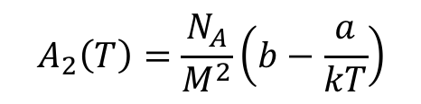
van der Waals model for incompatible polymer nanocomposites
a reflects the attractive energy of interaction between aggregates.
$$Π=\frac{RT}{(V+b)}−\frac{a}{V^{2}}$$
b is the excluded volume
$$T\sim \left\langle \dot{γ}\right\rangle =Ntψ$$
$$A_{2}\left(T\right)=\frac{N_{A}}{M^{2}}\left(b−\frac{a}{kT}\right)$$
$$A_{2}\left(t\right)=\frac{N_{A}}{M^{2}}\left(b^{∗}−\frac{a^{∗}}{t}\right)$$
Rishi, K.; Narayanan, V.; Beaucage, G.; McGlasson, A.; Kuppa, V.; Ilavsky, J.; Rackaitis, M. A Thermal Model to Describe Kinetic Dispersion in Rubber Nanocomposites: The Effect of Mixing Time on Dispersion. Polymer 175 272–282 (2019).
Greg Beaucage, University of Cincinnati gbeaucage@gmail.com

Slide 15
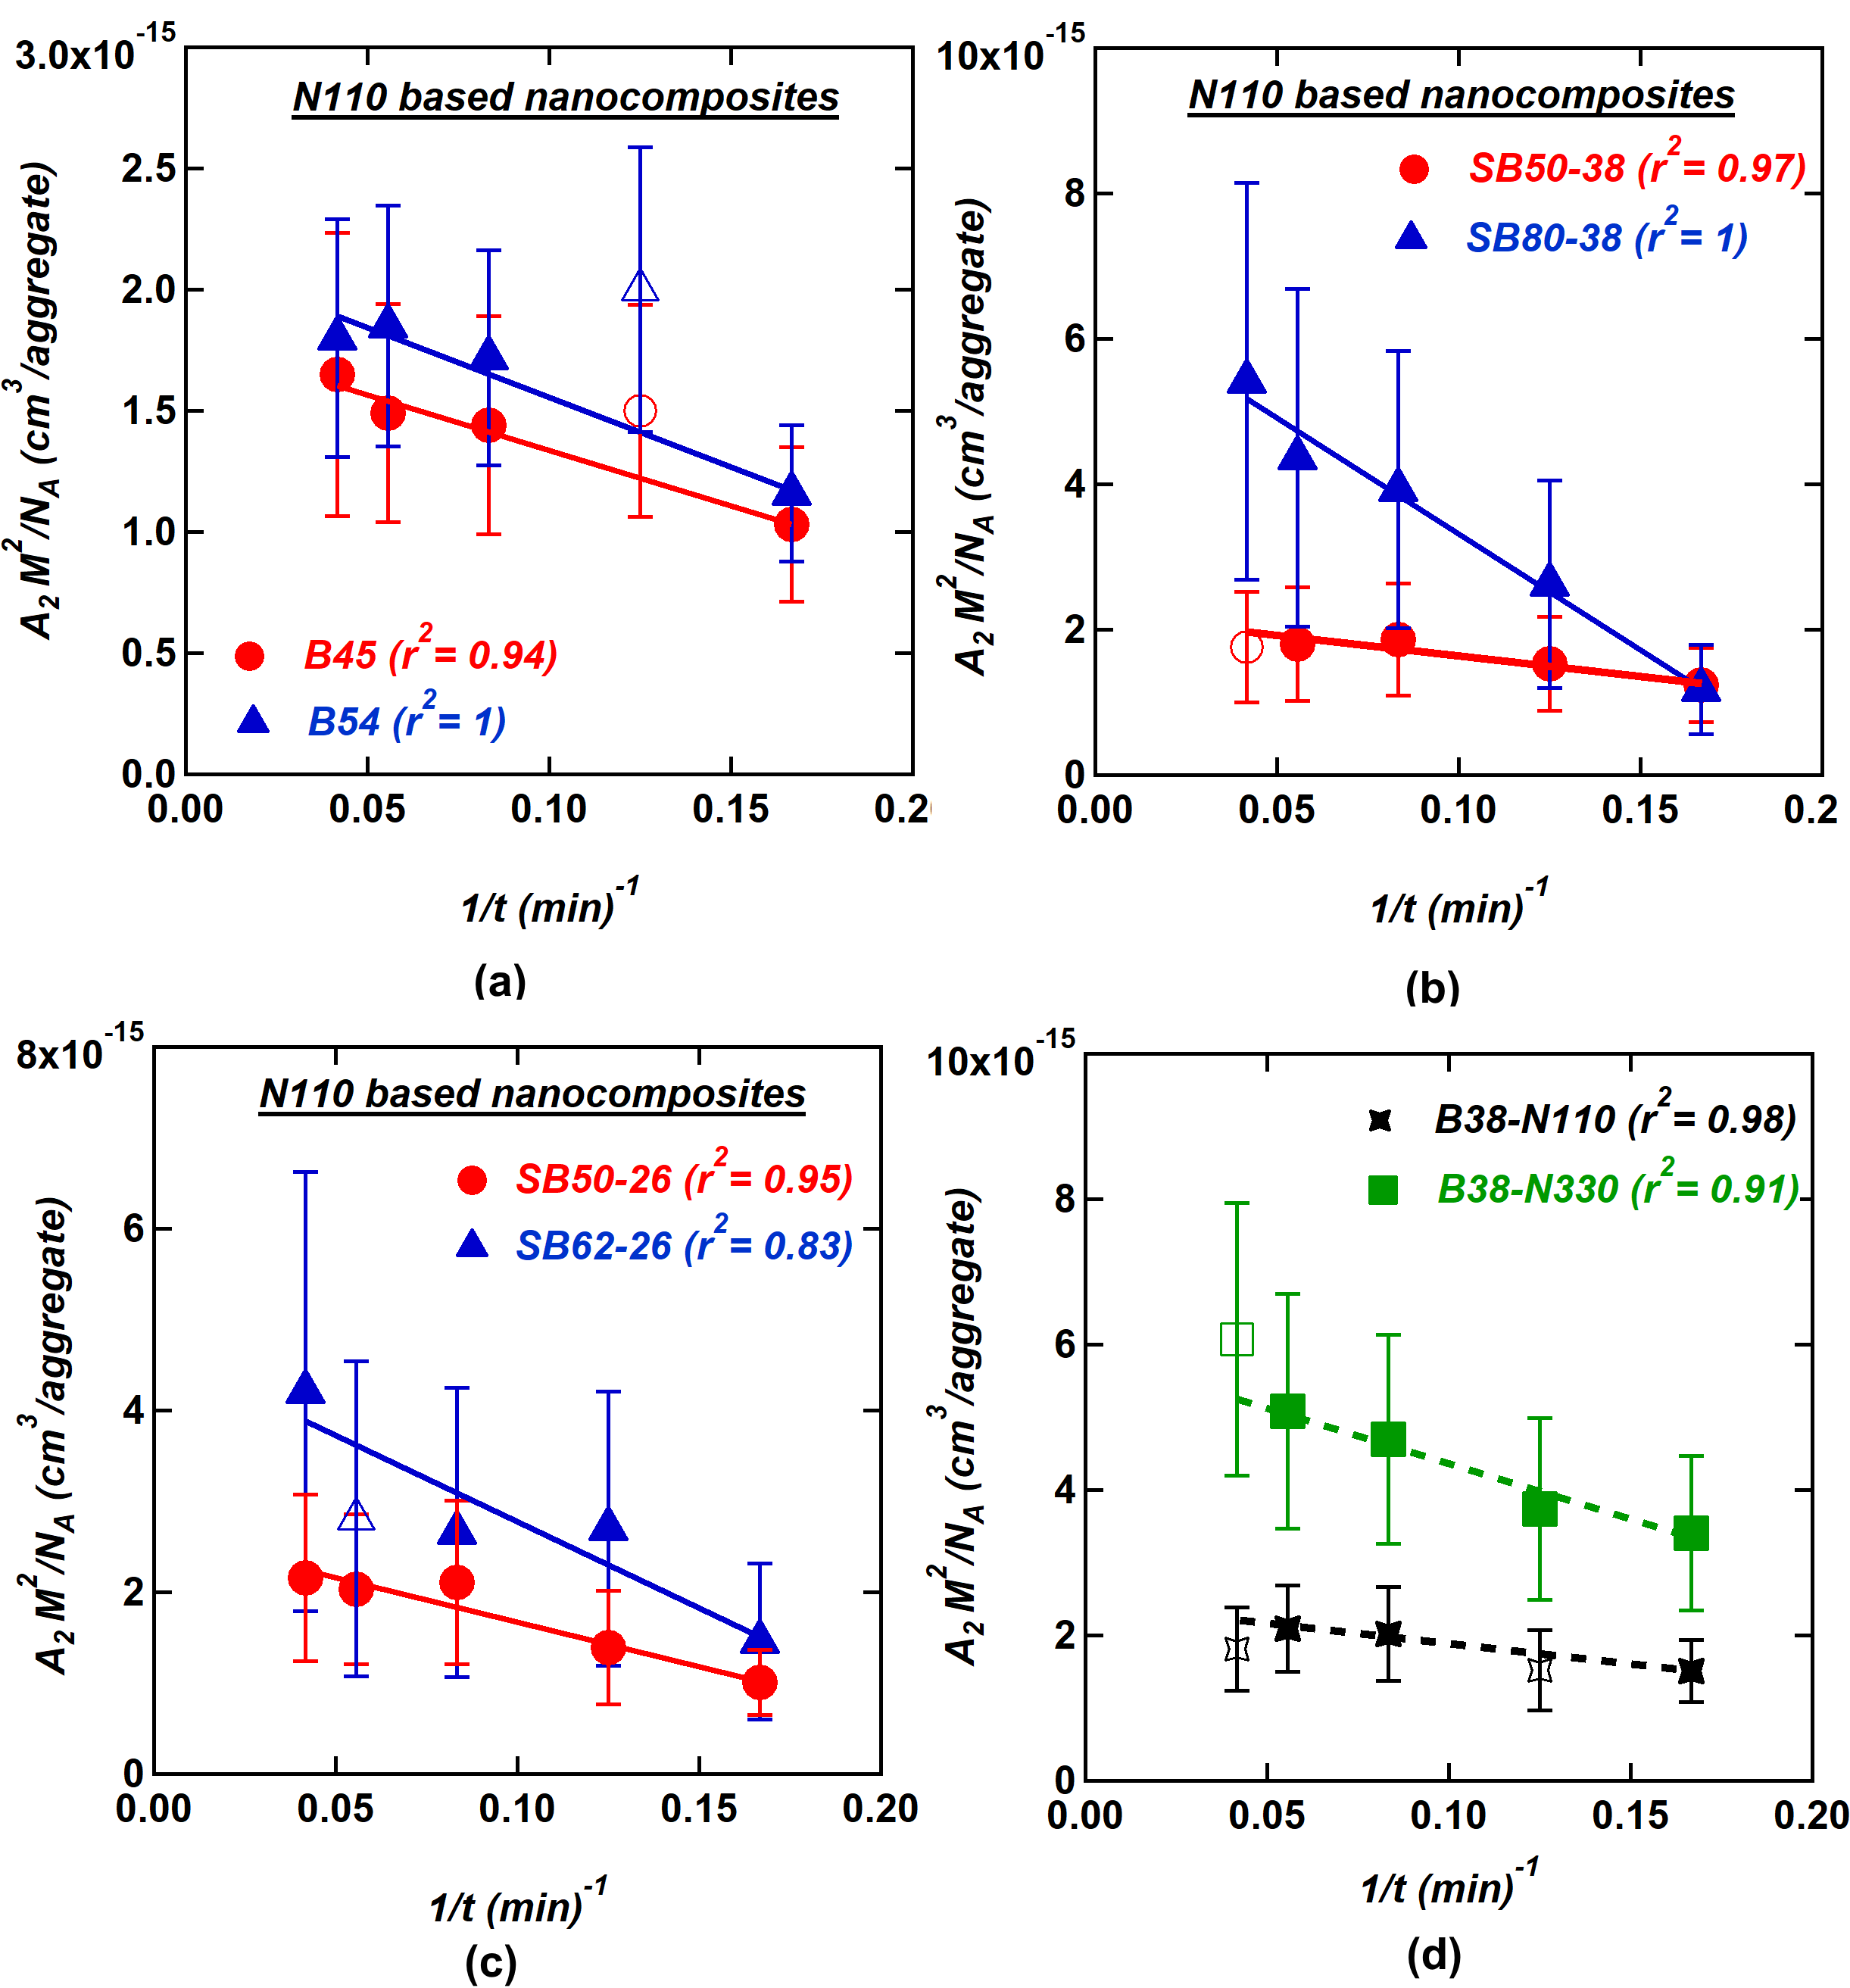
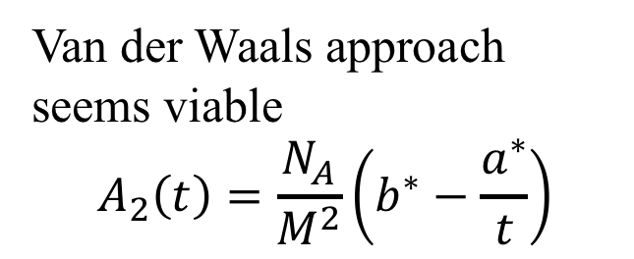
Van der Waals approach seems viable
$$A_{2}\left(t\right)=\frac{N_{A}}{M^{2}}\left(b^{∗}−\frac{a^{∗}}{t}\right)$$
Rishi, K.; Narayanan, V.; Beaucage, G.; McGlasson, A.; Kuppa, V.; Ilavsky, J.; Rackaitis, M. A Thermal Model to Describe Kinetic Dispersion in Rubber Nanocomposites: The Effect of Mixing Time on Dispersion. Polymer 175 272–282 (2019).
Greg Beaucage, University of Cincinnati gbeaucage@gmail.com

Slide 16
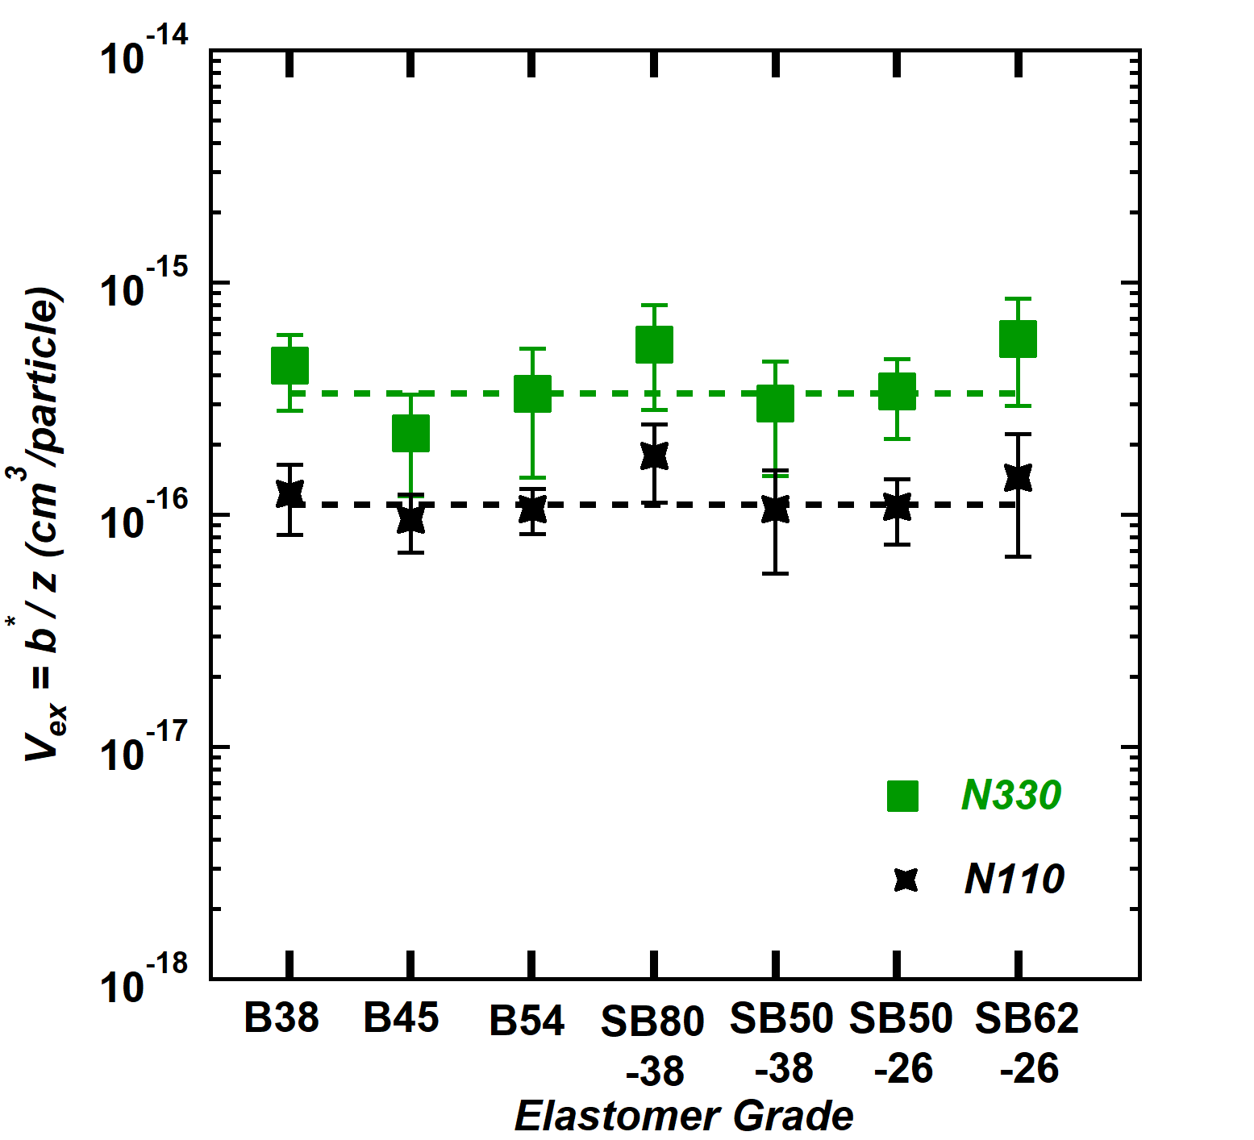
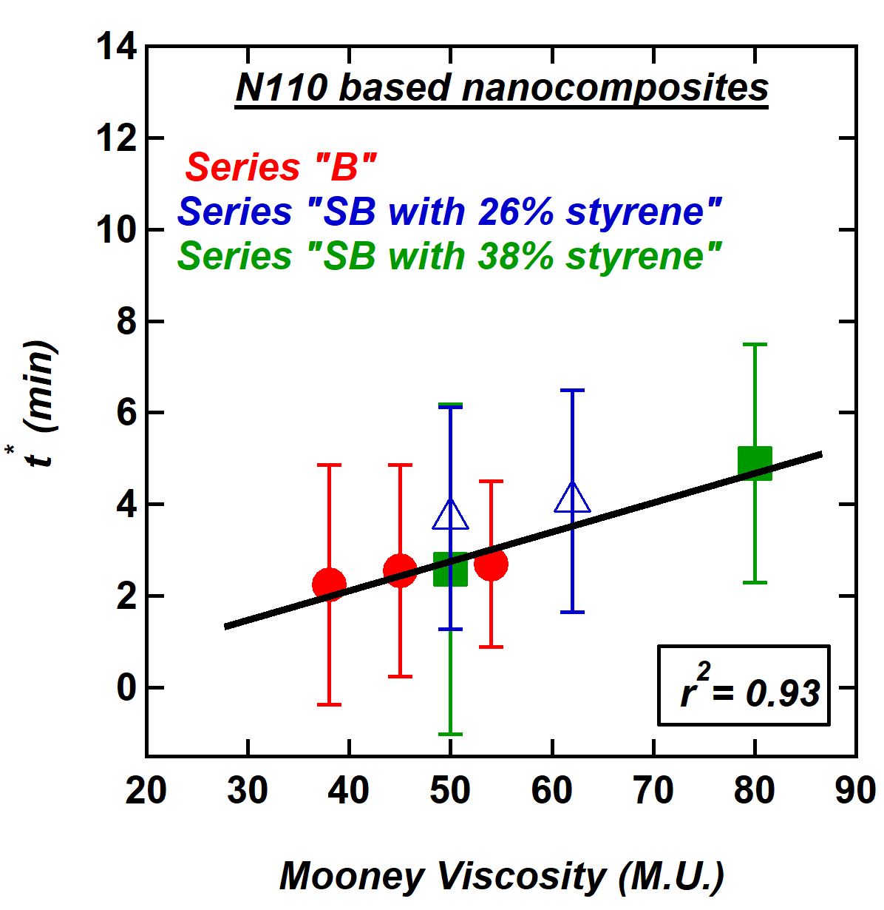
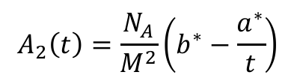
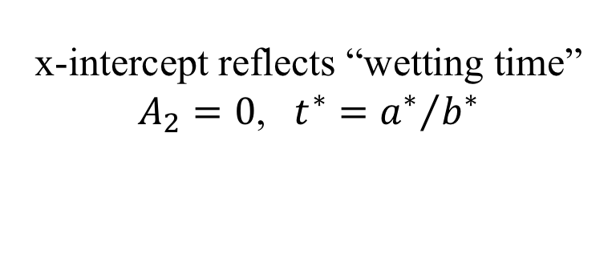
Excluded volume is associated with the occupied volume of an aggregate. (d_{p,N330}/d_{p,N110})³ = 4.2
Wetting time depends on viscosity and primary particle size
x-intercept reflects “wetting time”
$A_{2}=0$, $t^{∗}={a^{∗}}/{b^{∗}}$
$$A_{2}\left(t\right)=\frac{N_{A}}{M^{2}}\left(b^{∗}−\frac{a^{∗}}{t}\right)$$
N110 | Vulcan 8 (Cabot) | 123 m²/g 25.7 nm
N330 | Vulcan 3 (Cabot) | 76 m²/g 41.6 nm
Rishi, K.; Narayanan, V.; Beaucage, G.; McGlasson, A.; Kuppa, V.; Ilavsky, J.; Rackaitis, M. A Thermal Model to Describe Kinetic Dispersion in Rubber Nanocomposites: The Effect of Mixing Time on Dispersion. Polymer 175 272–282 (2019).
Greg Beaucage, University of Cincinnati gbeaucage@gmail.com

Slide 17
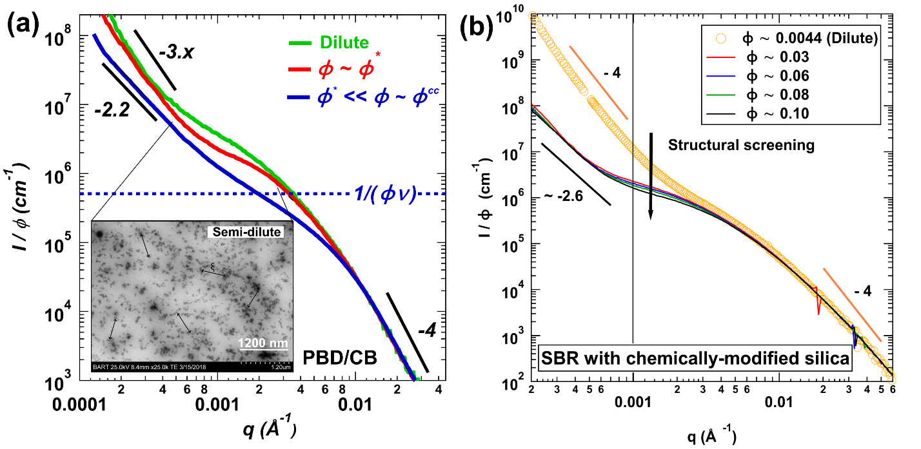
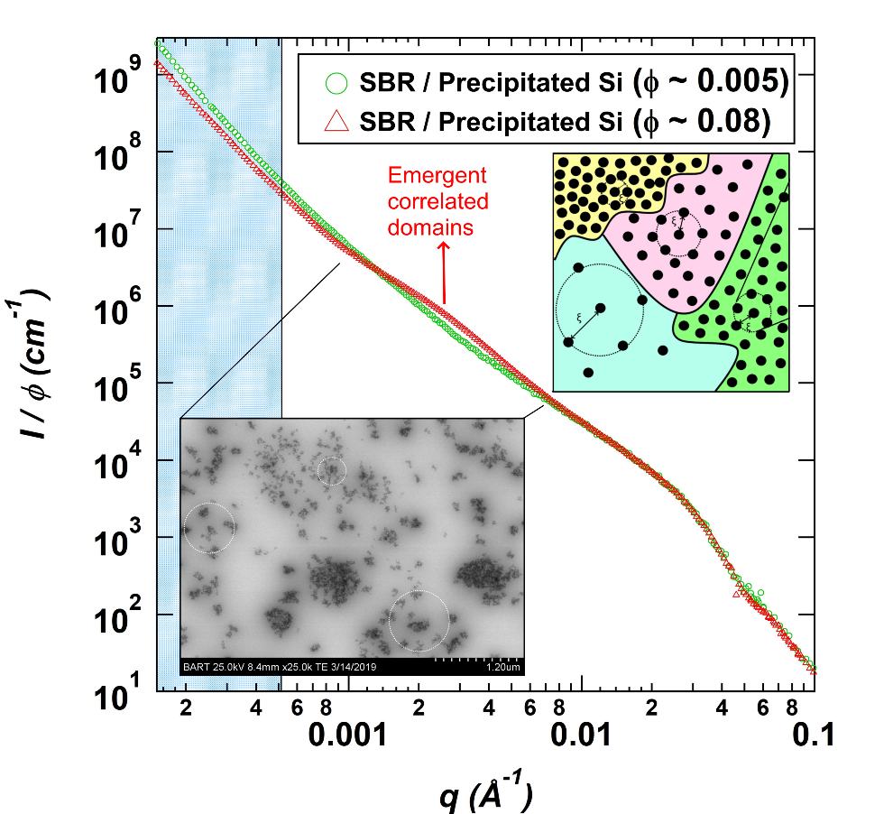
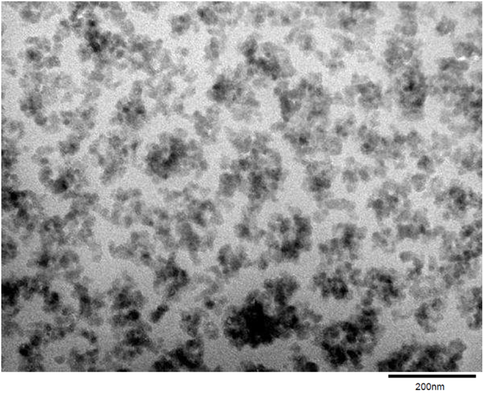
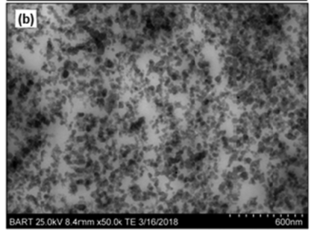
Mean field (CB) and specific interactions (Silica)
McGlasson, A., Rishi, K., Beaucage, G., Chauby, M., Kuppa, V., Ilavsky, J. and Rackaitis, M., 2020. Quantification of dispersion for weakly and strongly correlated nanofillers in polymer nanocomposites. Macromolecules, 53(6), pp.2235-2248.
Rishi, K., Beaucage, G., Kuppa, V., Mulderig, A., Narayanan, V., McGlasson, A., Rackaitis, M. and Ilavsky, J., 2018. Impact of an emergent hierarchical filler network on nanocomposite dynamics. Macromolecules, 51(20), pp.7893-7904.
Rishi, K.; Pallerla, L.; Beaucage, G.; Tang, A. Dispersion of Surface-Modified, Aggregated, Fumed Silica in Polymer Nanocomposites. J. Appl. Phys. 2020, 127 (17), 174702.
Greg Beaucage, University of Cincinnati gbeaucage@gmail.com

Slide 18
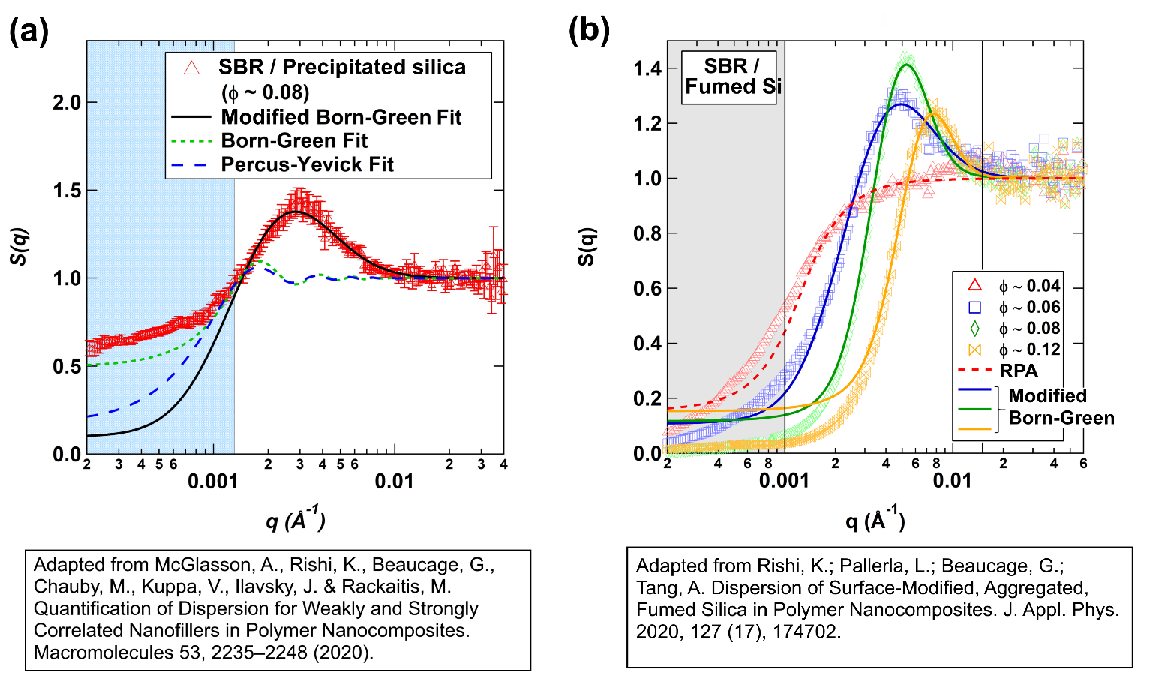
Specific interactions (Silica)
Positive a* can lead to correlated silica aggregates, New scattering function to fit these curves (solves an impossible task)
McGlasson, A., Rishi, K., Beaucage, G., Chauby, M., Kuppa, V., Ilavsky, J. and Rackaitis, M., 2020. Quantification of dispersion for weakly and strongly correlated nanofillers in polymer nanocomposites. Macromolecules, 53(6), pp.2235-2248.
Rishi, K.; Pallerla, L.; Beaucage, G.; Tang, A. Dispersion of Surface-Modified, Aggregated, Fumed Silica in Polymer Nanocomposites. J. Appl. Phys. 2020, 127 (17), 174702.
Greg Beaucage, University of Cincinnati gbeaucage@gmail.com

Slide 19
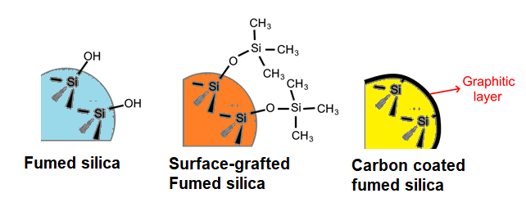
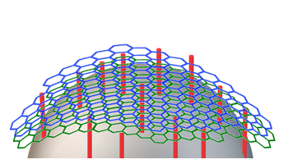
Aggregates to Clusters
Control immiscibility through surface modification
Okoli, U.; Rishi, K.; Beaucage, G.; Kammler, H. K.; McGlasson, A.; Michael, C.; Narayanan, V.; Grammens, J. Dispersion and Dynamic Response for Flame-Synthesized and Chemically Modified Pyrogenic Silica in Rubber Nanocomposites; 2022. Submitted to Composites Sci. & Tech..
Greg Beaucage, University of Cincinnati gbeaucage@gmail.com

Slide 20
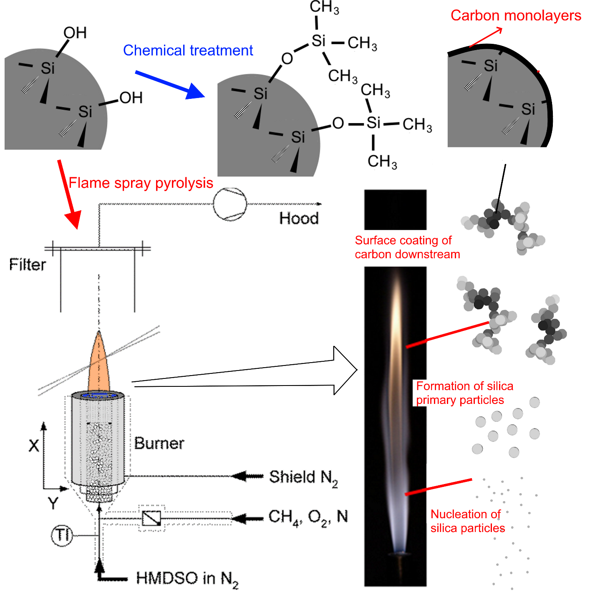
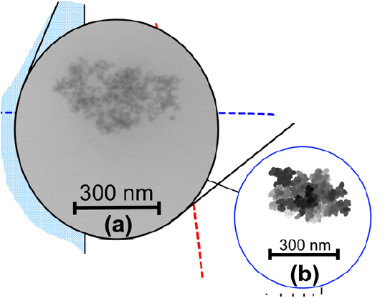
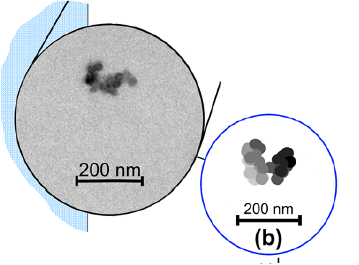
Silica
5-10nm
Carbon Black
~30nm
McGlasson, A., Rishi, K., Beaucage, G., Chauby, M., Kuppa, V., Ilavsky, J. and Rackaitis, M., 2020. Quantification of dispersion for weakly and strongly correlated nanofillers in polymer nanocomposites. Macromolecules, 53(6), pp.2235-2248.
Okoli, U.; Rishi, K.; Beaucage, G.; Kammler, H. K.; McGlasson, A.; Michael, C.; Narayanan, V.; Grammens, J. Dispersion and Dynamic Response for Flame-Synthesized and Chemically Modified Pyrogenic Silica in Rubber Nanocomposites; submitted 2022. Composites Sci. & Tech.

Slide 21
Clustered aggregates to bulk network
Carbon Black/Mean Field
Silica/Specific Interactions
Carbon Coated Silica/Mean Field
McGlasson, A., Rishi, K., Beaucage, G., Chauby, M., Kuppa, V., Ilavsky, J. and Rackaitis, M., 2020. Quantification of dispersion for weakly and strongly correlated nanofillers in polymer nanocomposites. Macromolecules, 53(6), pp.2235-2248.
Rishi, K., Beaucage, G., Kuppa, V., Mulderig, A., Narayanan, V., McGlasson, A., Rackaitis, M. and Ilavsky, J., 2018. Impact of an emergent hierarchical filler network on nanocomposite dynamics. Macromolecules, 51(20), pp.7893-7904.
Rishi, K.; Pallerla, L.; Beaucage, G.; Tang, A. Dispersion of Surface-Modified, Aggregated, Fumed Silica in Polymer Nanocomposites. J. Appl. Phys. 2020, 127 (17), 174702.
Greg Beaucage, University of Cincinnati gbeaucage@gmail.com
Notes:
Repelling the particles – perfectly dispersed cant make a network steric repulsion

Slide 22
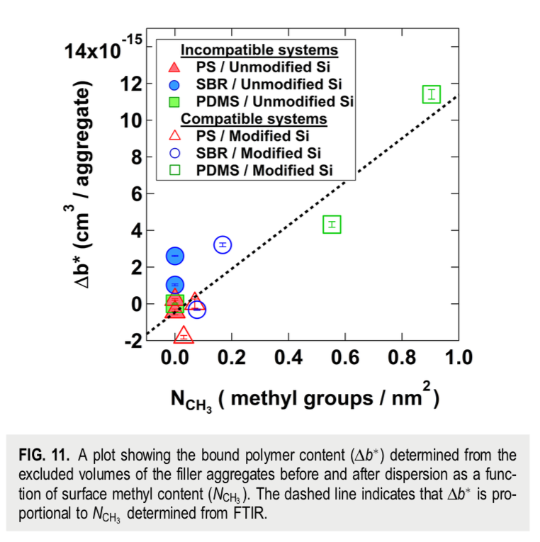
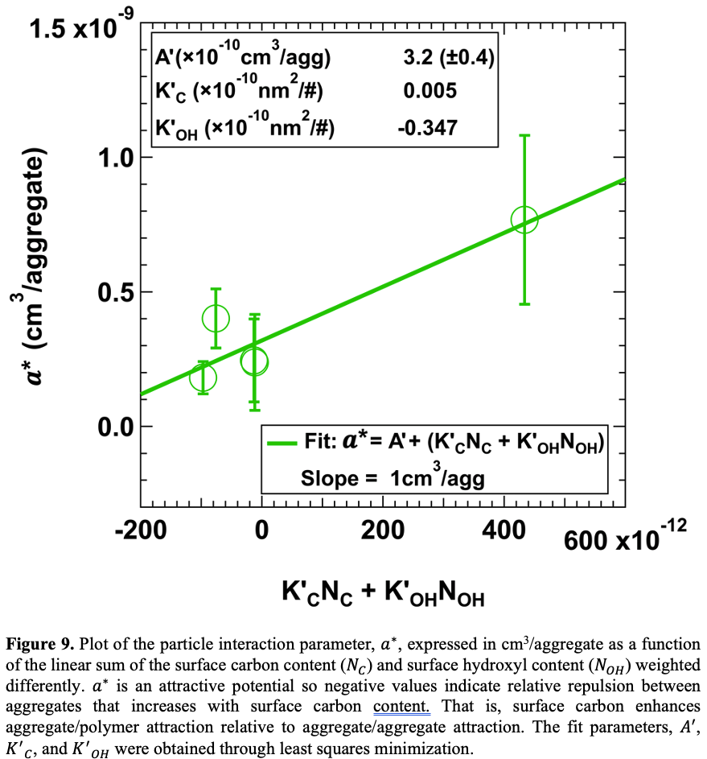
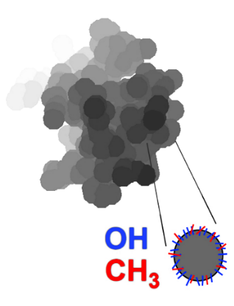
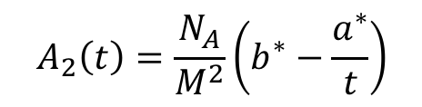
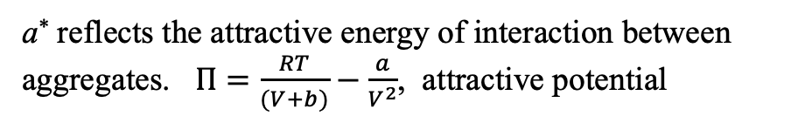
Surface Modification for Controlled Immiscibility
$$A_{2}\left(t\right)=\frac{N_{A}}{M^{2}}\left(b^{∗}−\frac{a^{∗}}{t}\right)$$
b* can be calculated as the excluded volume for an aggregate, zV_{0,} without bound rubber
b* increases with bound rubber.
a* reflects the attractive energy of interaction between aggregates. $Π=\frac{RT}{(V+b)}−\frac{a}{V^{2}}$, attractive potential
Rishi, K.; Pallerla, L.; Beaucage, G.; Tang, A. Dispersion of Surface-Modified, Aggregated, Fumed Silica in Polymer Nanocomposites. J. Appl. Phys. 2020, 127 (17), 174702.
Greg Beaucage, University of Cincinnati gbeaucage@gmail.com
Notes:
Excluded volume of agg, a retains the same idea (immiscibility comes from a). Chemically treat a would change, separated structure from interactions . Bound rubber increases excluded volume and the matrix doesn’t matter..

Slide 23
Morphology from rheology
How does this multi-hierarchical model relate to oscillatory rheometry?
Einstein/Guth-Gold:
G’ = G’₀ (1 + 2.5 φ_{f})
Network/Winter:
G’ ~ G” ~ ω^{α}
Filippone, G., Romeo, G. and Acierno, D., 2010. Viscoelasticity and structure of polystyrene/fumed silica nanocomposites: filler network and hydrodynamic contributions. Langmuir, 26(4), pp.2714-2720.
Filippone, G. and Salzano de Luna, M., 2012. A unifying approach for the linear viscoelasticity of polymer nanocomposites.
Macromolecules, 45(21), pp.8853-8860.
Greg Beaucage, University of Cincinnati gbeaucage@gmail.com

Slide 24
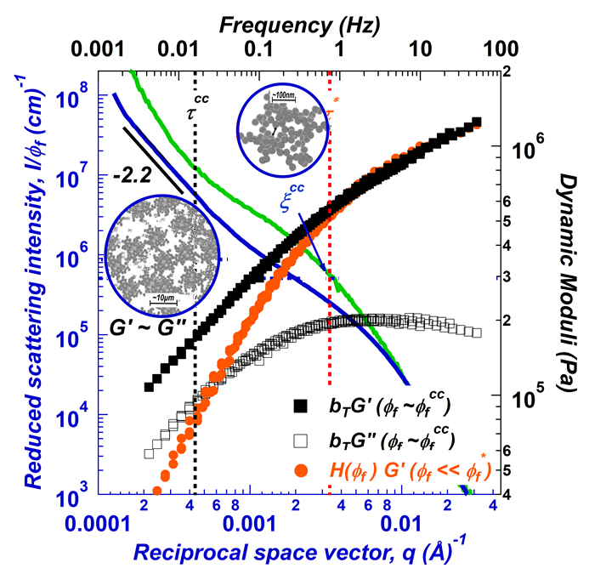
Einstein/Guth-Gold: G’ = G’₀ (1 + 2.5 φ_{f})
At intermediate frequencies, deviation of semi-dilute rheology from dilute under same shear conditions ascertained by scaling dilute sample by Einstein-Smallwood factor
At low oscillation frequencies, G’~G’’ indicates gel-like behavior*
Network/Winter
G’ ~ G” ~ ω^{α}
Rishi, K., Beaucage, G., Kuppa, V., Mulderig, A., Narayanan, V., McGlasson, A., Rackaitis, M. and Ilavsky, J., 2018. Impact of an emergent hierarchical filler network on nanocomposite dynamics. Macromolecules, 51(20), pp.7893-7904.

Slide 25
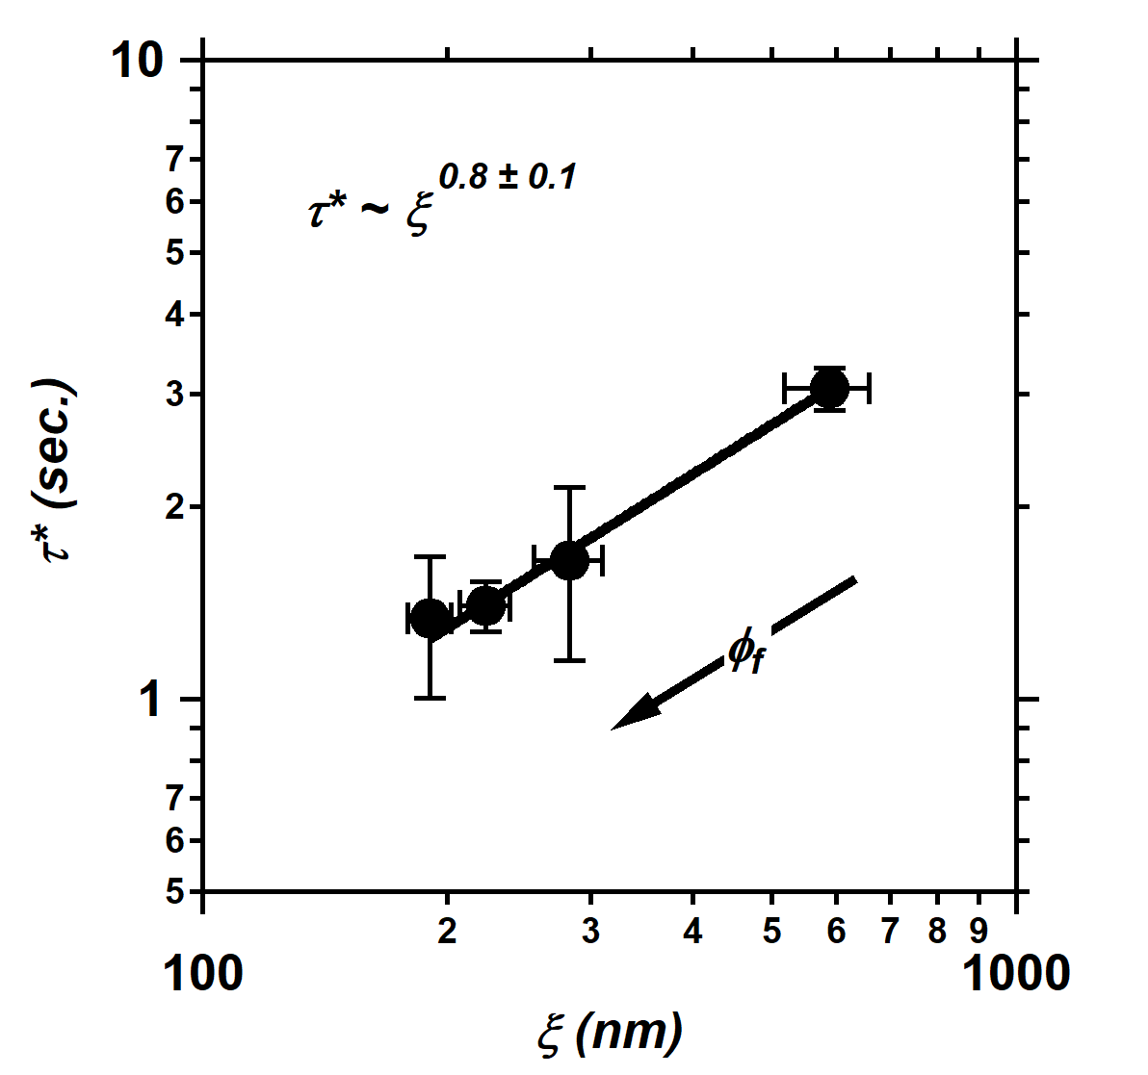

Rishi, K., Beaucage, G., Kuppa, V., Mulderig, A., Narayanan, V., McGlasson, A., Rackaitis, M. and Ilavsky, J., 2018. Impact of an emergent hierarchical filler network on nanocomposite dynamics. Macromolecules, 51(20), pp.7893-7904.
Greg Beaucage, University of Cincinnati gbeaucage@gmail.com
Notes:
Get that out of the scattering analysis and match it

Slide 26
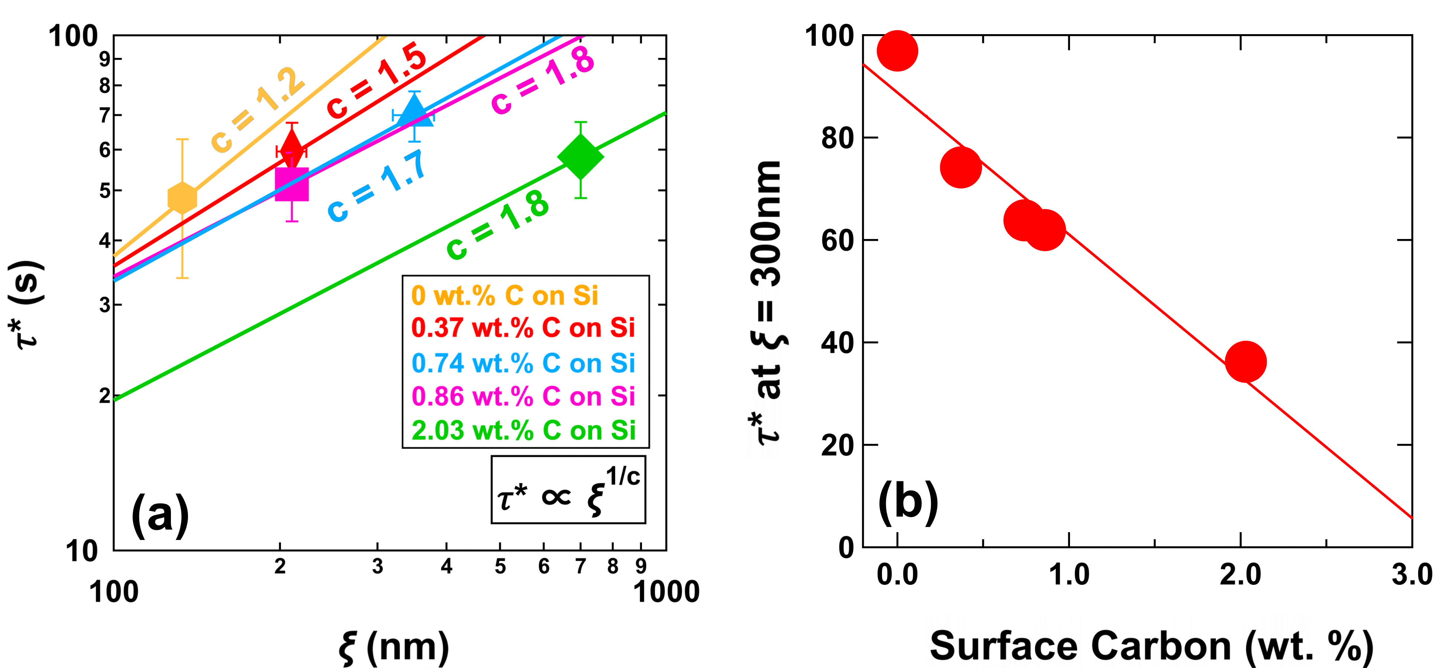
Okoli, U.; Rishi, K.; Beaucage, G.; Kammler, H. K.; McGlasson, A.; Michael, C.; Narayanan, V.; Grammens, J. Dispersion and Dynamic Response for Flame-Synthesized and Chemically Modified Pyrogenic Silica in Rubber Nanocomposites; submitted 2022. Composites Sci. & Tech.
Nanoscale control over hierarchical response
Rishi, K., Beaucage, G., Kuppa, V., Mulderig, A., Narayanan, V., McGlasson, A., Rackaitis, M. and Ilavsky, J., 2018. Impact of an emergent hierarchical filler network on nanocomposite dynamics. Macromolecules, 51(20), pp.7893-7904.
Greg Beaucage, University of Cincinnati gbeaucage@gmail.com
Notes:
Get that out of the scattering analysis and match it

Slide 27

Macroscopic network dynamics is related to nanoscale clusters through the network d_{f}
Rishi, K., Beaucage, G., Kuppa, V., Mulderig, A., Narayanan, V., McGlasson, A., Rackaitis, M. and Ilavsky, J., 2018. Impact of an emergent hierarchical filler network on nanocomposite dynamics. Macromolecules, 51(20), pp.7893-7904.

Slide 28
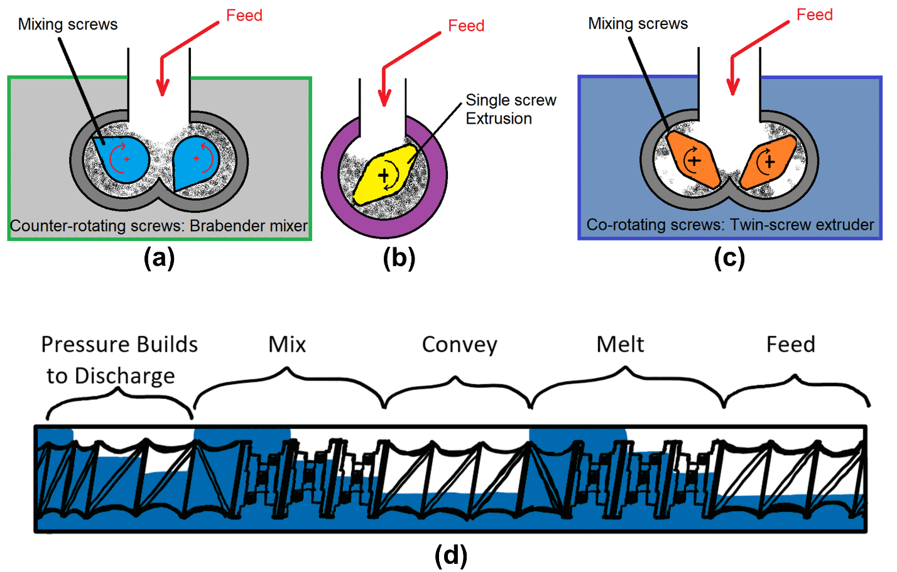
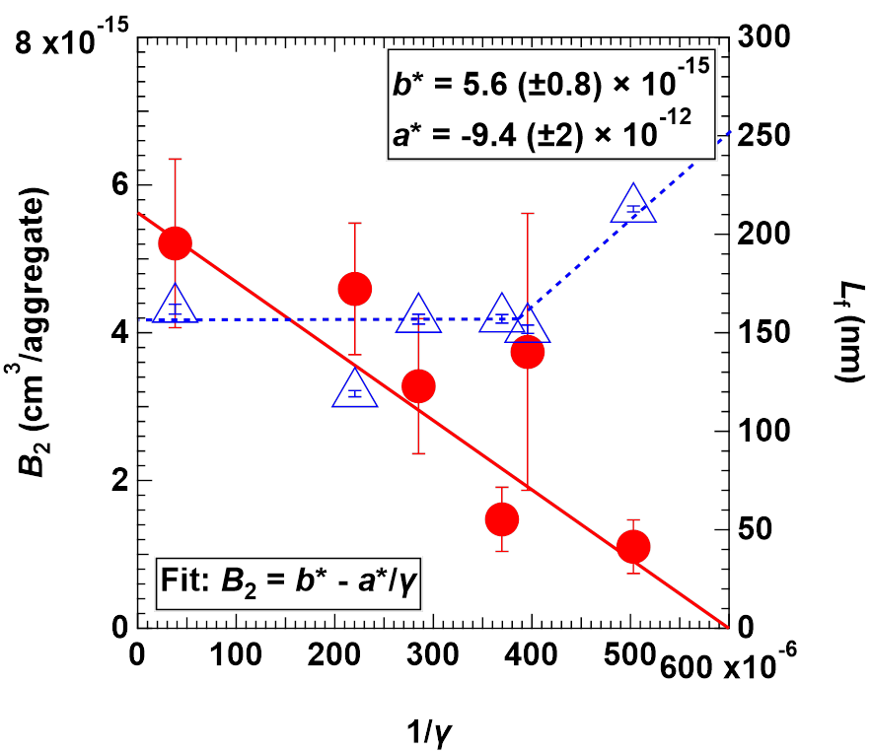
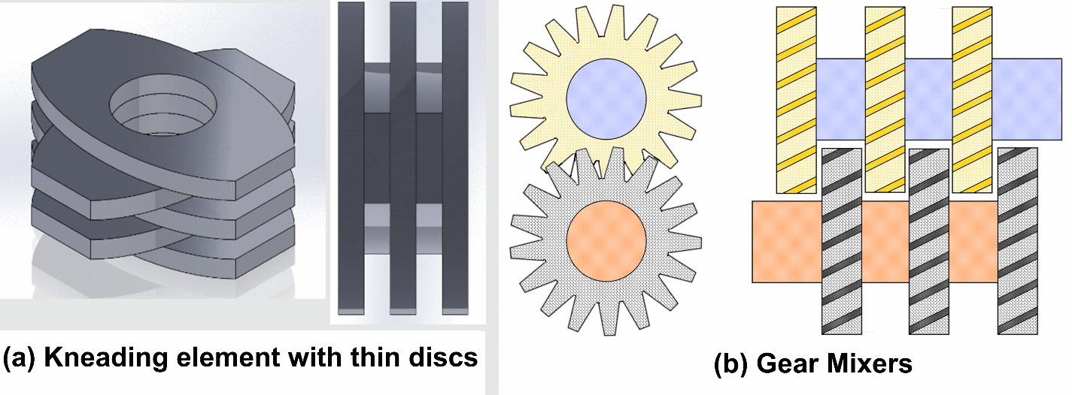
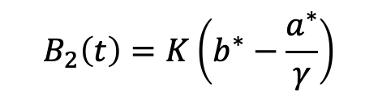
Mixing Geometry and Shear Rate => Hierarchical Emergence
$$B_{2}\left(t\right)=K\left(b^{∗}−\frac{a^{∗}}{γ}\right)$$
Carbon Black in Polystyrene
Veigel D., Rishi K., BeaucageG., Galloway J., Campanelli1 H., Ilavsky J., Kuzmenko I., Fickenscher M., Okoli U Nanocomposite dispersion in melt mixers in preparation for Polymer (2022).
Greg Beaucage, University of Cincinnati gbeaucage@gmail.com

Slide 29
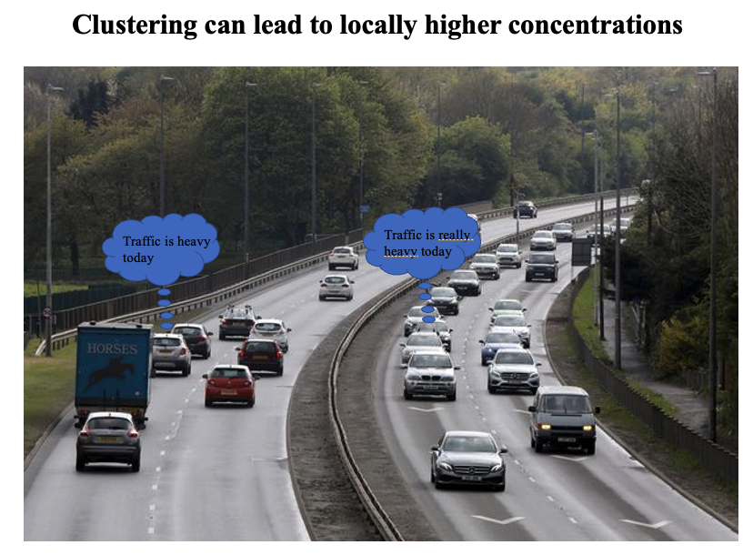
Mixing Geometry and Shear Rate => Hierarchical Emergence
Carbon Black in Polystyrene
B₂ within the cluster how are the aggregates distributed (larger is better distributed, 0 is unmixed).
L_{f} how the clusters are distributed between clusters (smaller is better distributed).
Veigel D., Rishi K., Beaucage G., Galloway J., Campanelli1 H., Ilavsky J., Kuzmenko I., Fickenscher M., Okoli U Nanocomposite dispersion in melt mixers in preparation (2022).
Greg Beaucage, University of Cincinnati gbeaucage@gmail.com

Slide 30
Nano-Maufacturing
One View of NM
Proposition: The Challenge is to Build Hierarchy
The formation of bulk network on the cm scale is dictated by the nature of clustered aggregates and the surface chemistry and particle size, and mixing kinetics
The point of particle modification is to control immiscibility and hierarchical emergence not to enhance miscibility
Hierarchical structure is associated with hierarchical dynamic response

Slide 31


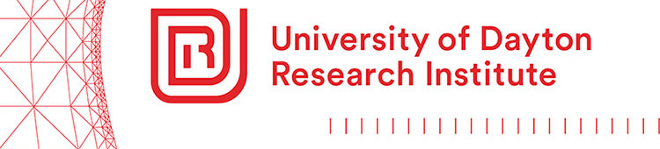




Acknowledgements
Greg Beaucage, Professor of Chemical and Materials Engineering (beaucag@uc.edu or gbeaucage@gmail.com)
Kabir Rishi, CDC/NIOSH
Department of Chemical and Materials Engineering, University of Cincinnati
Alex McGlasson (UMass), Vikram Kuppa (UDRI), Andrew Mulderig (Omya), Vishak Narayanan, Min Rackaitis (Bridgestone), Jan Ilavsky (Argonne), Karsten Vogtt, Hanqiu Jiang (CIP), Jan Jin, Jay Kim (Bridgestone), Lisa Clapp (Sun), Don Henderson (Sun), Danielle Veigel, Jeff Galloway (KraussMaffei), Hanna Campanelli
Greg Beaucage, University of Cincinnati gbeaucage@gmail.com

Slide 33
3660094 - Quantification of nano-dispersion in polymer nanocomposites: A thermodynamic analogy 03:40pm - 04:00pm USA / Canada - Eastern - March 22, 2022 | Location: Virtual 21
Gregory Beaucage, Presenter; Kabir Rishi
Division: [PMSE] Division of Polymeric Materials Science and Engineering
Session Type: Oral - Virtual
Nanoparticles in solution are characterized by colloidal thermodynamics such as the second virial coefficient and Debye charge screening. We have found that this approach can be adapted to kinetic mixing in Banbury mixers, twin screw and single screw extruders. An analogy is made between thermal dispersion and kinetic dispersion. This allows adaptation of the van der Waals model to describe nanoscale dispersion in terms of enthalpic interactions and excluded volume. Enthalpic interactions can be in the form of specific interactions that lead to correlated nanoparticles or mean field interactions that result in disordered particles. Specific Coulombic interactions display Debye screening that can result in a critical concentration where a transition between specific and mean field behavior is observed. In many situations, such as elastomer reinforcement, nano-scale dispersion is not optimal since agglomeration on the nano-scale can enable the formation of a network on macroscopic scales assocated with properties such as tear resistance.

Slide 34
Quantification of nano-dispersion in polymer nanocomposites: A thermodynamic analogy
Greg Beaucage, Professor of Chemical and Materials Engineering
Kabir Rishi, NIOSH Research Laboratory, Cincinnati Ohio
Department of Materials Science & Engineering, University of Cincinnati

Slide 35
Hierarchical emergent structure in commercial colloidal and polymeric systems
Greg Beaucage, Professor of Chemical and Materials Engineering
Kabir Rishi, CDC/NIOSH
Department of Materials Science & Engineering, University of Cincinnati
One View of NM:
Proposition: Nano-Manufacturing Involves Hierarchy, The Challenge is to Build Hierarchy
The formation of bulk network on the cm scale is dictated by the nature of clustered aggregates and the surface chemistry and particle size, and mixing kinetics
The point of particle modification is to control immiscibility and hierarchical emergence not to enhance miscibility
The hierarchical structure is associated with hierarchical dynamic response

