Slide 1
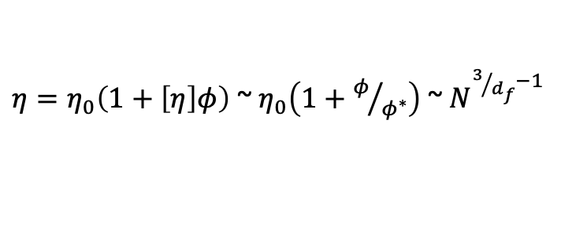

Zimm Model (Non-draining)
Zimm model predicts
D = kT/ξ = kT/(6π η_{s} b N^{1/2}) ~ N^{-1/df}
= N ξ = 6π η_{s} b N^{3/2} = 6π η_{s} b N^{3/df}
η ~ N^{3/df -1} = N^{0.5 or 0.8}
$$\left\langle r^{2}\right\rangle =2Dt$$
$η=η_{0}\left(1+\left[η\right]φ\right)$ ~ $η_{0}\left(1+φ/{φ^{∗}}\right)$ ~ $N^{3/{d_{f}}−1}$

Slide 2
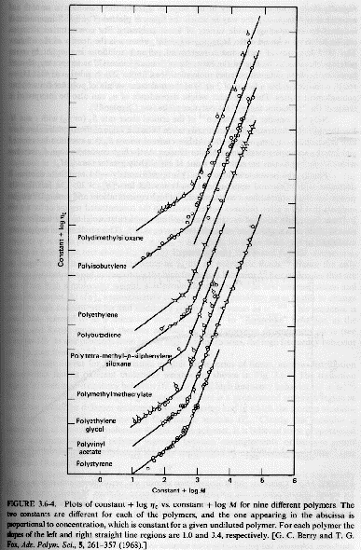
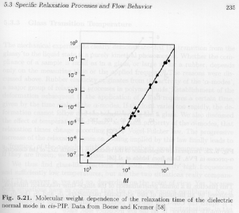
Rouse Model
Dilute Solution Chain
Dynamics of the chain
Rouse Motion
Rouse model predicts relaxation time follows N²
D = kT/ξ = kTN/τ follows D ~ kT/N
Predicts that the viscosity will follow N which is true for low molecular weights in the melt and for fully draining polymers in solution

Slide 3
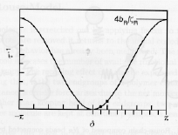

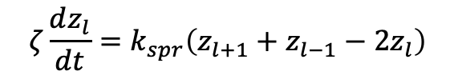
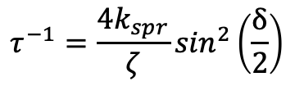
Rouse Model
$$ζ\frac{dz_{l}}{dt}=k_{spr}\left(z_{l+1}+z_{l−1}−2z_{l}\right)$$
Debye used ma for heat capacity
For L = ∞ You have a wave solution with no modes for δ
$z_{l}\sim e^{−\frac{t}{τ}}$ $e^{ilδ}$
Debye gets ω = (k/m)^{1/2}
τ is the relaxation time ζ/k_{spr}
δ is the phase shift between beads
There are four unknowns and two equations; z, t, τ , δ
So, we can solve for a relationship between τ and δ
$$τ^{−1}=\frac{4k_{spr}}{ζ}\sin^{2}\left(\frac{δ}{2}\right)$$

Slide 4
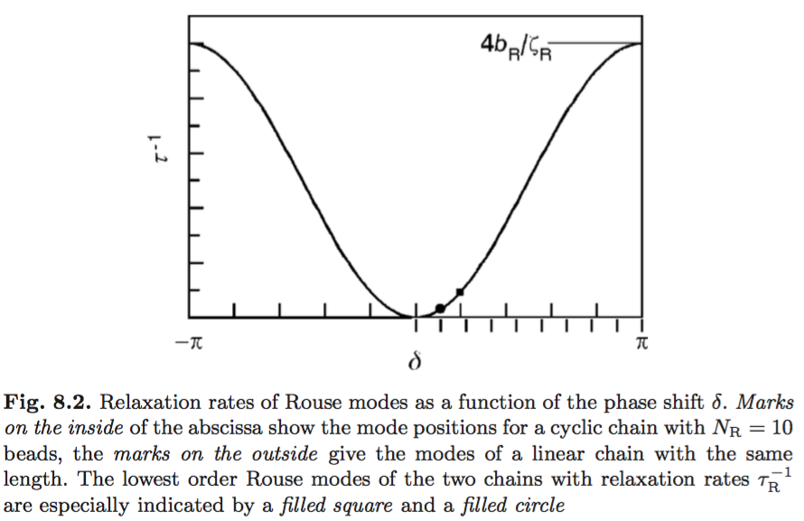
Cyclic Boundary Conditions:
For N_{R} = 10
NR values of phase shift

Slide 5
Free End Boundary Conditions:
For N_{R} = 10
NR values of phase shift
NR Rouse Modes of order “m”

Slide 6
The amplitude of the Rouse modes is given by:
The amplitude is independent of temperature because the free energy of a mode is proportional to kT and the modes are distributed by Boltzmann statistics
90% of the total mean-square end to end distance of the chain originates from the lowest order Rouse-modes so the chain can be often represented as an elastic dumbbell

Slide 7
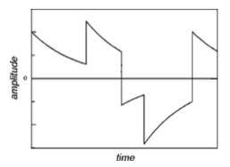
Rouse dynamics
(like a dumbell response)
Dumbbell
Rouse

Slide 8

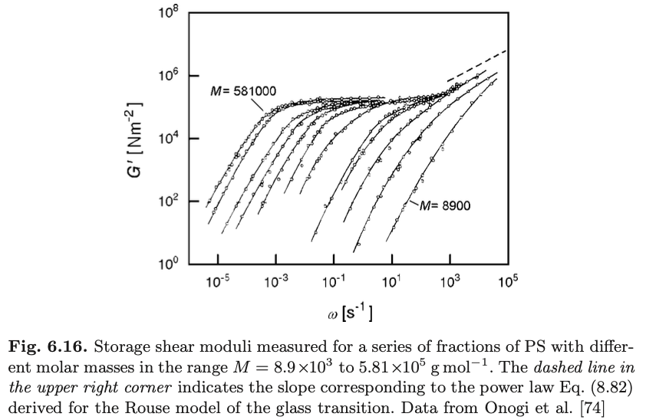

Slide 9

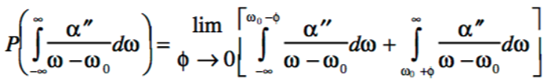
Some rules and approaches for complex constitutive parameters
Cox-Merz Rule time measurements are equivalent to frequency measurements. Complex viscosity and steady shear viscosity are equivalent measurements.
Kramers-Kronig Relation
Since there is a response function, μ(t), from which all mechanical responses can be calculated, then the loss and storage moduli are related to each other through the Cauchy integral, P().

Slide 10
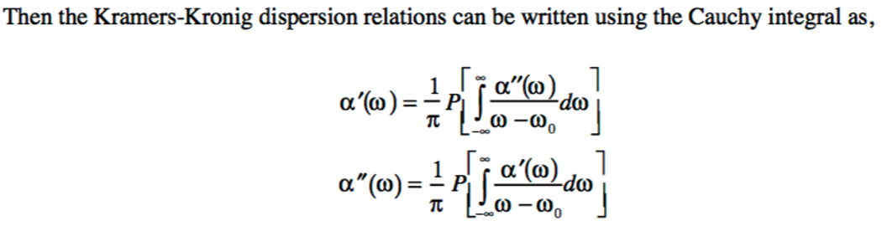

Slide 12
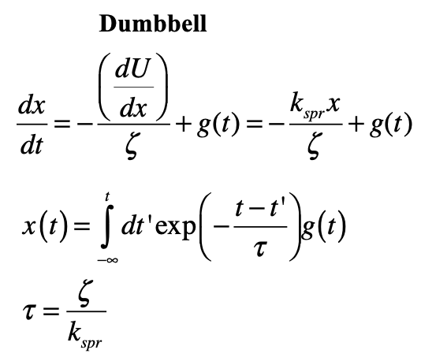
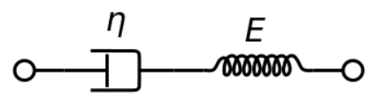
Consider the creep compliance, J(t) because it is easier to model.
(Stress relaxation is easier to measure, G(t).)
Maxwell Model or Simple relaxor or Dumbell Model

Slide 13
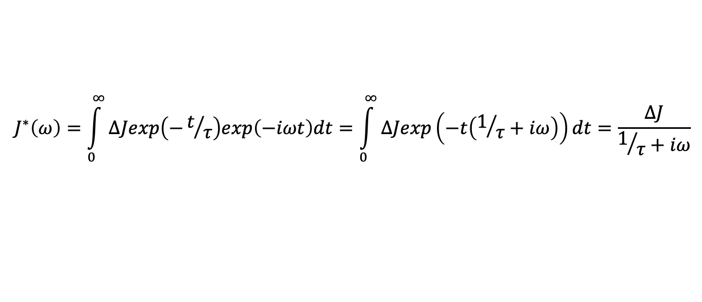
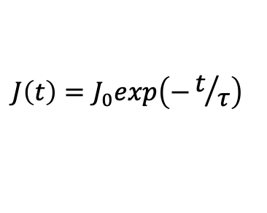
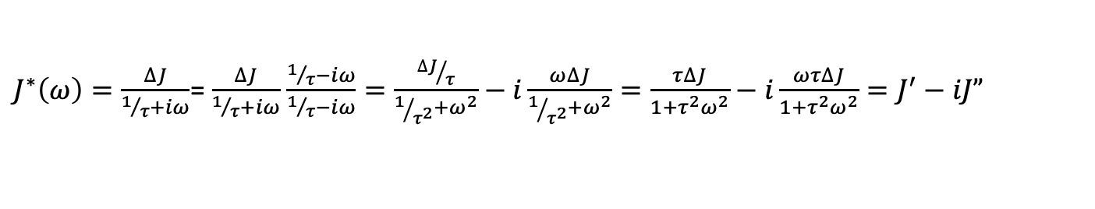
Debye Single Relaxation time “Relaxor”
$$J\left(t\right)=J_{0}exp\left(−t/τ\right)$$
For an oscillatory strain
$$J^{∗}\left(ω\right)=\int_{0}^{∞}{∆Jexp\left(−t/τ\right)exp\left(−iωt\right)dt=\int_{0}^{∞}{∆Jexp\left(−t\left(1/τ+iω\right)\right)dt=\frac{∆J}{1/τ+iω}}}$$
$J^{∗}\left(ω\right)=\frac{∆J}{1/τ+iω}$= $\frac{∆J}{1/τ+iω}$ $\frac{1/τ−iω}{1/τ−iω}=\frac{{∆J}/τ}{1/{τ^{2}}+ω^{2}}−i\frac{ω∆J}{1/{τ^{2}}+ω^{2}}=\frac{τ∆J}{1+{τ^{2}ω}^{2}}−i\frac{ωτ∆J}{1+{τ^{2}ω}^{2}}=J^{′}−iJ”$

Slide 14
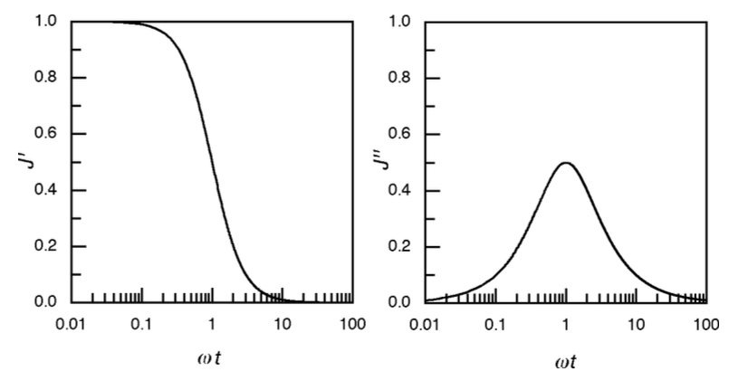
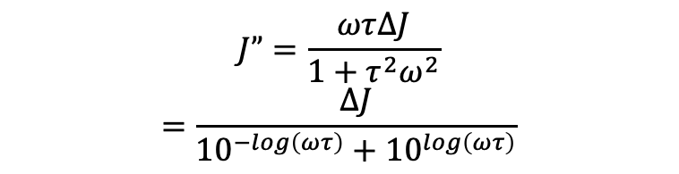
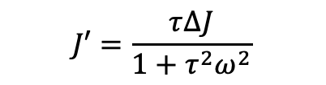
Maxwell Model
$$J^{∗}\left(ω\right)=\frac{τ∆J}{1+{τ^{2}ω}^{2}}−i\frac{ωτ∆J}{1+{τ^{2}ω}^{2}}=J^{′}−iJ”$$
$$J”=\frac{ωτ∆J}{1+{τ^{2}ω}^{2}}$$
$$=\frac{∆J}{{10}^{−log\left(ωτ\right)}+{10}^{log\left(ωτ\right)}}$$
$$J′=\frac{τ∆J}{1+{τ^{2}ω}^{2}}$$

Slide 15
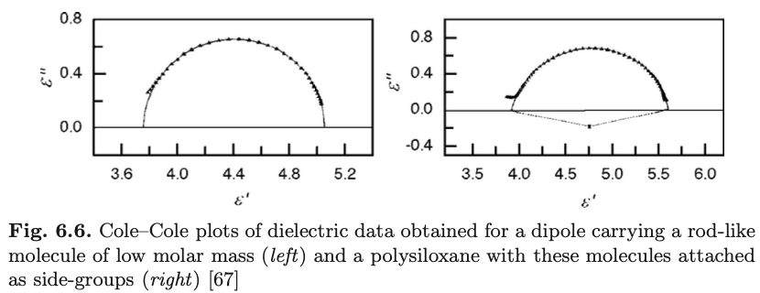
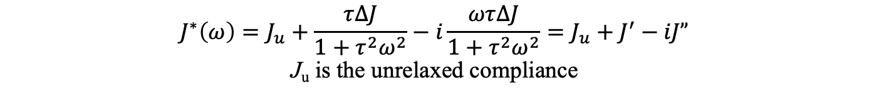
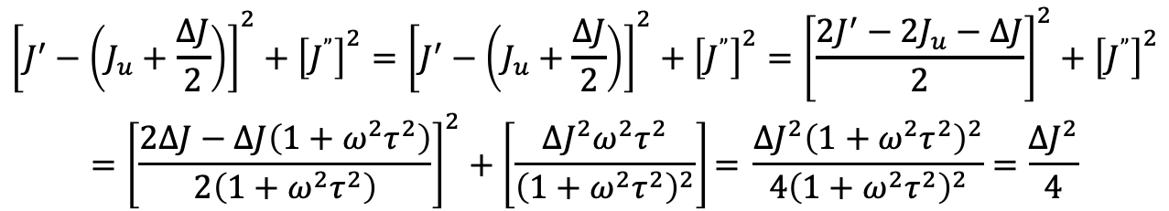
Cole-Cole Plot as an indication of a simple Debye relaxor
$$J^{∗}\left(ω\right)=J_{u}+\frac{τ∆J}{1+{τ^{2}ω}^{2}}−i\frac{ωτ∆J}{1+{τ^{2}ω}^{2}}=J_{u}+J^{′}−iJ”$$
J_{u} is the unrelaxed compliance
$$\begin{aligned}{\left[J^{′}−\left(J_{u}+\frac{∆J}{2}\right)\right]}^{2}+{\left[J^{”}\right]}^{2}={\left[J^{′}−\left(J_{u}+\frac{∆J}{2}\right)\right]}^{2}+{\left[J^{”}\right]}^{2}={\left[\frac{2J^{′}−2J_{u}−∆J}{2}\right]}^{2}+{\left[J^{”}\right]}^{2} \\ ={\left[\frac{2∆J−∆J\left(1+ω^{2}τ^{2}\right)}{2\left(1+ω^{2}τ^{2}\right)}\right]}^{2}+\left[\frac{{∆J}^{2}ω^{2}τ^{2}}{{\left(1+ω^{2}τ^{2}\right)}^{2}}\right]\text{=} \frac{{∆J}^{2}{\left(1+ω^{2}τ^{2}\right)}^{2}}{4{\left(1+ω^{2}τ^{2}\right)}^{2}}=\frac{{∆J}^{2}}{4}\end{aligned}$$
(x-a)² + (y-b)² = r²

Slide 16
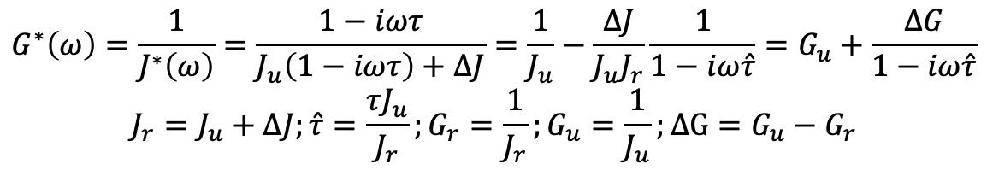
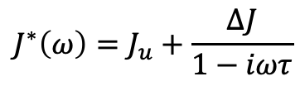
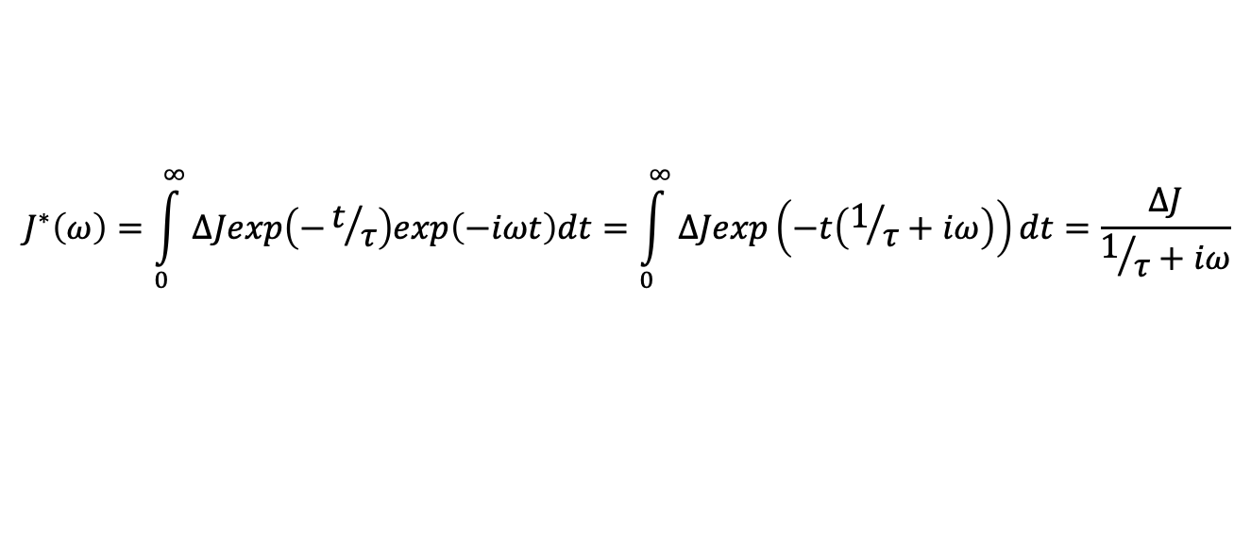
Shear compliance, J*(ω), easy to calculate. Shear modulus, G*(ω), easy to measure.
$$J^{∗}\left(ω\right)=J_{u}+\frac{∆J}{1−iωτ}$$
$$G^{∗}\left(ω\right)=\frac{1}{J^{∗}\left(ω\right)}=\frac{1−iωτ}{J_{u}\left(1−iωτ\right)+∆J}=\frac{1}{J_{u}}−\frac{∆J}{J_{u}J_{r}}\frac{1}{1−iω\hat{τ}}=G_{u}+\frac{∆G}{1−iω\hat{τ}}$$
$$J_{r}=J_{u}+∆J;\hat{τ}=\frac{τJ_{u}}{J_{r}};G_{r}=\frac{1}{J_{r}};G_{u}=\frac{1}{J_{u}};∆G=G_{u}−G_{r}$$
$$J^{∗}\left(ω\right)=\int_{0}^{∞}{∆Jexp\left(−t/τ\right)exp\left(−iωt\right)dt=\int_{0}^{∞}{∆Jexp\left(−t\left(1/τ+iω\right)\right)dt=\frac{∆J}{1/τ+iω}}}$$

Slide 17
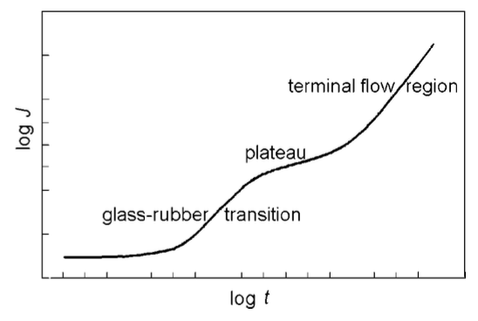

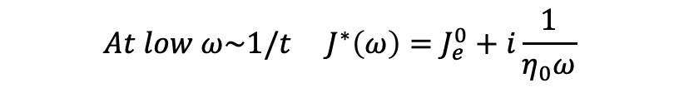
In the terminal flow regime
At long times, the Maxwell element is just viscous
$$γ\left(t\right)=J\left(t\right)τ_{0} τ\left(t\right)=G\left(t\right)γ_{0}$$
$$τ=η_{0}\frac{dγ}{dt}={τ_{0}η}_{0}\frac{dJ\left(t\right)}{dt} \frac{dJ\left(t\right)}{dt}=\frac{1}{η_{0}} slope is\frac{1}{η_{0}} at long times$$
In the terminal flow regime for the dynamic compliance
$${At low ω\sim 1/t J}^{∗}\left(ω\right)=J_{e}^{0}+i\frac{1}{η_{0}ω}$$

Slide 18
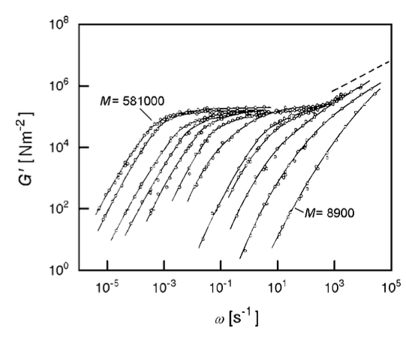
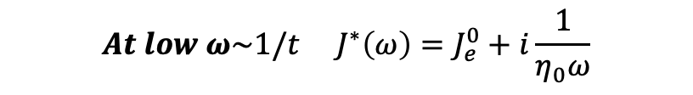
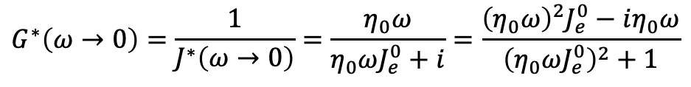
In the terminal flow regime/low frequency regime
In the terminal flow regime for the dynamic compliance
$${At low ω\sim 1/t J}^{∗}\left(ω\right)=J_{e}^{0}+i\frac{1}{η_{0}ω}$$
$$G^{∗}\left(ω→0\right)=\frac{1}{J^{∗}\left(ω→0\right)}=\frac{η_{0}ω}{η_{0}ωJ_{e}^{0}+i}=\frac{{\left(η_{0}ω\right)}^{2}J_{e}^{0}−iη_{0}ω}{{\left(η_{0}ωJ_{e}^{0}\right)}^{2}+1}$$
$$G^{′}\left(ω→0\right)={\left(η_{0}ω\right)}^{2}J_{e}^{0}{ G}^{”}\left(ω→0\right)=η_{0}ω$$

Slide 19
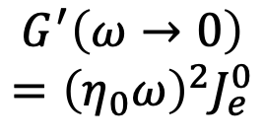
Rouse
Newtonian
$$G^{′}\left(ω→0\right)$$
$$={\left(η_{0}ω\right)}^{2}J_{e}^{0}$$

Slide 20
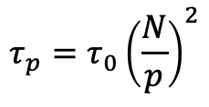
Rouse
Modulus has units of energy per volume, MPa
Each mode of vibration, p, in the Rouse Model has
$$τ_{p}=τ_{0}{\left(\frac{N}{p}\right)}^{2}$$
Larger p modes have smaller τ_{p} so larger p modes are relaxed when t = τ_{p}
When t = τ_{p} there are p unrelaxed modes composed of segments with kT energy
Each of these segments have N/p monomers of volume b³
For a volume fraction of monomers of φ, the number of unrelaxed segments per volume is φ/(b³N/p)
So, the storage modulus is G(τ_{p}) ~ kT (φ/(b³N/p)
We know that τ_{p} = τ₀ (N/p)² so p ~ (τ₀/τ_{p})^{1/2}N and
G(τ_{p}) ~ kT (φ/(b³N/p) = (kT/b³)φ(τ_{p}/τ₀)^{-1/2} and for time t = τ_{p} G(t) ~ (kT/b³)φ(t/τ₀)^{-1/2}
G’(ω) ~ (kT/b³)φ(ωτ₀)^{1/2} ~ (kT/b³)φ(ωη₀)^{1/2}
For τ₀ < t < τ_{R}
G(t) ~ (kT/b³)φ(t/τ₀)^{-1/2} exp(-t/τ_{R})
For τ₀ < t

Slide 21
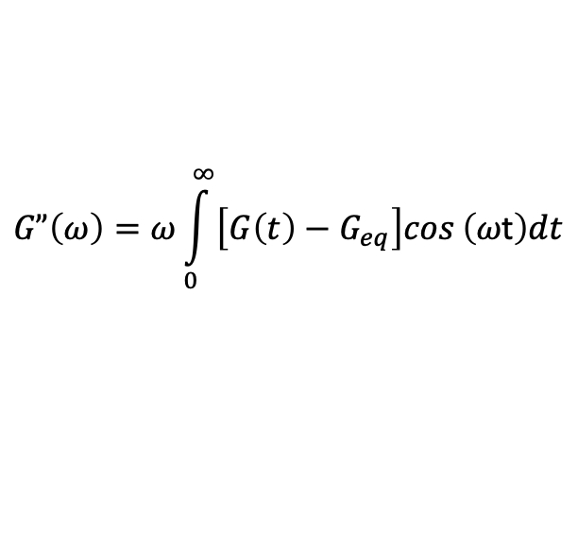
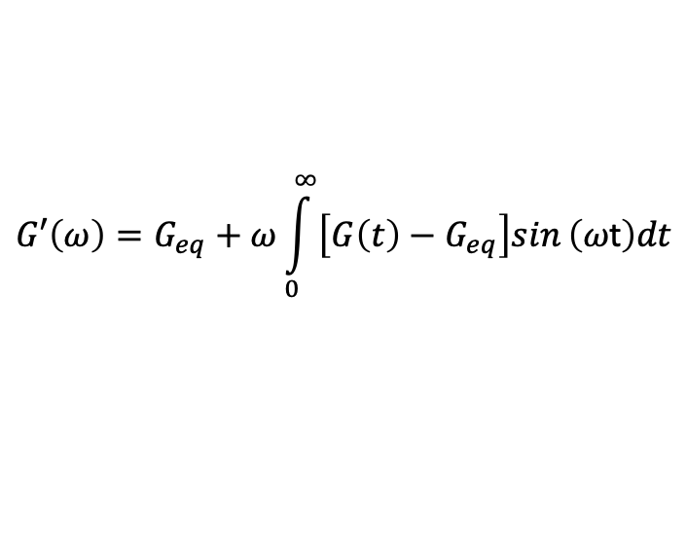
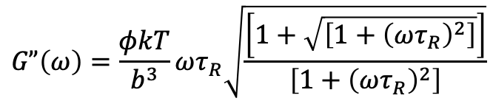
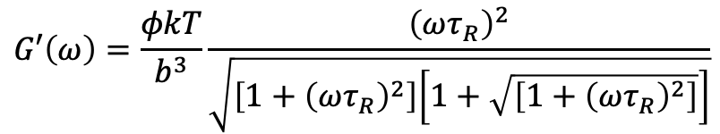
Rouse
G(t) ~ (kT/b³)φ(t/τ₀)^{-1/2} exp(-t/τ_{R})
For τ₀ < t
$$G′\left(ω\right)=G_{eq}+ω\int_{0}^{∞}{\left[G\left(t\right)−G_{eq}\right]sin}\left(ω\text{t}\right)dt$$
$$G”\left(ω\right)=ω\int_{0}^{∞}{\left[G\left(t\right)−G_{eq}\right]cos}\left(ω\text{t}\right)dt$$
$$G′\left(ω\right)=\frac{φkT}{b^{3}}\frac{{\left(ωτ_{R}\right)}^{2}}{\sqrt{\left[1+{\left(ωτ_{R}\right)}^{2}\right]\left[1+\sqrt{\left[1+{\left(ωτ_{R}\right)}^{2}\right]}\right]}}$$
For ω < 1/τ₀
$$G”\left(ω\right)=\frac{φkT}{b^{3}}ωτ_{R}\sqrt{\frac{\left[1+\sqrt{\left[1+{\left(ωτ_{R}\right)}^{2}\right]}\right]}{\left[1+{\left(ωτ_{R}\right)}^{2}\right]}}$$

Slide 22
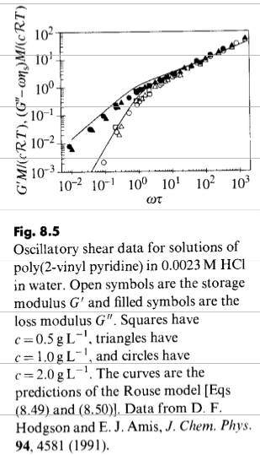
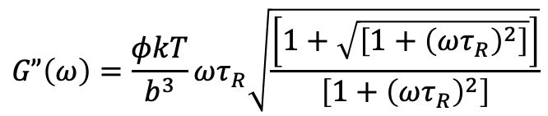

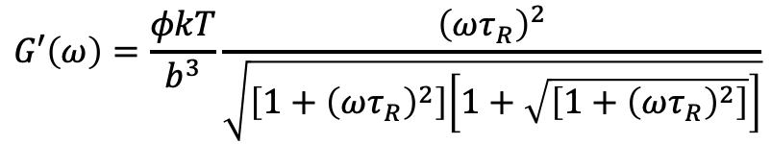
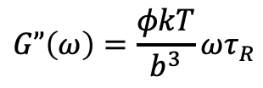
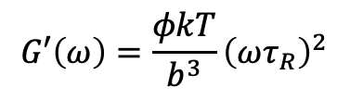
Rouse
$$G′\left(ω\right)=\frac{φkT}{b^{3}}\frac{{\left(ωτ_{R}\right)}^{2}}{\sqrt{\left[1+{\left(ωτ_{R}\right)}^{2}\right]\left[1+\sqrt{\left[1+{\left(ωτ_{R}\right)}^{2}\right]}\right]}}$$
$$G”\left(ω\right)=\frac{φkT}{b^{3}}ωτ_{R}\sqrt{\frac{\left[1+\sqrt{\left[1+{\left(ωτ_{R}\right)}^{2}\right]}\right]}{\left[1+{\left(ωτ_{R}\right)}^{2}\right]}}$$
For ωτ_{R} << 1, low frequency Normal Viscoelastic Fluid
$$G′\left(ω\right)=\frac{φkT}{b^{3}}{\left(ωτ_{R}\right)}^{2}$$
$$G”\left(ω\right)=\frac{φkT}{b^{3}}ωτ_{R}$$
kT per monomer
For 1/τ_{R} << ω << 1/τ₀, Rouse Range, Fluid acts like a gel (Winter-Chambon)
(Solution in the limit τ_{R}ω >> 1)
$$G^{′}\left(ω\right)=G^{”}\left(ω\right){ \sim \left(ω\right)}^{1/2}$$

Slide 23
For 1/τ₀ << ω, High Frequency limit
No relaxation modes,
G’(ω ) = kT φ/b³
High-frequency saturation of G’
G” (ω ) ~ ω
This is Solid Behavior

Slide 24
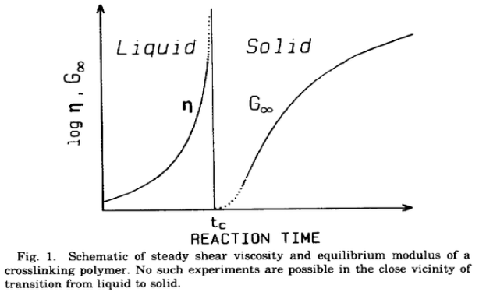
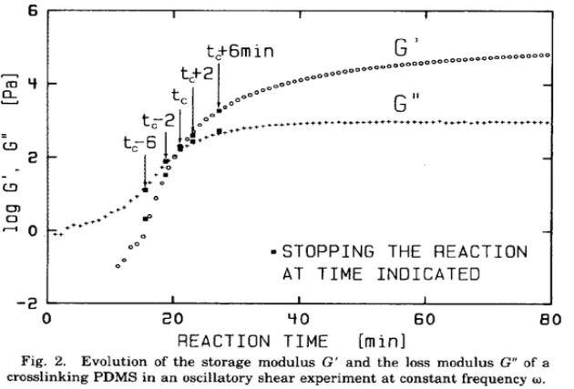
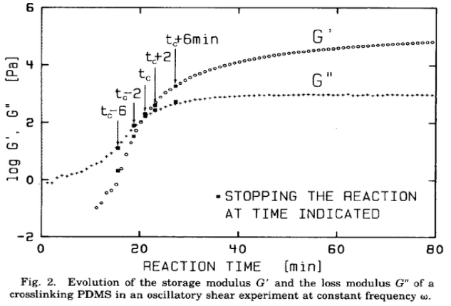
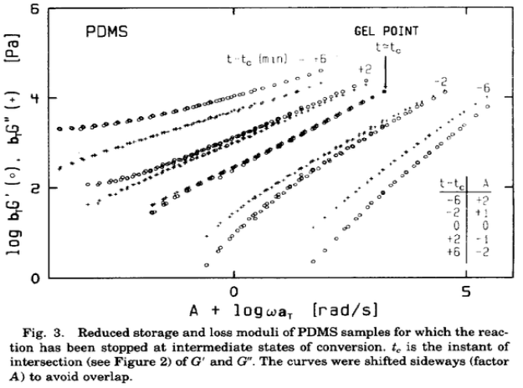
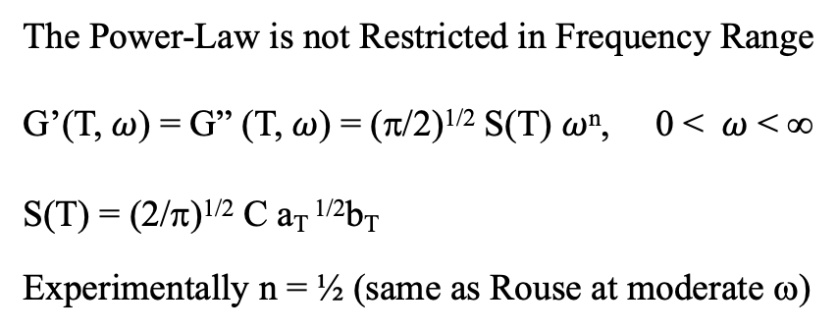
Winter HH, Chambon F, Analysis of Linear Viscoelasticity of a Crosslinking Polymer at the Gel Point J. Rheo. 30 367-382 (1986).
The Power-Law is not Restricted in Frequency Range
G’(T, $ω$) = G” (T, $ω$) = (π/2)^{1/2} S(T) $ω$^{n}, 0 < $ω$ < ∞
S(T) = (2/π)^{1/2} C a_{T} ^{1/2}b_{T}
Experimentally n = ½ (same as Rouse at moderate ω)

Slide 25
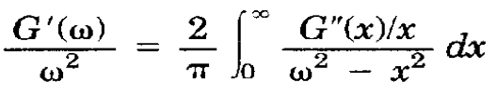
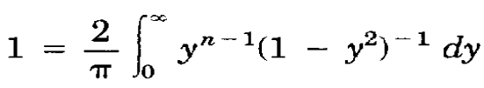
Winter HH, Chambon F, Analysis of Linear Viscoelasticity of a Crosslinking Polymer at the Gel Point J. Rheo. 30 367-382 (1986).
Kramers and Kronig relationship must be followed for this equation
Solve for n (only positive values are physical)

Slide 27
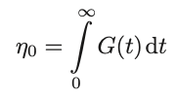

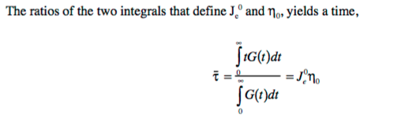


Slide 28

Newtonian
Flow
Entanglement
Reptation
Rouse
Behavior

Slide 30







Reptation
-One-dimensional diffusion along the tube
-Relaxation time, τ_{reptation}, is the time for the chain to diffuse a distance L ~ N by Rouse diffusion, D₀ ~ 1/N
$$\frac{dP}{dt}=D_{0}\frac{d^{2}P}{ds^{2}} Fick^{′}s 2^{′}nd Law in 1−d$$
$$P\left(s,t\right)=\frac{1}{{\left(4πD_{0}t\right)}^{1/2}}e^{{−s^{2}}/{4D_{0}t}}$$
$$\left\langle s^{2}\right\rangle =\int_{−∞}^{∞}{s^{2}}P\left(s,t\right)ds=2D_{0}t$$
$$τ_{rep}=\frac{L^{2}}{2D_{0}}\sim \frac{N^{2}}{N^{−1}}\sim N^{3}$$
Compare: τ_{Rouse} ~ N²
$$D_{rep}=\frac{\left\langle R^{2}\right\rangle }{6τ_{rep}}\sim \frac{N}{N^{3}}\sim N^{−2}$$
Compare: D_{Rouse} ~ $N^{−1}$

Slide 31




Reptation
-Consider a Maxwell model for the fluid
$$τ_{rep}=\frac{η_{rep}}{G_{0}}$$
Where G₀ is the plateau modulus, G₀ ~ 3kT/M_{e}
$$η_{rep}\sim G_{0}τ_{rep}\sim \left(\text{3}\text{kT}\text{/}\text{Me}\right)N^{3}$$
Experimental shows N^{3.4} due to tube renewal

Slide 32
Stress Relaxation Modulus for Reptation
τ_{e} = τ₀N_{e}²
Follows Rouse Relaxation
G(t) ~ G₀(t/τ₀)^{-1/2}
For τ₀ < t < τ_{e}

Slide 34


Normal Stress and Recoverable Shear Compliance

Slide 35


Slide 37





Relaxation Spectrum (Ströbl (2007) p. 242-245)
If there are multiple relaxations like x(t) = x₀ exp-(t/τ)
Each with an amplitude ΔJ_{l} and a relaxation time τ_{l}.
In integral form. Here we use ln τ as the argument since each relaxation is of exponential form.
The modulus function has a similar form but dramatically different values for τ.

Slide 38

Relaxation Spectrum (Ströbl (2007) p. 242-245)
d lnτ = dτ/τ
Then the functional dependence of interest is:
τH_{G}(τ) vs. τ
That is why we see plots like:
Qiao H, Zheng B, Zhong G, Li Z, Cardinaels R, Moldenaers P, Lamnawar K, Maazouz A, Liu C, Zhang H Understanding the Rheology of Polymer-Polymer Interfaces Covered with Janus Nanoparticles: Polymer Blends versus Particle Sandwiched Multilayers Macromolecules 56 647- 663 (2023)

Slide 40
Newtonian
Flow
Entanglement
Reptation
Rouse
Behavior

