Slide 1
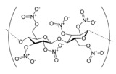
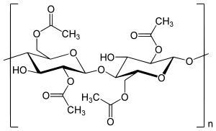
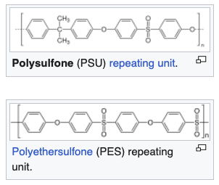
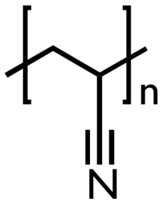
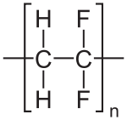
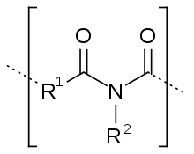

Polymer Membranes
Microfiltration: filtering particles in the range of 10 μm to 100 nm
Ultrafiltration: filtering particles and molecules in the range of 100 to 10 nm
Porous Membranes
Derivatized cellulose: Nitrocellulose or cellulose acetate
Chemical and thermal stability polysulfones, polyacrylonitrile, or poly(vinylidene fluoride)
Dense Membranes
Desalination of seawater by reverse osmosis and
separation of gases
oxygen enrichment in air,
purification of natural gas,
separation of carbon dioxide or hydrogen from various gas streams
Separation of olefins from paraffins (cryogenic separation by distillation of ethylene from ethane)
Separation of biomacromolecules, such as mixtures of similar-sized proteins
polyimides, polybenzimidazoles, and polysulfones
Problems with porous membranes: fouling and scaling aging (densification with time),
or compaction (densification caused by large transmembrane pressure)

Slide 2
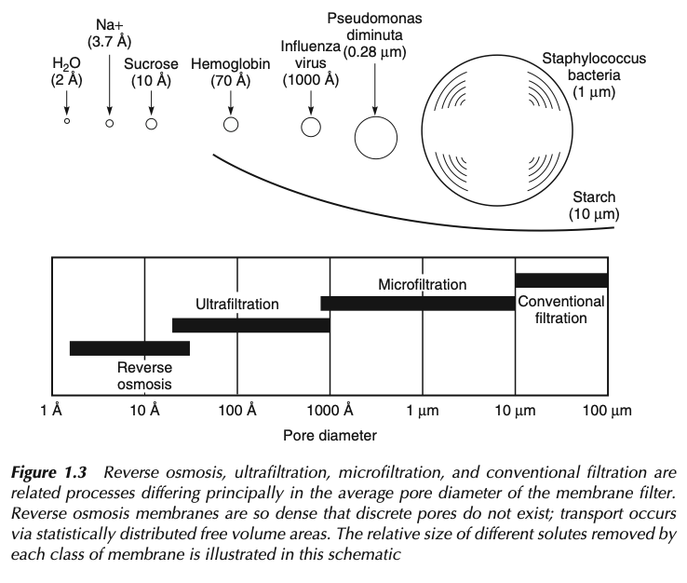
Polymer Membranes

Slide 3
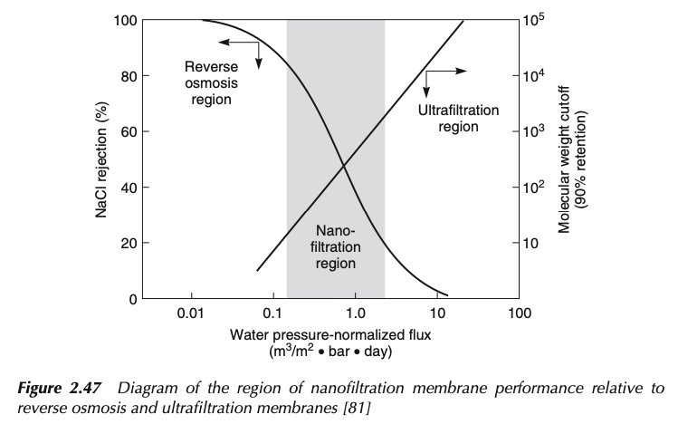
Polymer Membranes

Slide 4
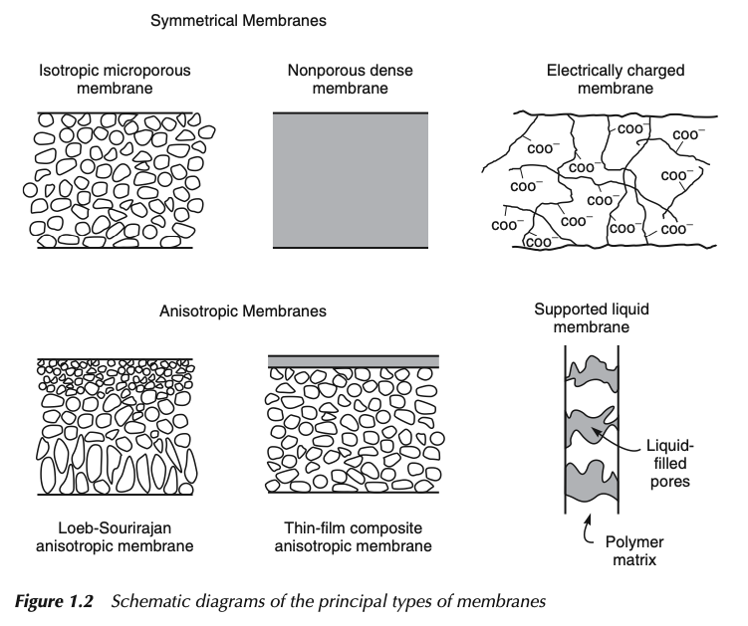
Polymer Membranes

Slide 5
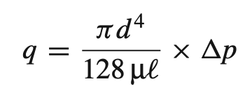
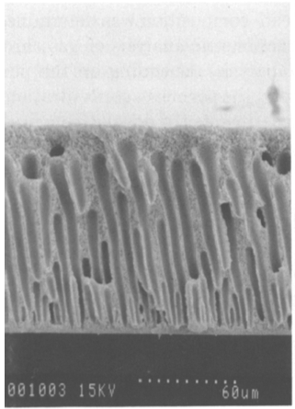
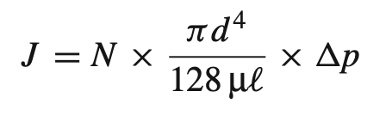
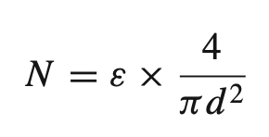
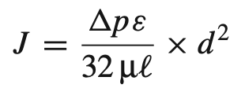
Poiseuille’s Law
Number per cm²
Porosity

Slide 6
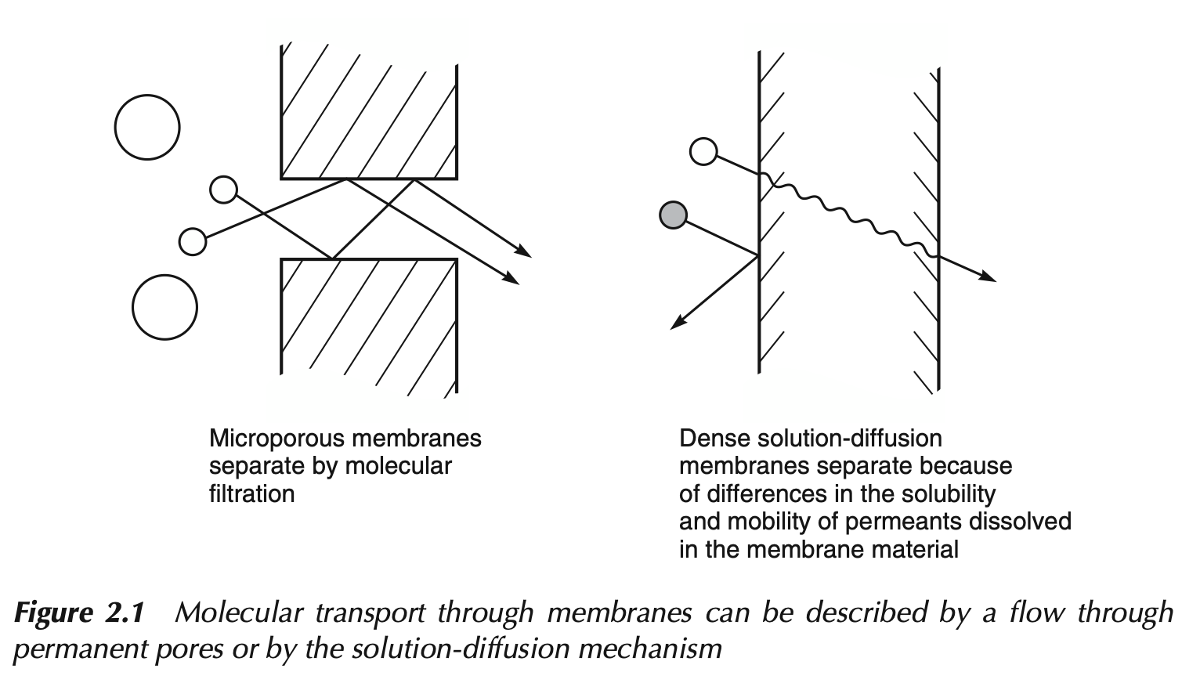

Slide 7
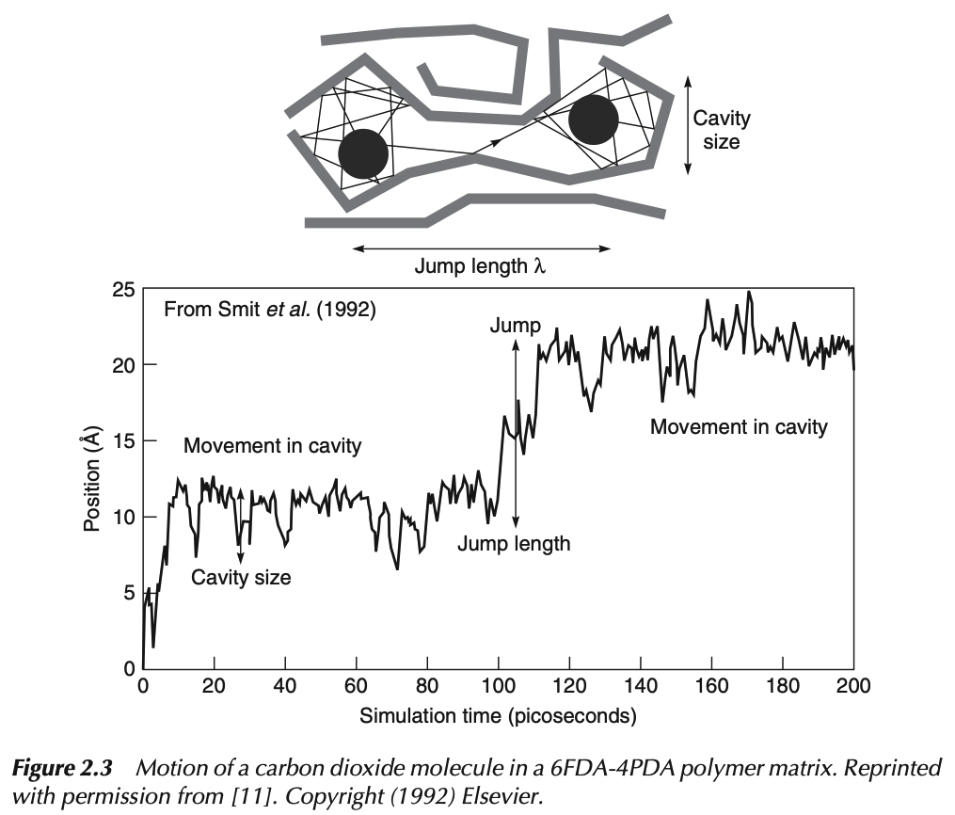
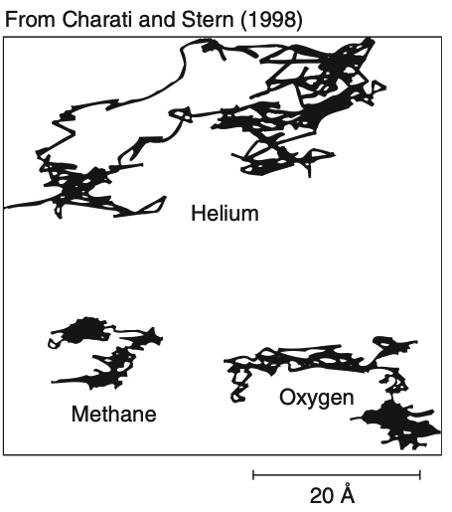

Slide 8




For Transport by Potential Gradient
Coefficient of proportionality
Incompressible
Ideal gas

Slide 9
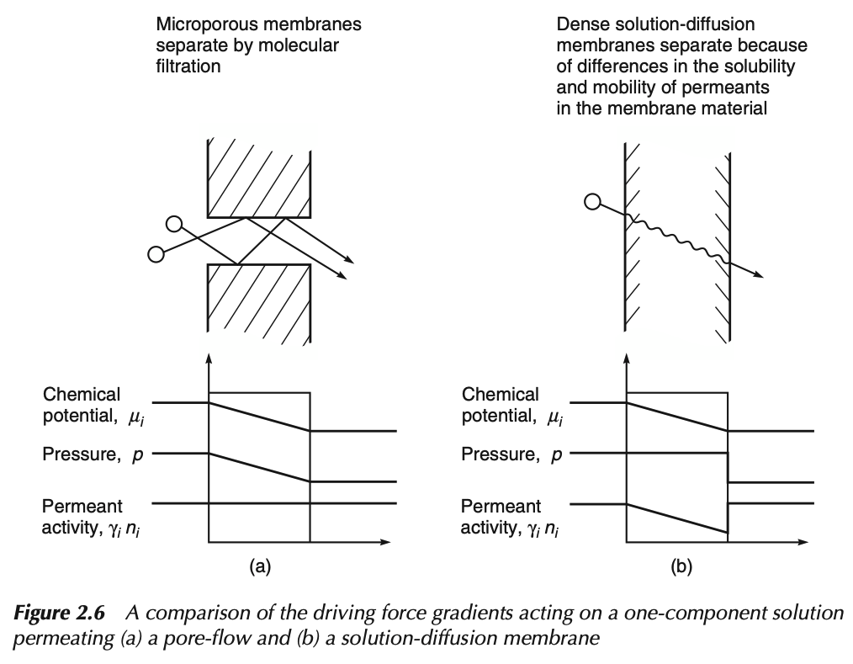

Slide 10



With no concentration gradient Darcy’s Law
Incompressible
With no Pressure gradient Fick’s Law

Slide 11
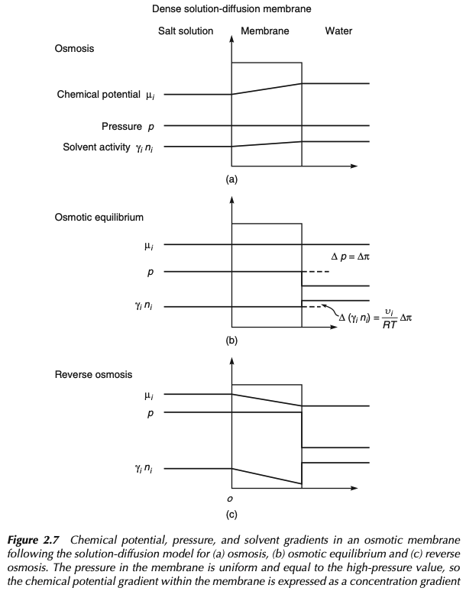

Slide 12
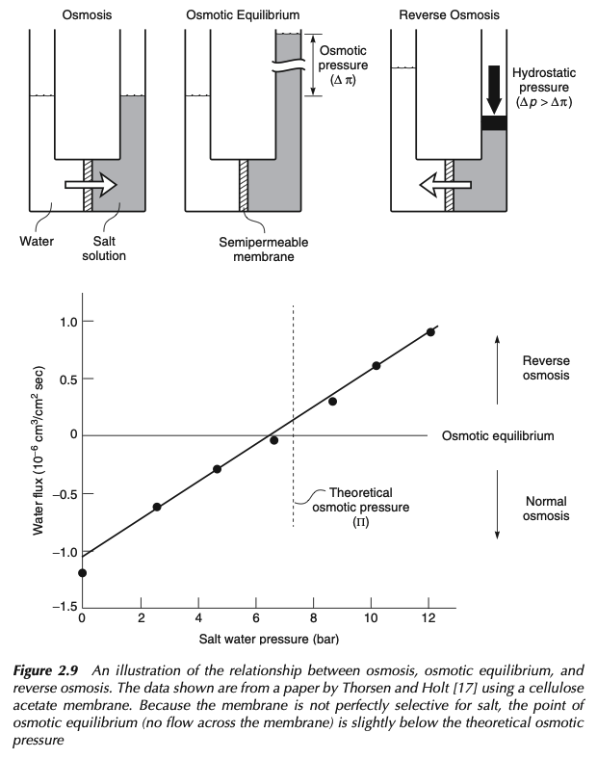

Slide 13
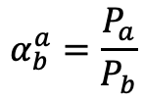
Gas Separation Polymer Membranes
Membrane Flux
Membrane Selectivity
Q_{a} = P_{a} A Δp_{a}/l
$$α_{b}^{a}=\frac{P_{a}}{P_{b}}$$
Q_{a} steady-state flux
P_{a} permeability coefficient for gas ”a”
P_{a} = S_{a} D_{a}
S_{a} Solubility Coefficient (at high pressure and/or concentration interface)
D_{a} Diffusion Coefficient
(desorption at low pressure and/or concentration interface)
A surface area
Δp_{a} differential partial pressure
l membrane thickness
Assumption of Fickian diffusion of dissolved gas
Isotropic dense polymer membrane
Goal: high flux of gas “a” with low flux of gas “b”

Slide 14
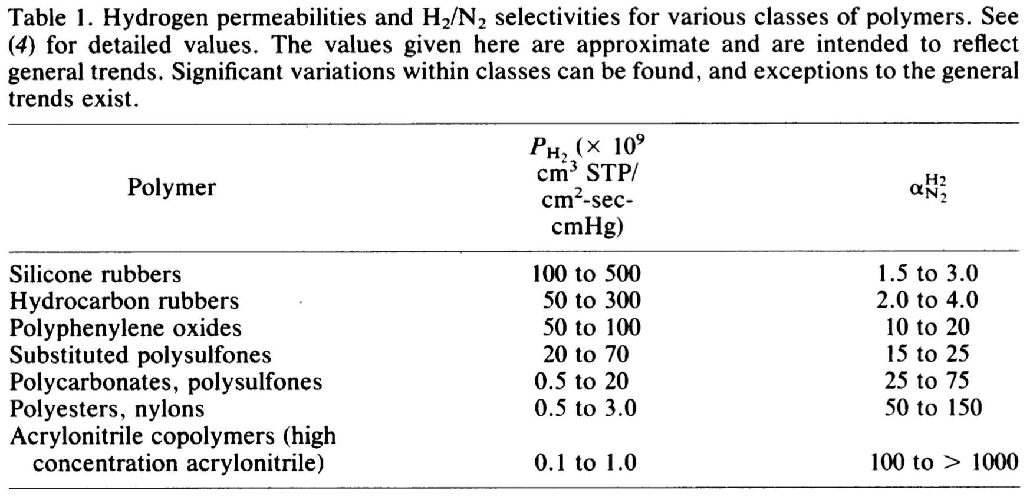
Gas Separation Polymer Membranes
Membrane Flux
Membrane Selectivity
Q_{a} = P_{a} A Δp_{a}/l
$$α_{b}^{a}=\frac{P_{a}}{P_{b}}$$

Slide 15
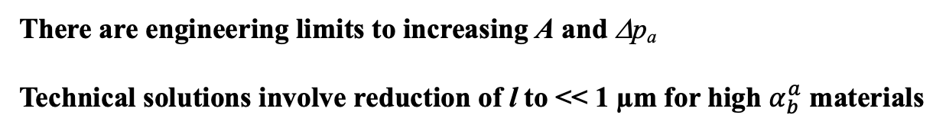
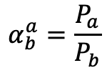
Gas Separation Polymer Membranes
Membrane Flux
Membrane Selectivity
Q_{a} = P_{a} A Δp_{a}/l
$$α_{b}^{a}=\frac{P_{a}}{P_{b}}$$
There are engineering limits to increasing A and Δp_{a}
Technical solutions involve reduction of l to << 1 µm for high $α_{b}^{a}$ materials

Slide 16
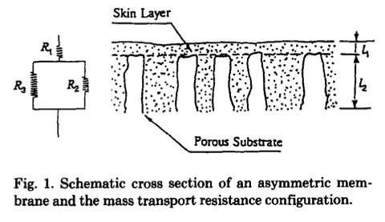
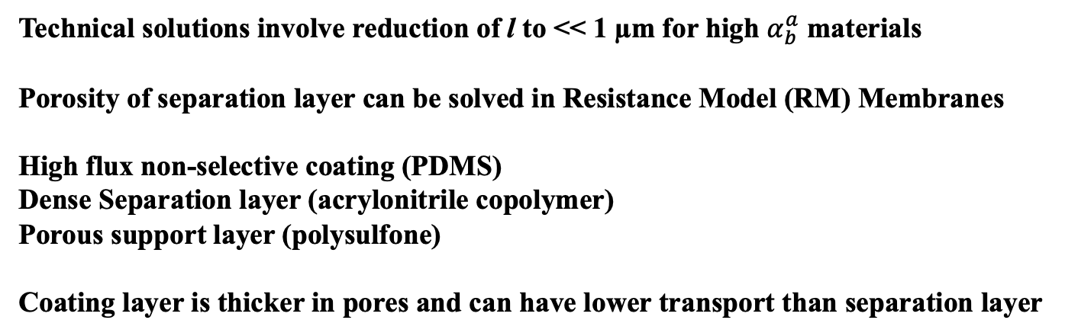
Gas Separation Polymer Membranes
Membrane Flux
Membrane Selectivity
Q_{a} = P_{a} A Δp_{a}/l
$$α_{b}^{a}=\frac{P_{a}}{P_{b}}$$
Technical solutions involve reduction of l to << 1 µm for high $α_{b}^{a}$ materials
Porosity of separation layer can be solved in Resistance Model (RM) Membranes
High flux non-selective coating (PDMS)
Dense Separation layer (acrylonitrile copolymer)
Porous support layer (polysulfone)
Coating layer is thicker in pores and can have lower transport than separation layer

Slide 17
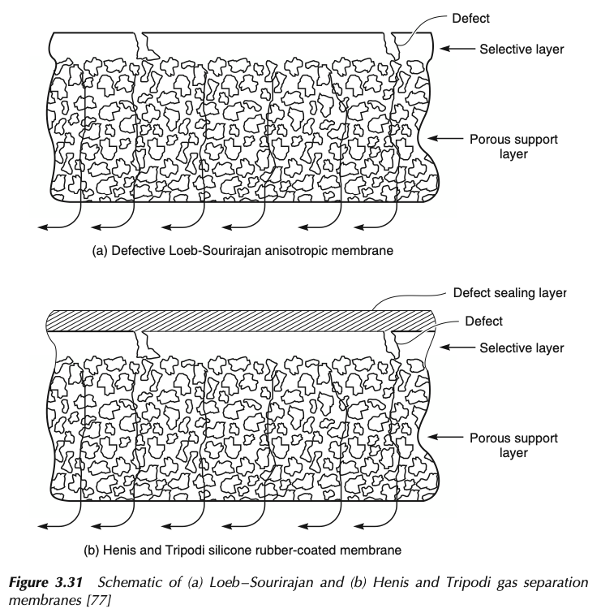

Slide 18
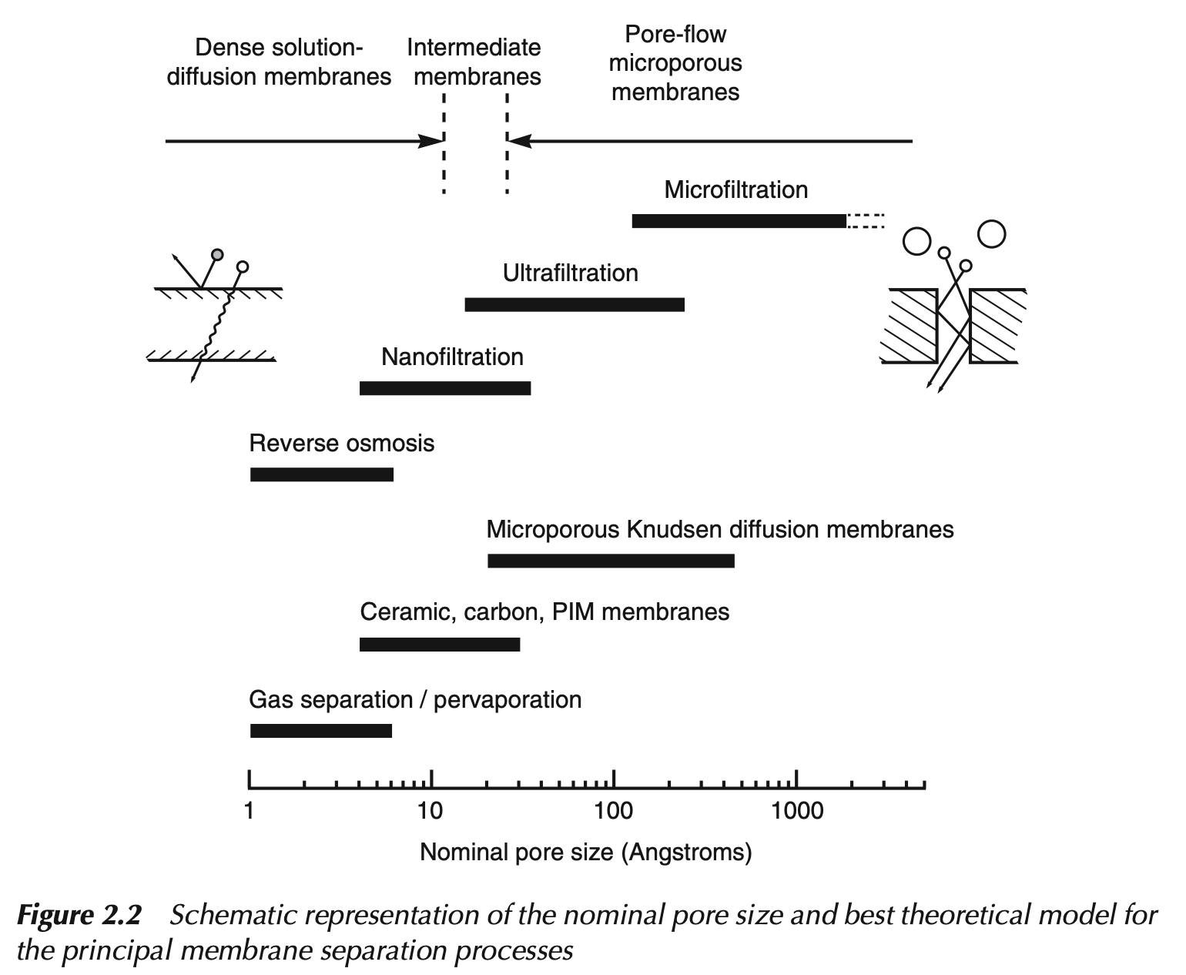

Slide 19
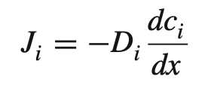
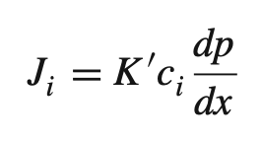
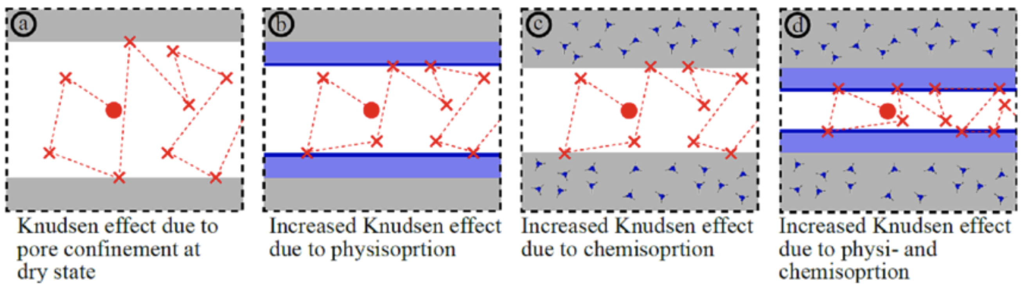
Fick’s Law
Darcy’s Law

Slide 20
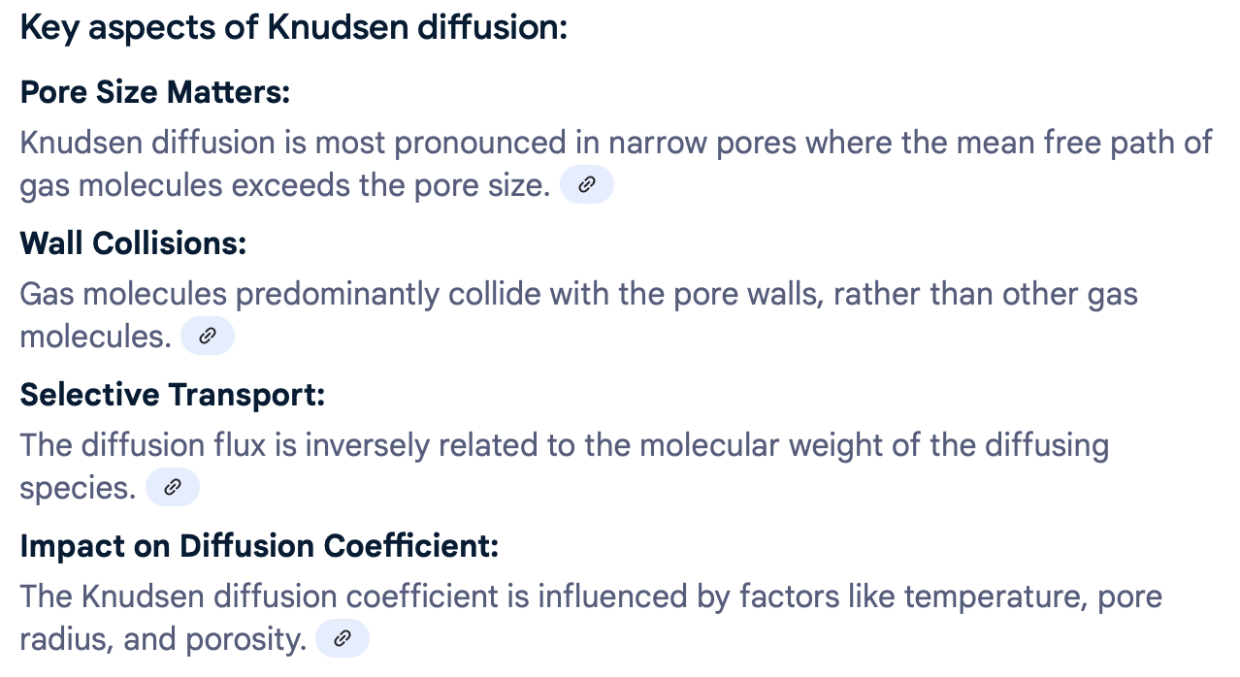
Fick’s Law
Darcy’s Law

Slide 21
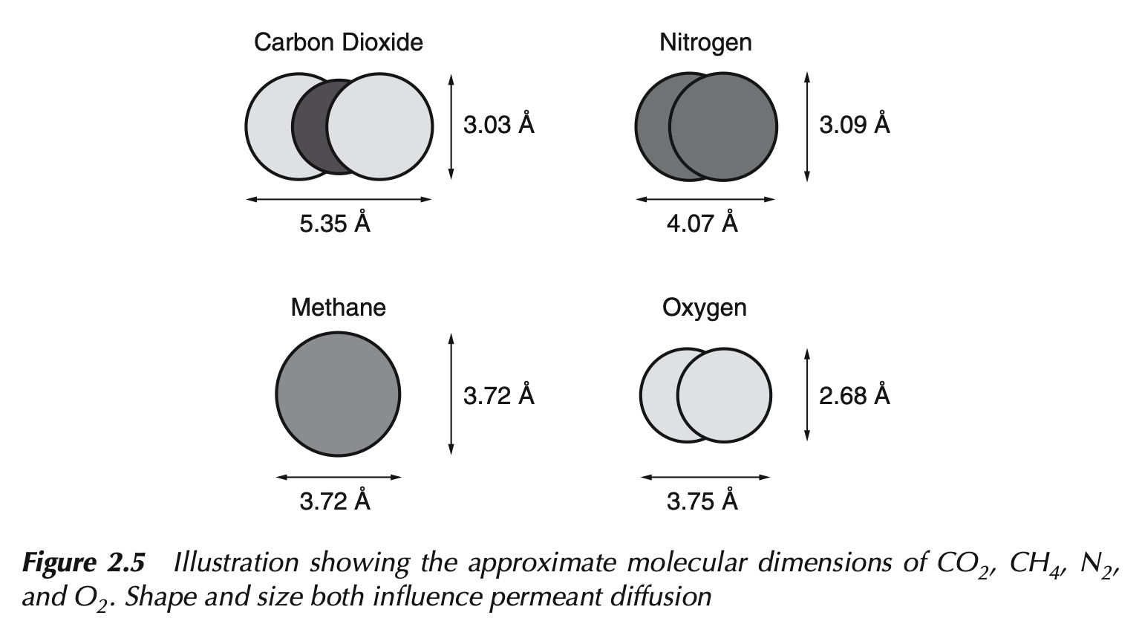

Slide 22
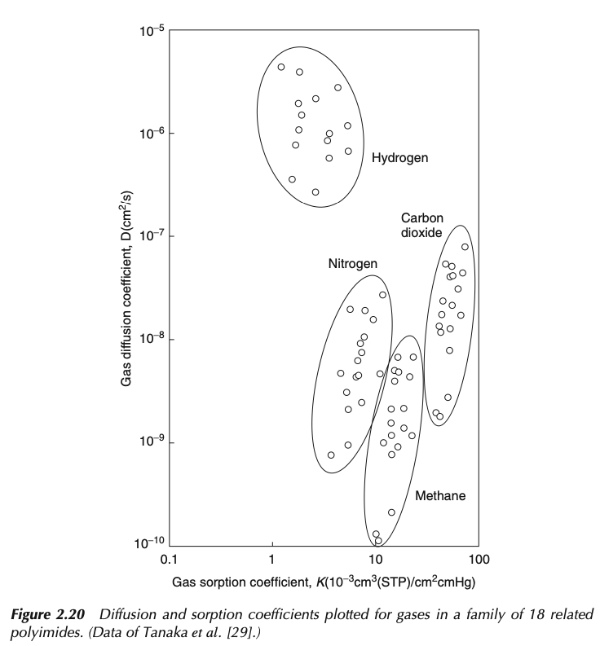
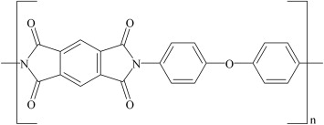

Slide 23
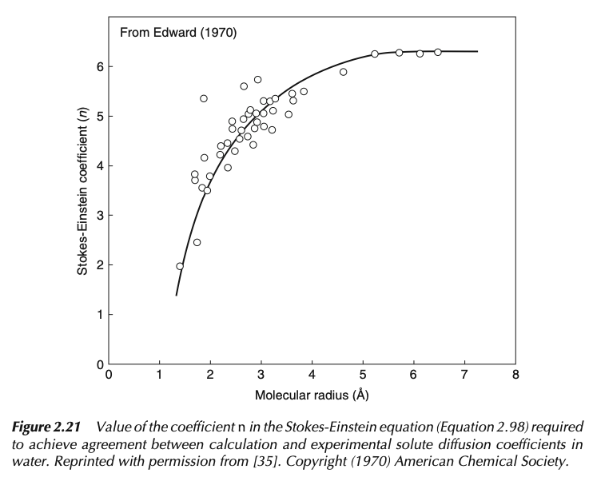
D = kT/(nπηR_{H})

Slide 24
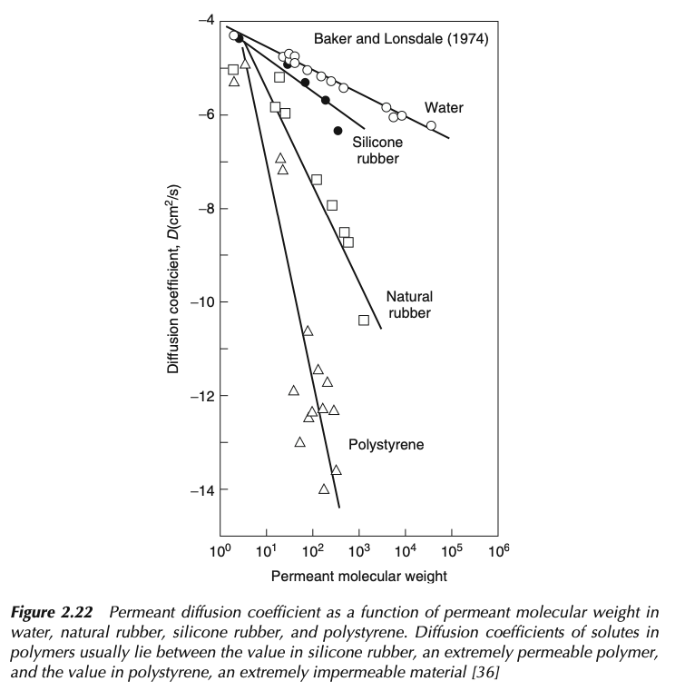

Slide 25
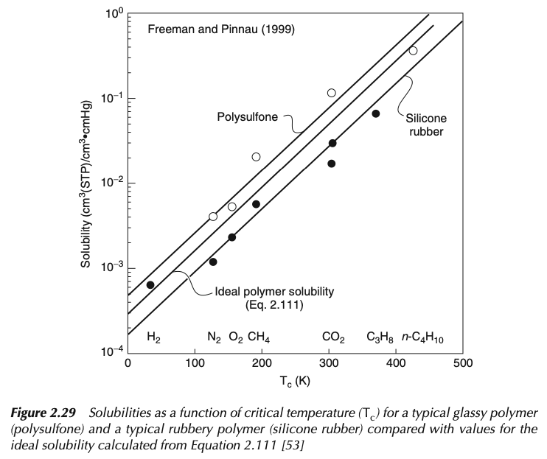

Slide 26
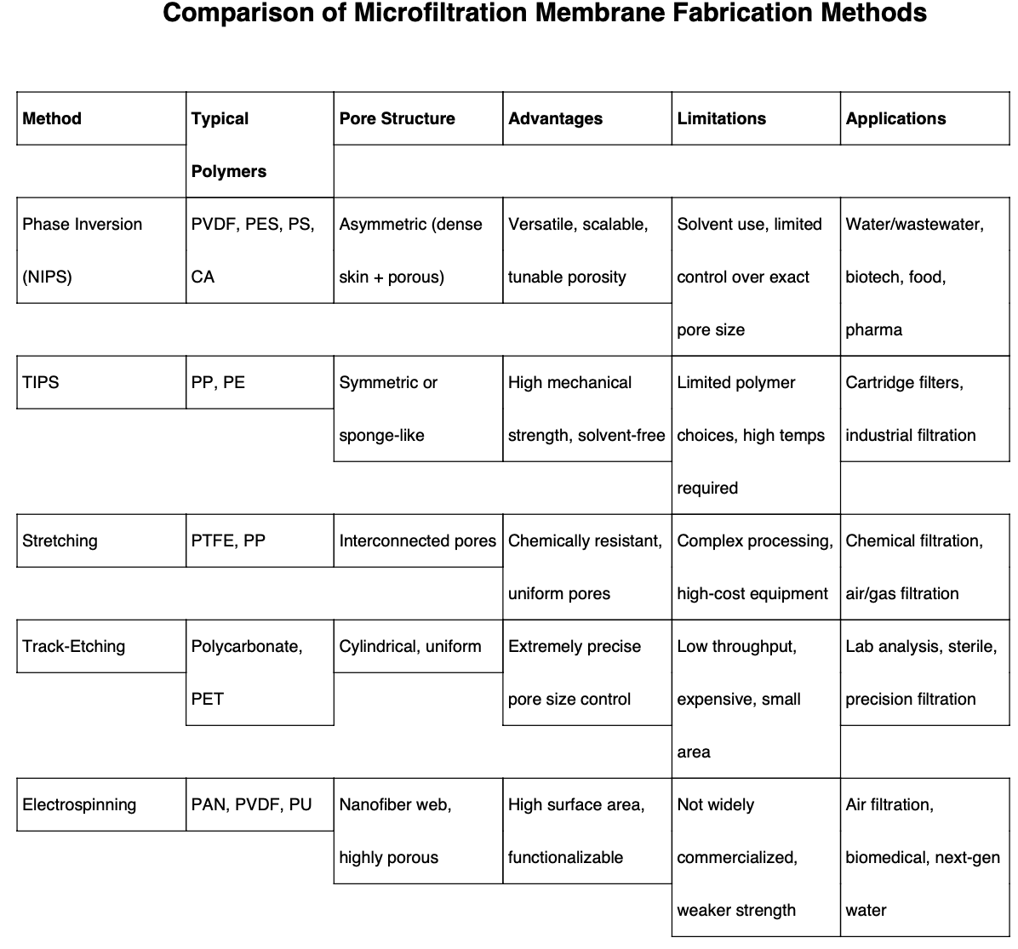

Slide 27
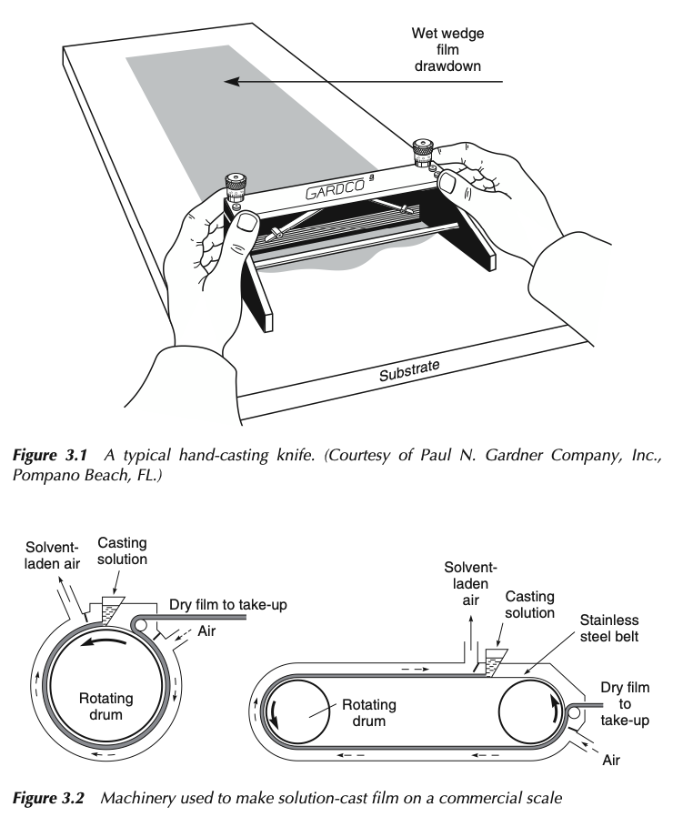
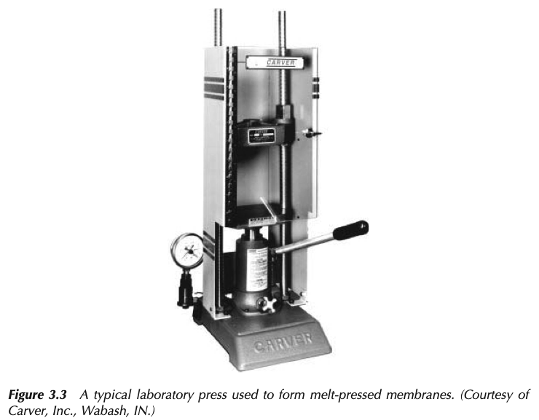

Slide 28
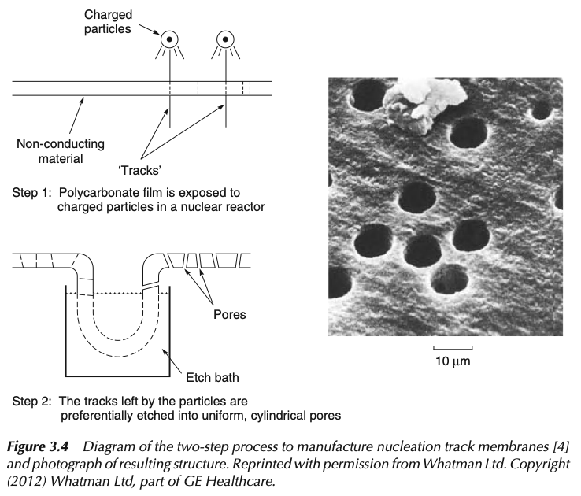

Slide 29
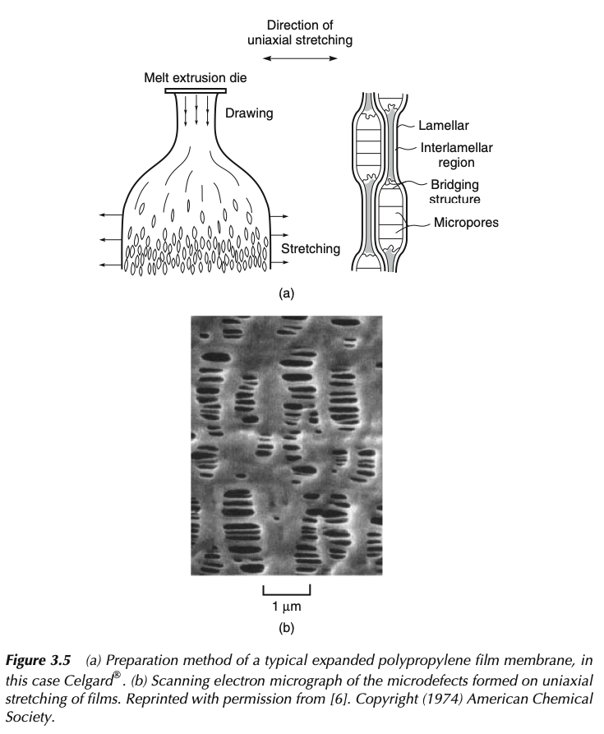
Microfiltration
Vapor barrier in construction, separator membrane in Li+ batteries, biological filtration membrane

Slide 30
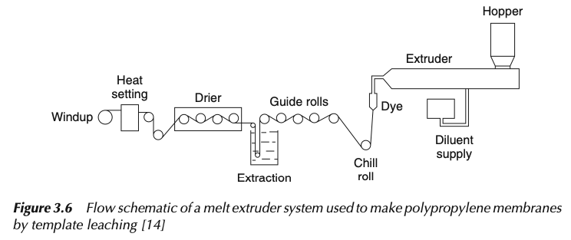
Microfiltration
Vapor barrier in construction, separator membrane in Li+ batteries, biological filtration membrane

Slide 31
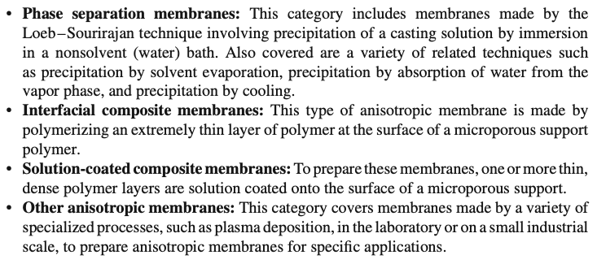
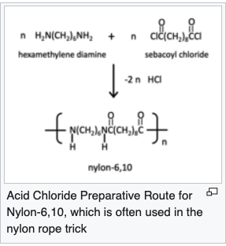
Anisotropic Membrane Preparation Methods
NIPS Non-solvent induced phase separation
Nylon rope trick (water/
cyclohexane)

Slide 32
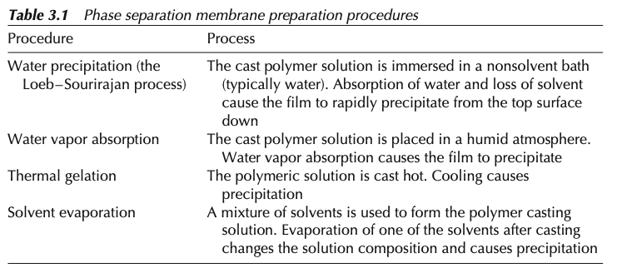
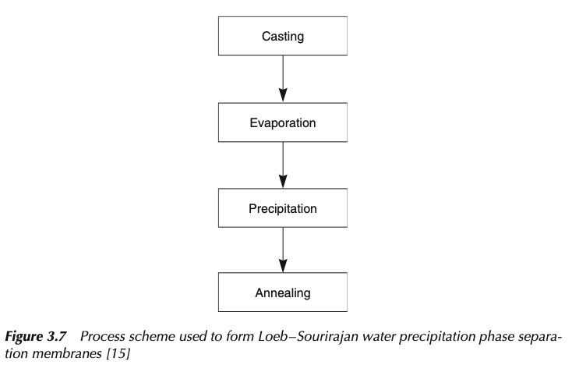
NIPS Non-solvent induced phase separation

Slide 33
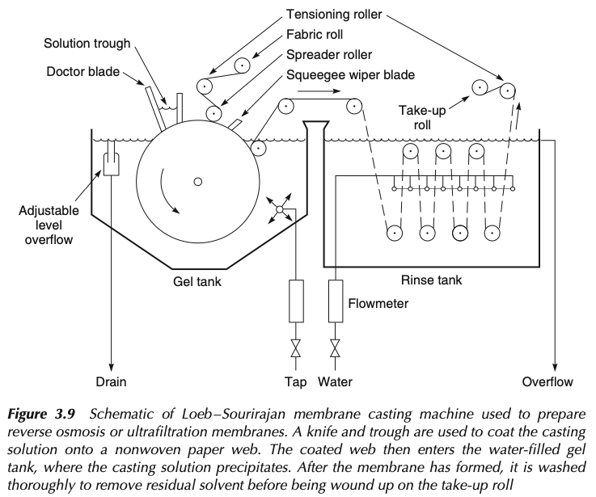

Slide 34
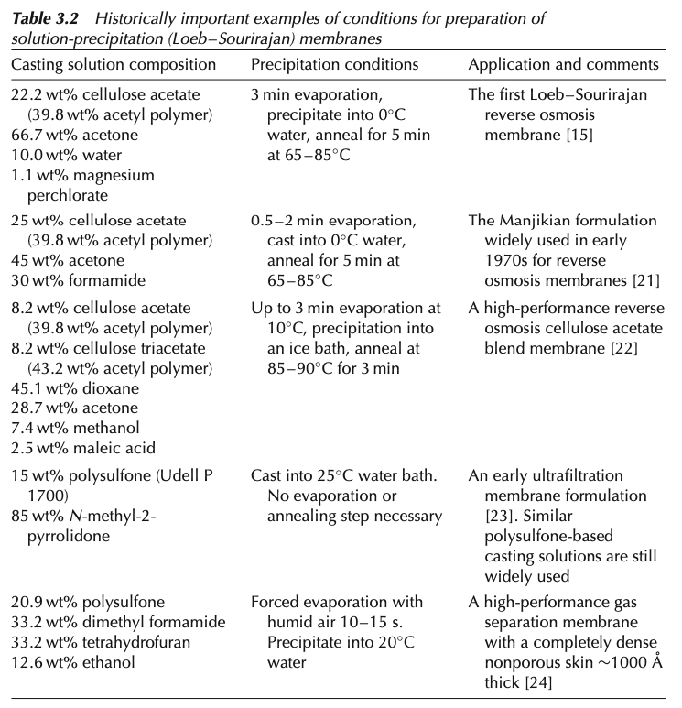

Slide 35




Water Precipitation
Polymer: Cellulose acetate, polysulfone, PVDF, polyetherimide, aromatic polyamides
Tough, amorphous, thermoplastic, T_{g} > T_{use} + 50°C, high MW (injection molding 30-50kDa, solution ppt. > 100kDa), soluble in water-miscible solvent but not water.
Casting Solution: aprotic solvents DMF, NMP, dimethyl acetamide. High solubility solvents for fast precipitation. Low d solvents, acetone, dioxane, THF, ethyl formate can be added as modifiers.
Higher concentration reduces porosity and flux. Ultrafiltration 15-20wt% polymer. 25 wt% reverse osmosis. 35 wt% for hollow fiber membranes spun hot 60-80°C
Precipitation Medium: Water
DMF

Slide 36


Slide 37


Slide 38


Slide 39



Slide 40


Slide 41


Slide 42


Slide 43


Slide 44


Combination of solvent evaporation and absorption of water vapor:
5-10 component casting solution:
8.1wt% cellulose nitrate,
1.3% cellulose acetate,
49.5% acetone (volatile good solvent),
22.3% ethanol,
14.7% n-butanol (nonvolatile poor solvents)
2.6% water (nonsolvent)
0.5% Triton X-100 (non-ionic surfactant
PEO based),
1.2% glycerine (plasticizer)

Slide 45

Nylon rope trick (water/
cyclohexane)

Slide 46



Slide 47


Solution-Coated Composite Membranes:
Langmuir Trough Method:
0.5-2.0 µm selective layer
Use Langmuir trough
Dilute polymer solution in volatile water-insoluble solvent on a water trough between Teflon® rods
Move rods apart to make thin film
Pickup the film on a microporous support
200Å films can be made
Riley method (meniscus technique):
Coat polymer solution on clean defect-free microporous support
50-100µm liquid film dries to 0.5 – 2 µm layer

Slide 48


Slide 49


Slide 50

Plasma Polymerized Membranes

Slide 51

Spin Coating Membranes

Slide 52


Slide 53


Poly dimethyl siloxane (PDMS) protective layer

Slide 54


For high pressure use thin fibers
Force = A x P on surface is lower

Slide 55


Slide 56


Slide 57



Slide 58


Slide 59


P84
PBI Polybenzimidazole

Slide 60


Slide 61


Slide 62


Slide 63


Slide 64


Slide 65


Slide 66


Slide 67


Slide 68


Slide 69


Slide 70
Polymer Membranes

Slide 71
Porous Membranes
high density of similar-sized short pores
mechanical stability
high size selectivity and a high flux
Integral-asymmetric isoporous membranes with a rather thin selective layer, supported by an open porous substructure
nonsolvent-induced phase separation (NIPS), also known as “phase-inversion process”
Loeb-Sourirajan cellulosic membranes
pore sizes from a few nanometers up to a few tens of nanometers,
self-assembling block copolymers

Slide 72
Polymer Membranes

Slide 73
Polymer Membranes

Slide 74

Polymer Membranes

Slide 75


Slide 76


Azeotropic Separation
A liquid mixture contacts one side of a membrane, and the permeate is removed as a vapor from the other. The driving force for the process is the low vapor pressure on the permeate side of the membrane generated by cooling and condensing the permeate vapor. The attraction of pervaporation is that the separation obtained is proportional to the rate of permeation of the components of the liquid mixture through the selective membrane.

Slide 77


Slide 78


Slide 79


Slide 80
Types of Membranes:
polymer, ceramic, metal, or combinations
flat sheet or also spiral wound, as well as tubular, hollow fiber, nanofibrous membranes
structure of their cross-section, which can be symmetric or asymmetric. separation properties.
separation layer can be dense or porous on different length scales.
nanometer-sized pores are categorized into micropores (<2 nm), mesopores (∼2−50 nm), and macropores (>50 nm).
Nanofiltration, ultrafiltration, and microfiltration membranes are characterized by pore-size ranges, which are approximately 1−10 nm, 1−100 nm, and 0.1−10 μm
Reverse-osmosis membranes for desalination and dense membranes for gas separation have “pore” sizes below ∼1 nm

Slide 81

Need to get someplace else:
Therefore, various important and challenging topics of interest such as, e.g., solvent evaporation from homopolymer mixtures,41−44 solvent annealing of copolymer films,45−51 directing the orientation of membrane pores by electric fields,52−71 polymerzation-induced phase-separation (PIPS),72 or polymerization-induced self-assembly (PISA)73−75 have not been covered. Functionalization of membrane pores76,77 and molecular transport on the atomic scale in the membranes78 that are critical for the operation of membranes

Slide 82




Darcy’s Law
Flow through sand
Fick’s Law
Brownian diffusion

Slide 83


Slide 84


Slide 85


Slide 86



Slide 87

Jump Diffusion Model

Slide 88



Slide 89


Slide 90


Slide 91



Slide 92



Slide 93

Gas separation membranes

Slide 94

Gas separation membranes

Slide 95

Gas separation membranes

Slide 96
Important and challenging topics for gas separation membrane production
Solvent evaporation from homopolymer mixtures,
Solvent annealing of copolymer films,
Directing the orientation of membrane pores by electric fields,
Polymerization-induced phase-separation (PIPS),
or polymerization-induced self-assembly (PISA)
Functionalization of membrane pores and
Molecular transport on the atomic scale in the membranes

Slide 97
Block Co-polymer Membranes
cylindrical, gyroidal, or lamellar pore
Cast a block copolymer solution onto a substrate and evaporate the solvent sufficiently fast to achieve alignment of the microdomains in the perpendicular direction.
An electric field can be applied to align, e.g., cylindrical domains.
The pore-forming block is etched away to obtain open pores, the film is transferred from the solid substrate onto a porous support
Isoporous top layer on a more open porous sublayer of the same material.
These membranes can be prepared directly on a porous nonwoven support

Slide 98





Early on, it has been recognized that two distinct sets of factors dictate the membrane structure:
the equilibrium thermodynamics of the multicomponent system and
the processing conditions as quantified, e.g., by the magnitude of the overall material transfer between film and bath during coagulation
(i) via a change of temperature (or effective polymer interaction, χ < 0) or (ii) by a variation of the polymer density, φP
Case (i) corresponds to thermally induced phase separation (TIPS). This method is mainly used to produce membranes from polymers that are difficult to dissolve and soluble only at
elevated temperatures, like polyolefins such as, e.g., poly- propylene, polyethylene, or poly(vinylidene fluoride) (PVDF). The phase separation upon cooling is coupled with crystallization in the case of these polymers.
TIPS can also be applied to other polymers such as polystyrene and poly(2,5-dimethyl-1,4-phenylene ether), when dissolved in cyclohexanol.

Slide 99
A special type of TIPS was observed for a solution of PVDF with cellulose acetate in a mixture of a good solvent (dimethylformamide) and a nonsolvent (nonane).
The solvent−nonsolvent mixture itself shows an upper critical solution temperature below the temperature of the initial polymer solution.
Therefore, the solution phase separates upon cooling, resulting in a highly surface-porous polymer film, where the pore size is dictated by the length scale of spinodal decomposition.
The subsequent phase separation, which leads to an increase of the pore size with time, is then stopped by quenching the whole system in a cold coagulant.

Slide 100
Early on, it has been recognized that two distinct sets of factors dictate the membrane structure:
the equilibrium thermodynamics of the multicomponent system and
the processing conditions as quantified, e.g., by the magnitude of the overall material transfer between film and bath during coagulation
(ii) corresponds, e.g., to the (slow) evaporation of a moderately poor solvent from an initially very dilute solution of collapsed coils. Then, upon decreasing the solvent density, the polymer precipitates when the binodal is crossed via the nucleation and growth of individual droplets of the polymer-rich phase.

Slide 101
Ternary Mixtures of Polymer, Solvent, and
Nonsolvent. The phase diagram of an incompressible three-
component system polymer, solvent, and nonsolvent or,
equivalently, of a compressible, two-component system can
already be complex. In fact, such a system may exhibit six
qualitatively different types of phase diagrams according to the
classification of van Konynenburg and Scott.
typical case
where one solvent is compatible with the polymer, whereas the
Other nonsolvent is a poor solvent for the polymer; the two
solvents, however, remain miscible in the range of thermody-
namic conditions of interest.
An incompressible system is
described by two thermodynamically independent order
parameters, e.g., the normalized density, φP, of the polymer
and the normalized density, φ , of the nonsolvent because the N
densities of polymer, solvent, and nonsolvent add up to unity, φP + φS + φN = 1

Slide 102





Insoluble
Soluble

Slide 103


Slide 104

Phase Triangle
Typically, polymer and solvent as well as solvent and nonsolvent are miscible at the thermodynamic states of interest. Macroscopic phase separation occurs between a polymer-rich and a polymer-lean phase. The latter phase predominantly consists of nonsolvent.
Additionally, other properties that are relevant for the processingin particular, the dynamic arrest of structure formation, such as vitrification or crystallizationare often indicated in the phase triangle.

Slide 105
A more quantitative description has to account for at least three additional aspects: (i) the spatial inhomogeneity of the system, (ii) the change of densities in the polymer film, as the solvent evaporates and the film thickness shrinks, as well as (iii) viscoelastic effects on the kinetics of phase separation.

Slide 106
Self-Assembly of Block Copolymer in Solutions and Melts
local microphase separation
spherical, worm-like cylindrical, or lamellar vesicles.
A way to form such self-assembled structures in solution is to slowly replace a good solvent for the different blocks by a very selective solvent, which is even a nonsolvent for one of the blocks. This can be achieved by dialysis of a block copolymer in a good solvent against a nonsolvent.
φ = φA/φP with φA
and φ = φ + φ denoting the density of polymer block A and PAB
the total polymer density
decoupling the fast microphase separation and the slow macrophase separation
self-assembly or microphase separation can be induced by temperature jumps, solvent evaporation, or solvent−nonsolvent exchange.

Slide 107
or a pure, symmetric diblock copolymer, the mean-
field prediction of the order−disorder transition (ODT) is χ N = 10.5

Slide 108

4. HOMOPOLYMER MEMBRANES 4.1. Phase-Inversion Membranes
integral-asymmetric membrane. It was a cellulose acetate membrane for reverse osmosis that displayed a good salt rejection combined with high flux
These membranes display a rather dense (and thus selective) surface layer on top of a more open, porous (and thus less resistive) substructure. The substructure can be spongy or display finger-like macrovoids.

Slide 109

Strathmann et al. presented experimental data on polyamide membranes, which were prepared by casting a polyamide solution film into a mixture of the solvent with water (nonsolvent).140 In this way, the effective incompatibility between polymer and precipitant was varied, and the resulting membranes showed macrovoids when precipitated in pure water and a sponge structure in water mixed with 75% of solvent. The formation of macrovoids was explained by the fast precipitation of a polymer-rich skin layer at the film surface in case of a strongly incompatible precipitant (in this case, pure water) and the concomitant mechanical stresses in this top layer, which lead to defects at the surface. Across these defects, a fast penetration of precipitant into the polymer film occurs, resulting in finger- like macrovoids. In the case of a weak precipitant, in contrast, phase separation occurs slower; i.e., the phase-separation front slowly moves across the polymer film, resulting in a cocontinuous sponge structure.

Slide 110



Slide 111



Slide 112


Slide 113
In addition to the bulk equilibrium thermodynamics, the different modeling approaches address
the role of spatial inhomogeneities such as the surface of the solvent- swollen polymer film in contact with a nonsolvent and
the kinetics of phase separation, as well as
the arrest of the structure formation by vitrification, crystallization, or gelation.

Slide 114



Slide 115


Slide 116


Slide 117


Slide 118


Slide 119


Slide 120


Slide 121


Slide 122



Slide 123


Slide 124


Slide 125


Slide 126


Slide 127


Slide 128


Slide 129


Slide 130


