Slide 1
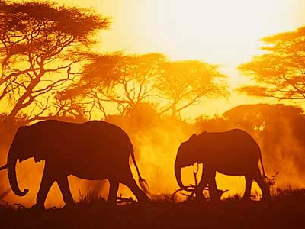
Alternative Aid to Africa: A Two-Way Street
Engineers Without Borders – University of Cincinnati
Alex Jones, Kevin Knollman, and Max Poyle

Slide 2

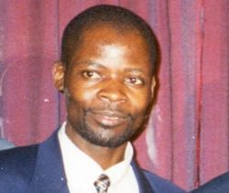
James Shikwati
Notes:
Kenyan economist
Western aid dollars are flowing into the pockets of corrupt politicians, funding re-election campaigns
African economic development best stimulated by stopping the cash flow
Undercuts African businesses who cannot compete with free products provided by foreign aid
“Unfortunately, the Europeans' devastating urge to do good can no longer be countered with reason.”

Slide 3
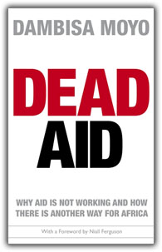
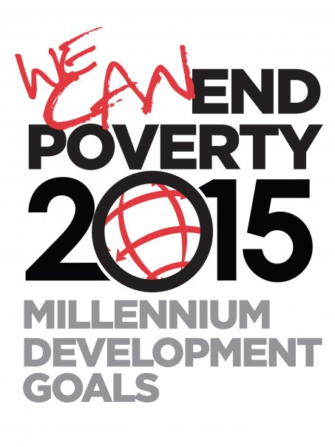
Dambisa Moyo
Jeffrey Sachs
Notes:
Economist from Zambia, shares Shikwati’s views
Expressed this in Dead Aid
Foreign aid removes the African governments’ accountability to their citizens
Chinese approach better – invest in African economies-make profits while providing funds
Opposed by Jeffrey Sachs
Helped set the Millenium Development Goals, which, if achieved, could set developing countries on their own feet
Expressed this sentiment in End of Poverty
Both philosphies agree once – when developing countries reach a threshold, they will become self-sufficient

Slide 4
Alternative Approach
Engineers Without Borders – improve the quality of life via sustainable, appropriate engineering projects
Partner with proactive communities to develop physical solutions to real problems
Provide a jumpstart for local initiatives
Notes:
Proactive – communities seek help from EWB-USA
Partnership – always use community input, ask for community contribution to project
Sustainability – use local materials and skilled/unskilled labor
Education – share all technology and techniques used with the community so they can replicate the product
Theory – jumpstart the local economy so our support will no longer be necessary in the future

Slide 5

Failed Attempts

Slide 6
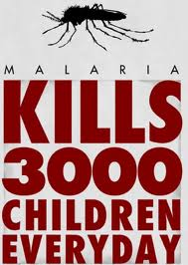
Roll Back Malaria
Started: 1998
Goal: Reduce Malaria Cases by 50%
$1.9 Billion per Year
Notes:
-Project started in 1998.
-Some major groups involved include UNICEF and WHO
-The goal was to reduce cases of malaria by 50% in Africa by 2010
-The effort was going to require $1.9 Billion a year though according to WHO

Slide 7
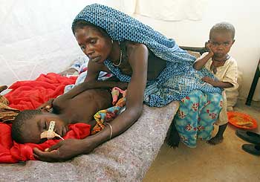
Too Little Money, Too Much Illness
2002: $200 Million per Year
2004: Malaria Increases by 12%
Notes:
-Highest amount generated by 2002 in a year was $200 Million
-By 2004: The opposite happens, Malaria goes up by 12%
-Political roadblocks begin to occur: Due to lack of money, cheap drugs were being used along with cheap mosquito nets.

Slide 8
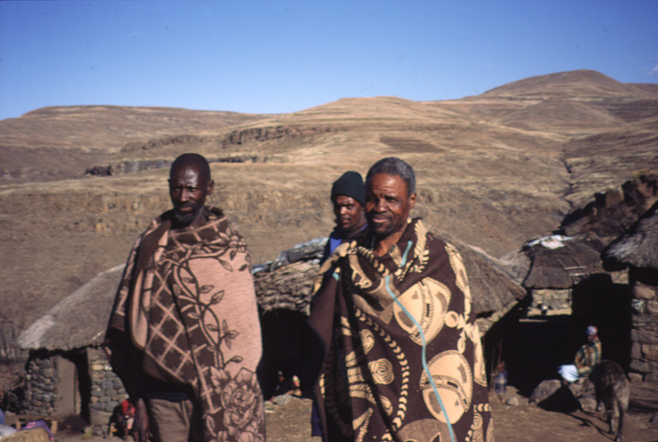
Lesotho Water Project
Started: 1986
Diverting Fresh Water
Mainly for Electricity and Sale
Notes:
-Project was proposed in 1950’s by the British.
-Finally started in 1986 by the World Bank
-Goal: Divert fresh water to South Africa to generate hydroelectricity and typical water uses for the country.
-Most of project was going to divert very large amounts of water for the dam being put in place.
-Many people were going to be affected by the diversion, but they were to be compensated.

Slide 9
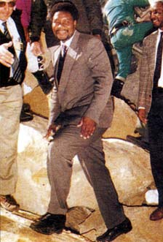
Evil, Expensive Water
Shut Down: 2003
Expense Issues
Political Corruption
Masupha Sole
Notes:
-Project shut down in 2003.
-Project got too expensive.
-South Africans couldn’t afford the electric or the water from the project.
-The people were never compensated that were supposed to be.
-Political Corruption got involved.
-3 large construction firms involved with it were accused to fraud.
-Masupa Sole, chief of the project, was accused of 16 accounts of bribery and 2 accounts of fraud
-Sentenced to 15yrs in prison, shortened to 3 yrs in 2002
-Project kickstarted in 2007
-Sole reinstated to chief of the project

Slide 10
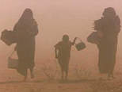
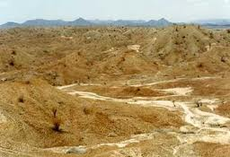
Lake Turkana Fish Processing Plant
Donor: Norwegian Government
Cost: $22 Million
Goal was to provide jobs and income for Kenyan people

Slide 11

No Fish in the Desert
Lack of research by Norway
Separation of Norway and then-president Daniel Arap Moi
Poor consultation with communities
Notes:
Lake Trukana Fish Processing Plant
Poor consultation with communities, a lack of monitoring progress, Turkana’s economic remoteness, a pastoral way of life unsuited to fishing and a diplomatic row between Norway and ex-president Daniel arap Moi.
Moi briefly broke off diplomatic ties with Norway in 1990 after accusing it of sheltering dissident politicians. Ties were restored in 1994 but development aid resumed only in 2004. Soegaard did not know how much money was pumped into the factory itself, but estimated that Norway spent about 1 billion Norwegian crowns ($152 million) in today’s money in Turkana over 20 years, on the factory and regional community projects.
Despite living near one of Africa’s biggest lakes, the Turkana people traditionally do not fish. Like other Nilotic peoples in the Horn of Africa, they are semi-nomadic pastoralists who live off the milk, blood and meat of their herds. Even today, few Turkana fish commercially. “If you fish it means you are poor because you have no livestock,” said Philip Ayane, 22, who lives in the remote village of Nandapal.
The project was designed in 1971 to provide jobs to the Turkana people through fishing and fish processing for export. However, the Turkana are nomads with no history of fishing or eating fish. The plant was completed and operated for a few days, but was quickly shut down. The cost to operate the freezers and the demand for clean water in the desert were too high. It remains a "white elephant" in Kenya's arid northwest.

Slide 12
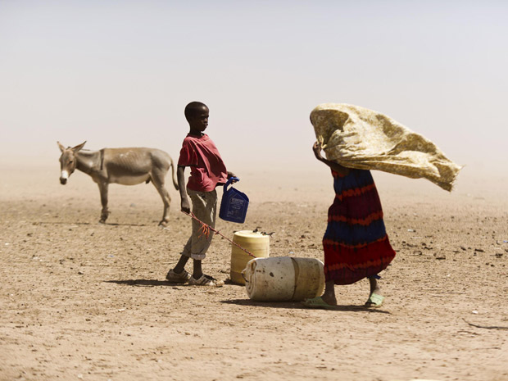
Mogadishu, Somalia
Donors: Red Cross and U.N.
Large food donations for the Somali people
Millions of dollars in “relief efforts”

Slide 13
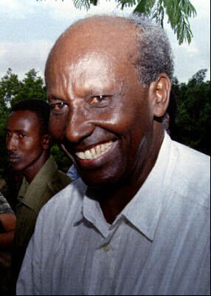
Warlord Takeover
Lack of a constant U.N. or U.S. military presence
No food distribution center
“Relief efforts” not making it to Somalia population
Notes:
Mogadishu
Lack of military presence in Somalia allowed for Aidid to assume control of the Somali government and use the “relief efforts” for his own causes
The food and money donations either didn’t make it to the Somali government or were sold by the government to buy weapons so they could assert their power over the people
The lack of a food distribution system by the donators allowed the Somali government to easily seize control of any donations

Slide 14

What EWB Does Differently
Partnership
Long-Term Relationships
Mutual Benefit for Both Parties
Sustainability
Use of Local Materials
Safe and Sturdy Projects
Education
Ensure Village’s Knowledge of Technology
Continued Communication Between Group and Village

Slide 15
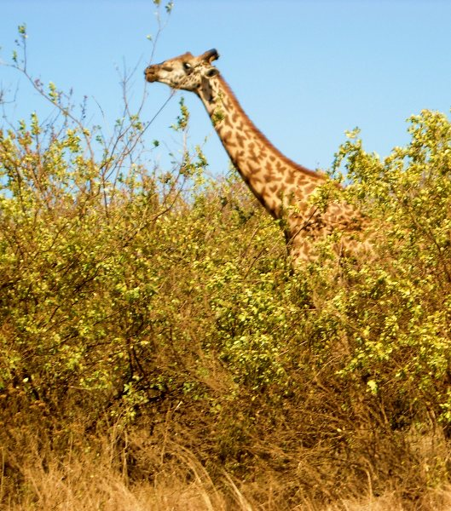
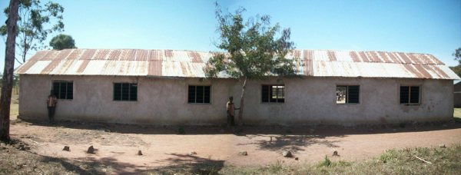
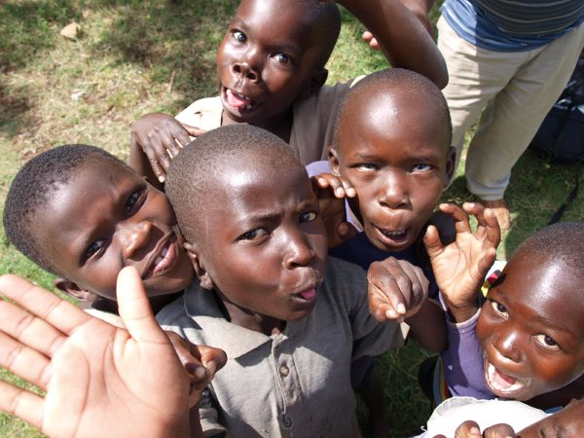
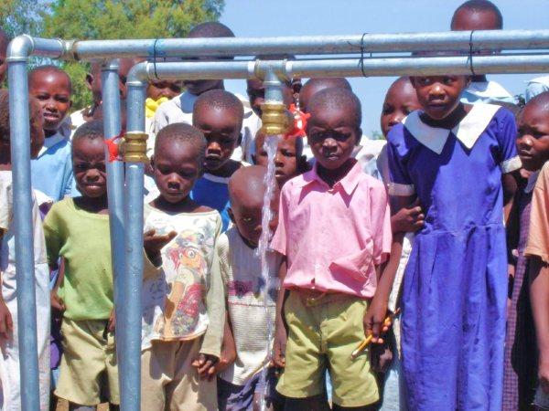
Our Projects
Burere
Nyambogo
Otho Abwao

Slide 16
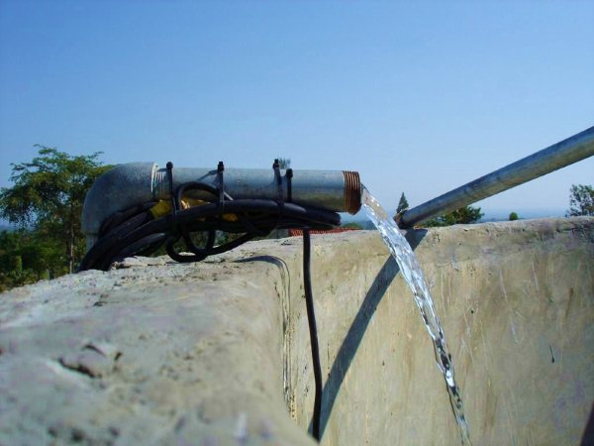
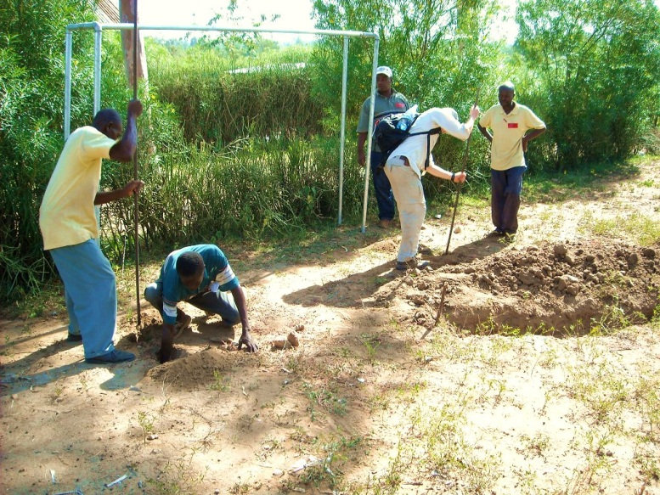

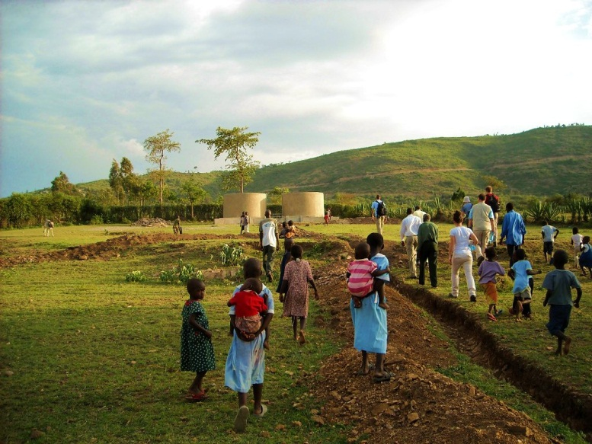
Otho Abwao

Slide 17
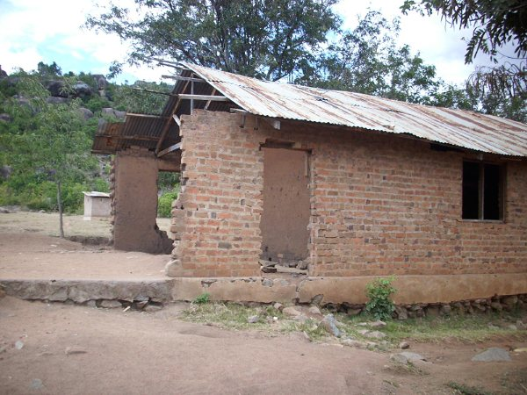
Burere
Schoolhouse Project
Located in Tanzania
Collapsing Schoolhouse
Could Lead to Large Long-Term Social Decline
New Schoolhouse

Slide 18
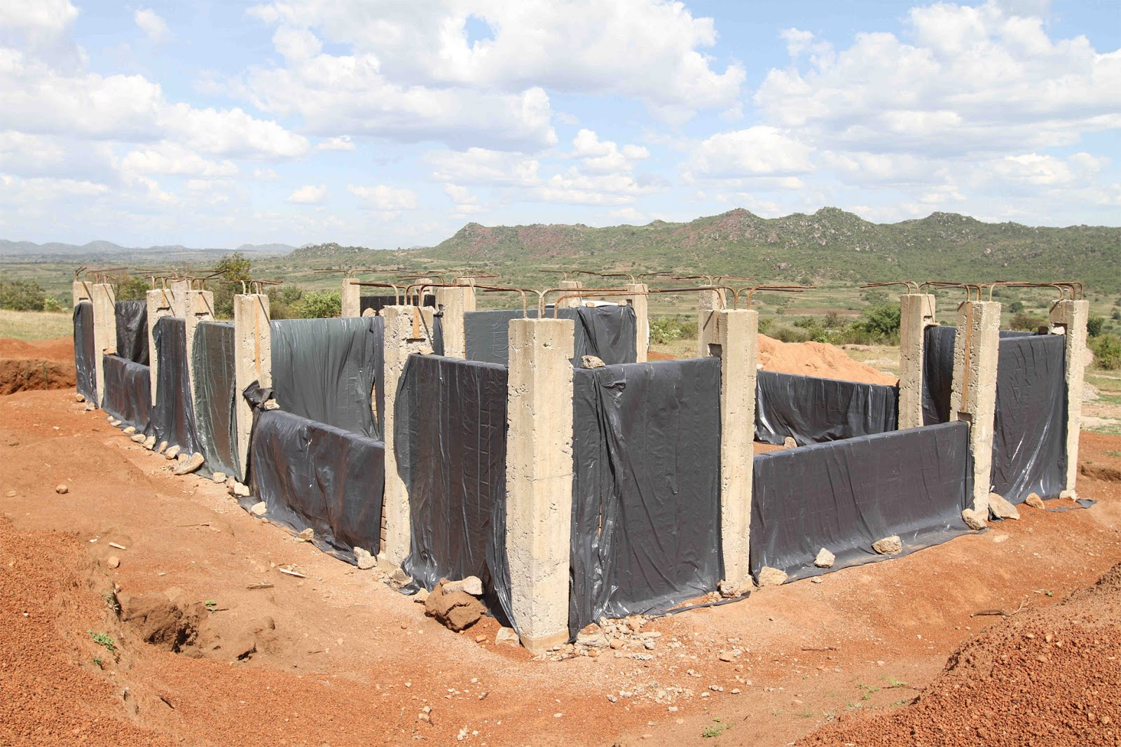

Slide 19

Nyambogo
Located in Tanzania
Population: 5,000
Long Dry Seasons
Lack Access to any Real Water
Water System in the Works

Slide 20
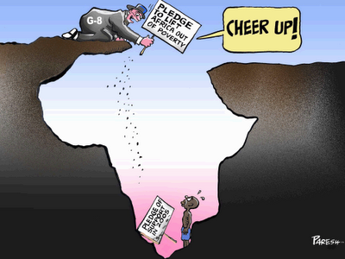
In Conclusion…

