Slide 1
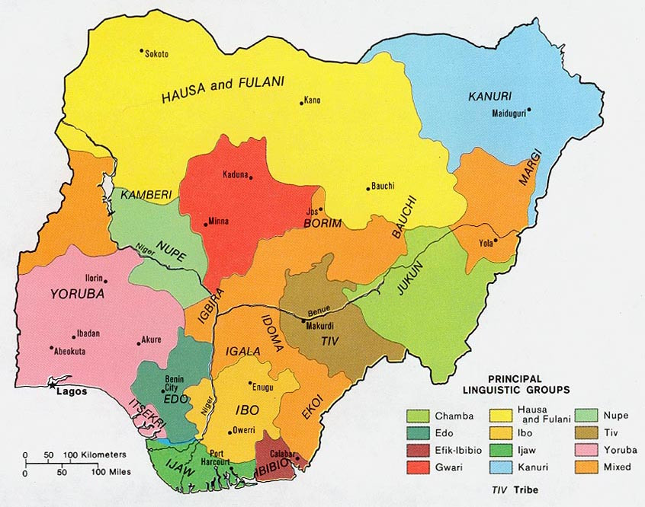
NIGERIA

Slide 2
Nigeria
There are 250 ethnic groups in Nigeria. The 3 largest according to geographical locations are:
Hausa/Fulani (29%) - North
Igbo (18%)- South East
Yoruba (21%)- South West
The Hausa/Fulanis are predominantly Muslims, the Igbos are predominantly Christians while the Yorubas are a blend of both.

Slide 3
Politics/Language
Nigeria regained democracy in May 1999 after 33 years of grueling military ruler ship. The nation’s federal capital territory is located in Abuja and the commercial nerve center is in Lagos.
The official language in Nigeria is English. However, there is a slightly modified form of English language called ‘pidgin’ which is common among illiterates/ semi-illiterate people who cannot speak the formal English.

Slide 4
Lagos
Lagos with a population of over 20 million people is the largest and most populous city in Nigeria. It is the largest city in Africa & the seventh fastest growing in the world. It is regarded as the entertainment city of Nigeria. It is home to Nollywood (Nigeria's growing movie industry) and dynamic music industry. It has produced a variety of styles of mucic such as Nigerian hip hop, high life, juju, fuji and afrobeat.
A large percentage of Lagosians are traders, business men/women and people white collar jobs. Major multinational companies like Procter & Gamble, Exxon Mobil, Shell Petroleum, GE & Guinness have their offices located in Lagos.

Slide 5
Some Notable People
Fela Anikulapo-Kuti popularly known as Fela is Nigeria's most famous Afro-beat legend. He was both a musician and a human rights activist who spoke against corruption through his music.
His music had a lot of political undertone and constantly challenged the government to transparency and honest leadership. His death in the late nineties was a huge blow to the music industry in Nigeria. In 2009, Fela (a production on his life began a run on Broadway)
http://www.youtube.com/watch?v=h4AA6EuZe-k

Slide 6
Some Notable People
Famous playwright and novelists Wole Soyinka (1986 Nobel prize winner in literature) and Chinua Achebe (writer of Things fall apart) are great writers who through their writings have been able to promote the true African spirit/culture and bring literary awards and recognition to Nigeria and Africa as a whole. They also played very active roles during Nigeria’s independence.

Slide 7
Some Notable People
Ken Saro Wiwa, an environmental activist who fought against indiscriminate and unlawful petroleum waste disposal in the Niger Delta region by multinational oil corporations with the help of the federal government was arrested and hastily tried by a special military tribunal, and hanged in 1995 by the military government in authority.
His execution provoked international outrage and resulted in Nigeria's suspension from the Commonwealth of Nations for over three years
http://www.democracynow.org/2009/5/26/shell_on_trial_landmark_trial_set

Slide 8
Energy Situation
Major source of power generation in Nigeria is Hydro. In the rainy seasons, power supply slightly increases due to sufficient water supply to the dams from which electricity is generated and it decreases in the drier months.
The country generates about 4,000 mega watts of electricity which it distributes to the states/cities through the national grid. This rarely meets the energy demands of the people so power supply is very erratic. To enjoy stable power supply, most Nigerians resort to generating their own power.

Slide 9

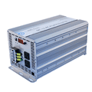

Energy Situation
Common ways by which people generate power are; with generators, inverters/batteries, gas lamps, e.t.c.

Slide 10
Energy Situation
Solar panels are not very common in Nigeria today because it is limited in supply and it is expensive too. Start-up businesses and poor home-owners cannot afford them.
If it becomes cheaper so that the teaming population of over 150 million Nigerians can afford them and is readily available for them to buy, it might replace all the other forms of power generation because it is cleaner and poses less hazard to the environment
Nigeria has a tropical climate with sunshine all year round so the solar panel will be a very useful form of sustainable clean energy generation.

Slide 11
Thank You

