Slide 1


Energy at UC
https://www.pbs.org/video/science-around-cincy-season-2-episode-1-hbo4jw/

Slide 2
Utilities at UC
East Utility Plant
Central Utility Plant

Slide 3
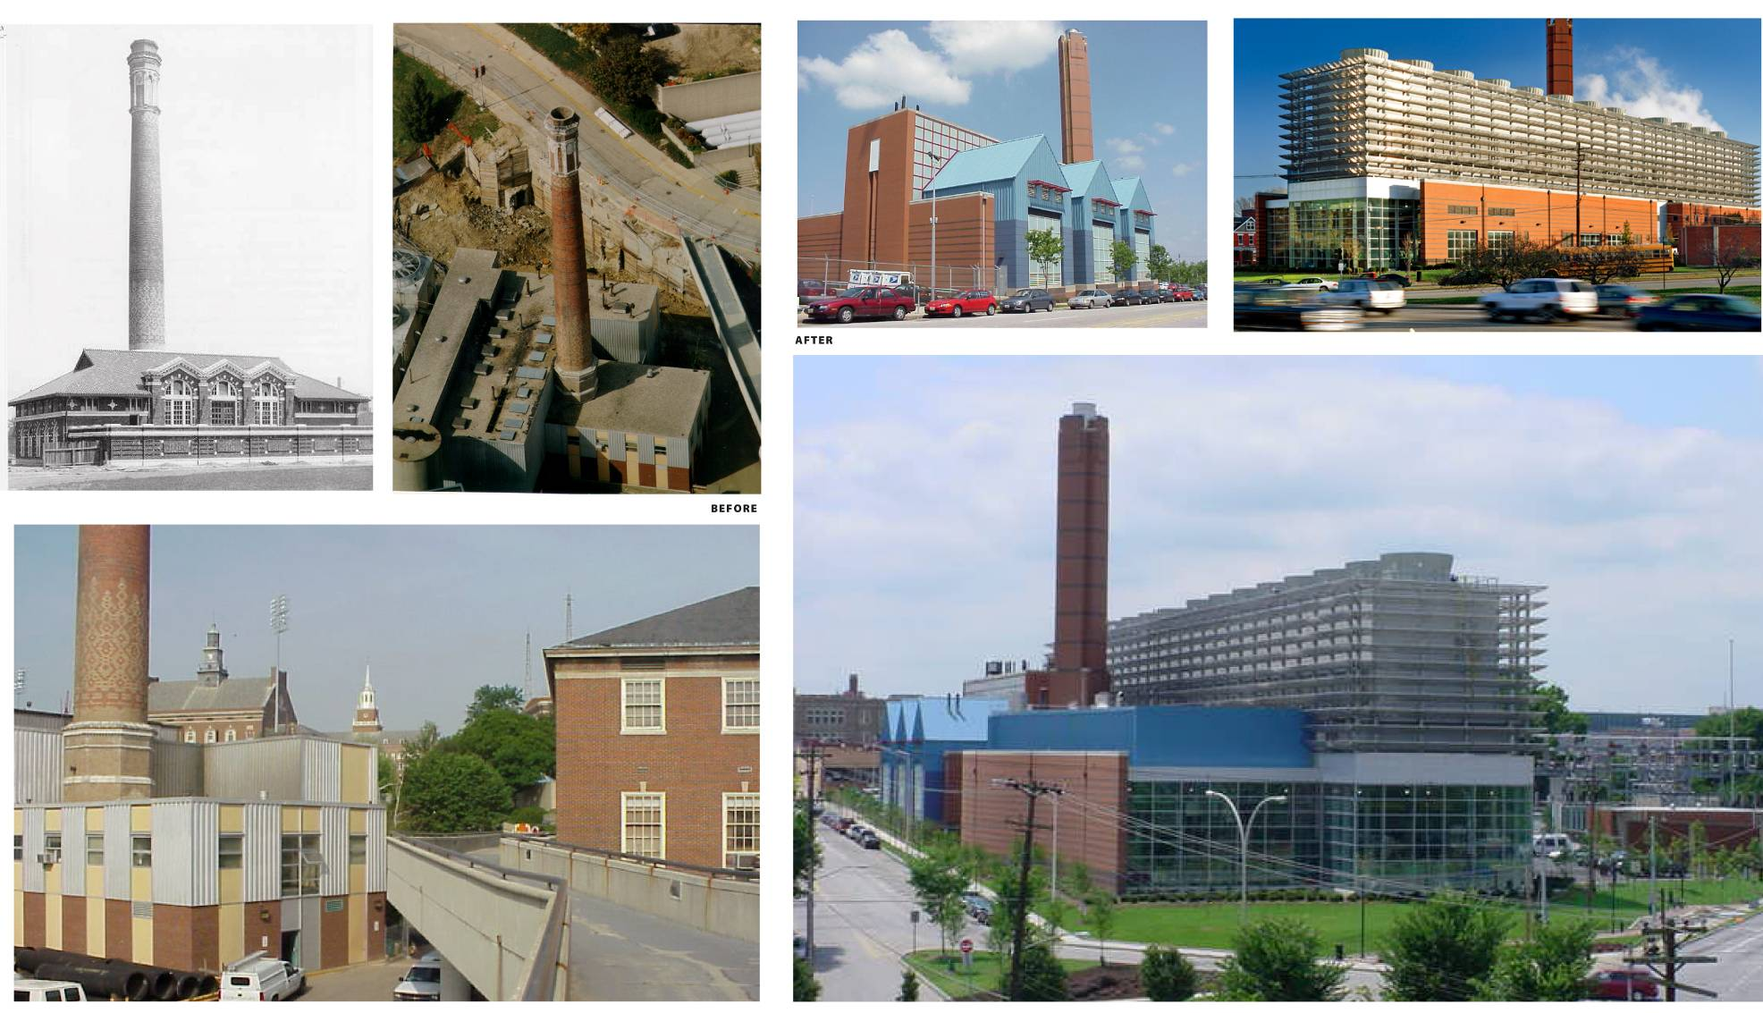
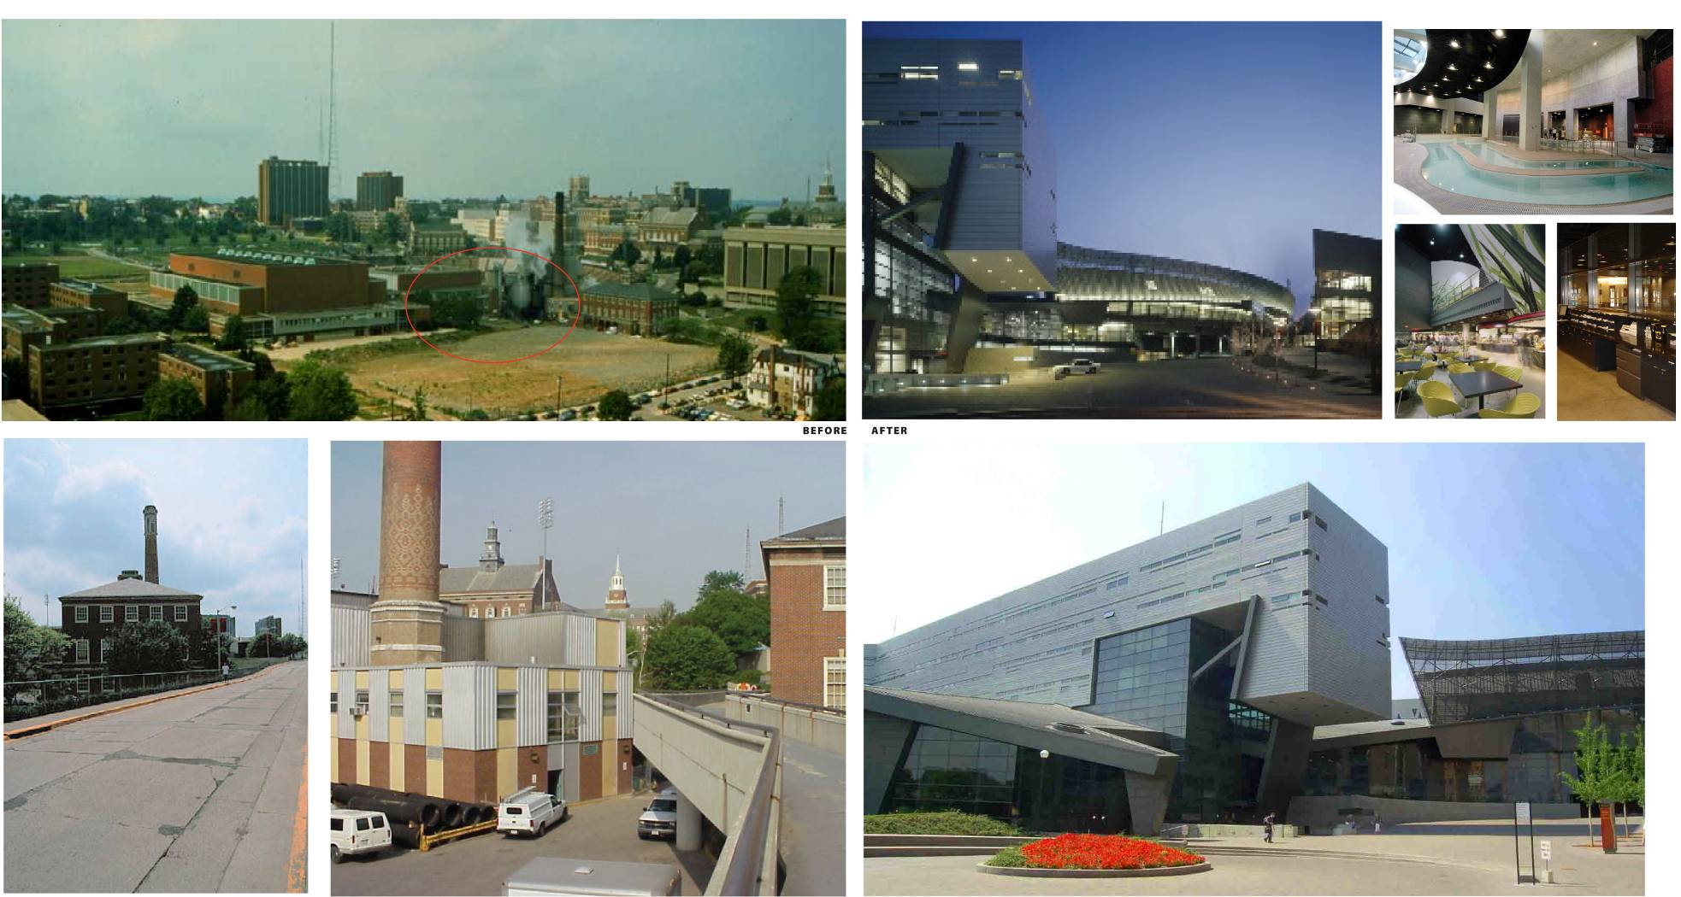
Transformation

Slide 4
Utilities Operations
Capacity
Annual Production & Distribution
Electric Production 49MW
Steam Production 721,000 pounds-per-hour capacity-gas, oil, (coal)
Chilled Water Production
36,000-ton capacity
Natural Gas and Electric chillers
Thermal Energy Storage
2.8 million gallons of chilled water
4.0 million gallons of chilled water
298 million kilowatt hours of electricity
864 million pounds of steam primarily for heating
68 million ton-hours of chilled water for air conditioning
894 million gallons of domestic water

Slide 5
Thermal Storage

Slide 6
Distribution System
Steam Pipes: 35,509 Linear Feet | Chilled Water Pipes: 32,889 Linear Feet
Tunnels: 13,947 Linear Feet

Slide 7
Critical Loads Served
University Hospital
Hoxworth
Veterans Hospital
Shriners Hospital
Holmes Hospital

Slide 8
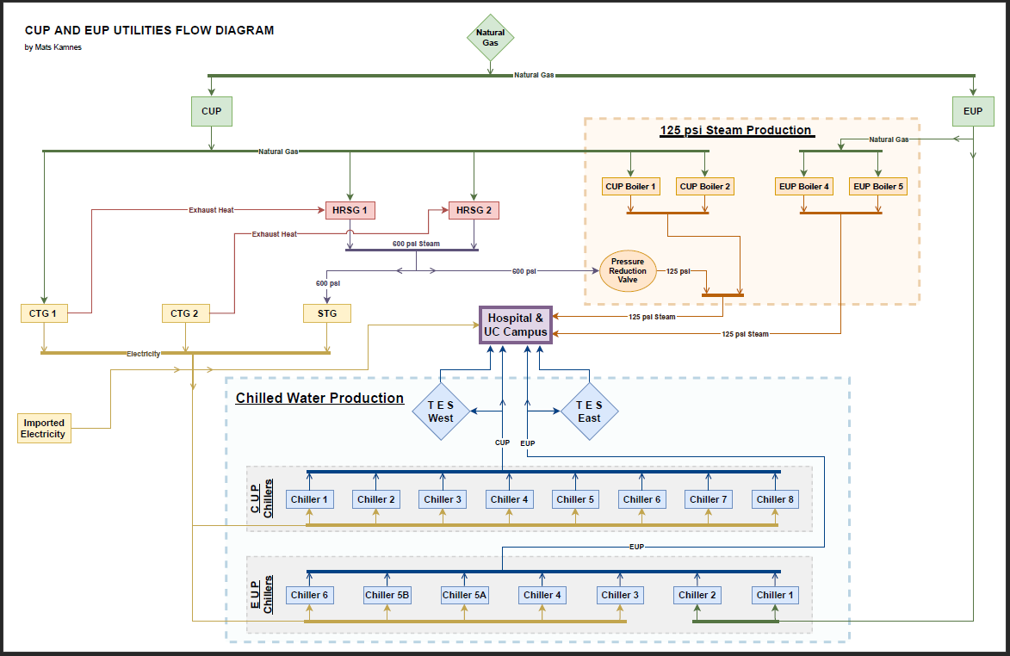
Equipment

Slide 9
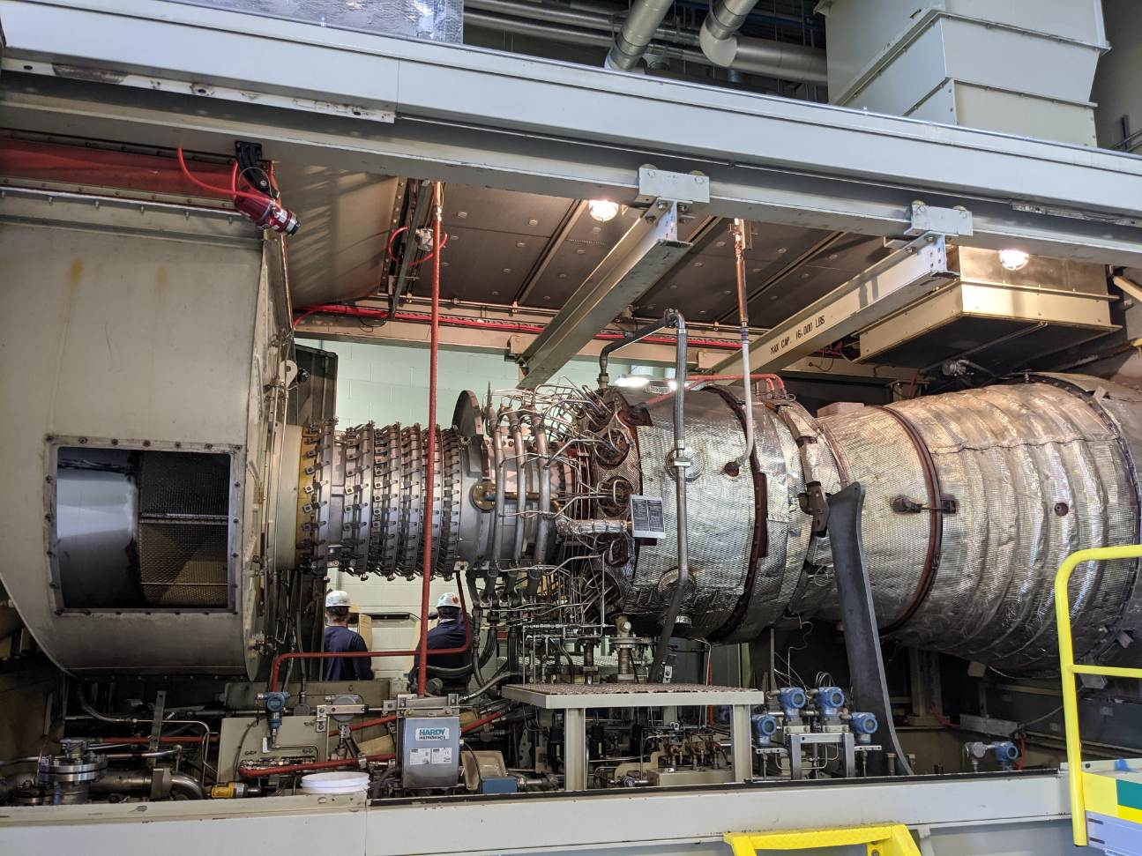
Combustion Turbine

Slide 10
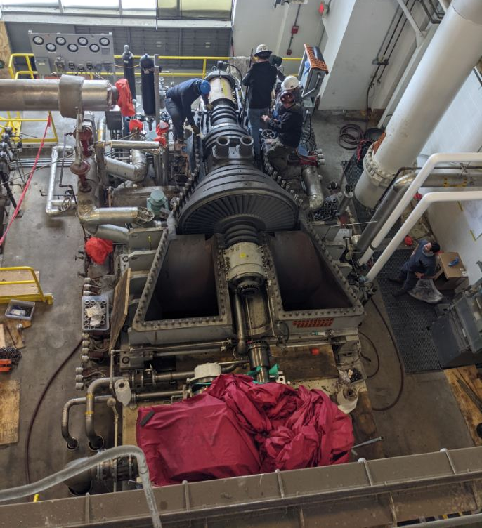
Steam Turbine

Slide 11
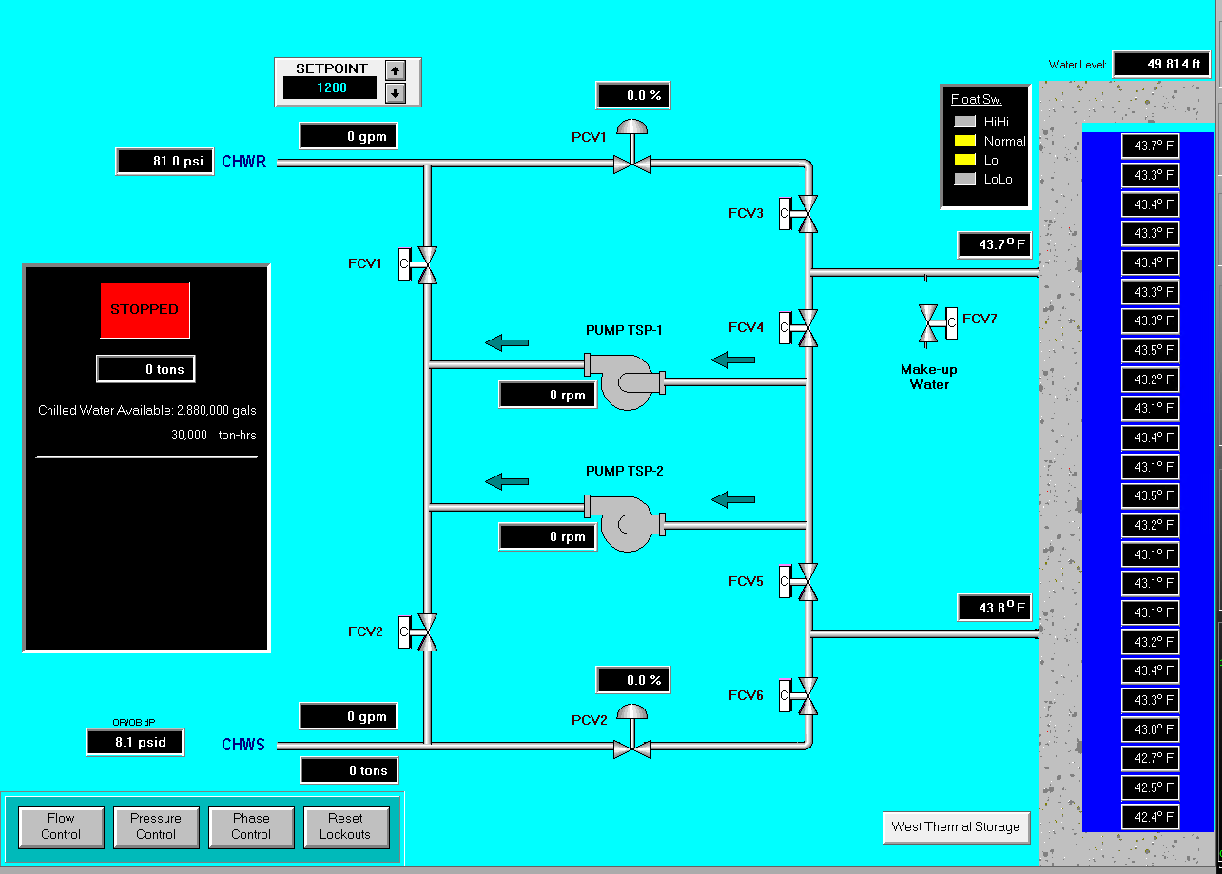
Thermal Energy Storage (East)

Slide 12
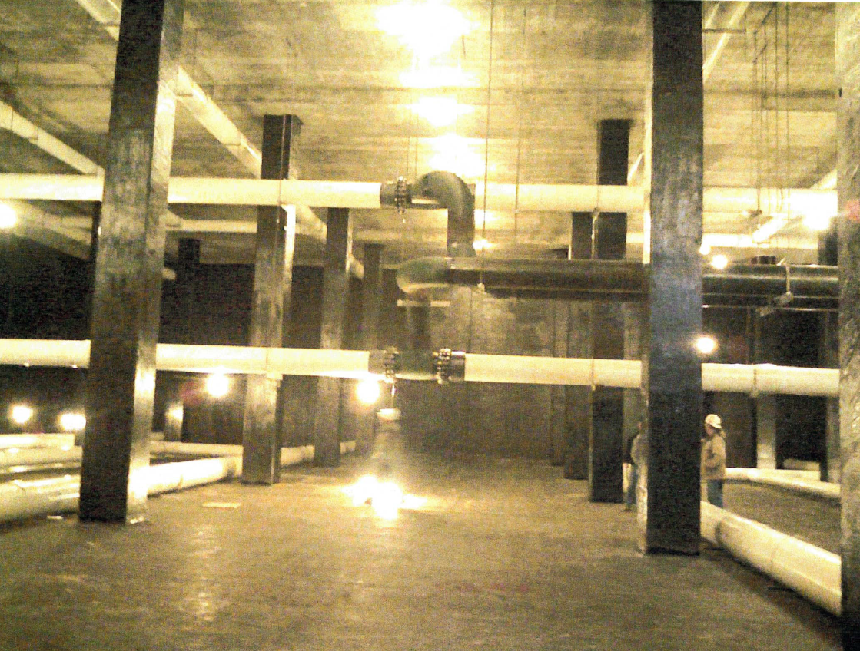
Time for that Tour!

Slide 13
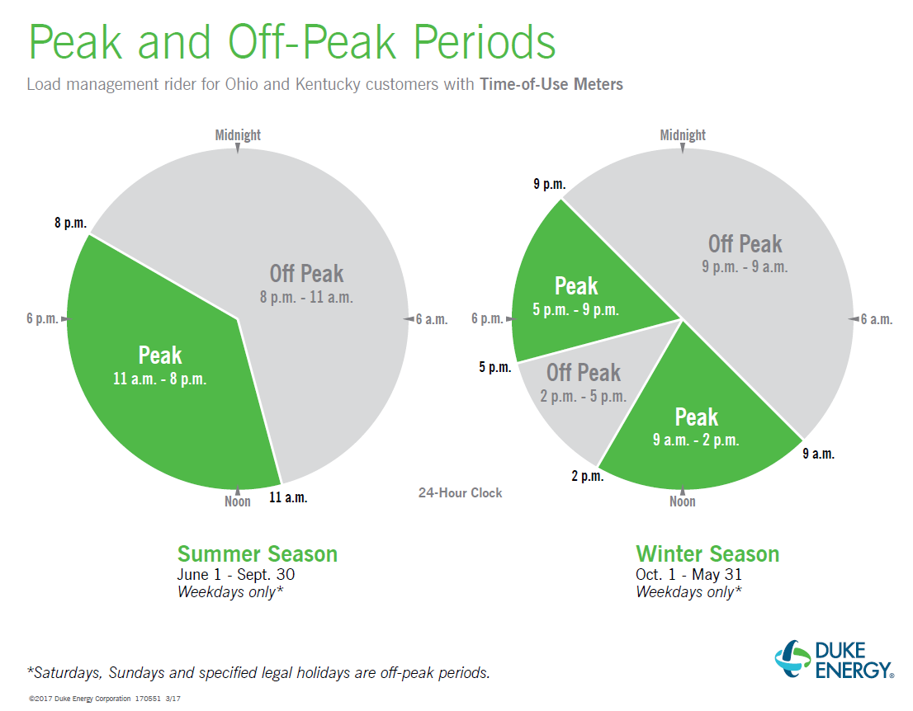
Tariff

Slide 14
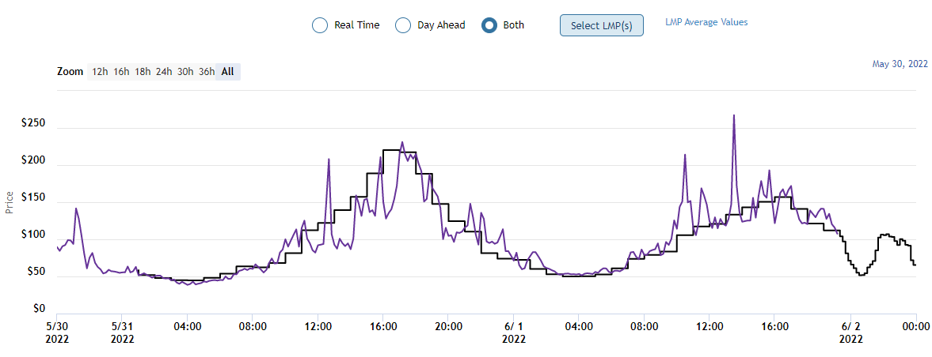
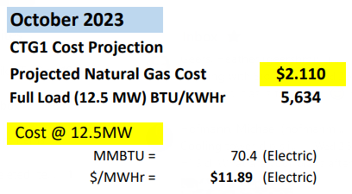
Pricing

Slide 15
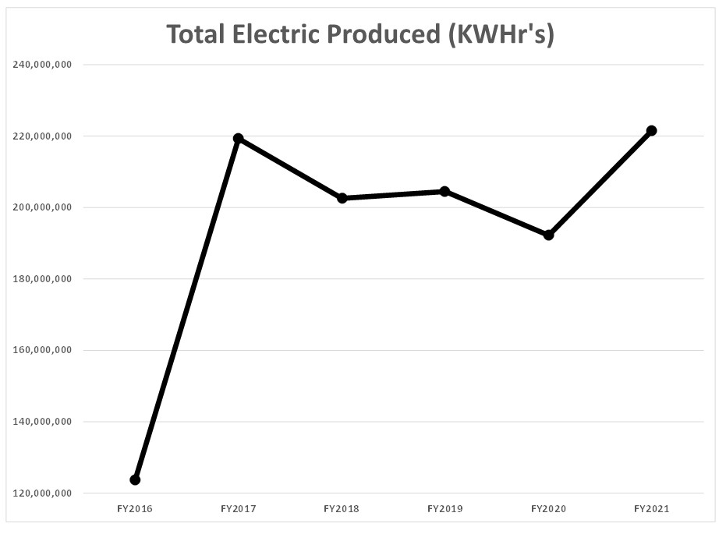
Electricity Production (kWh)

Slide 16
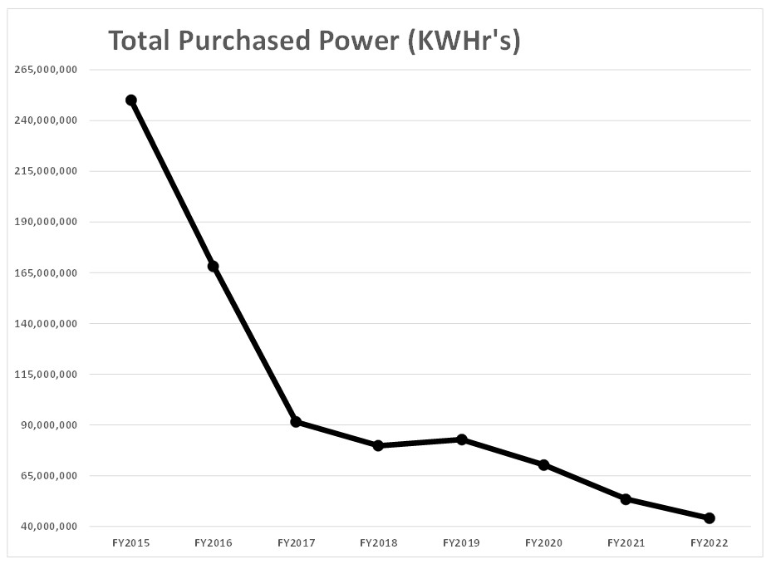
Electricity Purchased (kWh)

Slide 17
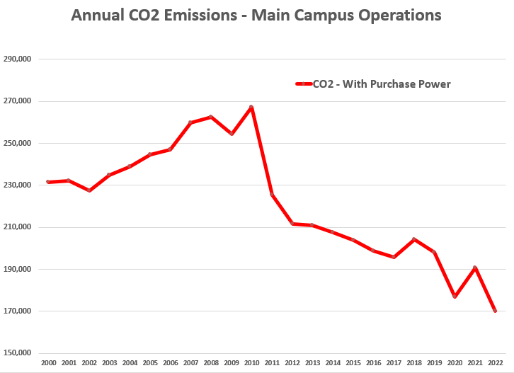
Annual CO2 Emissions (Main Campus)

Slide 18
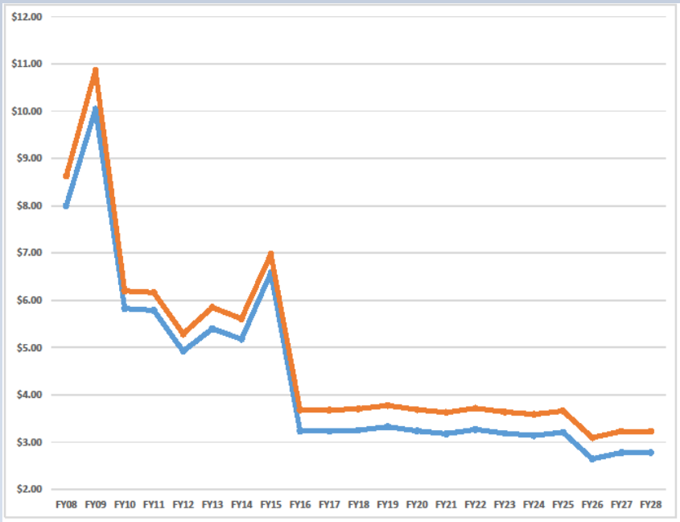
Natural Gas Hedging

Slide 19
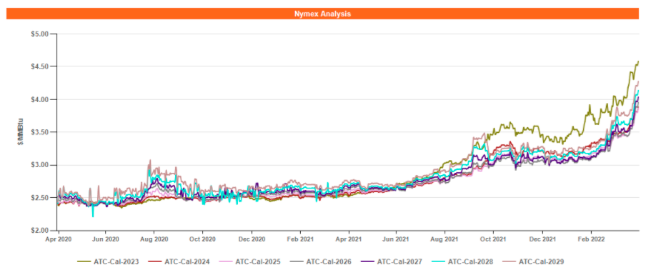
Natural Gas Price
80% increase in 11 months
UC Most Recent Purchase

Slide 20
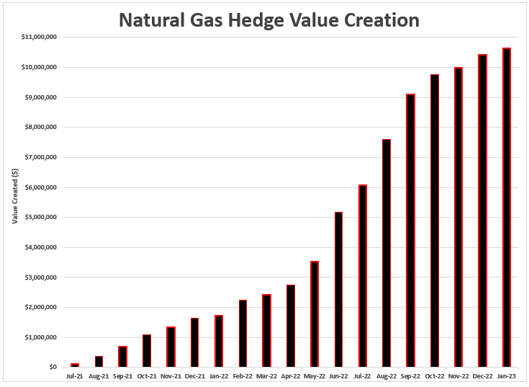
Hedging Strategies
Natural gas hedging strategies deployed by UC Utilities are projected to avoid $37M in fuel costs through 2030

Slide 21
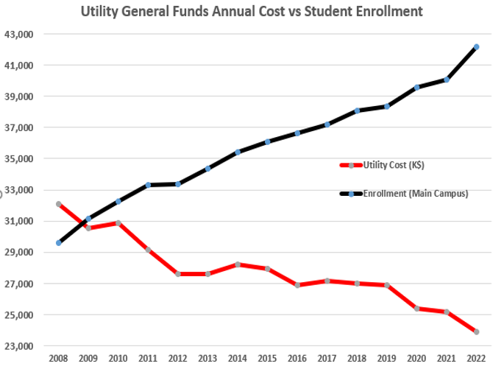
Utility Cost Per Student

Slide 22





Award Winning Operations
2023 Midwest CHP of the Year
2023 AEE Region III Innovative Energy Project of the Year
2023 AEE Region III Energy Project of the Year
2023 AEE Region III Young Professional of the Year
2022 AEE International Energy Manager Of The Year Award
2022 AEE Region III Institutional Energy Management Award
2022 AEE Young Professional Chapter Award
2022 Midwest Sustainability Summit Innovation Award
2022 IDEA Campus Video Contest First Place
2020 AEE International Institutional Energy Management Award
2020 AEE Region III Innovative Energy Project of the Year
2020 AEE Region III Energy Manager of The Year
2020 AEE Southwest Ohio Chapter Institutional Energy Management Award
2020 IDEA Campus Video Contest First Place

